Slide 1
Familia: Ingenui Servi Liberti [Alumni]
Pater familias Mater familas (matrona)
Filius familia Filia familias
Tutor ius (trium) liberorum
Familia urbana vs. Familia rustica
Elite familiae vs. poor familiae
Slave hierarchy
Differentiation of slave roles

Slide 2
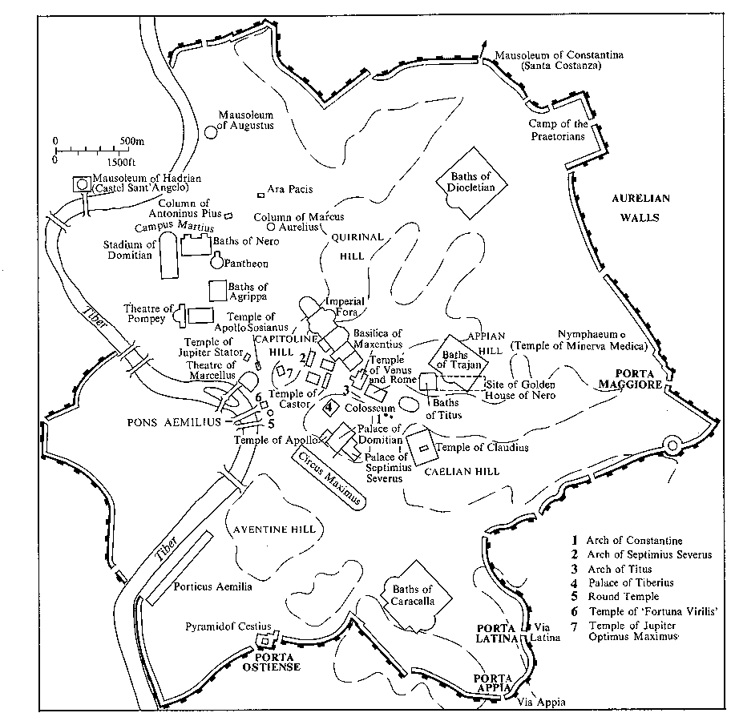
Columbarium of the Statilii Tauri (near Porta Maggiore)

Slide 3
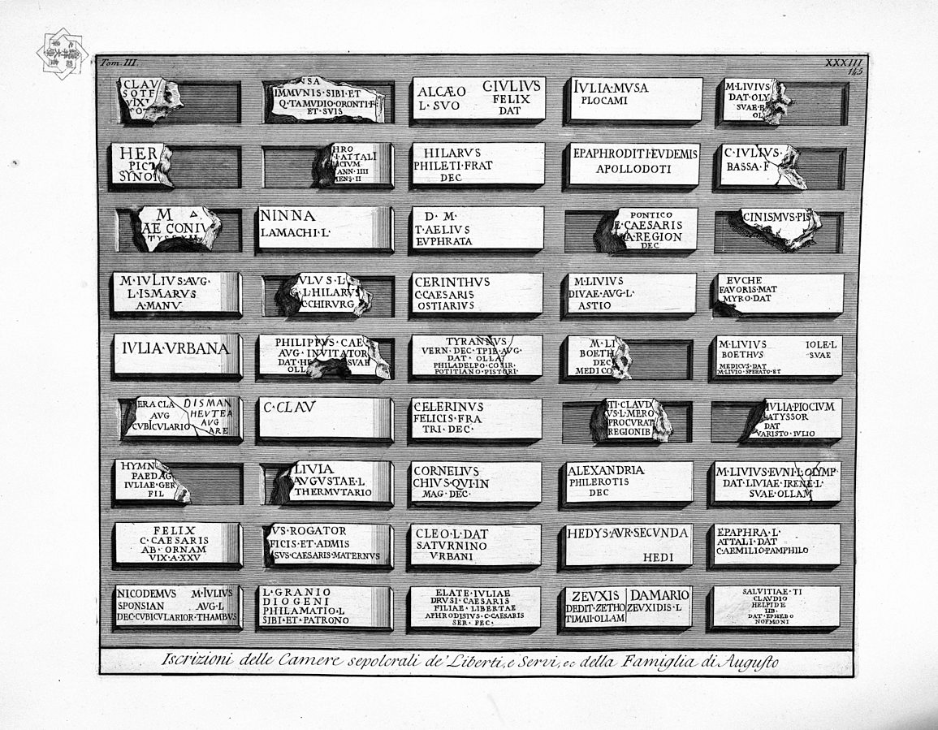
Drawing of inscriptions from the columbarium for the slaves of the imperial family

Slide 4
Birth: Obstetrix
Childhood:
nutrix - educatrix – paedagoga (female)
nutritor, educator, paedagogus (male)

Slide 5
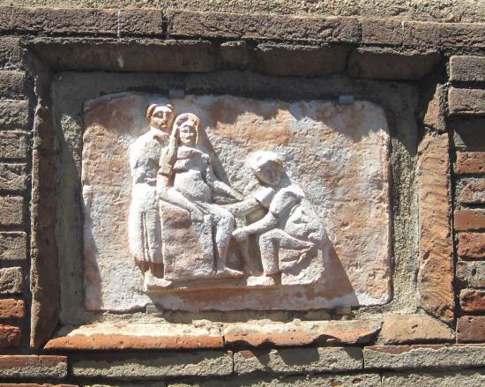
Obstetrix on tomb (Tomb 100, Isola Sacra near Ostia)

Slide 6
May this monument be protected against intentional evil! Scribonia Attice has built <this monument> for herself and for Marcus Ulpius Amerimnus, her husband, for Scribonia Callityche, her mother, for Diocles and for her freedmen with their descendants, with exception of Panaratus and Prosdocia.
The monument can't be inherited by strangers
Inscription from the monument

Slide 7
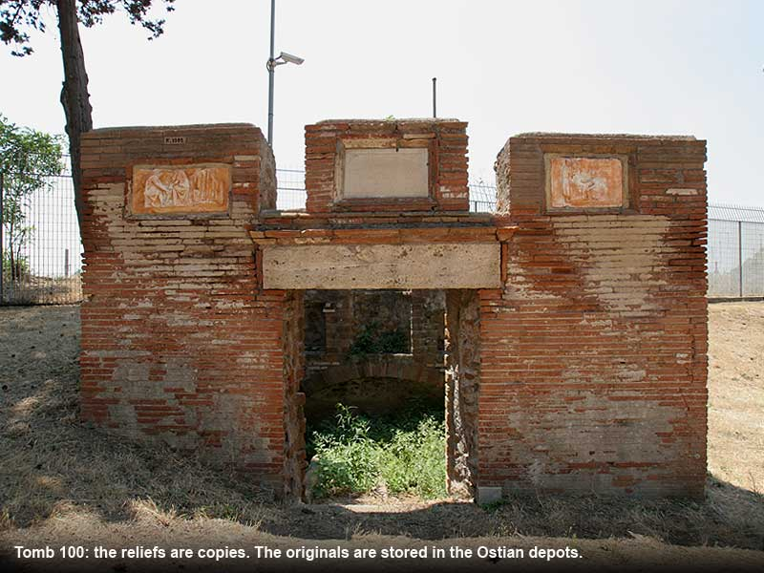

Slide 8
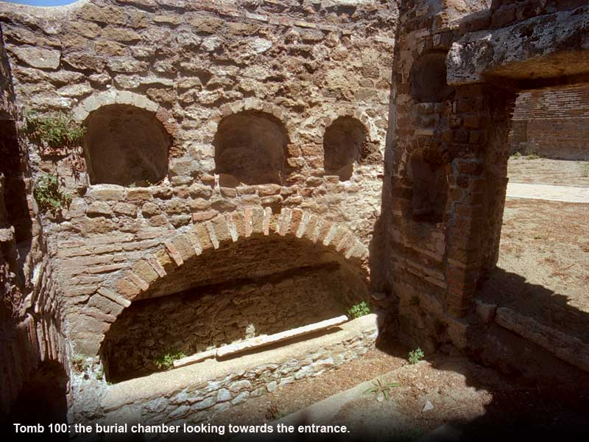

Slide 9
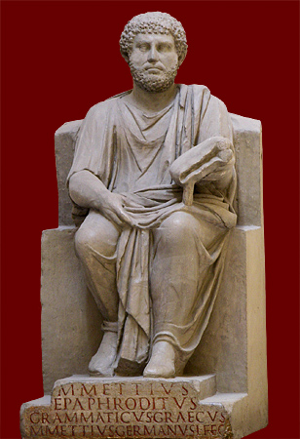
Statue of the grammaticus Marcus Mettius Epaphroditus
(1st/2nd century CE)

Slide 10
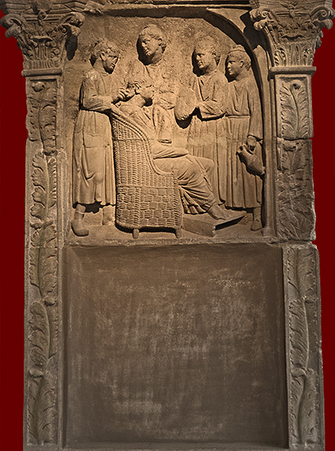
Woman surrounded by her slaves on funerary monument
Roman, from Neumagen, before 220 CE
Trier, Rheinisches Landesmuseum

Slide 11
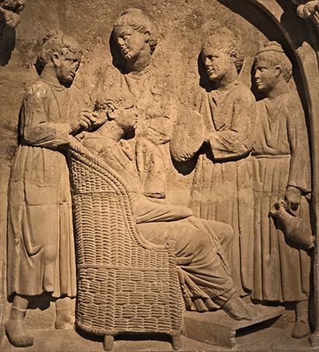
Close up of same panel: notice difference in clothing between slaves and mistress

Slide 12
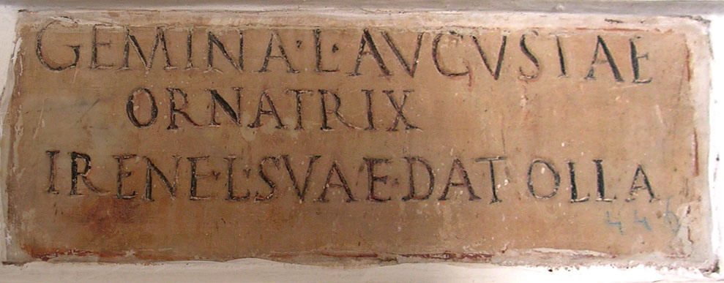
Gemina l(iberta) Augustae / ornatrix / Irene l(ibertae) suae dat olla(m) Gemina, the freedwoman of Augusta, hair-dresser, put this up to Irene, her freedwoman.
CIL VI 3994 (Columbarium of Livia)

Slide 13
Inscription by an ostarius of Livia for his wife:
Amphio Liviae / ostiar(ius) dat Liviae / Augeni coniugi
Amphio, the doorkeeper of Livia, set this up for his wife Livia Auge.
(CIL VI 3995 - Columbarium of Livia)

Slide 14
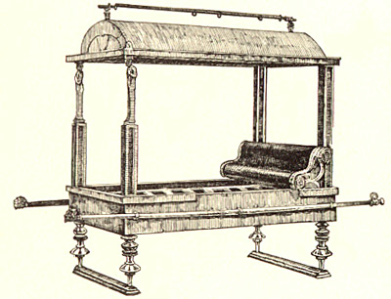
Lecticarius: litter bearer (Drawing of a Roman litter

Slide 15
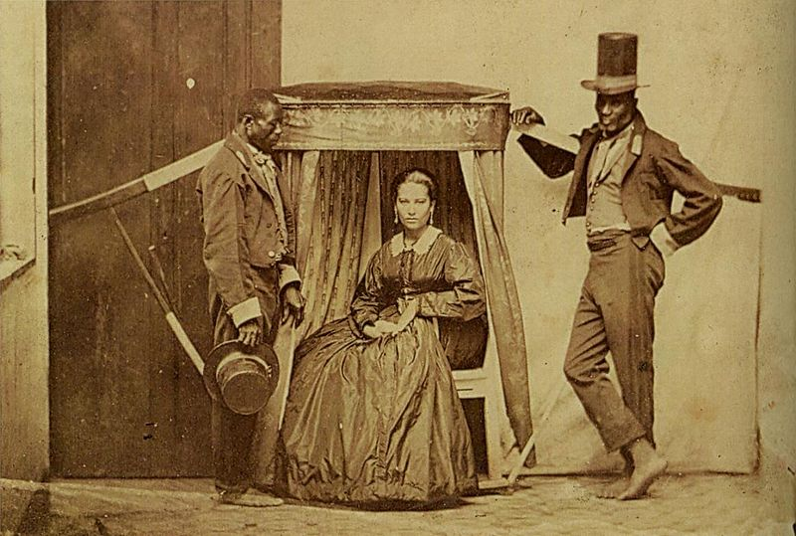
Brazilian woman with her slave litter bearers, c. 1860

