Slide 1
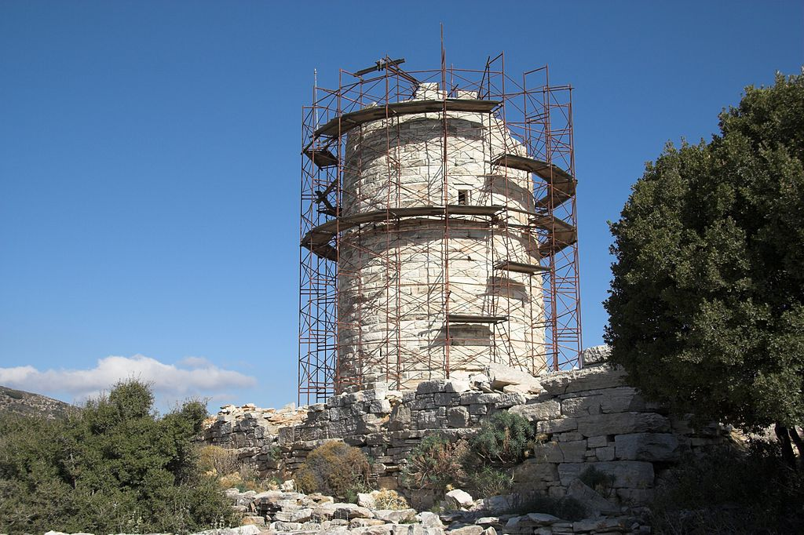
Late Classical or early Hellenistic tower from Cheimarrou, Naxos (Image source: despite labelling this is not a military tower)

Slide 2
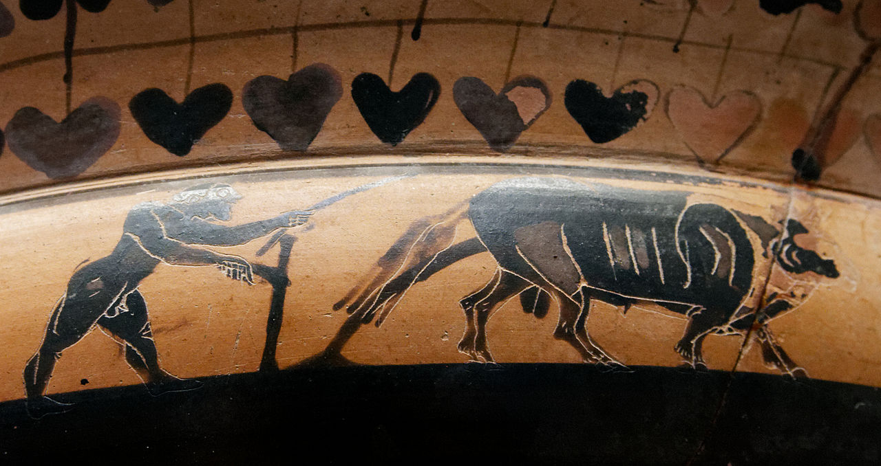
Ploughman. (Black-figured Attic kylix 560-550 BCE; by the painter of the Burgon Sianas

Slide 3
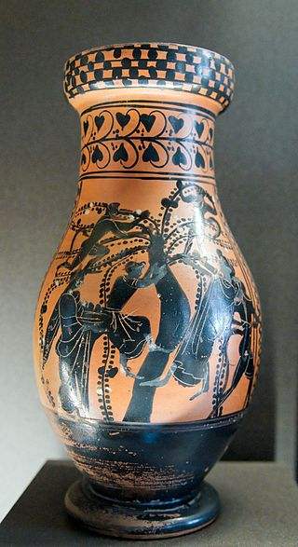
Olive gathering on Attic black-figured olpe, ca. 500–490 BCE
(Yes, the Olive gatherers

Slide 4
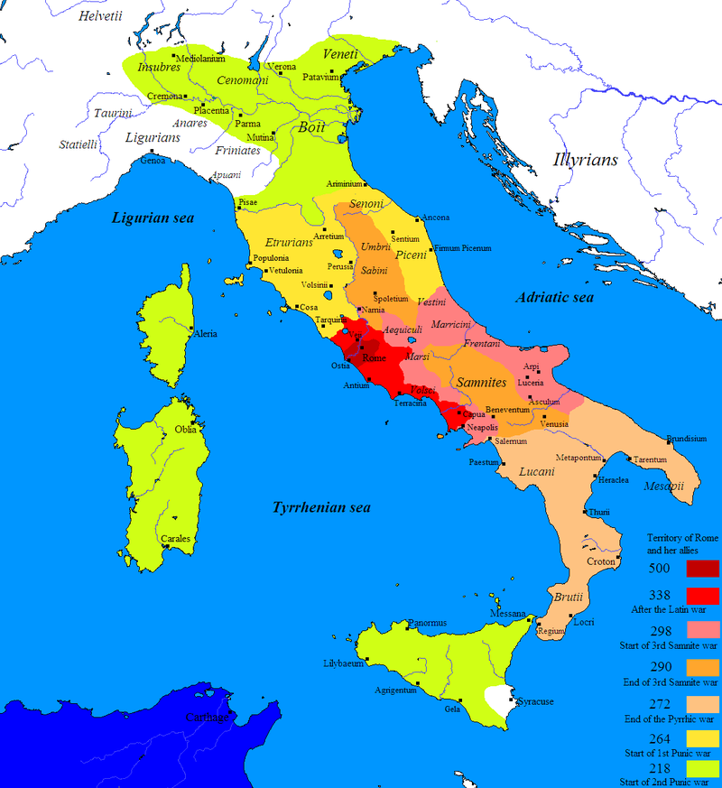
Roman expansion in Italy + land confiscations

Slide 5
Sources:
Cato the Elder (Mid-Republic)
Varro (Late Republic)
Columella (Neronian – 60-5 CE)
Intrumentum vocale
Vilicus
Villa rustica
Colonus (Coloni)

Slide 6
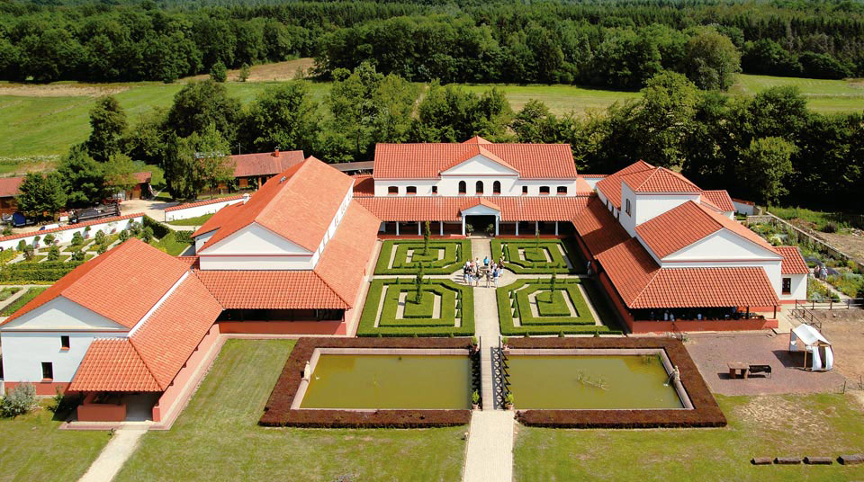
Reconstructed villa rustica (Villa Borg; Saarland, Germany

Slide 7
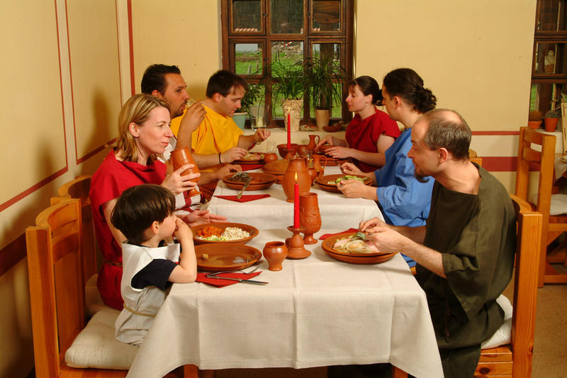
Dine! Like a Roman! At the Roman tavern at Villa Borg!

Slide 8
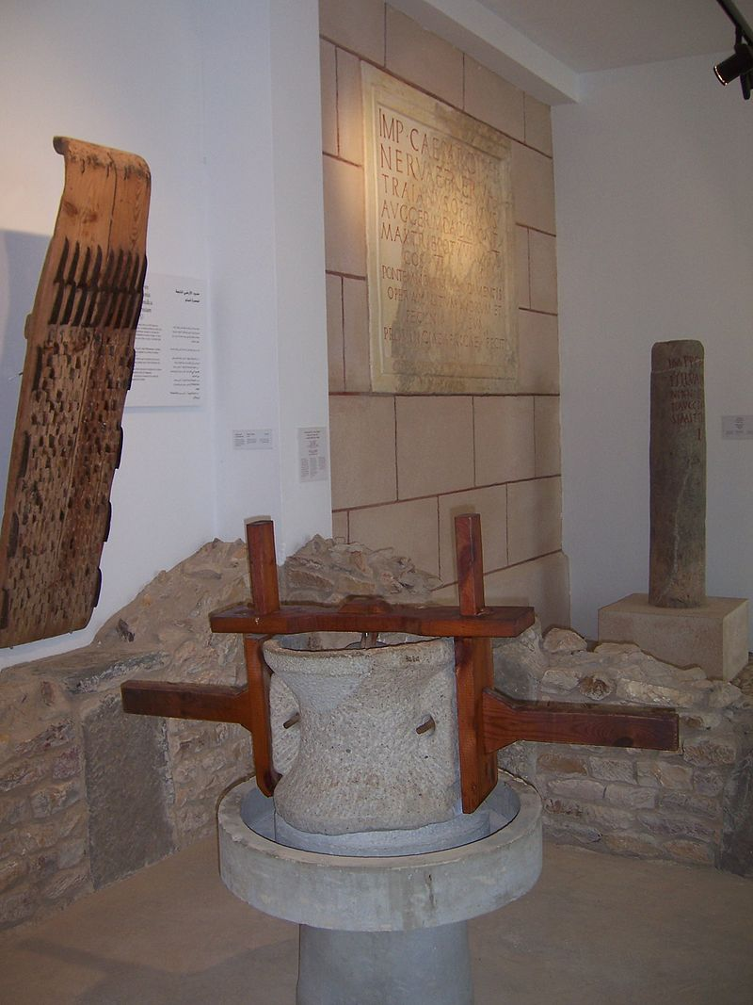
Roman millstone

Slide 9
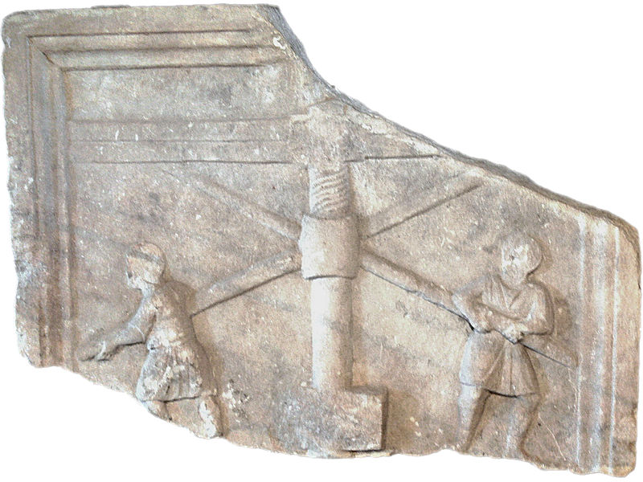
Olive press Archeological museum, Aquileia. Relief ( 3rd century ) Image by Wolfgang Sauber

Slide 10
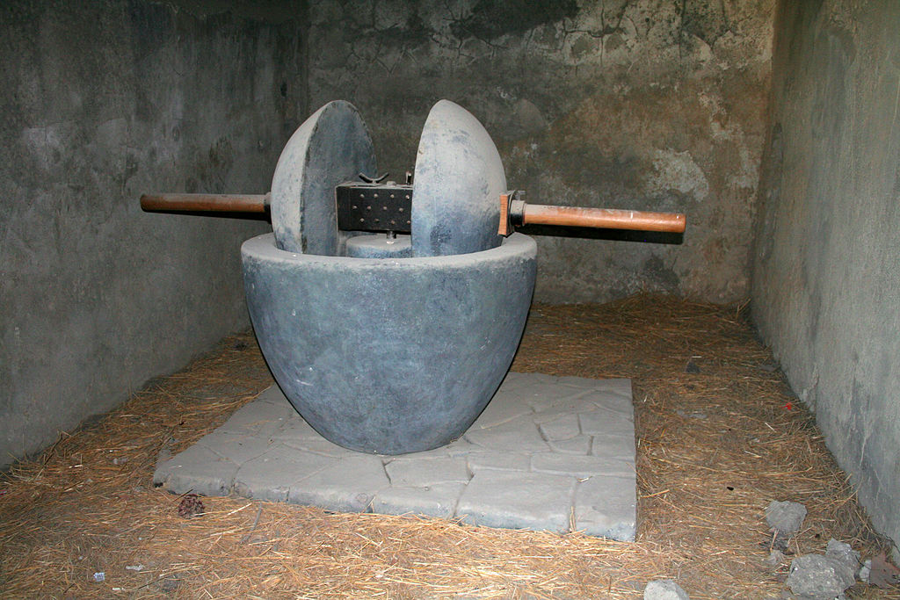
Olive mill, Pompeii (Image by Heinz-Josef Lücking)

Slide 11
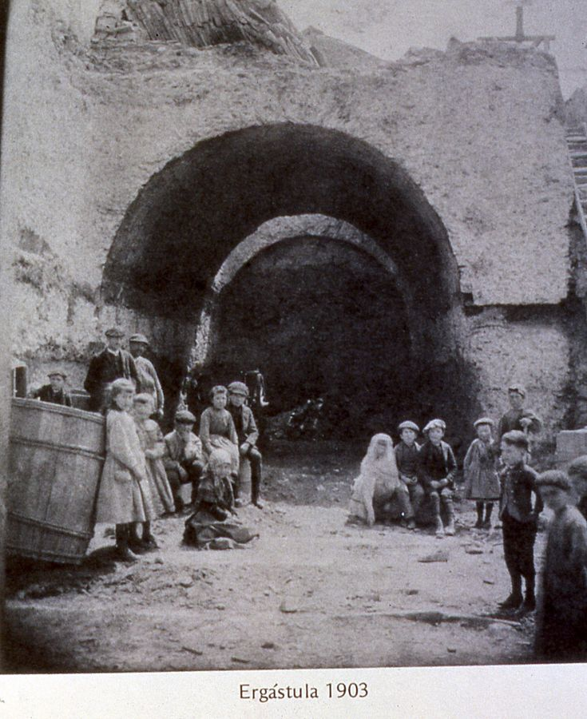
Roman Ergastulum in Astorga, Spain

Slide 12
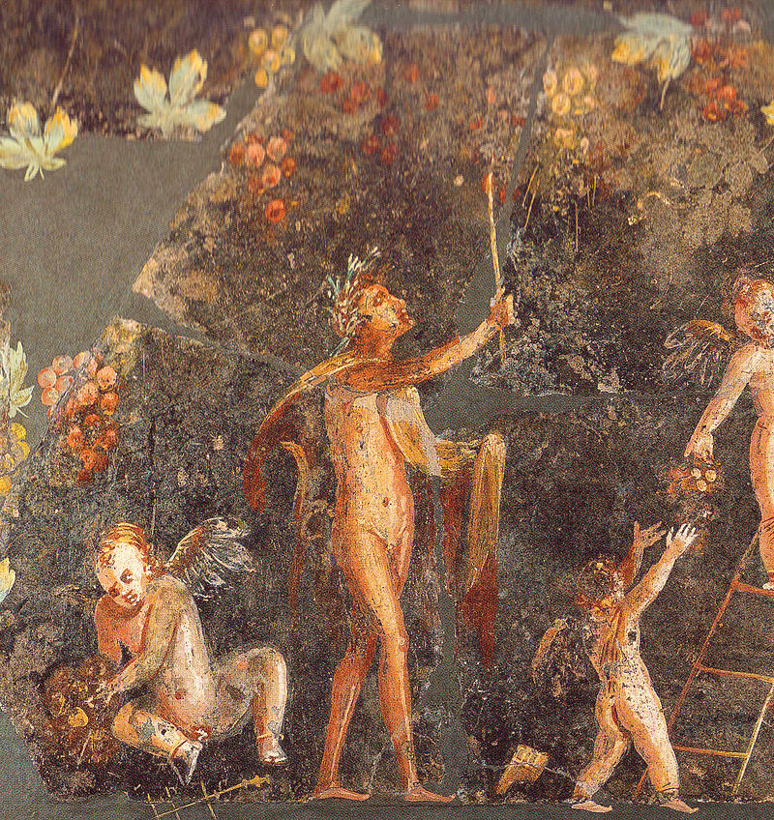
One of approximately 5 billion Roman images of Cupids harvesting grapes

Slide 13
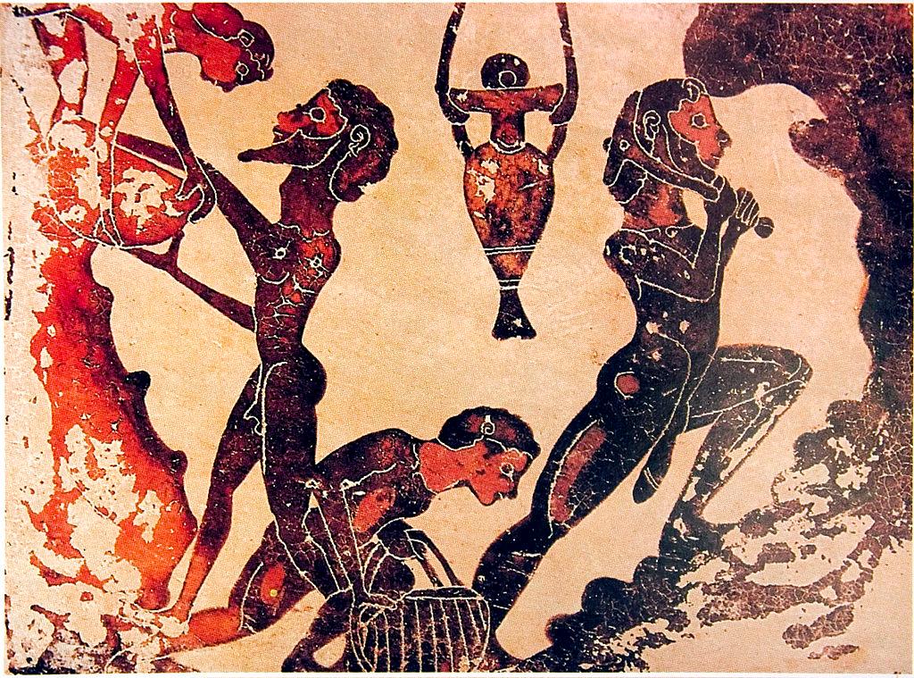
Slaves miners in Laurion (5th century BCE, Athens)

Slide 14
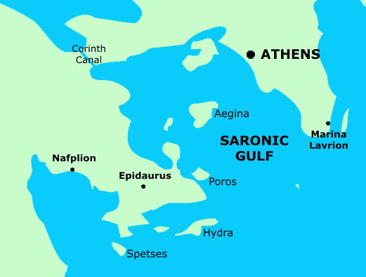
Silver mines of Laurion (now Lavrion)

Slide 15
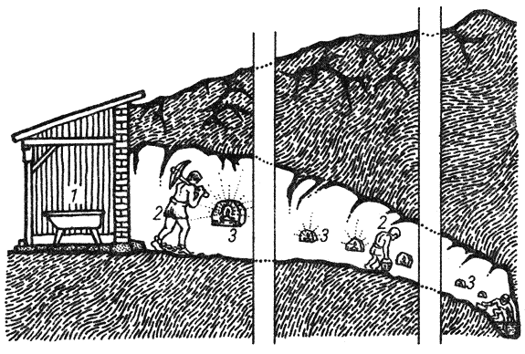
Reconstruction of ancient marcasite mine
1 — entrance into the adit with marcasite tubs established in it, 2 — slave-miner in foot fetters, 3 — lamp

Slide 16
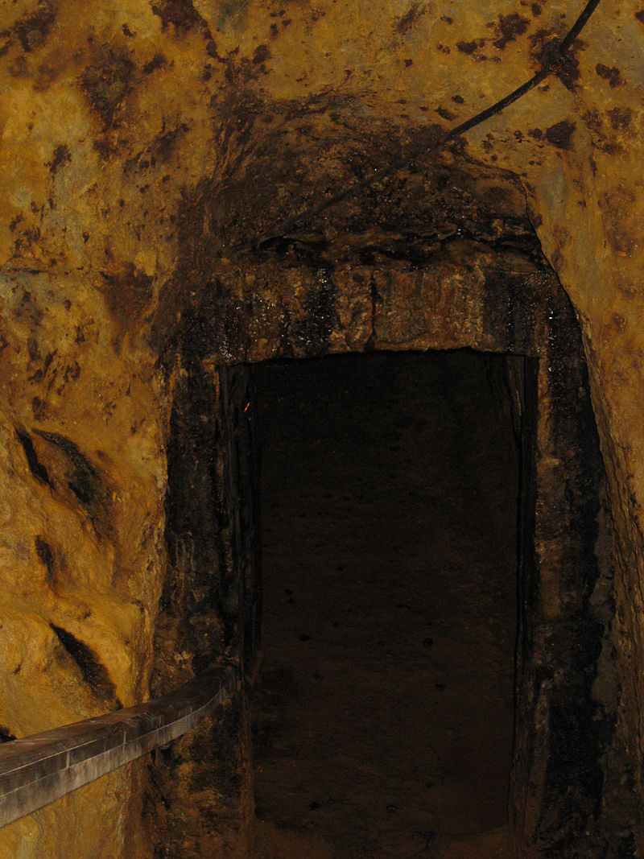
Rosia Montana Roman Gold Mines
(Transylvania, Romania; former province of Dacia)

