Slide 1
Cults that appear to appeal especially to slaves:
helper gods: Apollo, Isis and Serapis, Asclepius etc.
liminal gods: Diana (Artemis), Silvanus, Bacchus (Dionysus)
cults deriving from household worship: Lares, Silvanus
cults of ‘high’ Roman tradition: Jupiter Liber, Fortuna, Bona Dea
cults of non-Roman origin: Isis, Mithras, Magna Mater

Slide 2
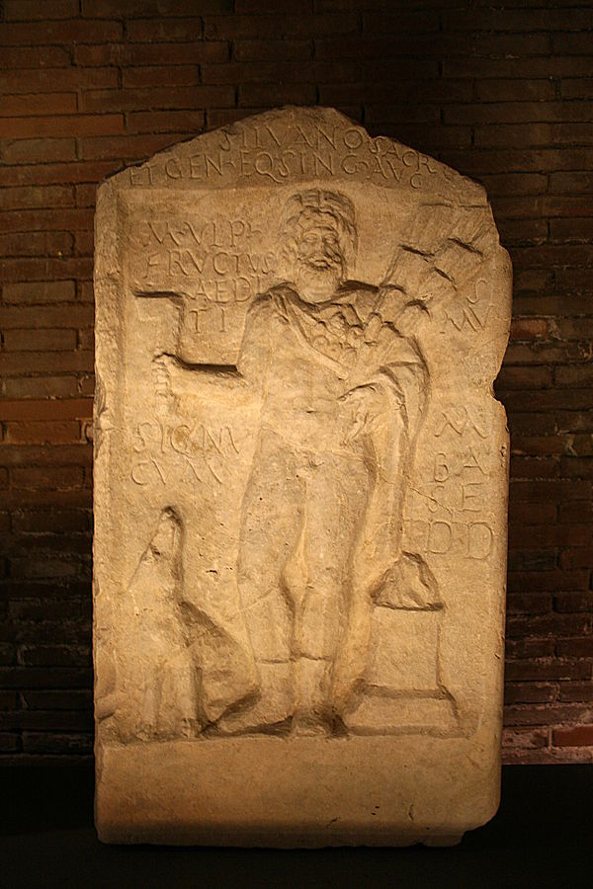
Silvanus
CIL VI 003712; now in Capitoline: Image by Jean-Pol Grandmont

Slide 3
Fortuna
- Servius Tullius (mid 6th century BCE)
Fortuna Primigenia (Praeneste)
The Cooks of the Hall bestowed this as a gift on Fortuna Primigenia. Foremen: Rodos, slave of Orcevius. . .: Artemo, slave of Quintus Dindius; Apollinaris slave of Protus, slave of Aemilius..
CIL 1(2).1447

Slide 4
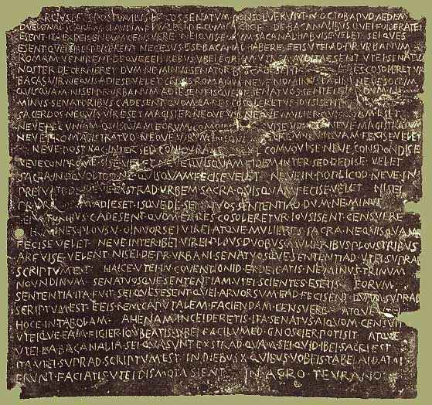
Hysteria about slave involvement in religion: the Bacchanalian Conspiracy of 186 BCE

Slide 5
Slave exclusion from religion
Hercules at the Ara Maxima
Mater Matuta (Matralia)
Slave involvement in religion
Saturnalia Compitalia
Ancillarum feriae
Servorum dies festus
ministri vs. magistri

Slide 6
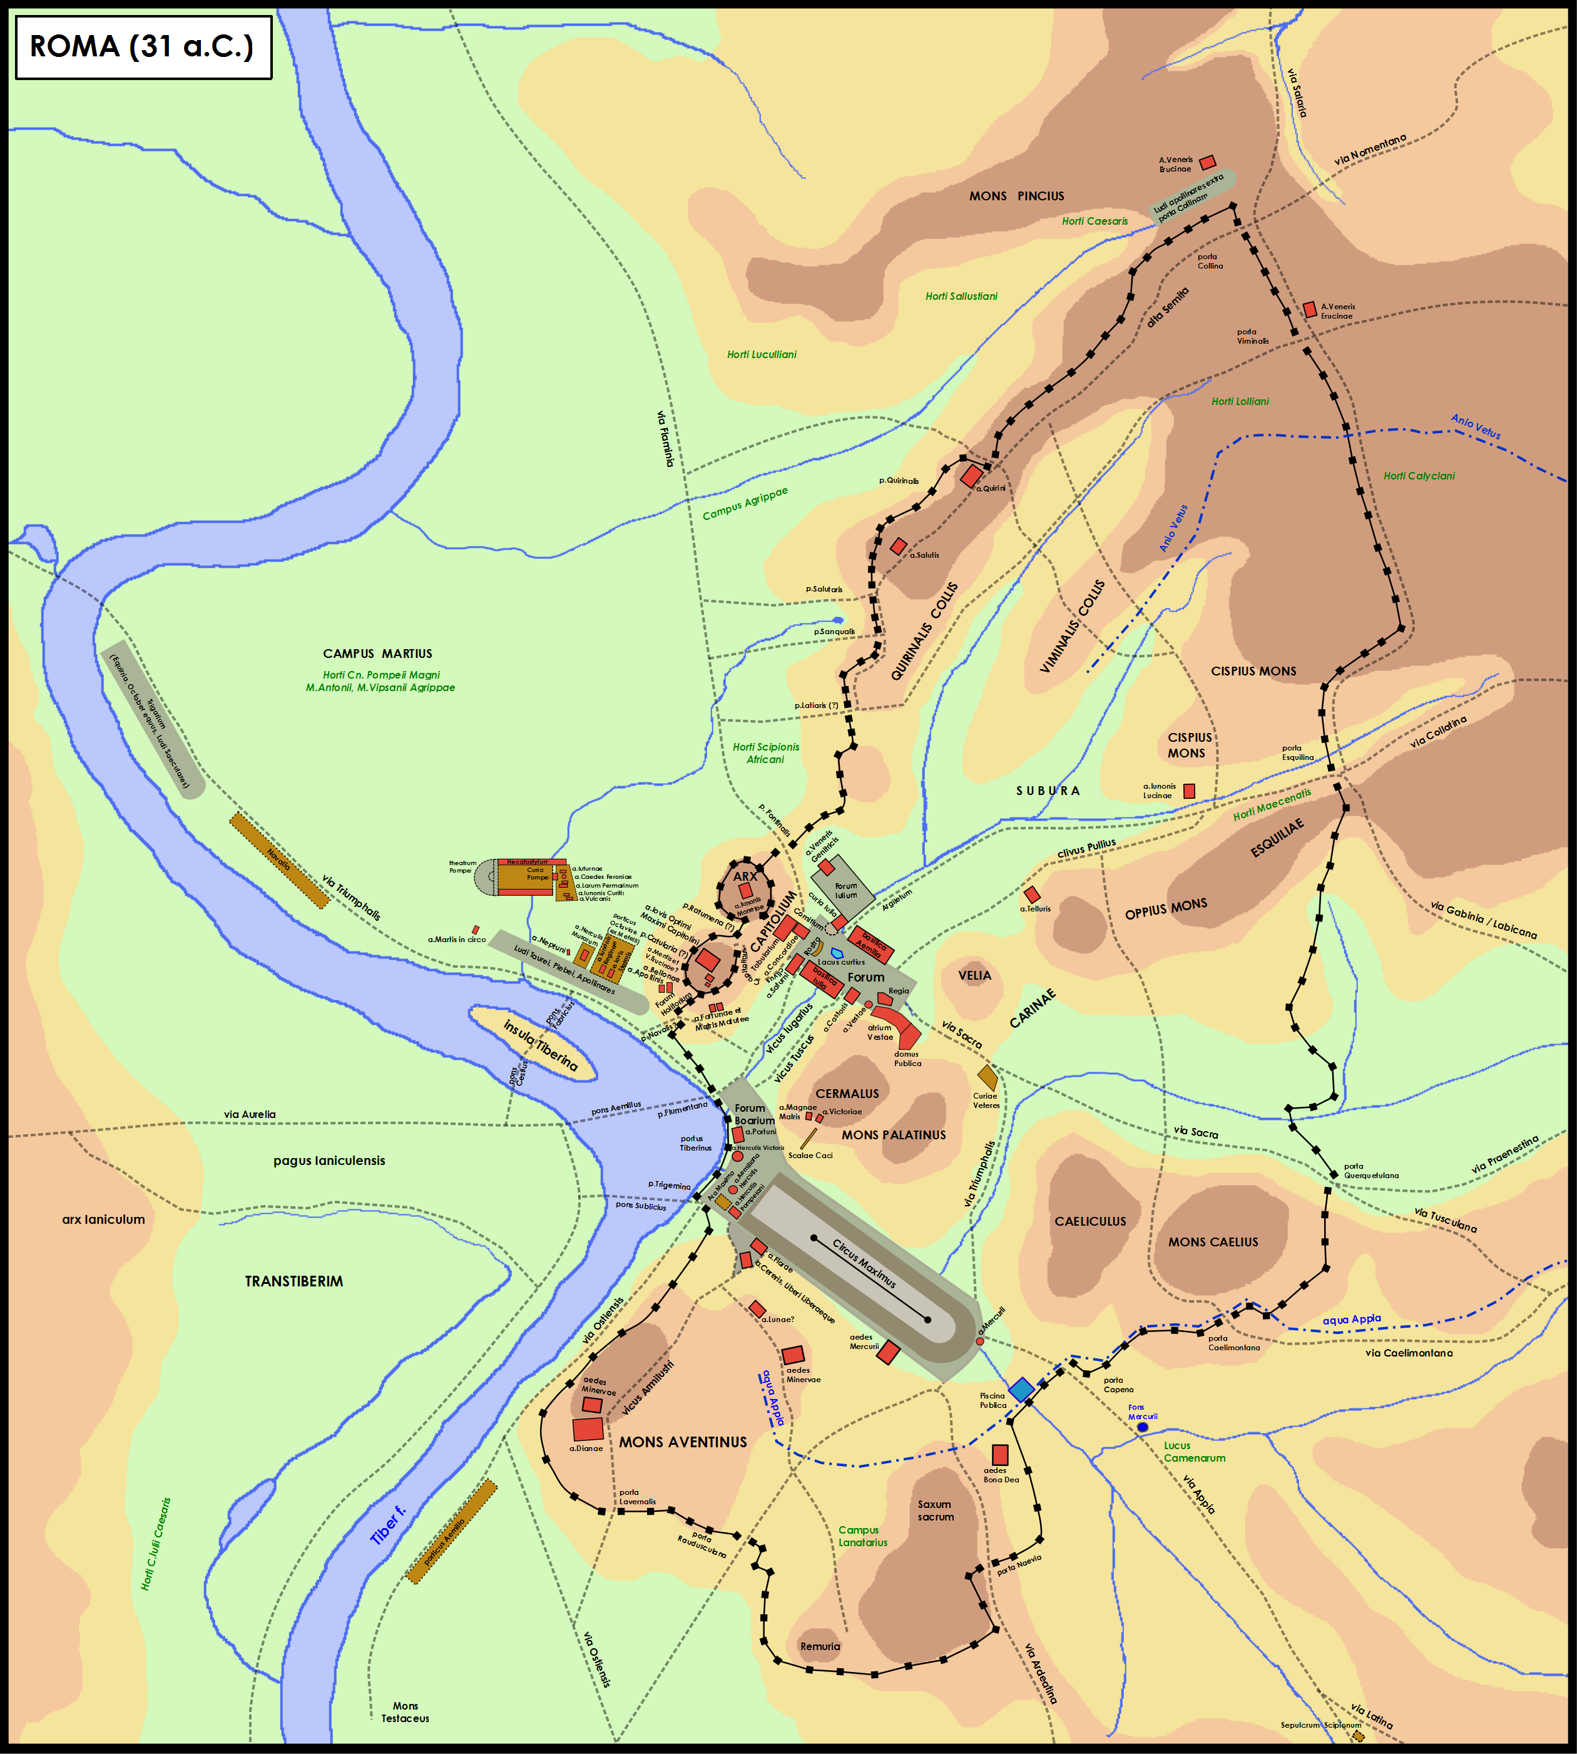
Burial
Rome I n31 BCE (the year of Actium): all burials in ancient cities had to be outside the walls

Slide 7
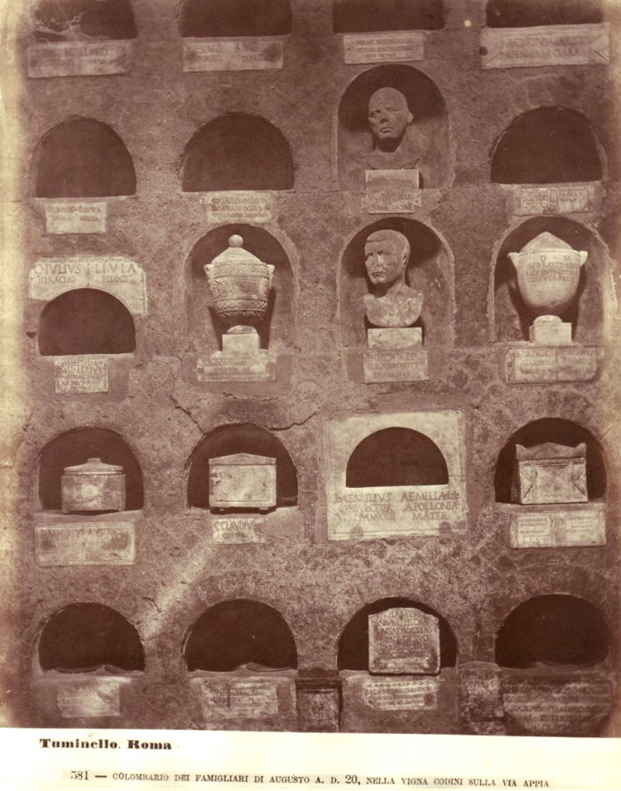
Imperial columbaria
(now under Vatican)

Slide 8
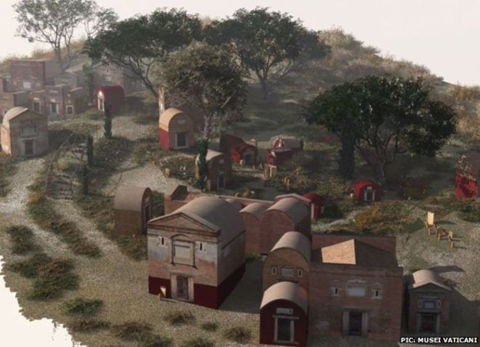
Reconstruction of the imperial columbaria (tour is available from here)

Slide 9
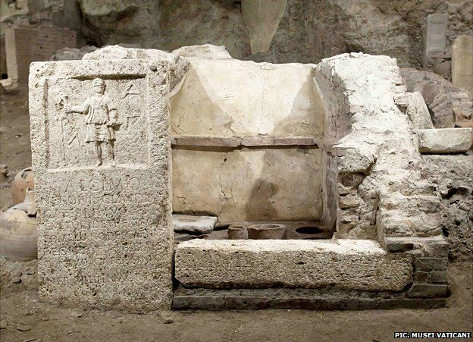
Tomb of Alcimus (a set designer at Pompey’s theatre) from the imperial columbaria

Slide 10
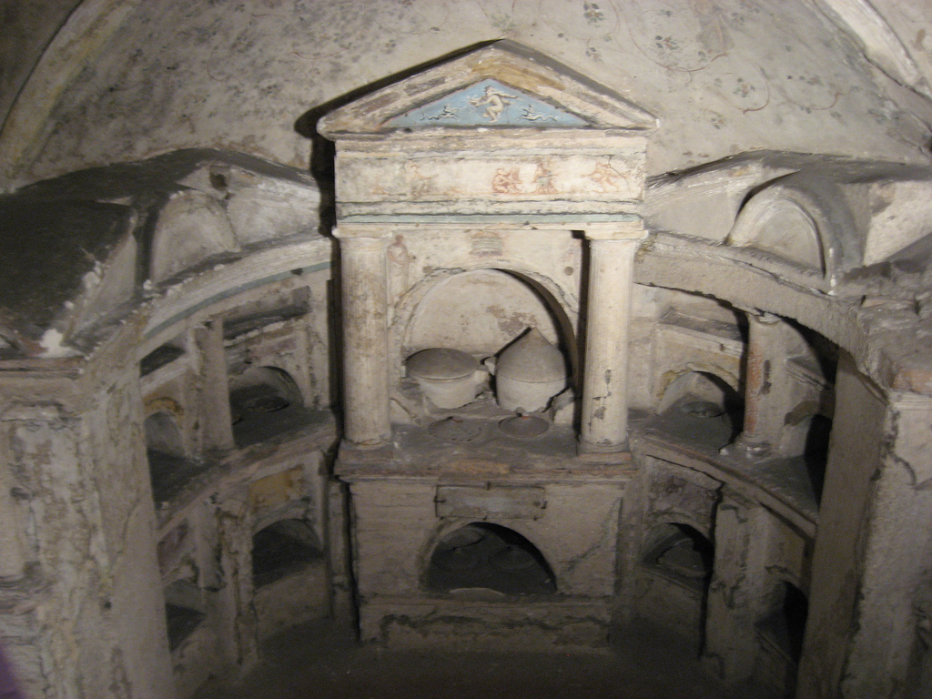
Columbarium of Pomponius Hylas

