Slide 1
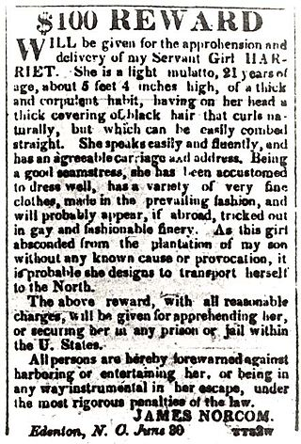
Reward notice for Harriet Jacobs (1813-1897)

Slide 2
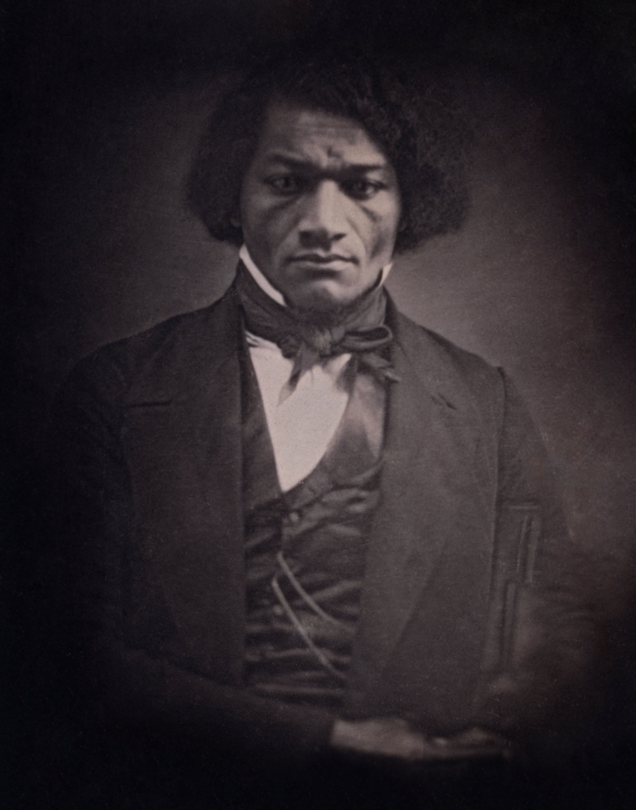
Frederick Douglass
(1818-1895)
c. 1850

Slide 3
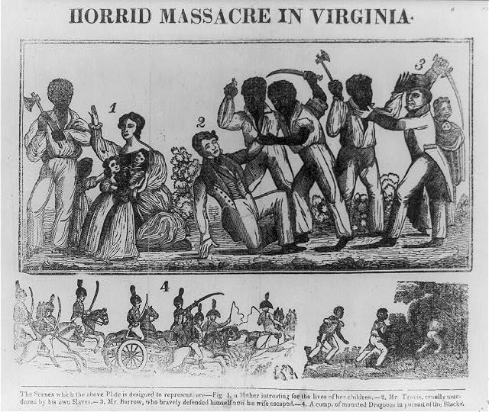
Nat Turner rebellion (1831) and consequences for slave manumission

Slide 4
Conubium = right to contract a iustum matrimonium
“There is no conubium with slaves” (Ulpian 5.5
Contubernalis – Contubernium (= slave ‘marriage’)
Coniunx/Maritus/Uxor/ Pater/Mater Filius/Filia
Adoption (adrogatio)
Libertinus/Libertina vs. Ingenuus/Ingenua
Libertus/Liberta

Slide 5
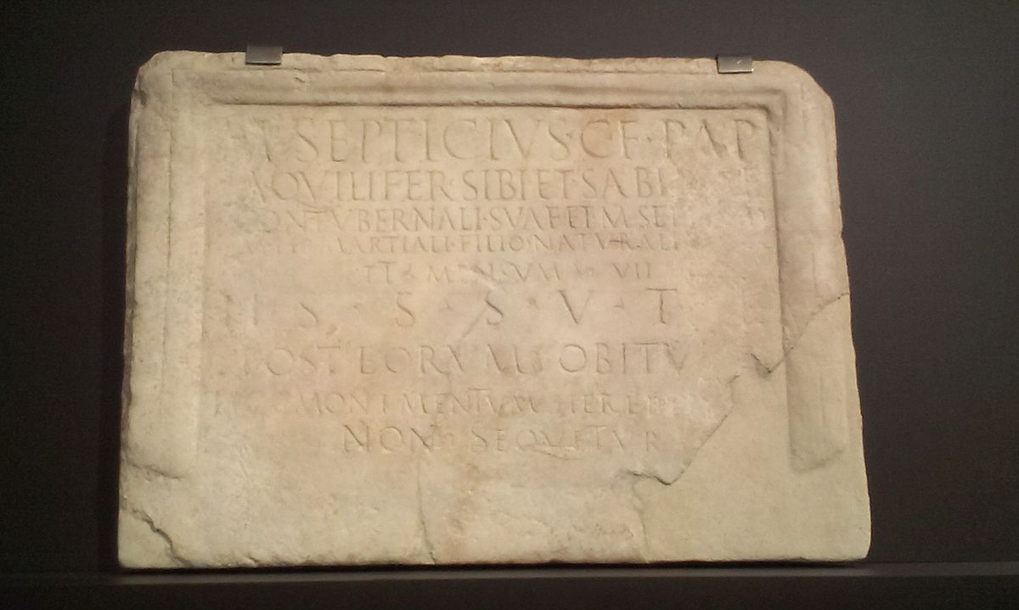
By M(arcus) Septicius C(ai) f(ilius) Pap(iria) aquilifer for himself and Sabina his contubernalis, Marcus his freedman and Martialis his filio naturali
CIL II2.7, 288

Slide 6
Different slave relationships:
Publius Marcius Philodamus, builder, freedman of Publius, for himself and his. Here was buried Jucunda his darling (delicia)
.
CIL 1².1734 Beneventum
If anyone cares to add his own grief to ours, here let him be; and with no scanty tears let him deign to weep. Here an unhappy parent (infelix) has laid to rest his one and only daughter (unica) Nymphe whom he cherished in the joy of sweet love while the shortened hours of the Fates allowed it. Now she is torn away from home - earth covers her, dear to her own; now her fair face, her form too, praised as fair, - all is airy shadow and her bones are a little pinch of ashes.
CIL 1².1222. Nymphe (?). Found at Rome.
Gaius Numitorius Asclepiades, and Mummia Zosima, freedmen of Lucius.
These are two persons of one heart (duo concordes), good report, and honourable passing. Blest.
CIL 1².1347. On a piece of sarcophagus. Rome. First century BCE

Slide 7
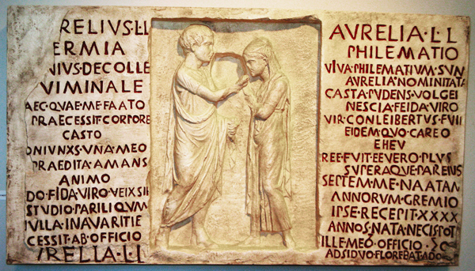
Tombstone for Lucius Aurelius Hermia and Aurelia Philematium, colliberti and spouses
corpore / casto / [c]oniunx…casta pudens CIL 1².1221

Slide 8
Proculus to his grandson, Greeting. Where a female slave marries, and gives her husband money, as dowry, whether she knows that she is a slave or not, she cannot make her husband the owner of said money, and it will still remain the property of the person to whom it belonged before it was given as dowry to her husband, unless he should have obtained it by usucaption. And not even after the woman has become free, while living with the same man, will she be able to change the condition of this money. Hence, not even after a divorce has taken place, can she legally bring an action based on her right of dowry, or a personal action to recover the money, but the party to whom it belongs can legally sue for it.
Digest 23.3.67
Dowry in contubernium

Slide 9
Children and slave parents: some further complexities
If a minor of twenty years of age manumits a female slave who is pregnant, before the proper tribunal, for the purpose of marrying her, and, in the meantime, she should have a child, the condition of the child whom she brought forth, that is to say, whether it is a slave or a freeman, shall remain undetermined.
Digest 40.2.19

