Slide 1
Liberti Patroni
(liberta/libertus) (patrona/patronus)
Legal limitations
Marriage
Some magistracies
Some priesthoods
Petronius’ Satyricon (Neronian period): Trimalchio
Funerary monuments of freedpeople
Imperial freedmen: Pallas, Narcissus, Callistus (Claudius)
Claudius Etruscus’ father (Statius, Silvae)
Remember! The status of most freed people was probably like that of most free people: pretty grubby.

Slide 2
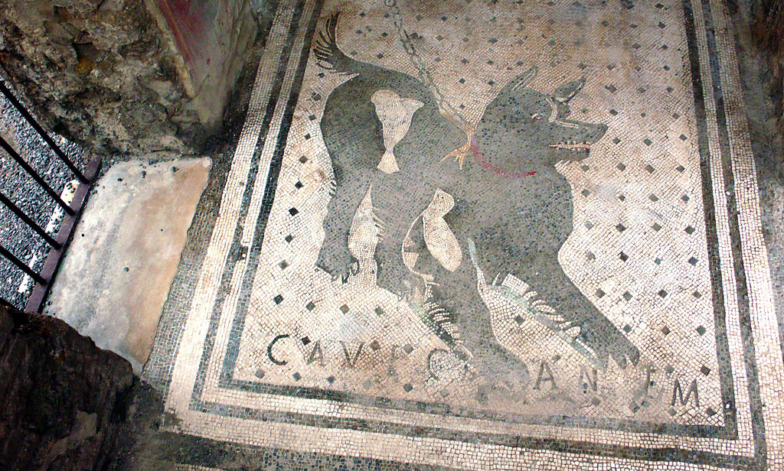
‘Beware of the dog’ mosaic from Pompeii

Slide 3
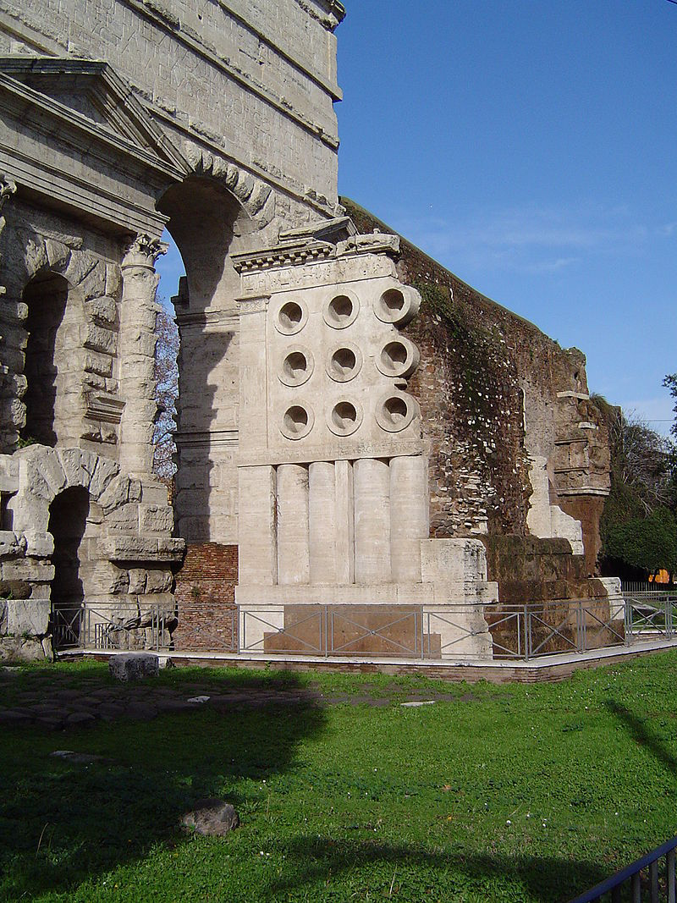
Porta Maggiore with Tomb of Eurysaces, the baker
(Late Republic)

Slide 4
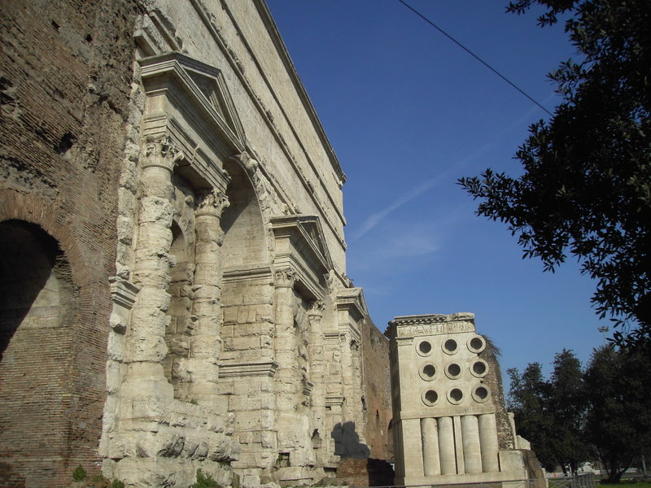

Slide 5
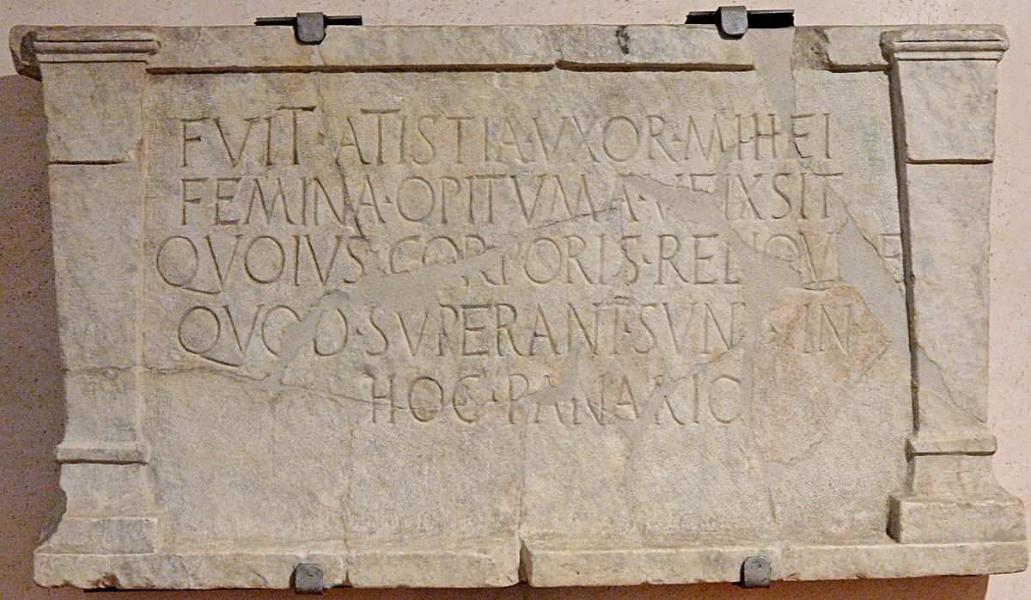
For Eurysaces’ wife (?): “Fuit Atistia uxor mihei/ femina opituma ueixsit/ quoius corporis reliquiæ/ quod (sic) superant sunt in/ hoc panario”
“Atistia was my wife. She lived as an excellent woman, whose surviving remains are in this bread basket” (CIL I2 1206)

Slide 6
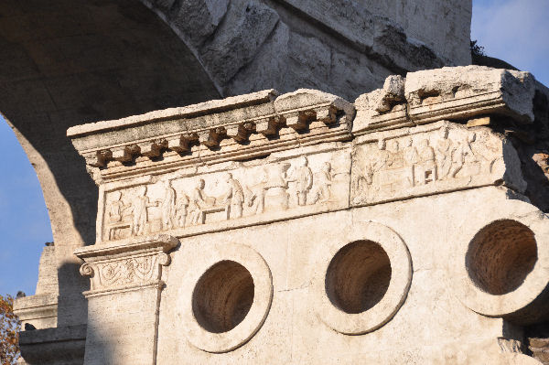

Slide 7
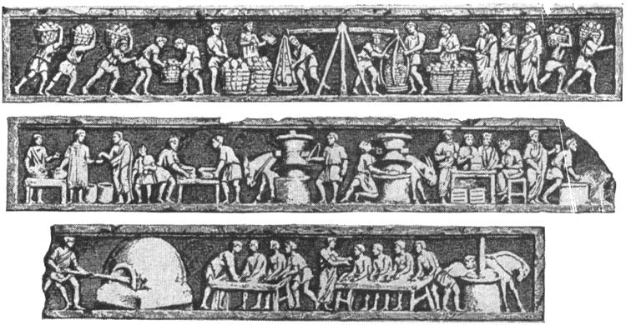
The relief from the tomb

Slide 8
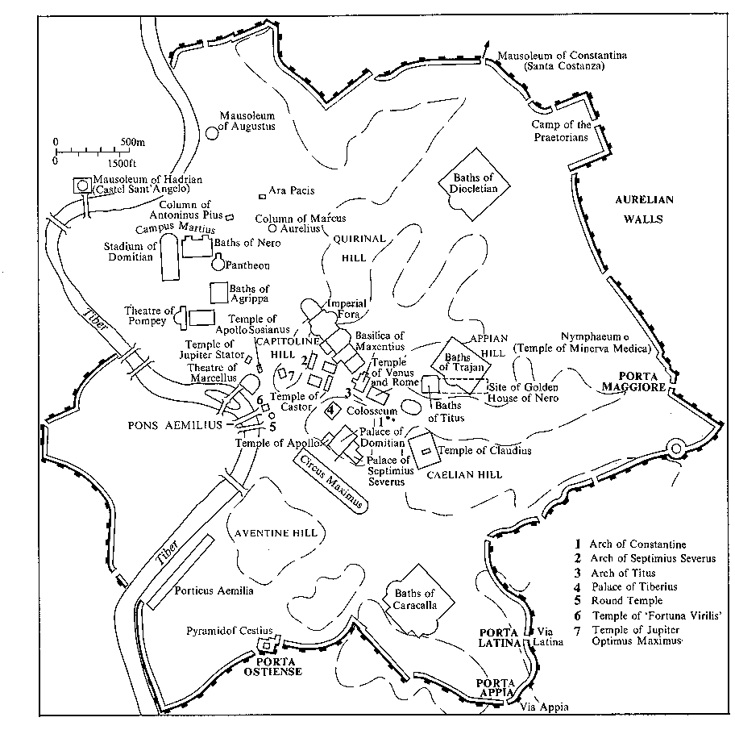
Location of tomb of Eurysaces (close to columbarium of the Statilii Tauri

Slide 9
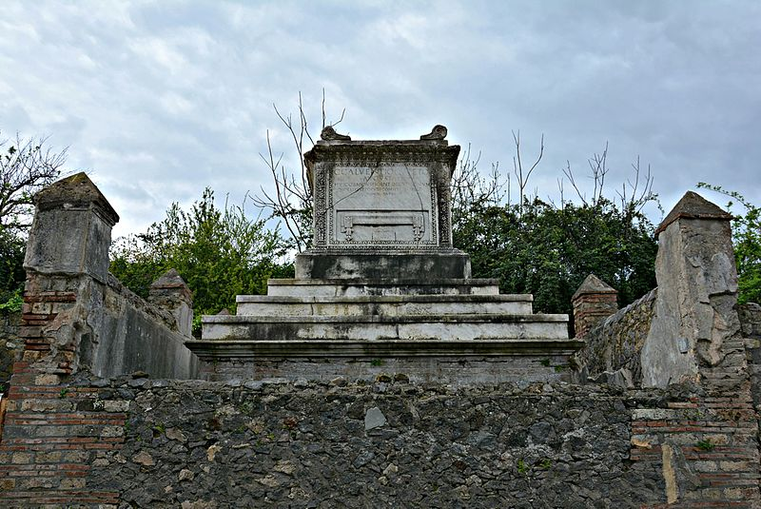
Tomb of C. Calventius Quietus, Pompeii

Slide 10
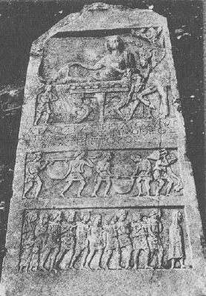
Tombstone for the slave dealer Aulus Caprelius Timotheos from Amphipolis

Slide 11
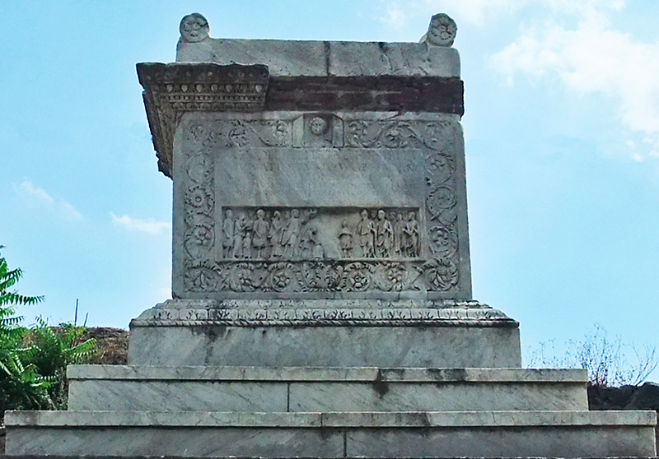
Tomb of Naevoleia Tyche (freedwoman?) and her husband C. Munatius Faustus

Slide 12
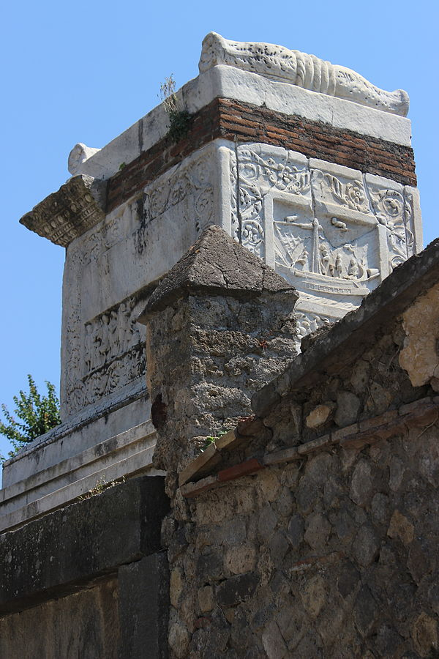

Slide 13
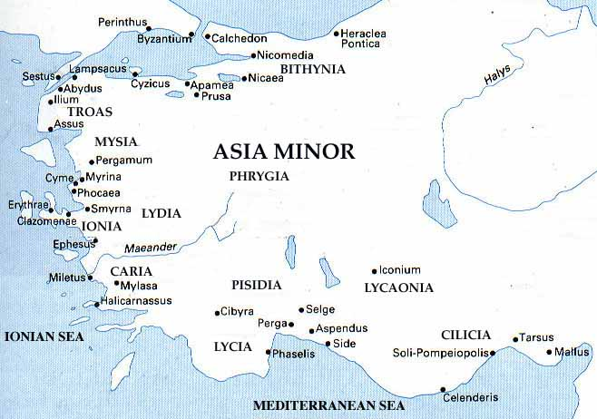
Claudius Etruscus’ father’s birthplace (Wiedemann 170

Slide 14
The career of the nameless (but important) father of Claudius Etruscus
Enslaved/sold/born in Smyrna
Freed under Emperor Tiberius
Was with Caligula in Gaul
Further promotion under Claudius
A rationibus to Nero
Took part in Vespasian's triumph: 71 CE
Raised to Equestrian rank: ca. 73/4
Exiled to Campania by Domitian; soon recalled
Died under Domitian, aged ca. 90

