Slide 1
Slaves in the Roman Civil Service
- Levels and positions
Why use slaves?
Roman Republic
- limited evidence
- viatores, praecones
mix of slave and free
Individualized staff of governors
Taxes collected via private companies not Roman officials
Empire
Overview of emperors
Overview of systems and needs
Changes over time
The familia Caesaris
where do they come from?
terminology
Ranks and positions

Slide 2
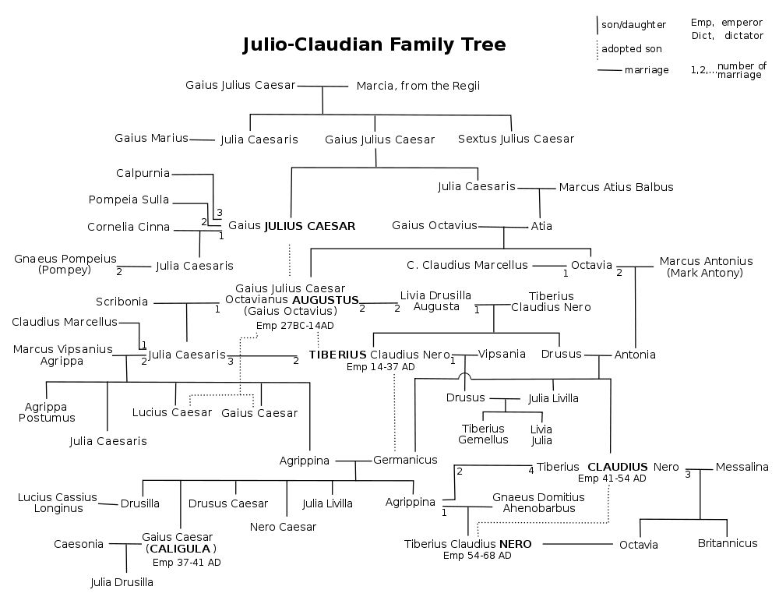
Transition with empire: Augustan

Slide 3
Empire
Julio-Claudians (27 BCE-68 CE)
Augustus, Tiberius, Caligula, Claudius, Nero
Flavians (69-96 CE):
Vespasian, Titus, Domitian (Colosseum: 80)
Nervo-Antonine Dynasty (98-192)
Trajan, Hadrian, Antoninus Pius, Marcus Aurelius, Commodus
Severans (193-235)
Septimius Severus, Elagabalus, Alexander Severus
235-284: 16 emperors (Crisis of the Third Century)
Diocletian (ruled 284–305 CE) and the splitting of the empire in to East and West
Constantine (306-336)
- inauguration of Constantinople 330
Eventual collapse of Western Empire and rise of Eastern Empire

Slide 4
Increased complexity of needs in the civil service under empire
Rome:
aid for emperor in administration
aid for magistrates in administration
aid for senators
central archives keeping track of citizenship, birth and other records of all Roman citizen
taxes
manage imperial properties and estates
Provinces
aid for governors
aid for citizens: access to legal services
record keeping and sending relevant copies to Rome
army requisitions and expenses
grain (always grain)
taxes
trade
dealing with client kings and threats

Slide 5
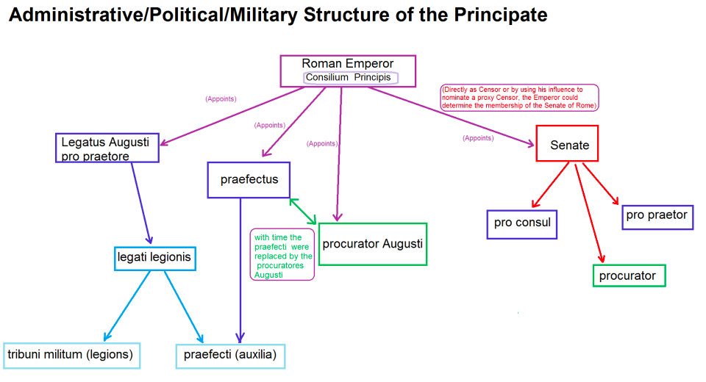

Slide 6
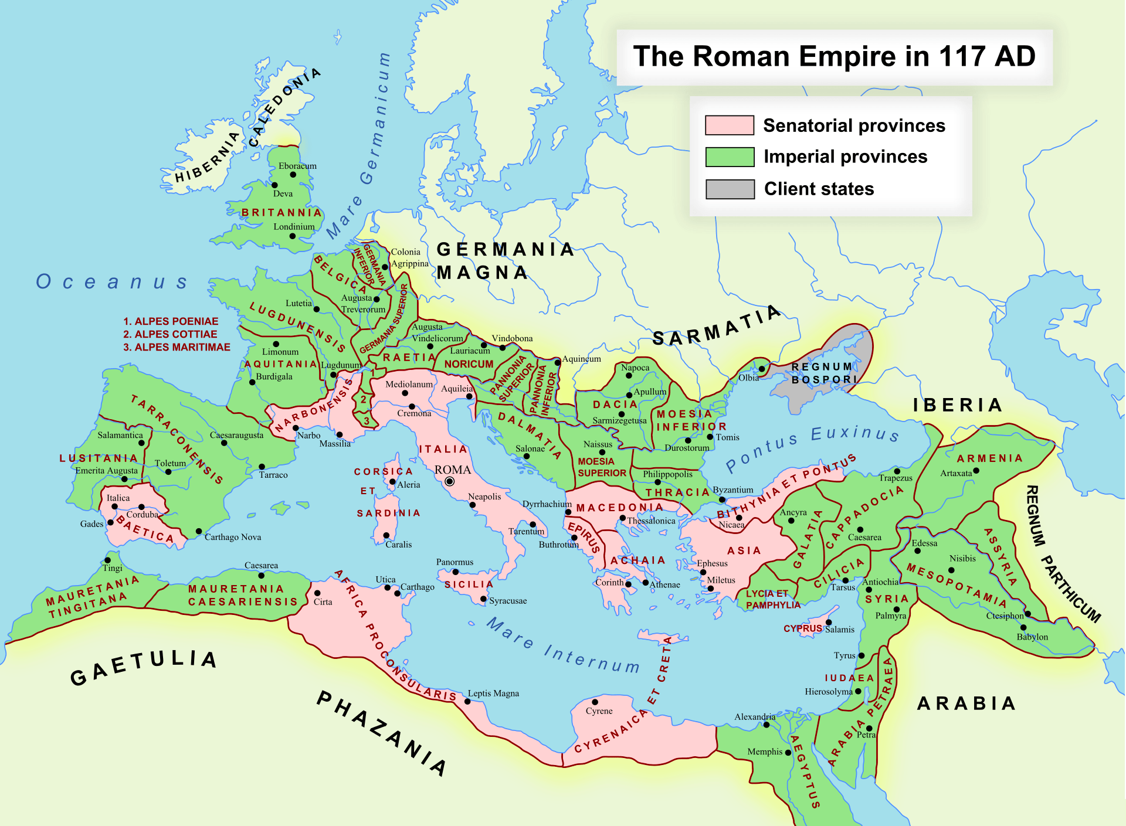
Governing the Roman empire: need for civil servants inside and outside Rome

Slide 7
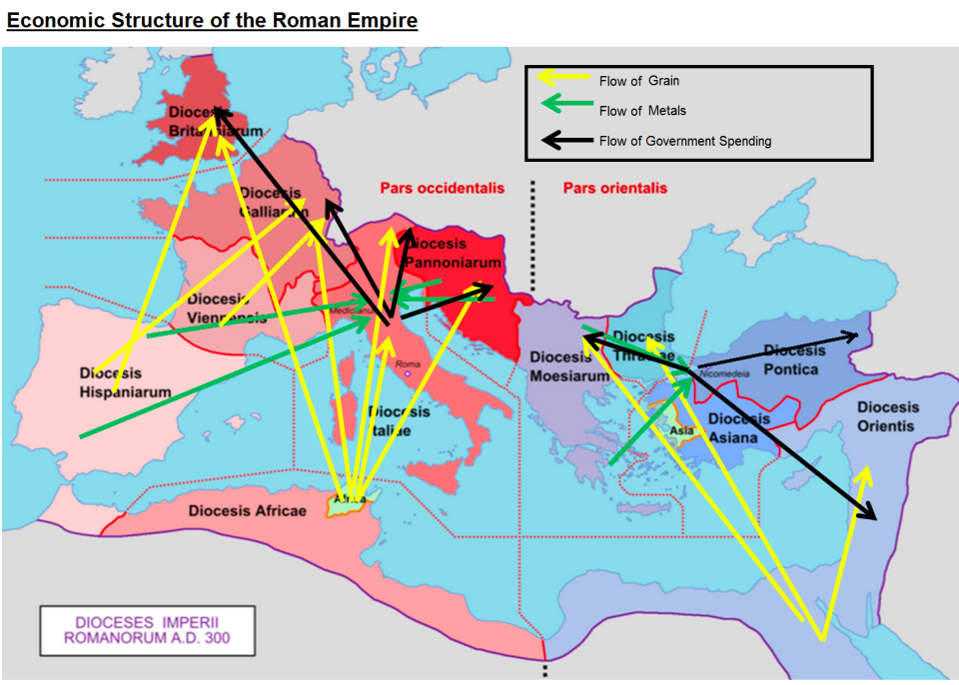

Slide 8
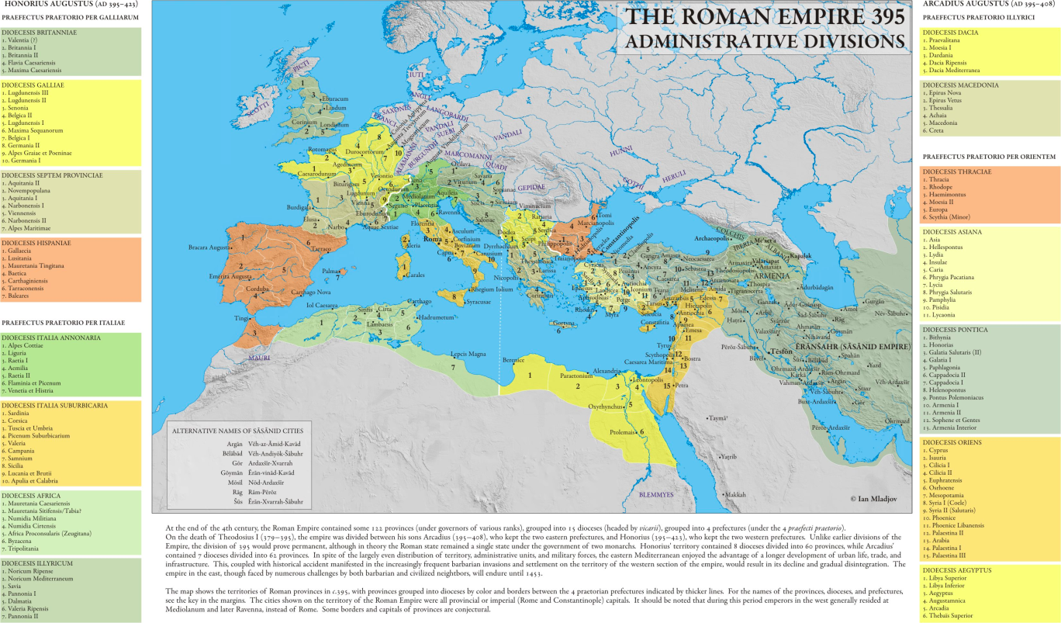
No, you don’t have to remember this: it is here for illustrative purposes to show the complexity of the system after Diocletian’s reforms

Slide 9
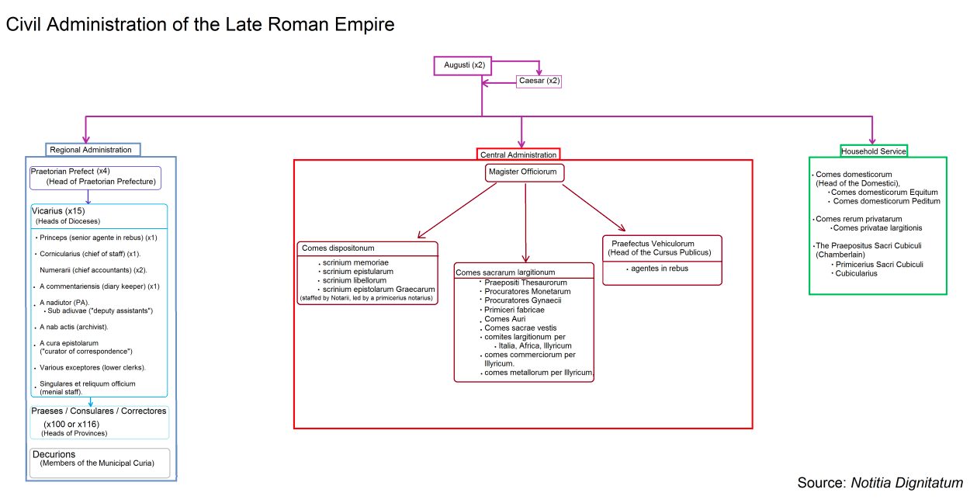
Be very grateful that we’re not focusing on the Late Roman civil service…

Slide 10
Familia Caesaris
How people became imperial slaves and civil servants
Specific terminology for imperial slaves
Top levels of the service (shift from freedmen to equestrians)
Lower levels + examples from inscriptions
Entertaining as the ruler of the world
Do not expect an organizational chart. It’s hard to define the relationships of some of these positions except at the very high end until the 300s CE

Slide 11
Entering the familia caesaris
- Birth (most common)
- within household as part of 2 slave marriages or children of slave women
- S.C. Claudianum 52 CE: children of free women and imperial slaves took status of father (Wiedemann 168)
Inheritance (hard to track but names suggest largish numbers) or gifts
- from relatives and friends of emperor (Pallantinus, Agrippinus)
- also client kings (Archelaianus, Herodianus, Iubatianus)
Purchase (rare)

Slide 12
Familia Caesaris: Terminology
Caes[aris] ser[vus]
Aug[usti] vern[a] (members of the familia Caesaris who die under 18, generally; not always slaves)
Aug[usti]
Caes[aris]
Slaves of imperial slaves
Vicarii:
Servus vicarius Liberti [servus] Liberti [liberti]
Musicus Scurranus (Wiedemann 127)

Slide 13
Top level: many shift to being equestrian positions in 2nd century CE
a rationibus: head of the fiscus, the private treasury of the emperor
ab epistulis Latinis: in charge of the emperor’s correspondence in Latin
ab epistulis Graecis: in charge of the emperor’s correspondence in Greek
(Created under Hadrian/Trajan and later headed by rhetors and literary figures)
a libellis: drafted legislation
a patrimonio: oversaw imperial estates

Slide 14
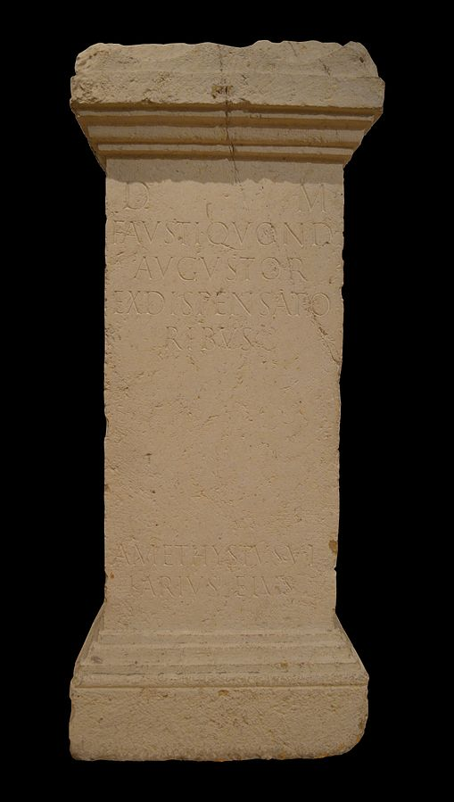
Imperial dispensatores
Tombstone for imperial dispensator
D(iis) M(anibus) / Fausti / quond(am) / Augustor(orum) (servi) / ex dispensato/ribus / Amethystys vi/karius eius
CIL XIII 1818
Dispensator = steward in private familae. But has larger function and importance in imperial familia in addition
subordinates: arcani

Slide 15
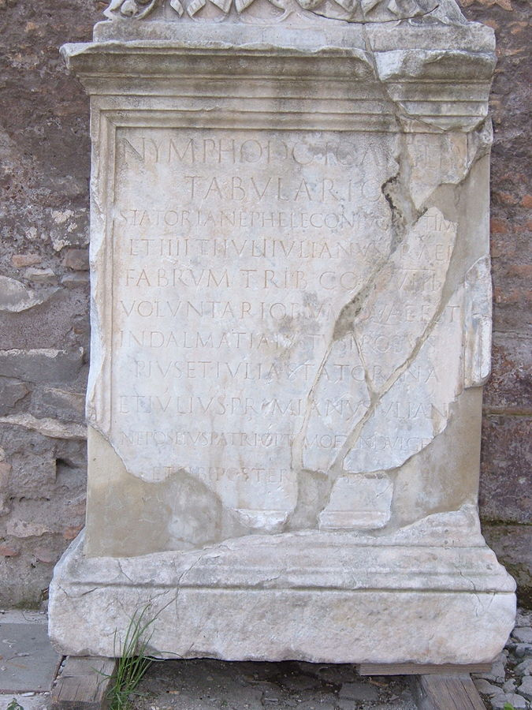
Inscription for a freed imperial tabularius Nymphodotus (‘Gift of the Nymphs’)
AE 1913, 0194
Tabularius: accountant/bookkeeper/record keeper
Varying types and subsets
Ranks below include adiutor: account assistant

Slide 16
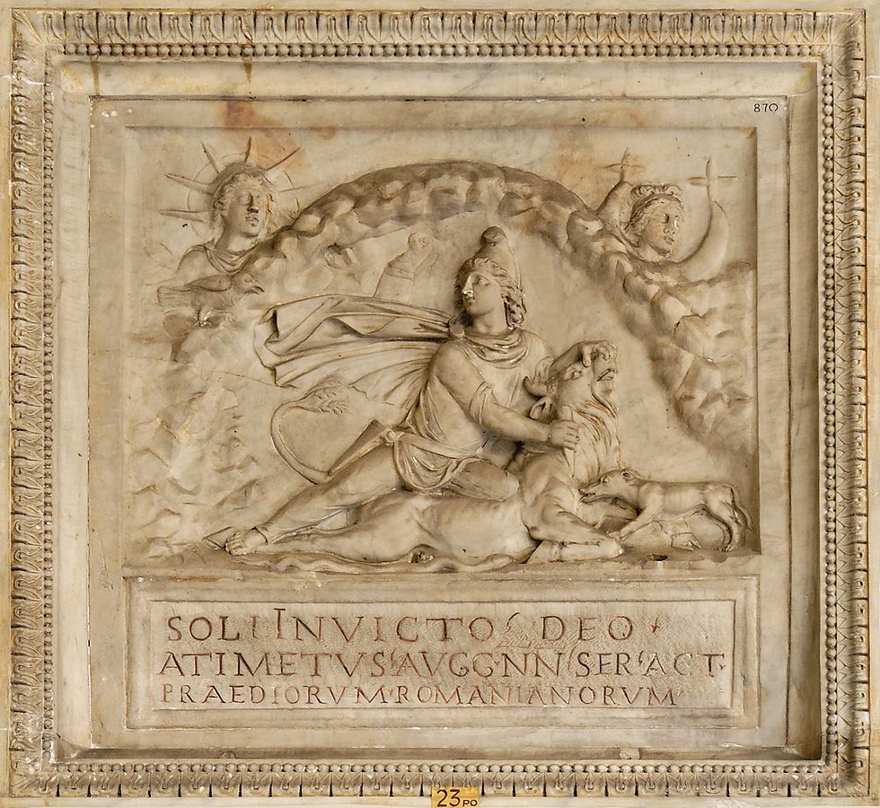
Actuarius: fiscal official.
Various postings and types
Inscription for the ‘Unconquered Sun’ by Atimetus, imperial slave and
act(uarius) praediorum Romanianorum /cashier of the Romanian farms
(CIL VI, 721)

Slide 17
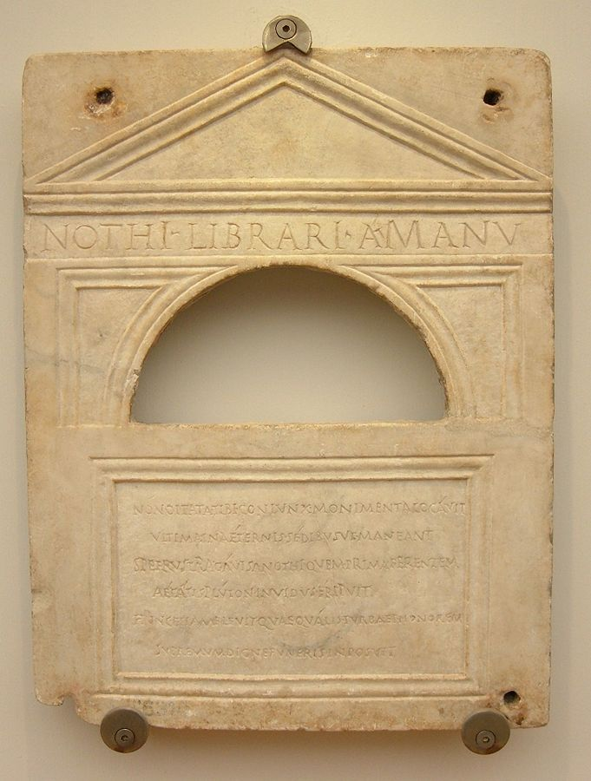
Inscription for Nothus, a
Librarius a manu
(Copyist or dictation clerk)
Erected by his wife
(CIL VI 6314)

Slide 18
Entertaining and managing the imperial household
Dispensator/dispensatores: stewards
Rogator: secretary in charge of invitations and arrangements
ad admissione: controlled the entrance and exits of visitors
nomenclator: reminded people of names and other information
ab hospitiis: in charge of guest accommodations
opsonator: caterer

Slide 19
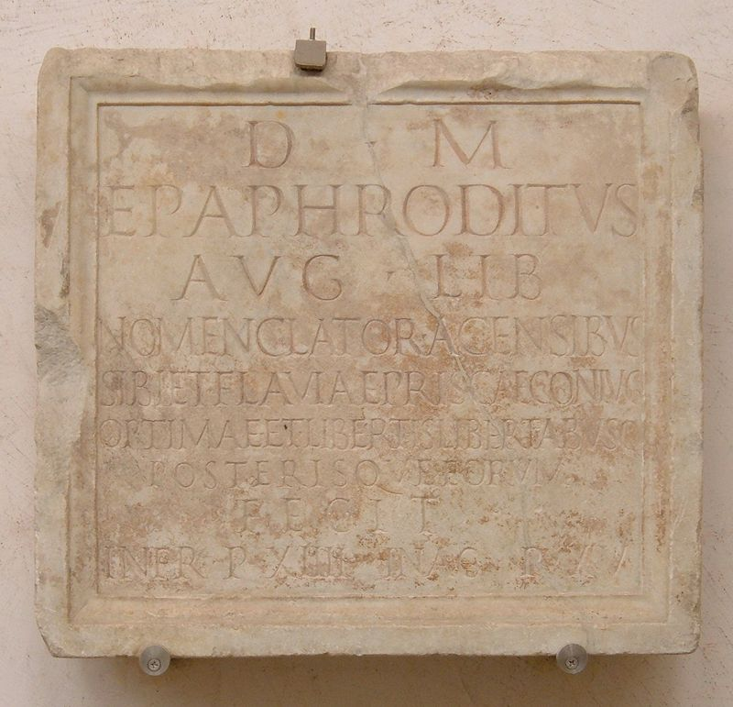
Inscription for the imperial nomenclator, Epaphroditus

