Slide 1
Terminology
Greek:
Emporos/emporoi (common)
Somatemporos (less common)
Andrapodokapelos (very rare)
Roman:
venalicus/venalicarius
mango/mangones (possibly specialised in eunuchs and boys for the sex trade)

Slide 2
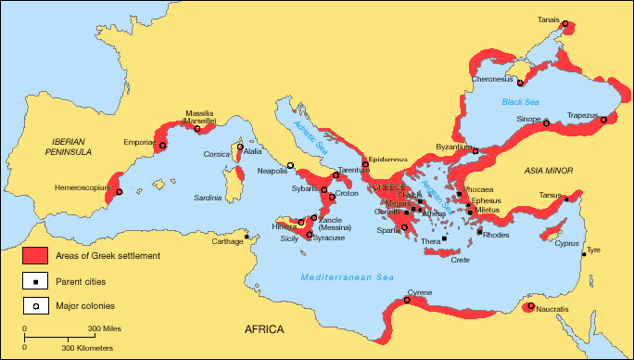

Slide 3
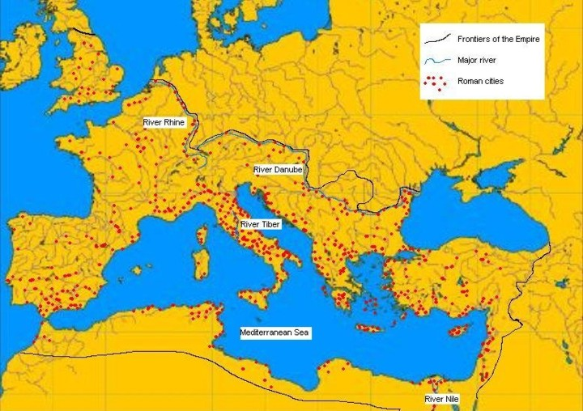
Trading in slaves: marks (urban centres in the Roman Empire)

Slide 4
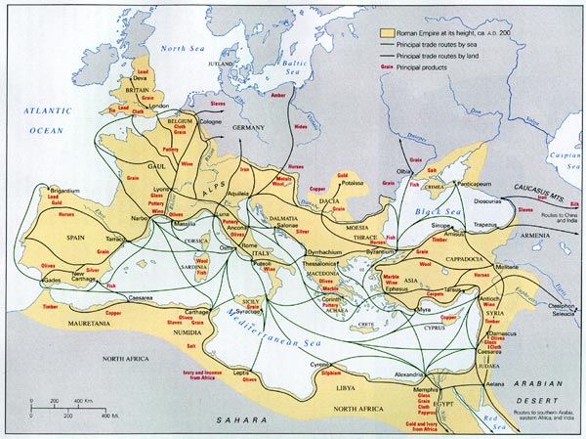

Slide 5
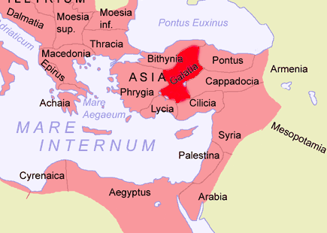
St Augustine and the Galatians (Roman province of Galatia)

Slide 6
Some slave dealers + locations
C. Sornatius Barba (72-1 BCE) Acmonia (Phrygia)
Toranius Flaccus (40-30s BCE) - Rome
Tiberius Claudius Secundus (44 CE)- Ephesus*
C. Sallustius Crispus Passsienus (43 CE) – Ephesus
Vespasian? (60s CE) – North Africa
Alexander, son of Alexander, late 2nd century CE - Thyateira (Lydia)
*full inscription here)

Slide 7
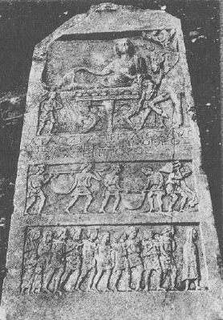
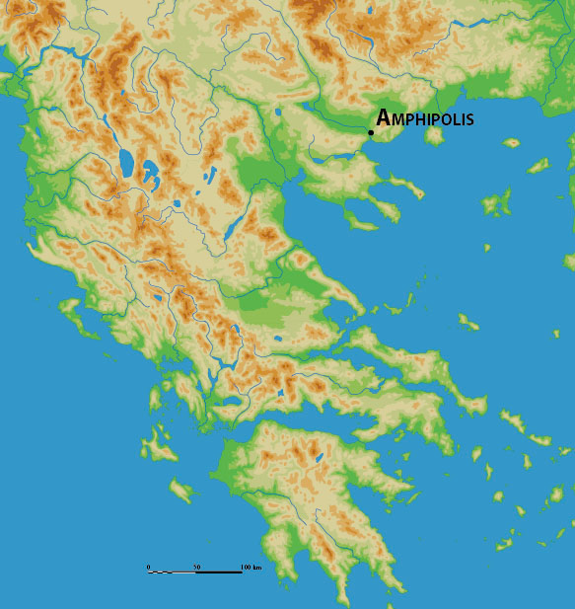
Funerary stele for a slave dealer (somatemporos)
Aulus Caprilius Timotheos
Early 1st century CE?
Amphipolis

