Slide 1
Resisting slavery (or just surviving)
non-violent resistance:
theft, lying, property damage…
Flight
Carmen Astrologicum of Dorotheus of Sidon
Timing
War (example of Sextus Pompeius), chaos, travel…
Risk
Slave-catchers
Violent resistance
Suicide
Assault and murder
Larius Macedo, killed in 108 CE (W 209)
Hostius Quadra (under Augustus)
L. Pedianus Secundus, city prefect, killed in 61 CE

Slide 2
Carmen Astrologicum of Dorotheus of Sidon
Chapter 36
If the benefics are in the ascendant or aspect the ascendant or are with the Moon. then release from slavery truly [and] certainly is determined for the runaway who has runaway at that hour. The best of the benefics in this matter [is] Venus when it aspects the ascendant or the Moon or is with the Moon or in the ascendant, as, if Venus happens to be in this position, then, if the runaway who ran away at that hour escapes, he will not be caught, and if he is caught and sent back to his master, then he will be content with him and grant him his rule

Slide 3
Digest 11.4 on fugitive slaves (See Shaw 14 for full text
(3) Every person whosoever who arrests a fugitive slave is bound to produce him in public.
(4) And the magistrates are very properly notified to detain them carefully in custody to prevent their escape….
(6) A slave is understood to be produced in public who is delivered up to the municipal magistrates or officers of the government.
(7) Careful custody permits the use of irons.
(8) The slaves must be held in custody until they are brought before the Prefect of the Watch, or the Governor. Information must be given to the magistrates of their names and marks, as well as the addresses of the party to whom any one of them says he belongs; in order that fugitive slaves may be the more easily recognized, and claimed. And in the word "marks" scars are also included.

Slide 4
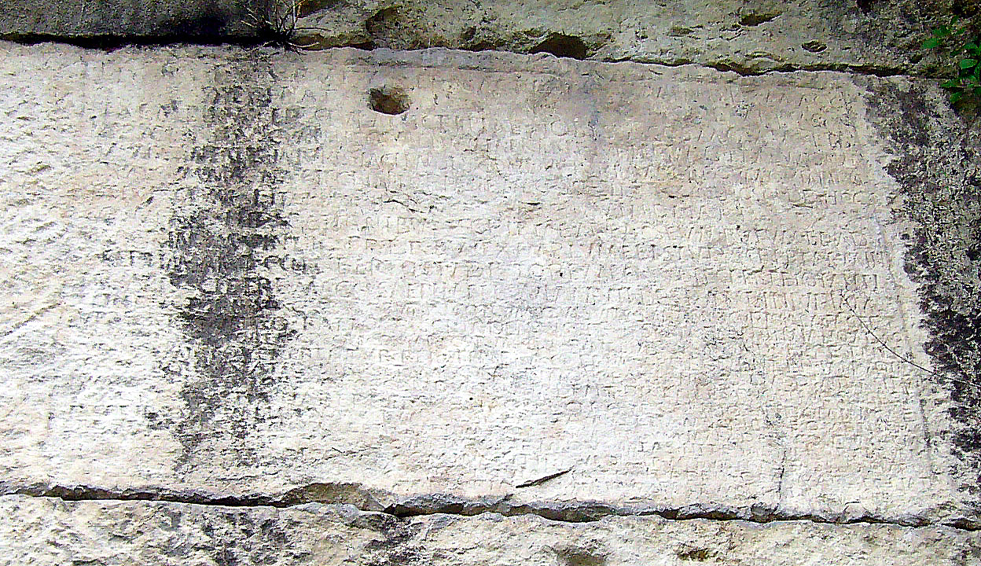
Stationarii: soldiers who also functioned as slave catchers
CIL IX.2438 and the over-zealous stationarii and magistrates of Saepinum

Slide 5
The text of the inscription:
Written by Septimianus to Cosmus: the contractors of the sheep flocks under your care repeatedly complain to me in person that they are often injured on the paths of itinerant shepherds by outposted soldiers (stationarii) and the magistrates of Saepinum and Bovianum, because they detain in transit the pack animals and shepherds leased by the contractors, saying the shepherds are runaway slaves, and the pack animals stopen. Under this façade sheep belonging to the emperor are also disappearing amid this disorder. So it is necessary for us to write again [and ask them] to have more peacefully, lest the emperor’s affairs suffer. Since they persist in this same obstinacy, saying they will pay not attention either to my letters or to yours if you write to them. I ask you, sir, if it seems good to you, to notify the most eminent Praetorian Prefects Basseus Rufus and Macrinus Vindex to send letters to those same magistrates and outposted solider… (the rest is lost)

Slide 6
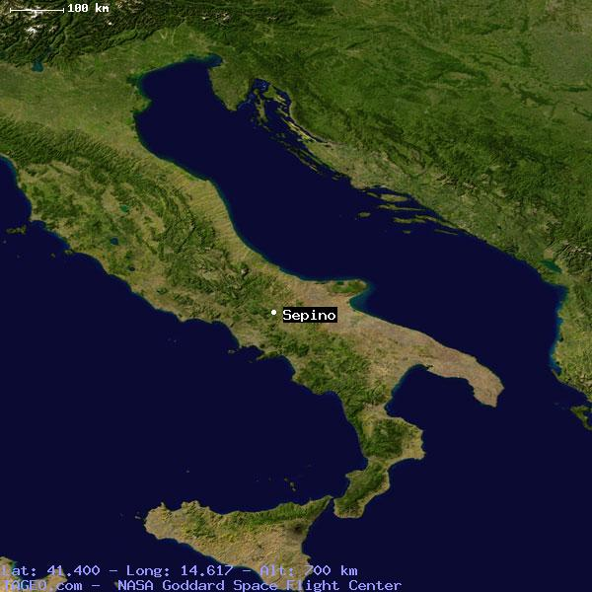
Location of the inscription
(Saepinum = modern Sepino)

Slide 7
Curse tablet from the Greek island of Amorgos, against Epaphroditus
“Mistress Demeter, queen, I, your suppliant, your slave kneel before you. One Epaphroditus has lured away my slaves. He has taught them evil ways. He has put ideas into their heads, he has given them advice., he has taught them evil ways. He has put ideas into their heads, he has given them advice, he has seduced them. He has laughed at me, he has given them wings to waste time in the marketplace. He gave them the idea of running away. He himself bewitched my slavegirl, so that he could take her to wife against my will. For this reason he bewitched her to run away along with the others. Lady Demeter, being the victim of these things, and being on my own, I take refuge with you. May I find you propitious, and grant that I should find justice. Grant that the one that has done such things to me should find no peace in body or mind anywhere, whether still or moving. May he fail to accomplish his aims…
(SGD 60 = CT 75)

Slide 8
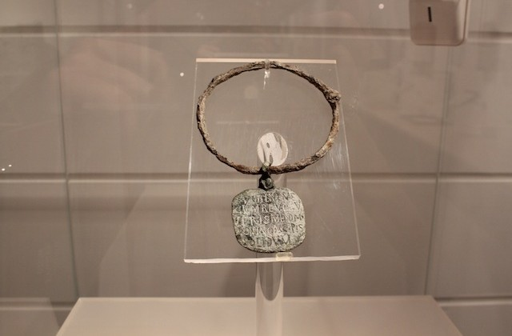
Slave collar in the Baths of Diocletian = W 219 (See also W 220-221)

Slide 9
Other slave Collar texts:
I am a slave of my master Scholasticus, an important official. Hold me so that I don’t escape from the mansion called Pulverata
(AE 1892.68, Rome)
Seize me because I have fled and bring me back to my master, the highly estimable Cethegus in the Livian market, third region of the city of Rome
(CIL 6.41335, Rome)

Slide 10
Hostius Quadra
There was a man named Hostius Quadra, whose obscene acts even became the subject of a theatrical performance. He was rich, greedy, a slave to his millions. The deified Augustus did not consider him worth being avenged when he was murdered by his slaves, and almost proclaimed that he seemed to have been murdered justly.
Seneca the Younger, Natural Questions 1.16
L. Pedianus Secundus (61 CE)
Soon afterwards one of his own slaves murdered the city-prefect, Pedanius Secundus, either because he had been refused his freedom, for which he had made a bargain, or in the jealousy of a love in which he could not brook his master's rivalry. Ancient custom required that the whole slave-establishment which had dwelt under the same roof should be dragged to execution, when a sudden gathering of the populace, which was for saving so many innocent lives, brought matters to actual insurrection..
Tacitus, Annales 42

Slide 11
Inscriptions recording slave murder
CIL 13.7070 (Mainz , Germany)
Jucundus, freedman of Marcus Terentius, a cattleman, lies here. Passerby, whoever you might be, stop and read. See how I uselessly complain, undeservedly taken from life. I was not able to live more than 30 years. A slave tore life from me and then cast himself headlong into the water below. The River Main took from that man whathe had taken from his master. Jucundus’ patron erected this monument.
AE 1992.1037 (Clunia, Spain)
Atia Turellia,, daughter of Gaius Turellius, age 27, was killed by a slave. Gaius Turellius and Valeria [set this up]

Slide 12
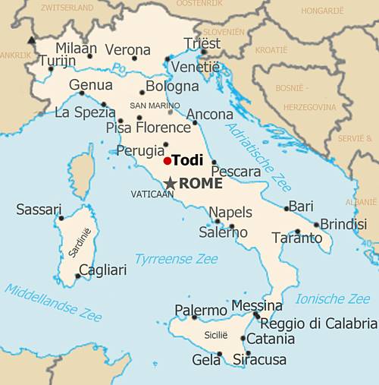
(CIL XI:2 4639; ILS 3001) = Wiedmann 210: from Todi, Italy
Pro salute/coloniae et ordinis decurionum/ et populi/ Tudertis,
Iovi opt(imo]) max(imo)/custodi conservatori/ quod is sceleratissimi servi/ publici infando latrocinio | defixa monumentis ordinis/ decurionum nomina/ numine suo ervit ac vindi/cavit et metu periculorum/ coloniam civesque liberavit
L(ucius) Cancrius Clementis lib(ertus)/ Primigenius/ sexvir et Augustalis et Flavialis/primus omnium his honoribus ab ordine donatus/ votum solvit

