Slide 1
How many slaves and how many each year?
What type of slaves and at what period?

Slide 2
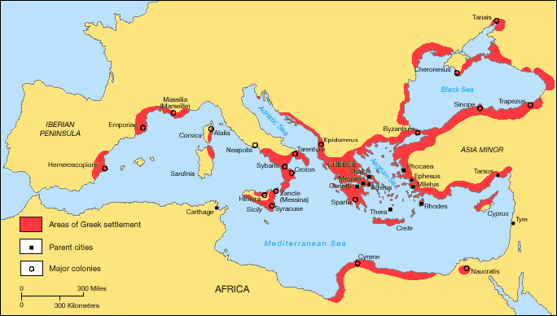

Slide 3
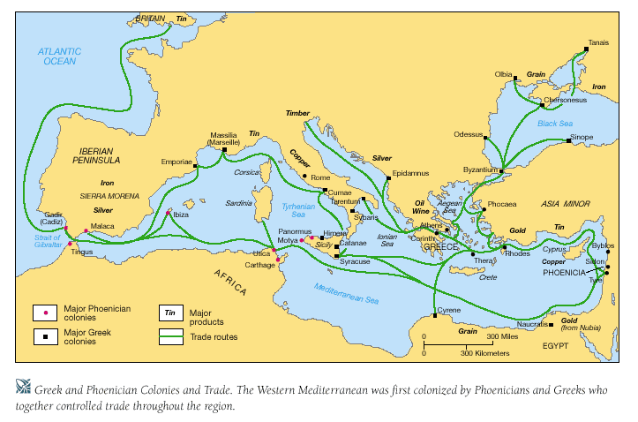

Slide 4
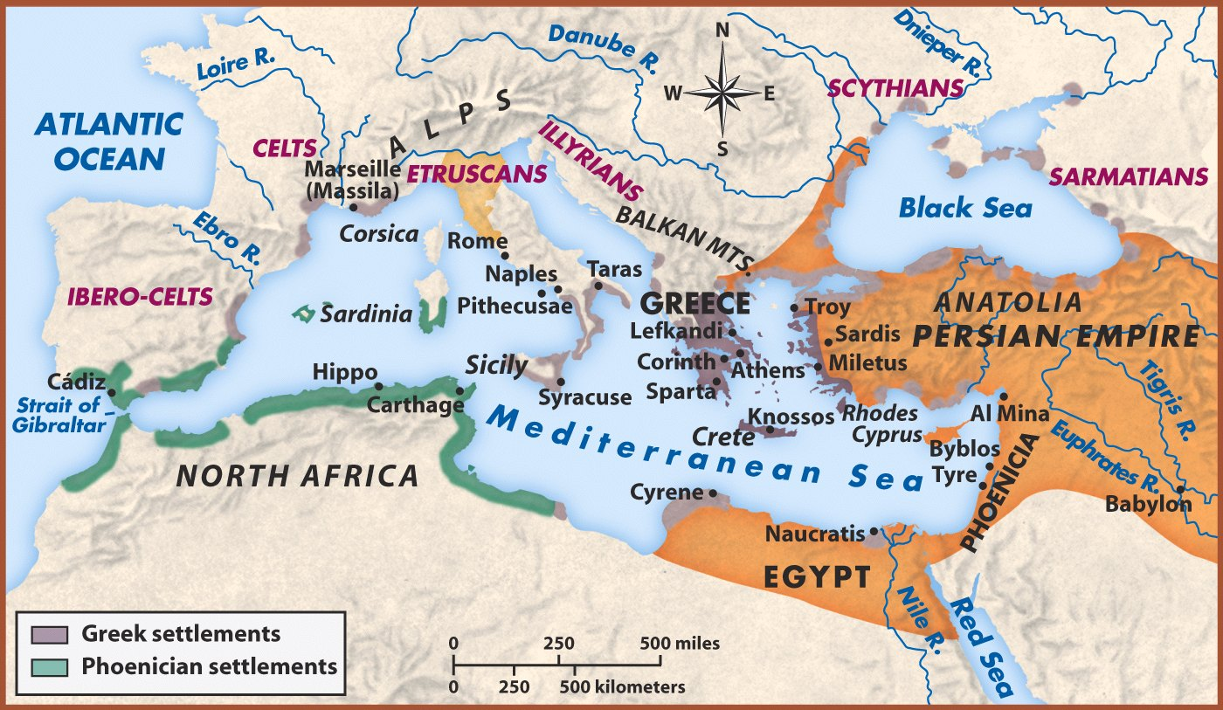
Greece and the Persian Empire

Slide 5
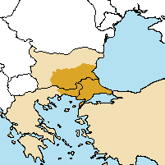
Major source (Classical Greece) I: Thrace

Slide 6
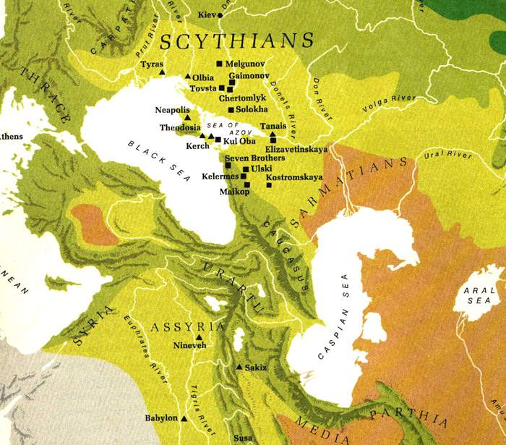
Major source (Classical Greece) II: Scythia
(For Scythians as the Athenian police force see here)

Slide 7
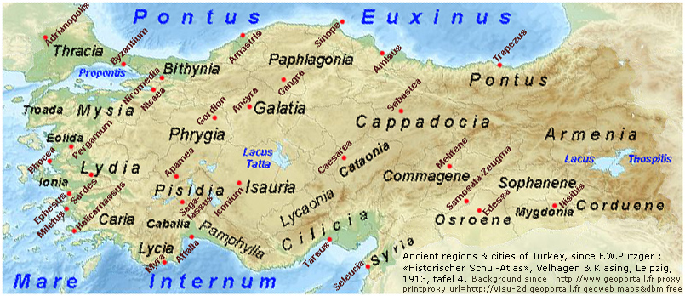
Source of slaves (Classical Greece) III: Phrygia – cf. the name ‘Manes’

Slide 8
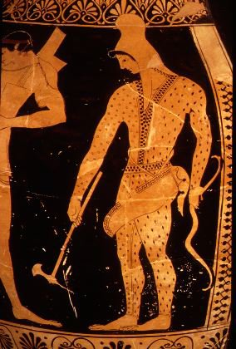
Scythian archer on an Attic red-figure kylix (590-490 BCE)
(more information on the kylix can be found here)

Slide 9
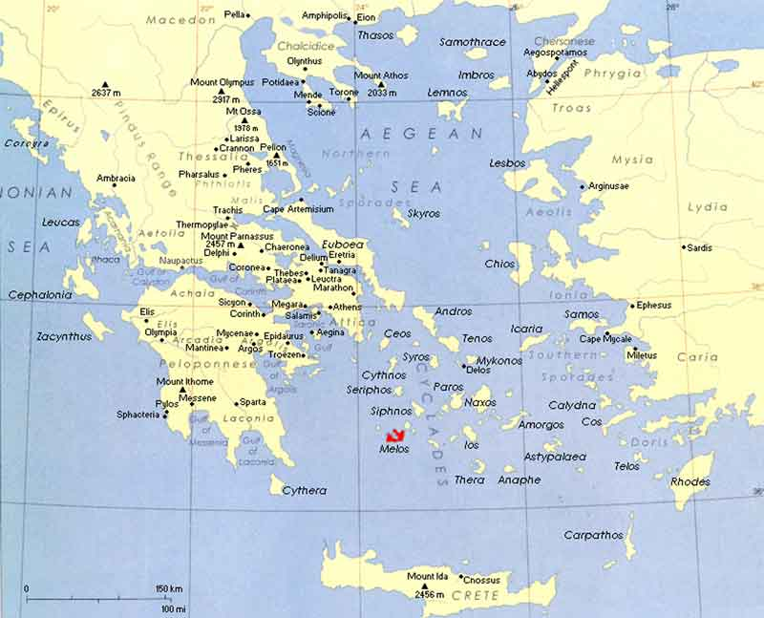
Major source (?) IV: enslavements in war in Greece (Melos in 416 BCE)

Slide 10
Major source (Classical and Hellenistic Greece) V: piracy, kidnapping and brigandage
Major source (Classical and Hellenistic Greece) VI: Child exposure
Major source (Classical and Hellenistic Greece) VII: Birth

Slide 11
Greek colonies and the enablement of the slave trade

Slide 12
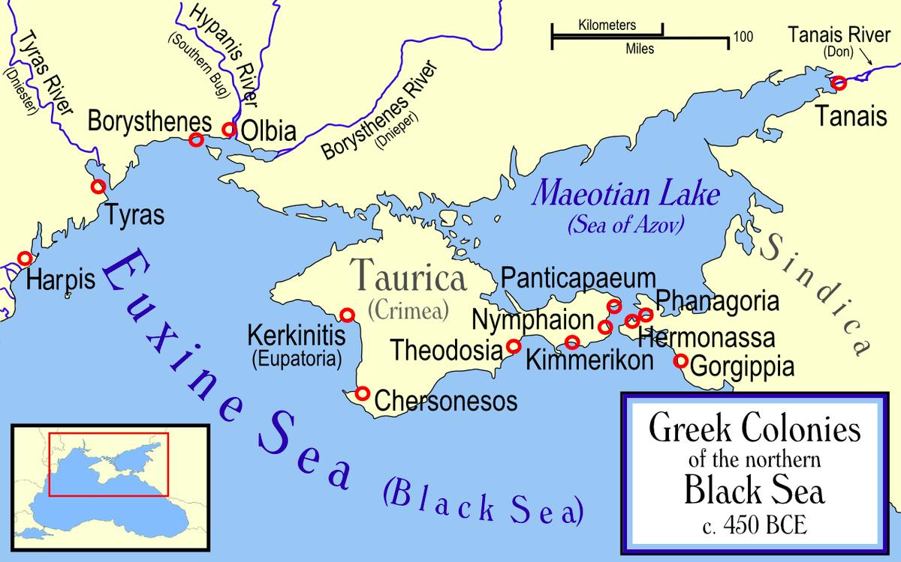
North Black Sea Greek colonies and trade in Scythian slaves (cf. especially Tanais)

Slide 13
Greece and the Persian Empire

Slide 14
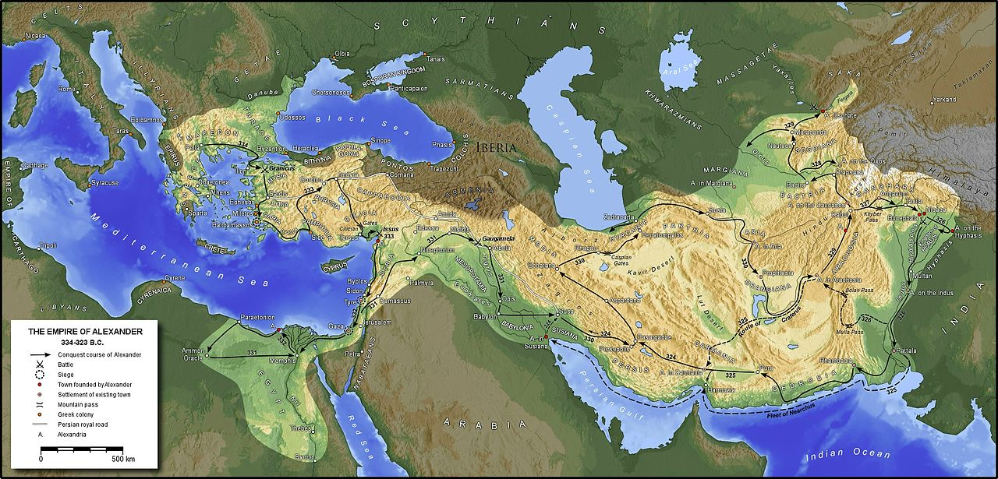
The empire of Alexander the Great (source)

Slide 15
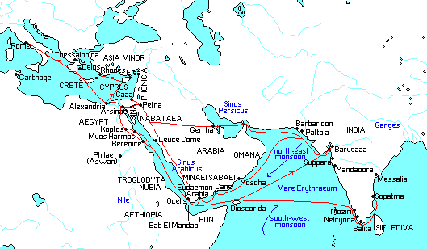
Trade routes in Hellenistic Greece and Rome (source)

Slide 16
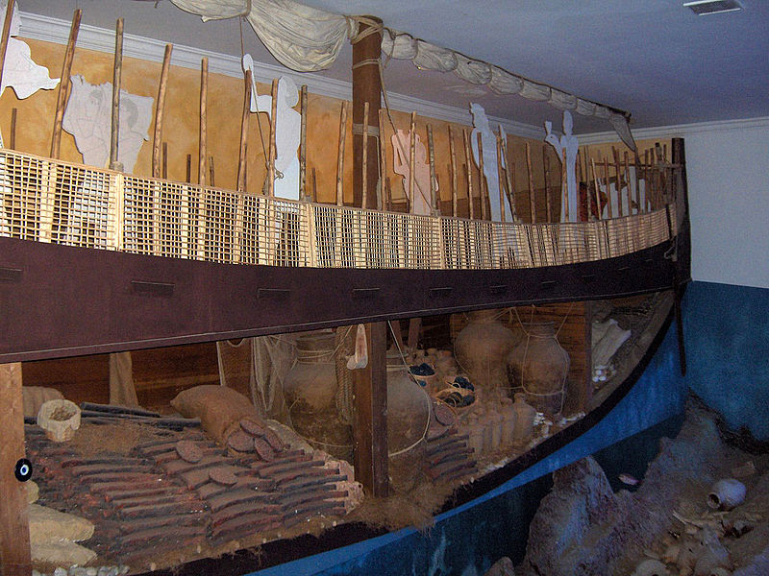
Transport: Phoenician merchant ship (based on the Bronze Age Uluburun shipwreck)

Slide 17
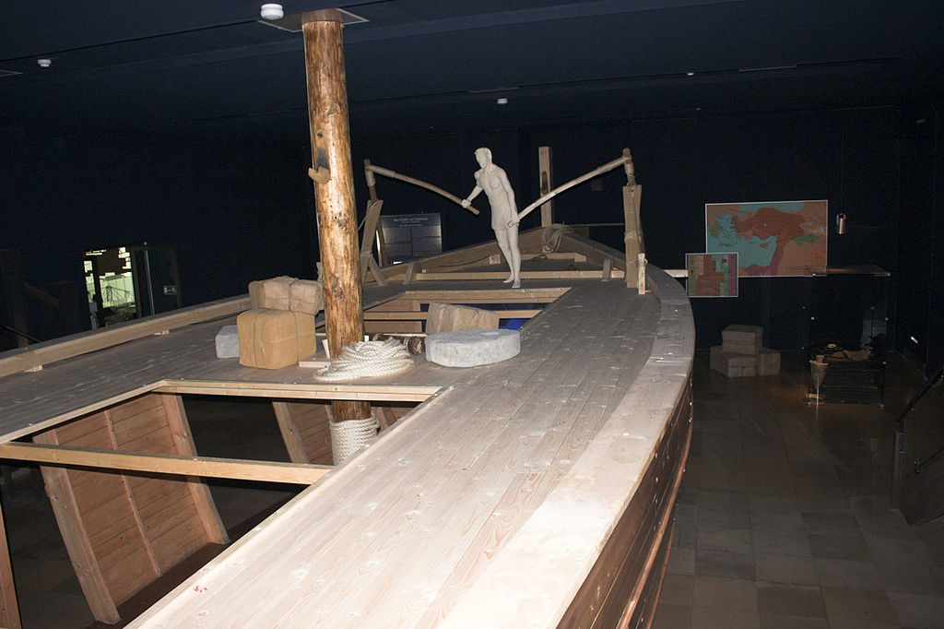
Transport: Phoenician merchant ship (based on the Bronze Age Uluburun shipwreck)

Slide 18
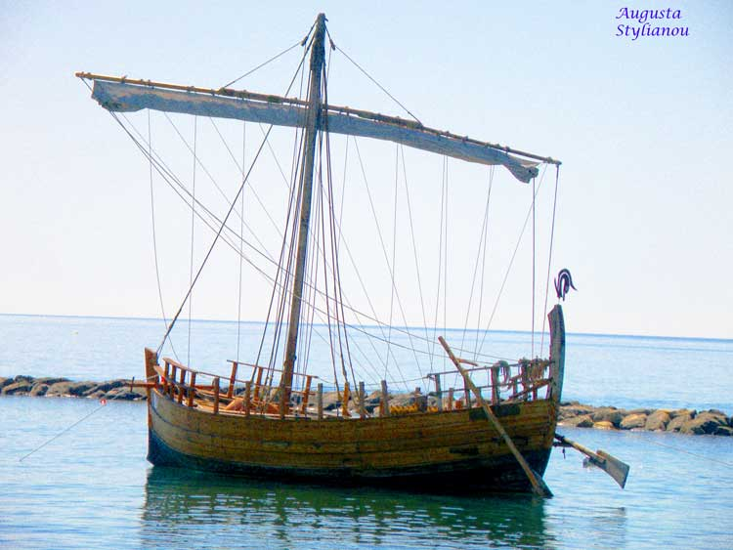
Replica of a Greek merchant ship (c. 300s BCE; based on Kyrenia shipwreck)

