Slide 1
How many slaves and how many each year?
Sources of Roman slaves (hey! They’re the same as the Greeks!)
Warfare
Kidnapping/Piracy/Brigandage
Trade
Exposure
Birth
Self-enslavement

Slide 2
Reported enslavements through war 297-167 BCE
Third Samnite War (297-293) 58.000-77,000
First Punic War (264-241) 107,000-133,000
Gallic War (225-222) 32,000
Second Punic War (218-202) 172,000-186,000
Sack of Epirus (167) 150,000
Other wars (201-168) 153,000

Slide 3
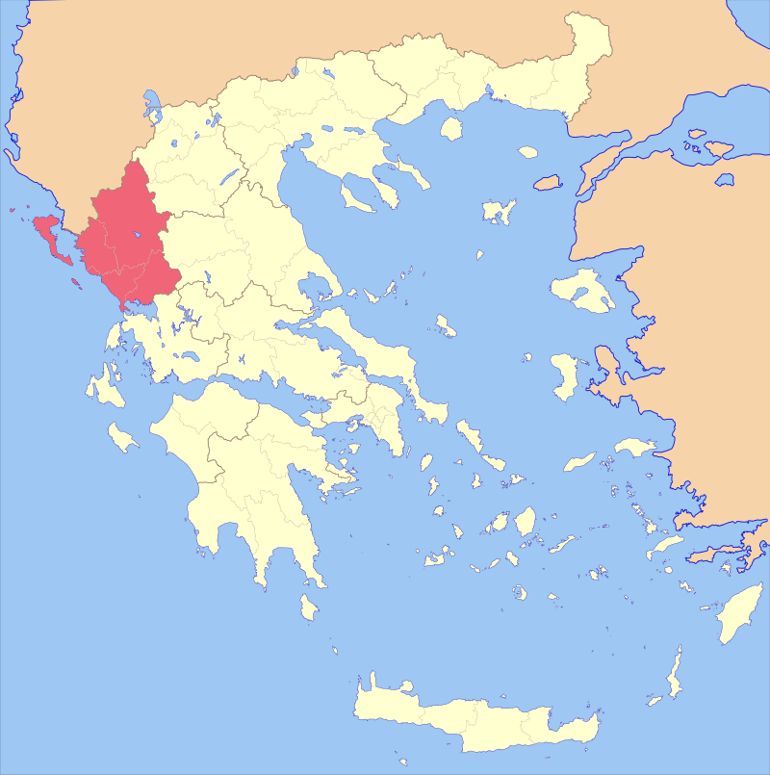
Enslavement through War: Epirus 167 BCE (Image source)

Slide 4
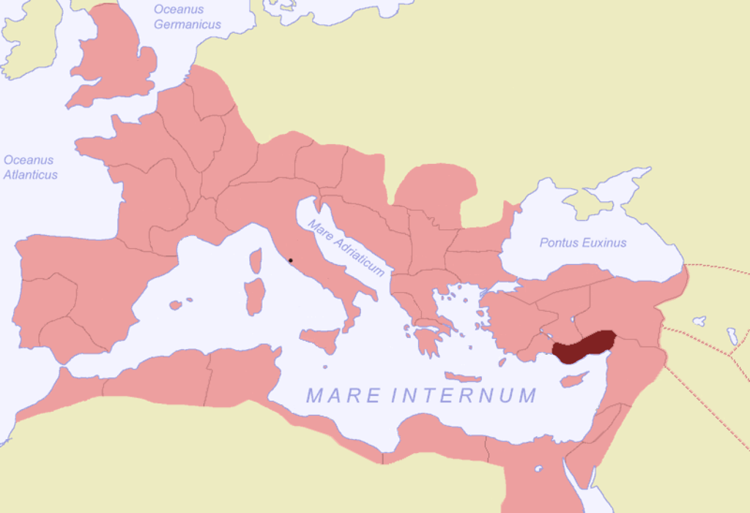
Enslavement through piracy: Cilicia

Slide 5
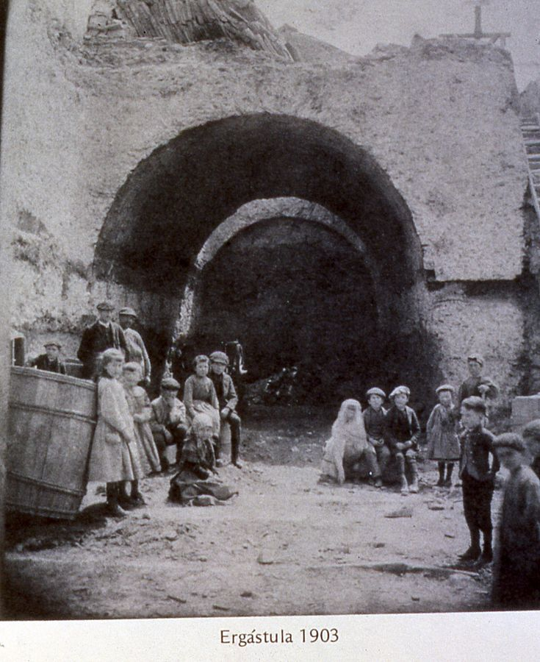
Slavery through kidnapping: Roman Ergastulum in Astorga, Spain

Slide 6
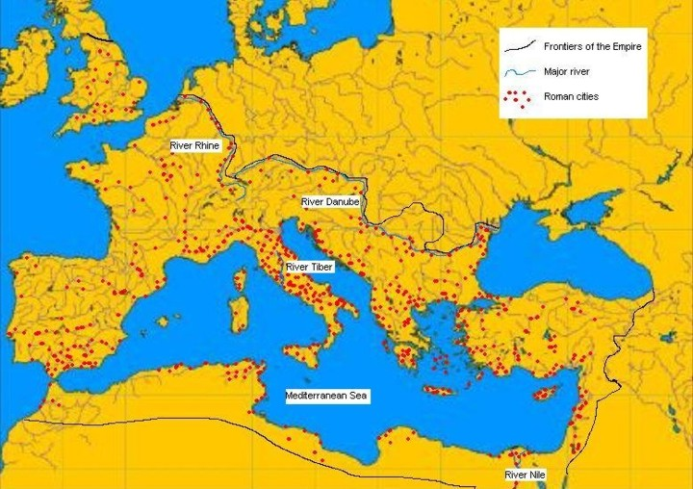
Trading in slaves: marks (urban centres in the Roman Empire)

Slide 7
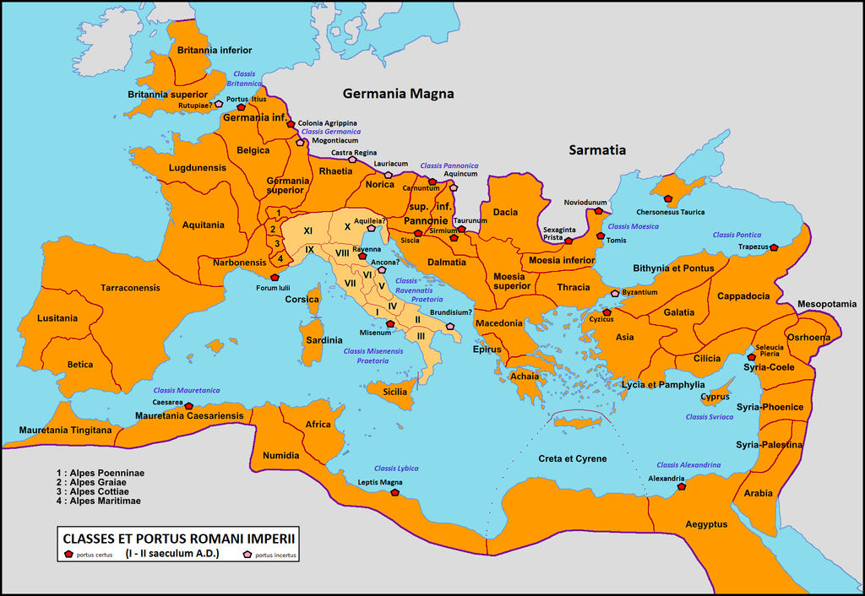
Trading in slaves: Imperial fleets and some major ports

Slide 8
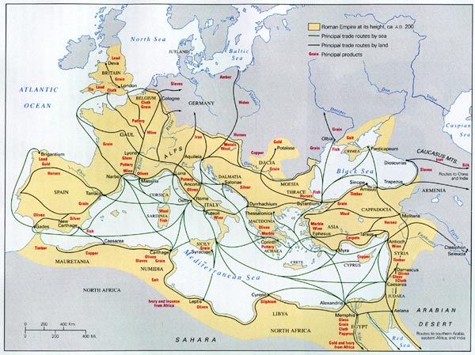

Slide 9
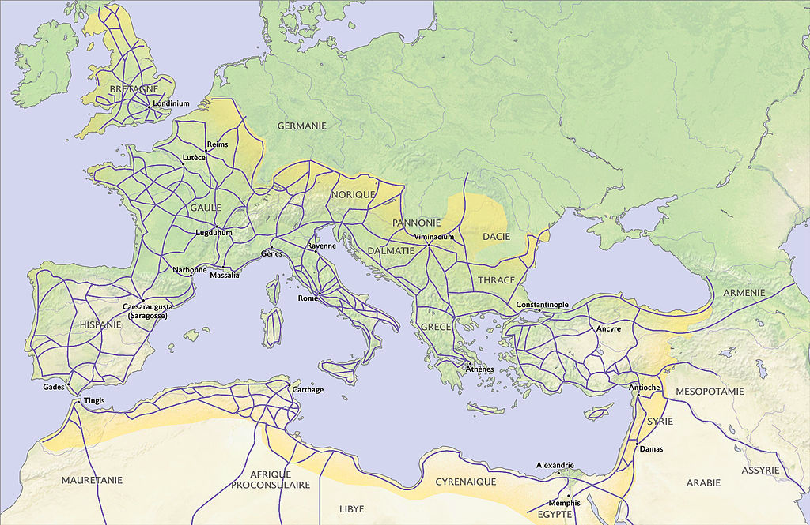
Major road routes within the Roman empire (image source)

Slide 10
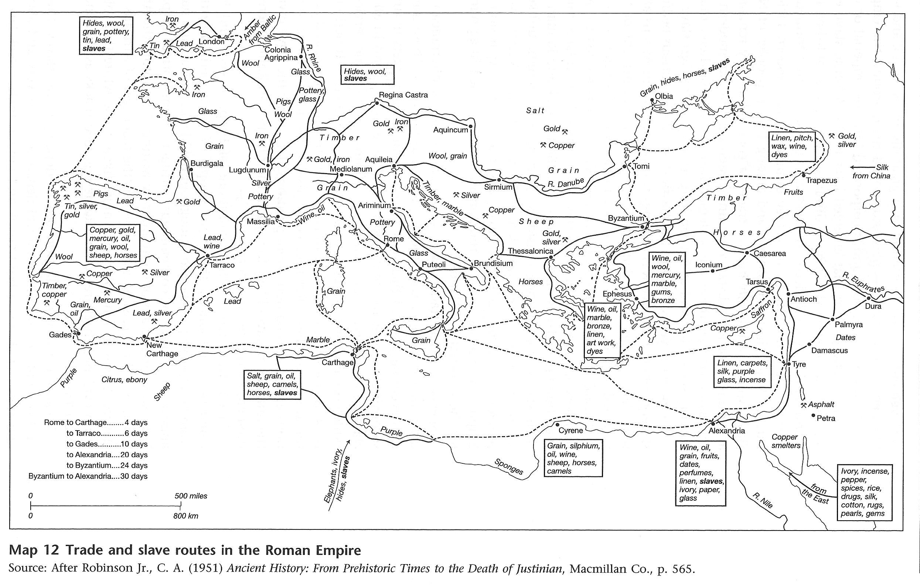
Importation of slaves: trade routes

Slide 11
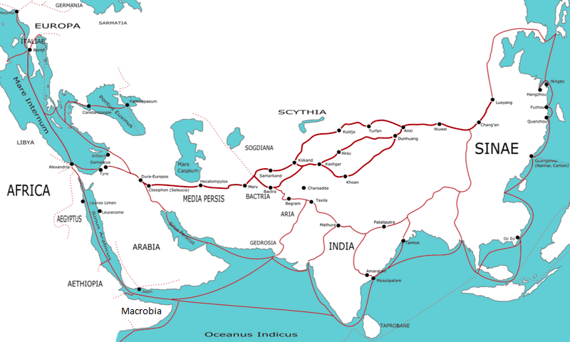
Importation of slaves: Asian trade routes

Slide 12
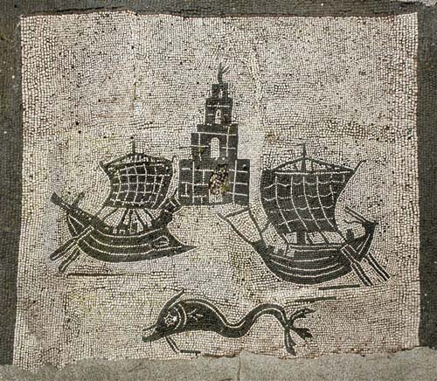
Ostia: Rome’s port (mosaic of ships and habour tower from Ostia (for more information on the site see here)

Slide 13
Birth:
Gender balance
Reproductive rates
Child mortality
Expense vs. exposure
Slave resistance
How typical is US slavery?

