Slide 1
Slaves and Greek law
Multiple city-states (poleis) = multiple legal systems
Gortyn
serfs or slaves?
two terms: dolos and woikeus

Slide 2
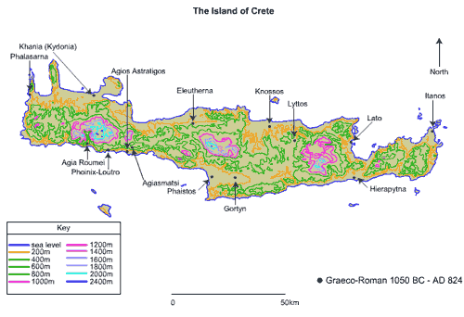
Gortyn law code

Slide 3
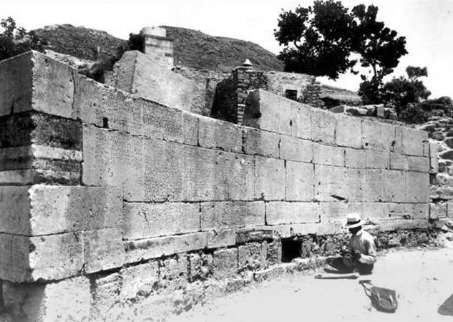
Gortyn law code (photo taken before 1900; shows Federico Halbherr (1857-1930) the discoverer of much of the code)

Slide 4
Gortyn law code
Reading 3, Wiedemann
Anyone who initiates proceedings concerning a free man or a slave is not to lead the person off before the trial

Slide 5
Gortyn law code: beyond Wiedemann
If someone rapes a free man or woman, he shall pay 100 staters, and if on the son or daughter of an apetairos [resident alien] ten, and if a slave a free man or woman, he shall pay double, and if a free man a male or female slave five drachmas, and if a slave a male or female slave, five staters. If one deflower a female house-slave by force he shall pay two staters, but if she is not a virgin, in the daytime, an obol, but if at night, two obols…If someone is taken in adultery with a free woman in her father's house, or her brother's or her husband's, he is to pay 10 staters; if in another man's house, 50 staters; if with the wife of an apetairos, 10 staters. But if a slave is taken in adultery with a free woman, he must pay double. If a slave is taken in adultery with a slave, 5 staters.

Slide 6
Gortyn law code: slave property?
If a female slave be separated from a male slave while alive or in case of his death, she shall have her own property, but if she carry away anything else she shall be answerable….
Living apart from masters:
If a divorced woman should expose her child before presenting it according to the law, she shall pay 50 staters for a free child, and 5 for a slave, if she is convicted. If the man to whom she brings the child has no house, or she does not see him, she shall not pay a penalty if she exposes the child…
Slave families and parents
If an unmarried female slave conceives and bears a child, the child shall belong to the master of her father. If the father is not alive then to the masters of her brothers…

Slide 7
Gortyn law code: slave and free unions:
If a slave lives with a free woman marries her, the children shall be free; but if the free woman lives with a slave, the children shall be slaves; and if from the same mother free and slave children be born, if the mother die and there be property, the free children shall have it; otherwise her free relatives shall succeed to it.

Slide 8
Athens
the law on hubris (reading 183)
Antiphon (reading 181)
Court of the Ephetae
Asylum

Slide 9
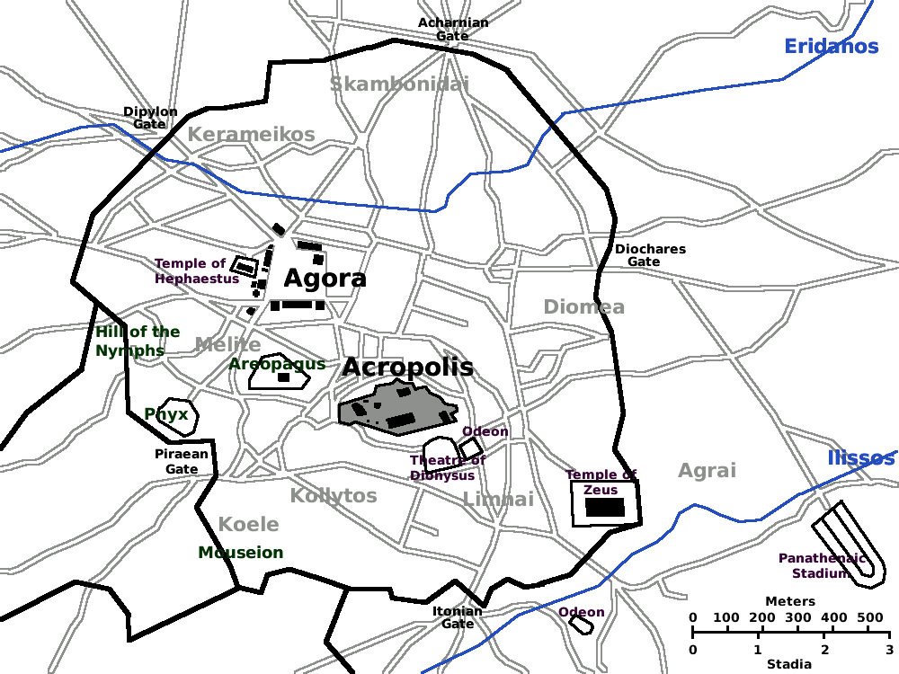
Asylum: Theseum/Temple of Hephaestus and Sanctuary of the Eumenidies/Furies on the Areopagus

Slide 10
Manumission
Purchasing manumission
- fictive religious sale
- fictive private sale
- gender imbalance in ability to earn money for freedom
- freedom grows more expensive over time

Slide 11
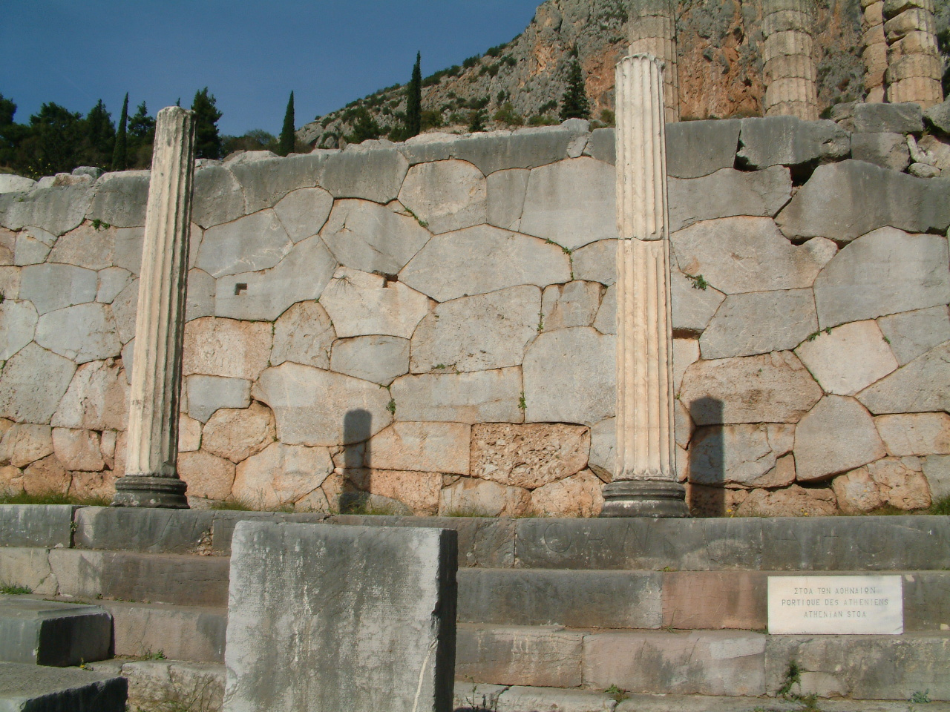
Paranome: wall in Delphi, with inscriptions recording the manumission of slaves

Slide 12
Paranome agreements:
Function
Locations
Changes over time
Challenges after freedom
Apostaiou: a civil action allowed to patrons against their freedmen, if they cease to recognise them or seek legal protection from someone else or fail to do the other things required by the laws. Those found guilty have to become slaves oncemore, and those acquitted become absolutely free. (Reading 27, Wiedmann)

