Slide 1
First Servile War (135?-132 BCE)
Slave Leader: Eunus (King Antiochus)
Lieutenant: Cleon
Roman leaders: Lucius Hypsaeus (useless); C. Fulvius Flaccus (useless); L. Calpurnius Piso Frugi (not quite useless;
Publius Rupilius
Main source: Diodorus Siculus
(Photius/Photios and Constantine Porphryrogennetos)

Slide 2
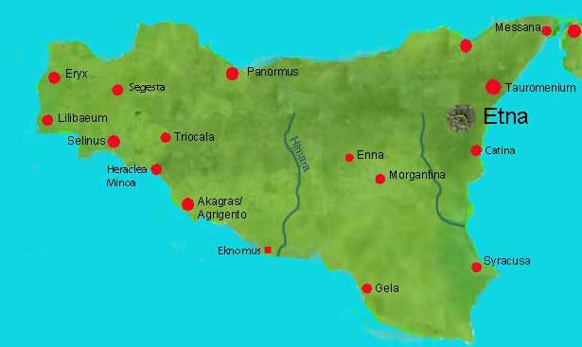
Key locations in the 1st and 2nd Slave Wars

Slide 3
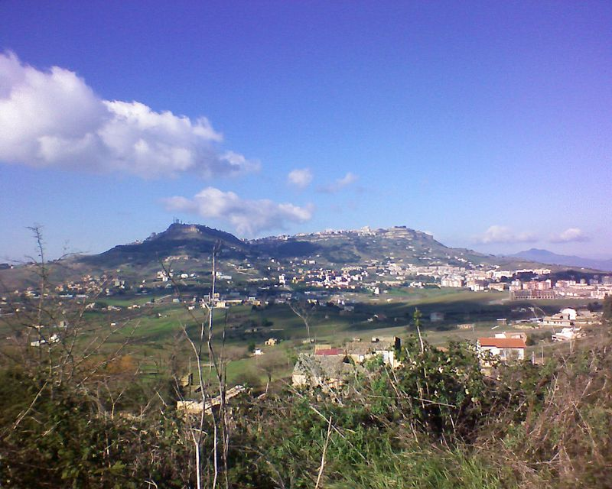
Enna

Slide 4
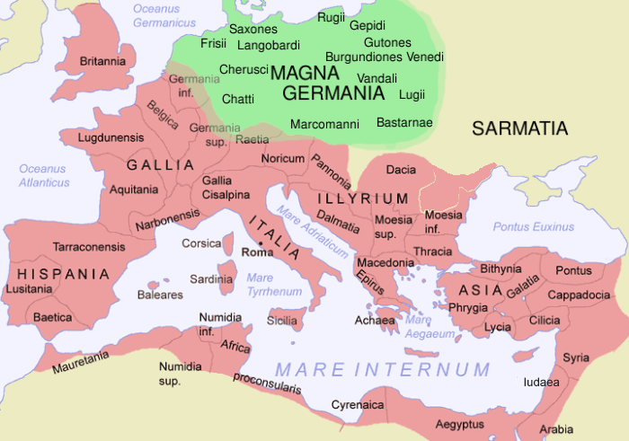

Slide 5
2nd Servile War/Slave War (104-101)
Slave leaders: Salvius (Tryphon), Athenion
Roman generals: P. Licinius Nerva; L. Licinius Lucullus; C. Servilius; M’ Aquilius

Slide 6
Key locations in the 1st and 2nd Slave Wars

