Slide 1
Greece:
Hetaira(i) Porne Symposium
Pornoboscos/Pornoboscus
Rome:
Atellan Farce Mime (masked and unmasked)
Infamis/infamia Dediticii
Charioteers Gladiators Venatores
Leno
Cytheris Theodora

Slide 2
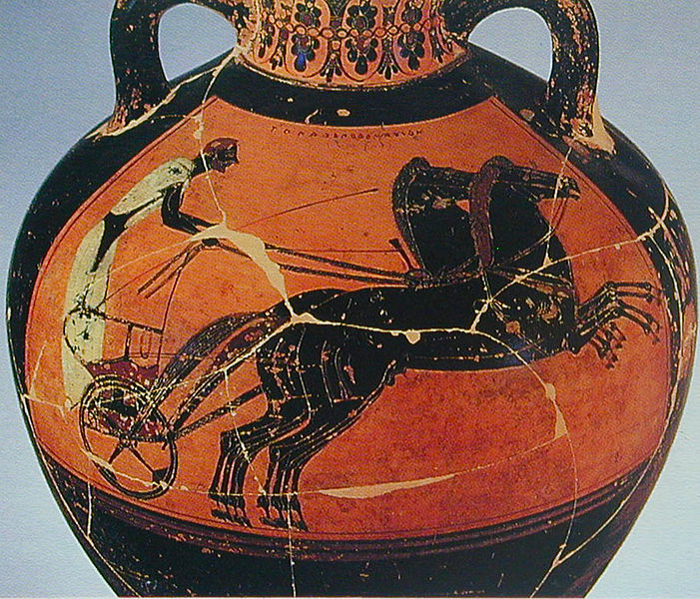
Panathenaic amphora. Side B: Chariot. C.550-540 BCE

Slide 3
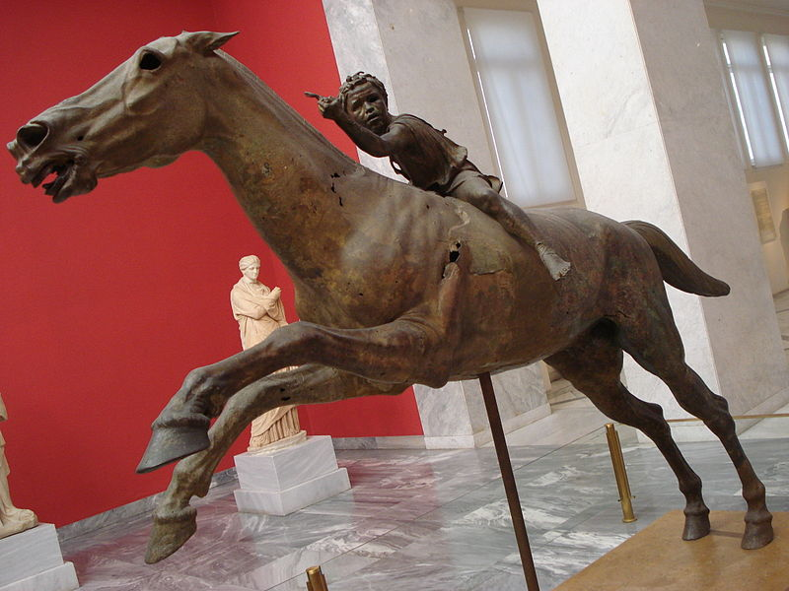
Artemision jockey

Slide 4
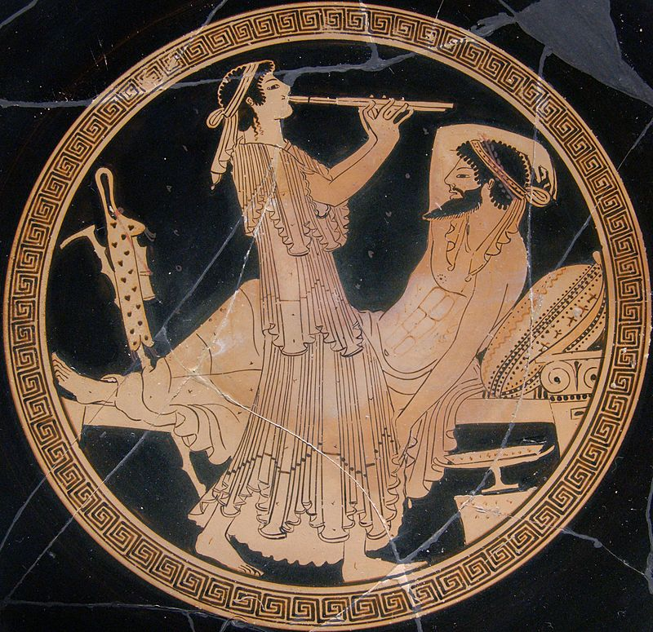
Flute player at symposium (kalos inscription tondo from an Attic red-figure cup, ca. 490 BCE. Found in Vulci, S. Italy.)

Slide 5
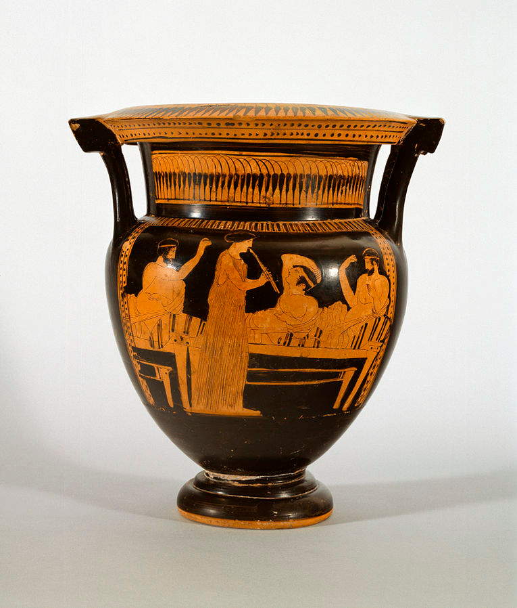
Another sympotic scene
(there are a lot of them)

Slide 6
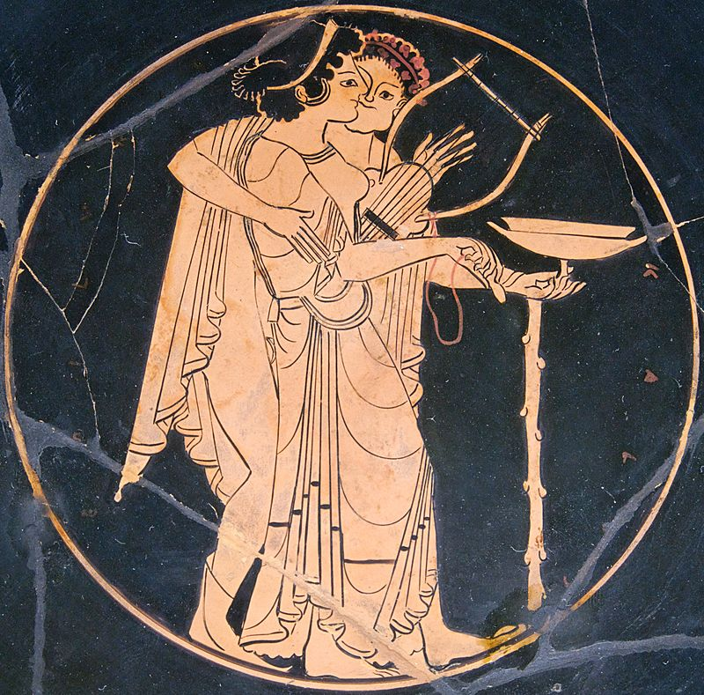
Lyre player supports a drunken symposiast (Attic red-figure kylix, c. 510 BCE)

Slide 7
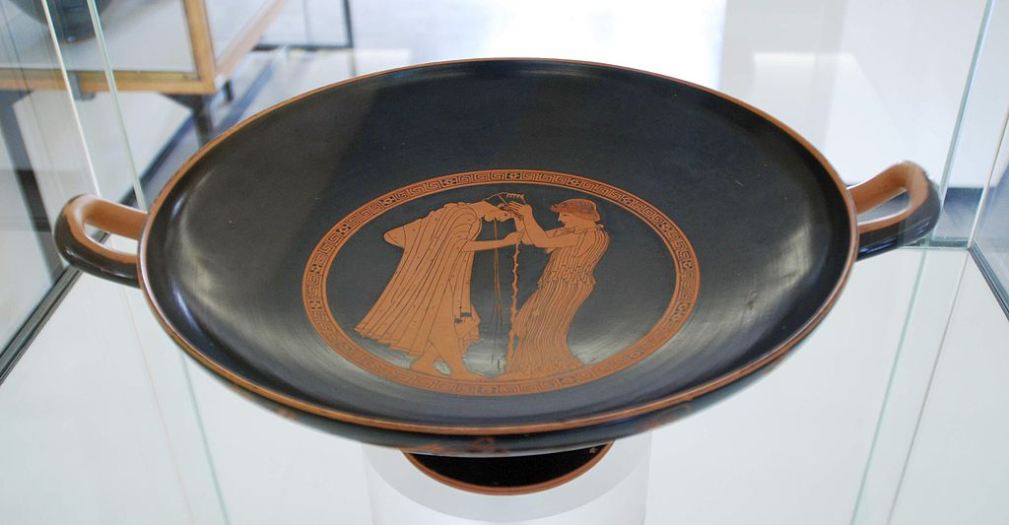
A young man throws up at a symposium as a hetaira holds his head (Attic Kylix by the Brygos painter c. 480 BCE; Martin von Wagner Museum Würzburg)

Slide 8
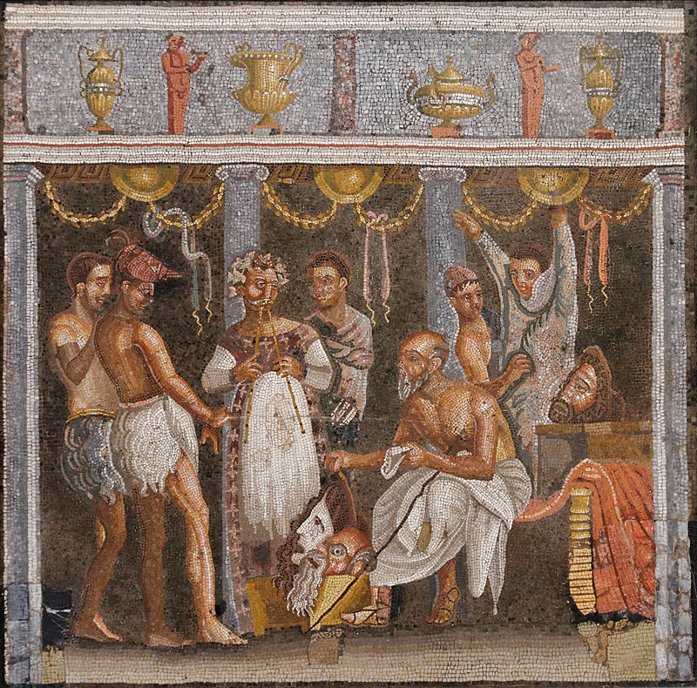
Roman actors and musician from a fresco from Pompeii (From the House of the Tragic Poet)

Slide 9
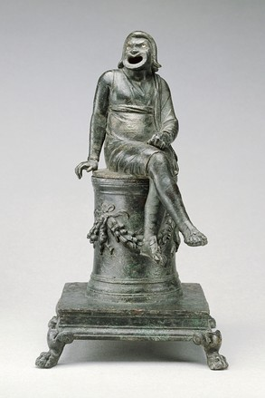
Incense burner in the form of a comic actor
1st century CE; Roman
Notes:
Now in Getty (87.AC.143). Described as “Thymiaterion in the Form of a Comic Actor Seated on an Altar and a Separate Theatrical Wig.” Have to get to second alternative title to see that this is a comic actor dressed as a slave (therefore likely a slave playing a slave on top of an altar which sets fire to his arse and then blows the smoke out his mouth. Not subtle that.

Slide 10
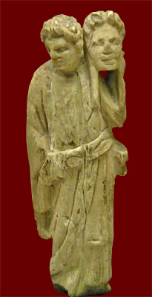
Roman mime artist
(3rd-4th century CE)

Slide 11
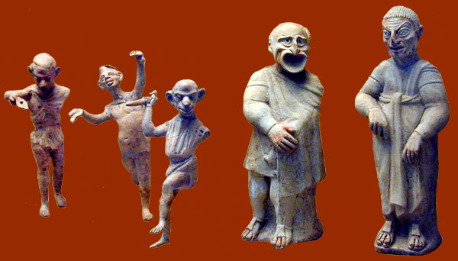
Mime artists (3 figures on the right; Roman 1st century CE)

Slide 12
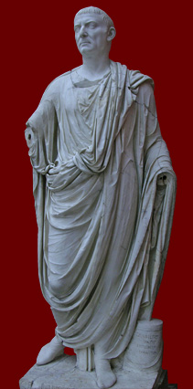
Gaius Fundilius Doctus
Mime artist; 1st century CE; freedman of Fundillia for whom he set up a companion statue
Both found in the sanctuary of Diana at Nemi

Slide 13
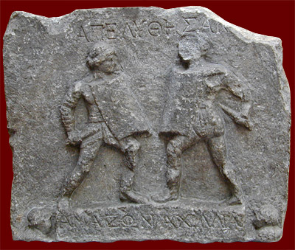
Relief for two female gladiators commemorating being stantes missae
(from Halicarnassus (Turkey), 1/2nd century CE)

Slide 14
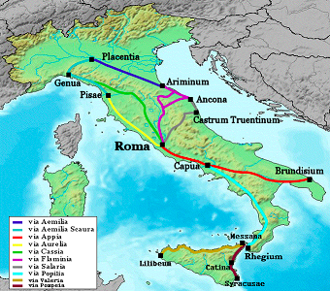
Capua: centre for gladiatorial skills in Republic

Slide 15
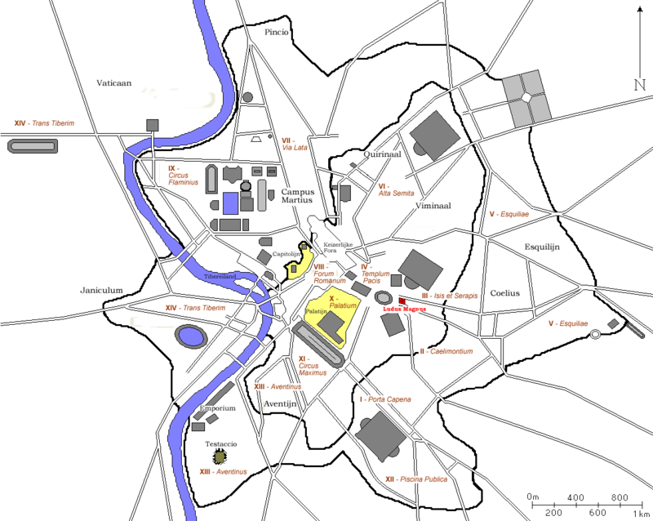

Slide 16
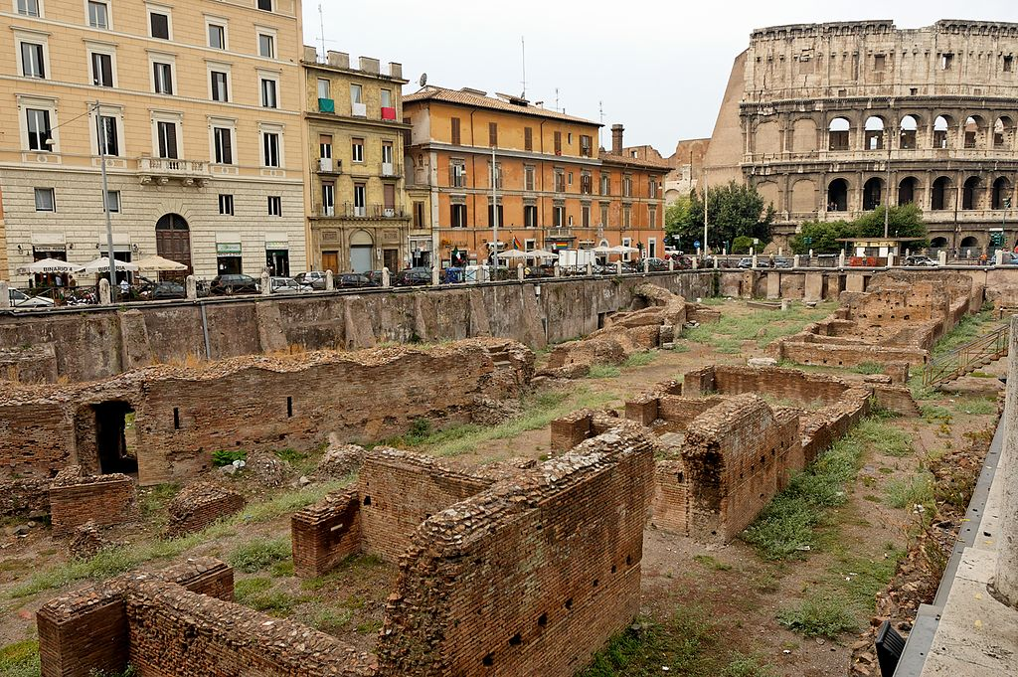
Ludus Magnus, Rome

Slide 17
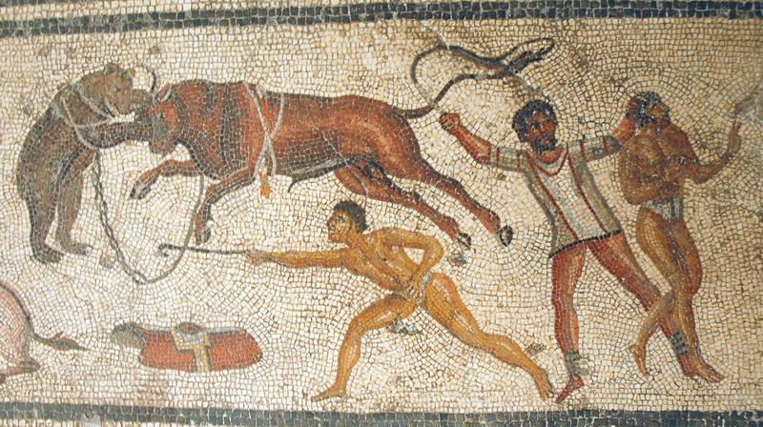
Mosaic from Zliten, Libya, 200 CE

Slide 18
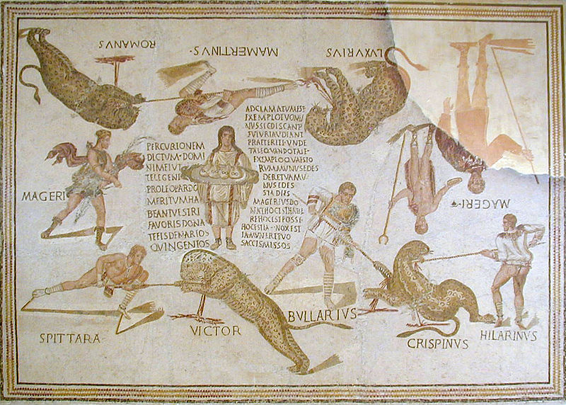
Mosaic of Magerius from Smirat, 3rd century

Slide 19
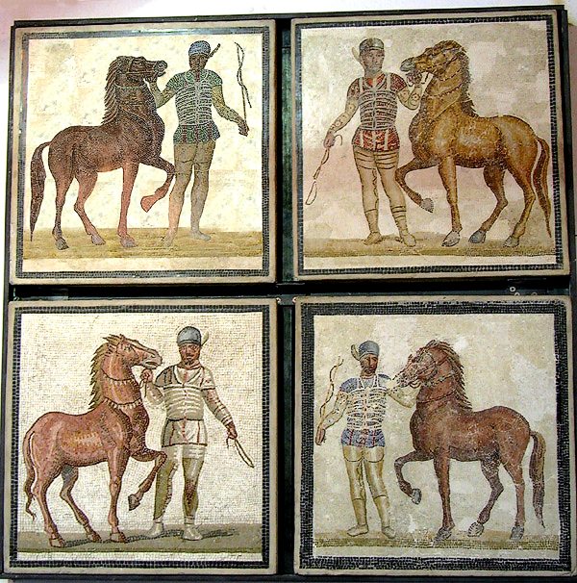
Mosaic showing all 4 factions (Roman first half of the 3rd century CE. From the Villa dei Severi (the imperial villa of the Severan dynasty) at Baccano, 16 miles from the Via Appia in Rome).

Slide 20
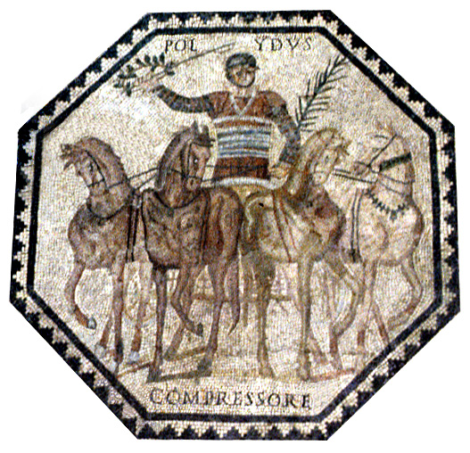
Mosaic showing Polydus, charioteer for the Red faction, with his horse Compressor (Trier, mid third century CE: found in the bath complex)

