Slide 1
Lab 7
Creating your robot - part 1

Slide 2
Robot Tournament
Challenge:
Using ML Agents in Unity, create a robot which can beat everyone else in the class
Competition will be held on Dec 3 (Thurs of last week of class)
Grading Rubric: Coming soon (this week)

Slide 3
Robot Abilities
Movement:
Robot can move anywhere in the x,z plane
Move by changing dirToGo variable
No changing the y coordinate of your robot (no jumping)
Robot can rotate only around the y axis
Rotate by changing the rotateDir variable
Robot moves in fixed update and has a built-in max travel speed and max rotate speed
Sensing
Robot can look in any direction at any distance
Use Raycasts
Feel free to add what you want (any direction, any distance)
There is a builtin one for unity ML that we will be showing you (RayPerceptionSensor3D), which will add the result directly to your network observation
Able to observe any variable you have access to
Sensor.AddObservation() -> Acts as inputs to your network
Shooting
Use the built in setLaser() function
Distance is automatic
Shoots in the direction you are facing (transform.forward)
While shooting you cannot move
Freezes the enemy when it hits them
Frozen
Cannot move or shoot for 3 seconds after being hit by laser
Invincible for 1 second after becoming unfrozen

Slide 4
Robot Tournament Coding Rules
Only change the code in the “YourGroupName.cs” file
All other files are read only (not enforced by code)
Ex: You can read the info about where a target is -> don’t change it
You will be handing in “YourGroupName” folder.
Put everything you need (code, materials, robot costume, etc…) inside it
NO CHEATING
If it feels like cheating, it’s probably cheating. If you are unsure about something, feel free to ask on piazza
Don’t change our movement script in fixedUpdate
Move by changing dirToGo and

Slide 5
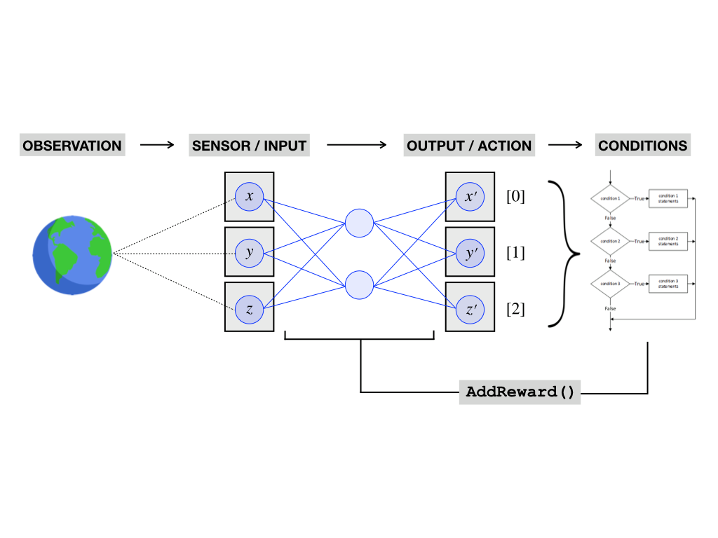
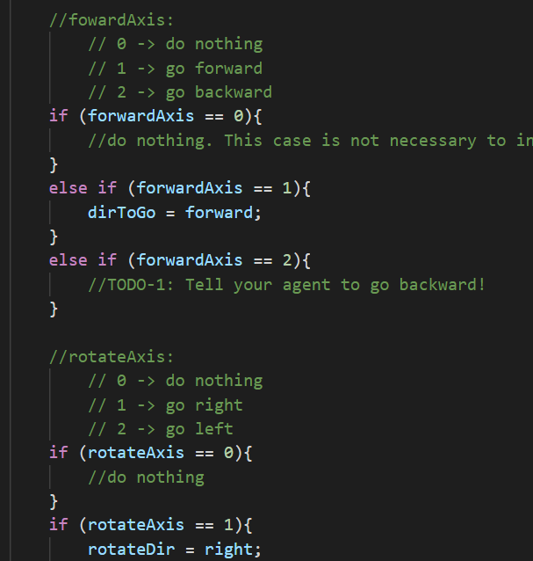
ML Agents
CollectObservations()
OnActionReceived()
MovePlayer()

Slide 6
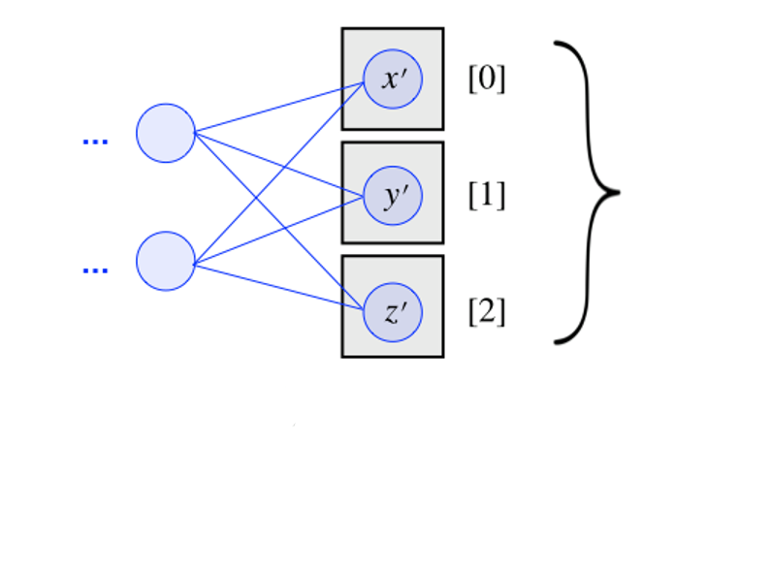
Today’s Lab
Heuristic()
OnActionReceived()
MovePlayer()
KEYBOARD INPUT
OUTPUT/ACTION
CONDITIONS

