Slide 1



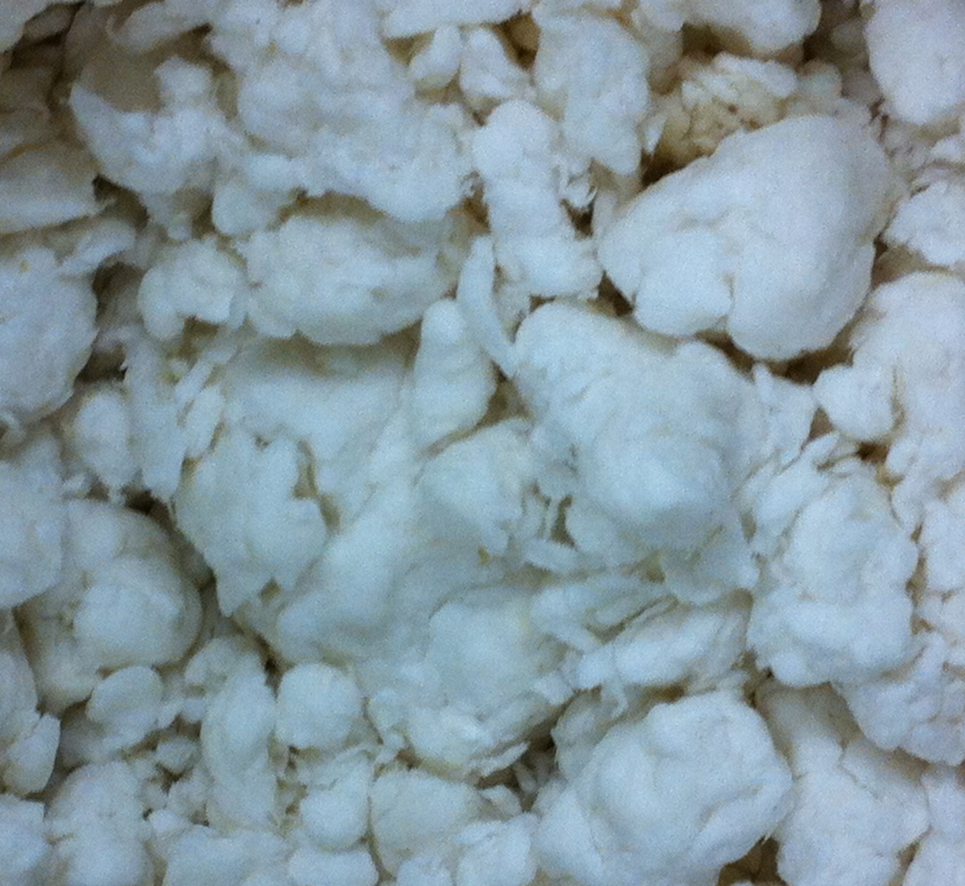
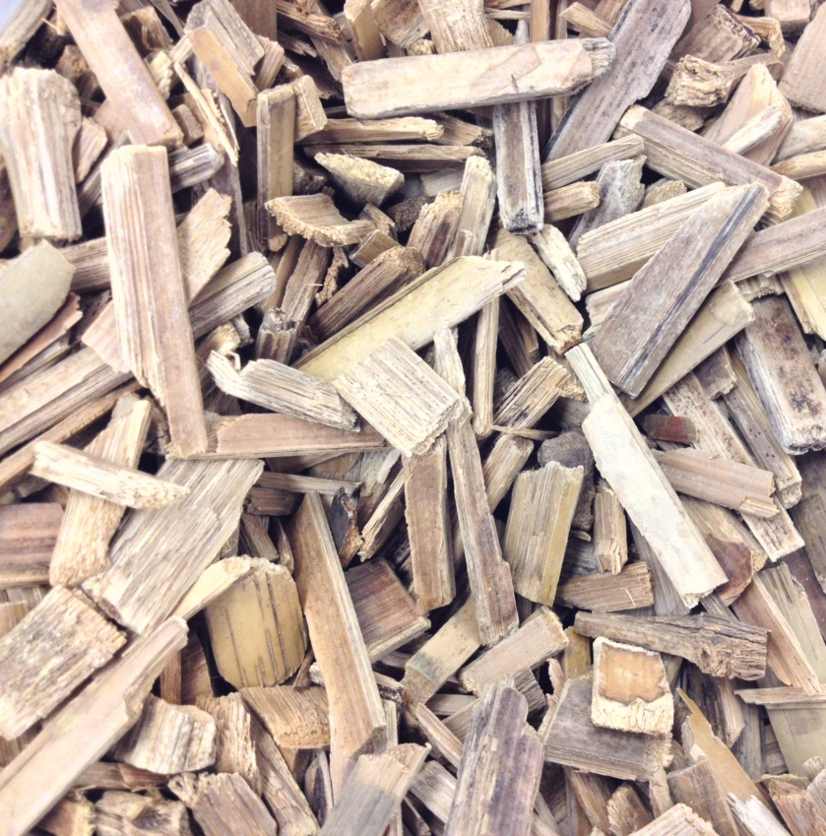
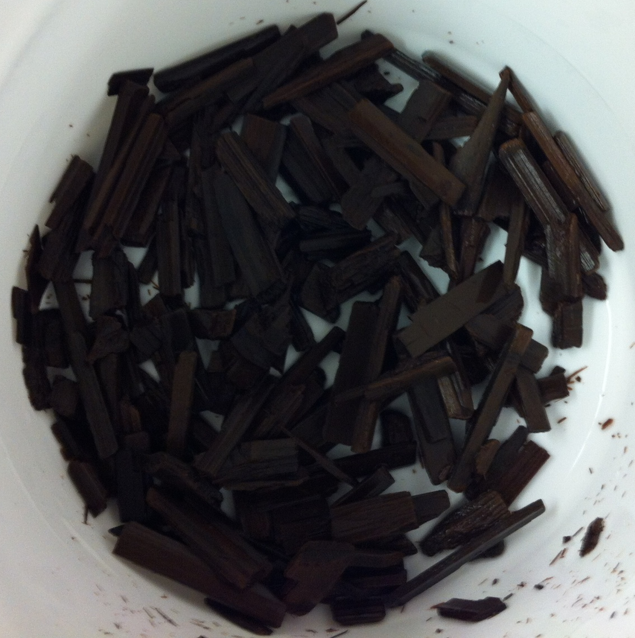
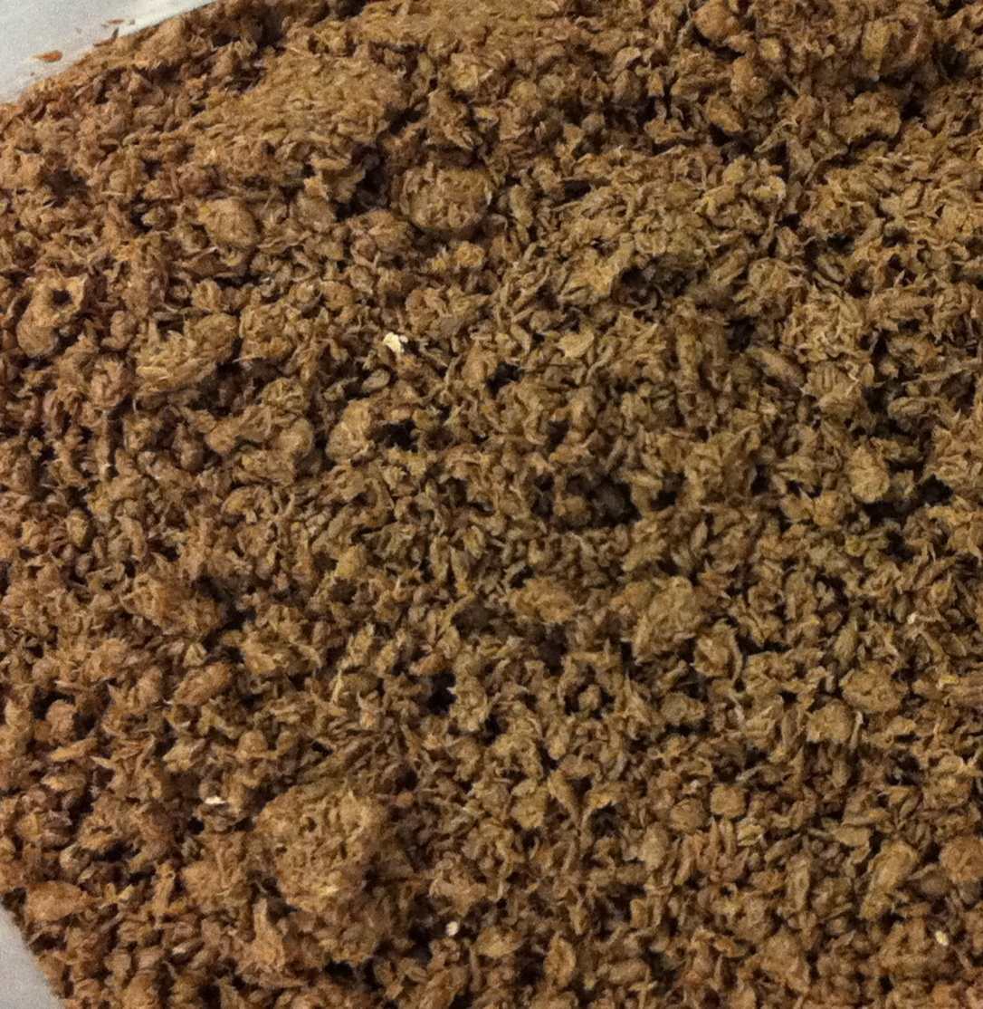

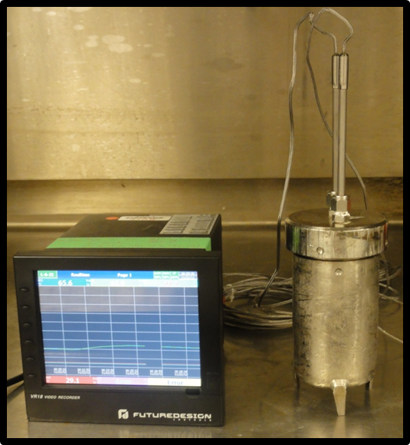
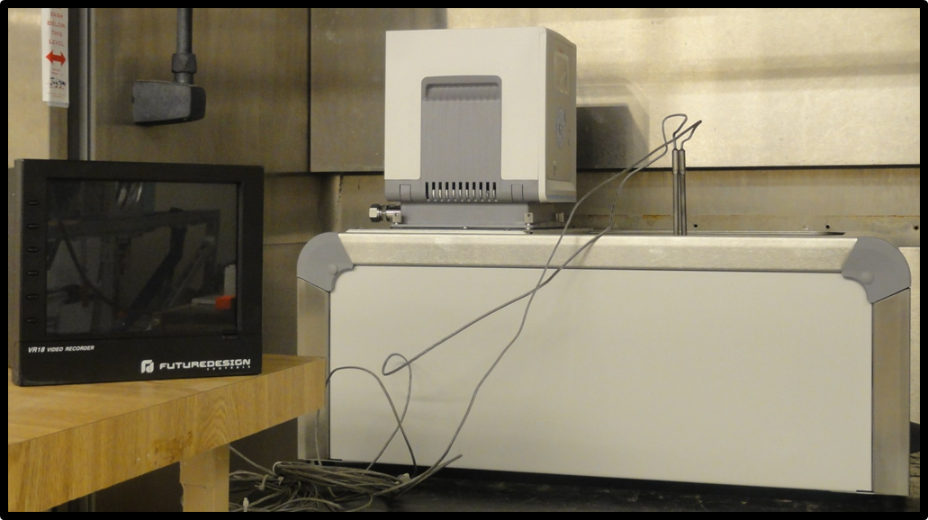
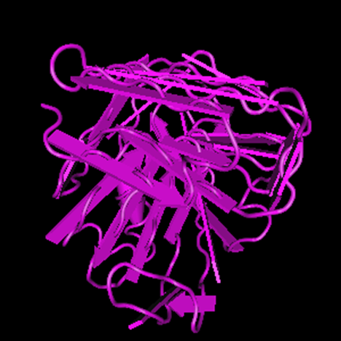
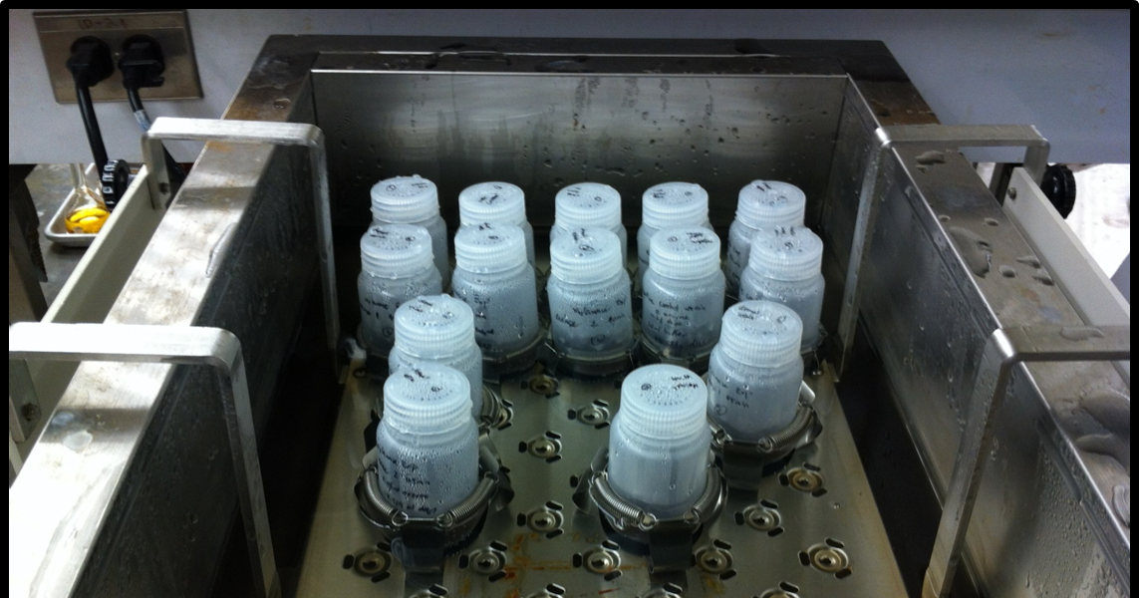
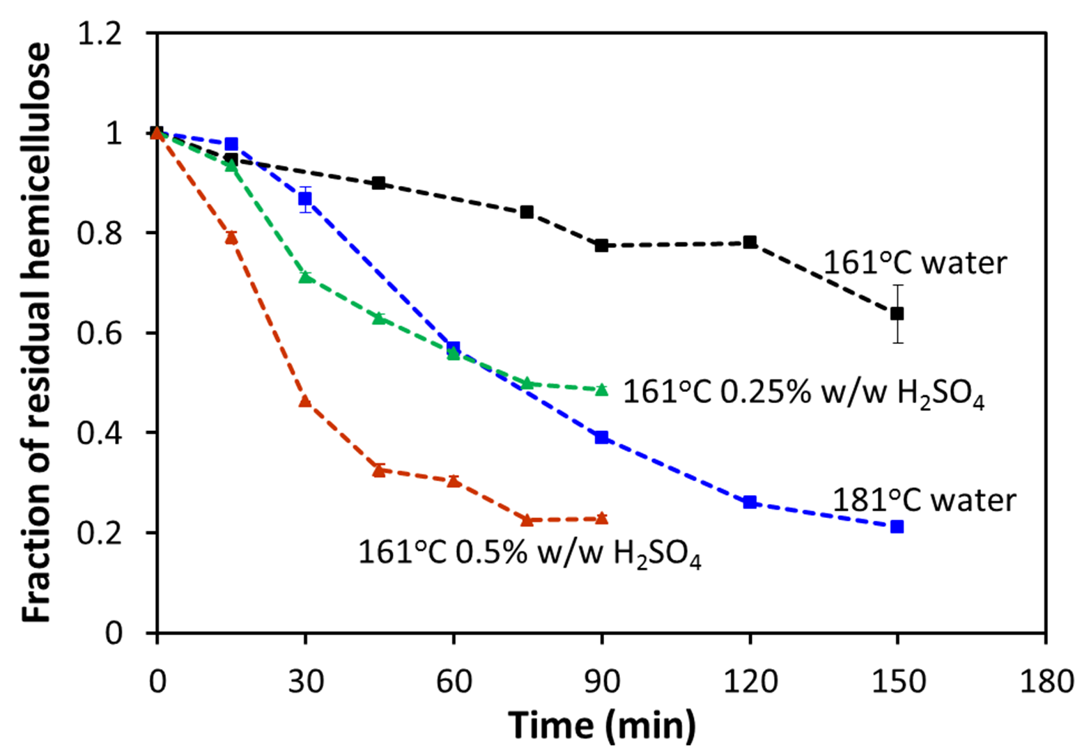
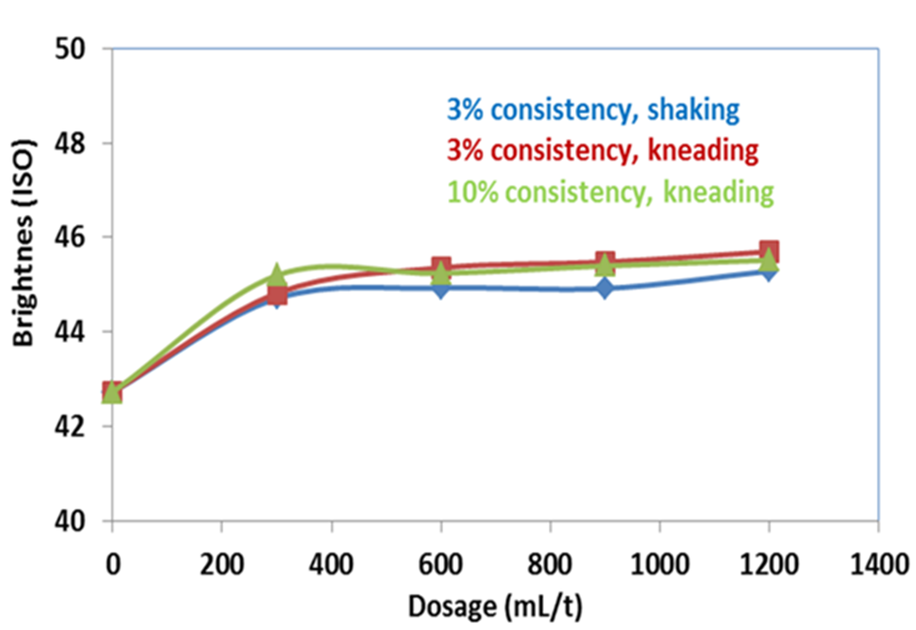
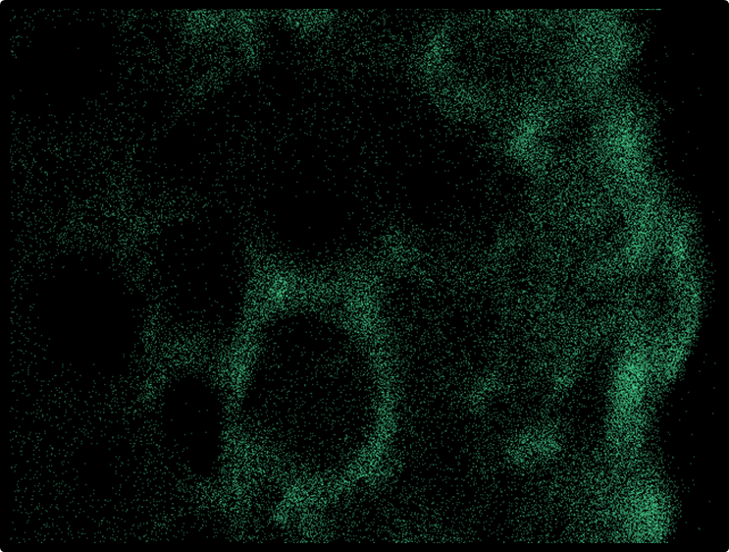

Developing Bamboo as an Alternative Feedstock for Bio-products
Nuwan S. Kapu^{1,2}, Zhaoyang Yuan^{1,2}, Xufeng Cheng^{1,4}, Lingfeng Zhao^{1,2}, Colby Song^{1,2}, Joel Kumlin¹, David Houghton¹, James Olson^{2,3}, Mark Martinez^{1,2}, Rodger Beatson^{1,2,4}
¹Dept. of Chemical & Biological Engineering, ²Pulp & Paper Center, ³Dept. of Mechanical Engineering, Univ. of British Columbia; ⁴Chemical & Environmental Technology, British Columbia Institute of Technology,
Vancouver, Canada
Background
Comparative composition of bamboo and other types of wood²
Vision:
Develop cost effective pulping schemes to produce high quality dissolving pulp and other products from bamboo
Characteristics of dissolving pulp¹
>94% α-cellulose with uniform molecular weight distribution
<3% hemicellulose, <0.5% lignin
High chemical reactivity, 90-96% ISO brightness
Feedstock | Cellulose (%) | Hemicellulose (%) | Lignin (%) | Extractives and ash (%)
Bamboo | 40-50 | 20-25 | 11-28 | 1-5
Hardwood | 40-55 | 20-35 | 20-25 | 1-4
Softwood | 40-55 | 25-30 | 28-32 | 1-3
Opportunity:
Fast growing feedstock ; harvest-ready in about 3 years
Highly abundant in Asia: 1.5 billion trees harvested annually
Composition comparable to that of softwoods and hardwoods
Liquid streams of the pulping scheme are rich raw materials for bio-products
Challenges:
High ash content; silica content can be as high as 5% by weight
Low chemical penetrability
High feedstock variability depending on species and age
Not extensively studied
Bamboo as an alternative feedstock for dissolving pulp and bio-products: Pulping scheme
chipping
pre-hydrolysis
Kraft cooking
Delignification & bleaching
dissolving pulp
liquor with hemicellulose
black liquor with lignin
textiles
viscose/rayon
starting material for many consumer products
SEM of bamboo stem
biofuels, biofilms, xylitol, furfural etc.
power, pellets, carbon fiber etc.
acetates
LCD screens
microcrystalline cellulose
pharmaceuticals
Silica in Bamboo
Removing Hemicellulose: Pre-hydrolysis
Removing Hemicellulose: Using xylanase
Silica reduces the efficiency of chemical recovery:
forms scale in evaporators
reduces causticizing efficiency
forms glass on lime particles
Results in dissolving pulp with poor filterability
High levels of hemicellulose in dissolving pulp lead to:
poor filterability
Hemicellulose in bamboo is mainly arabinoxylan.
Consequently, treatment of pulps with xylanase may result in:
hemicellulose removal
improved brightness of pulp, lower bleaching costs
Objectives:
Remove greater than 80% of hemicellulose
Develop a kinetic model to predict hemicellulose removal based on pre-hydrolysis process conditions
Objectives:
Determine the distribution and content of silica in bamboo
Develop methods to remove silica
Objectives:
Investigate the feasibility of using xylanase to remove hemicellulose
Optimize xylanase treatment conditions
Key results:
Xylanase treatment of chips in a
shaker-water bath
Silica is mainly located in the outermost cell layers of the bamboo stem
Structure
of a fungal endoxylanase
Part of the tree | cross sectional layer of stem | Ash content (%) | Silica content (%)
Top part | outer layer | 1.73 ± 0.01 | 0.98
 | Middle layer | 1.35 ± 0.01 | 0.19
 | Inner layer | 2.00 ± 0.25 | 0.52
Bottom part | outer layer | 2.51± 0.02 | 0.85
 | Middle layer | 2.57± 0.03 | 0.16
 | Inner layer | 3.21± 0.04 | 0.16
Key results:
Pre-hydrolysis reactor system
(www.ncbi.nlm.nih.gov)
About 80% of the hemicellulose can be removed using acid and/or high temperature
Key results:
Xylanase treatment appears to improve the brightness of delignified pulp
epidermis
SEM-EDX analysis of bamboo stem segments. Green dots represent silica.
References:
Sixta H. 2006. Pulp properties and applications. In: Sixta H (ed) Handbook of Pulp, Vol 2, Wiley-VCH, Weinheim, 1009–1069
Saka, S. 2004. Wood as natural raw materials for cellulose acetate production. Macromolecular Symposia, 208(1):7–28.
Acknowledgements:
Sponsor: Lee & Man Paper Ltd.

