Slide 1
First Nations Business
Guest Lecture
Danielle Levine, Associate Director
Ch’nook, Sauder School of Business
October 13, 2015
Notes:
Introduce myself
Co-instructed pilot of Comm 390 Aboriginal topics last year
Realistic assignments on current topics and issues that could be found in workplace
Consultant with close to 20 years of experience working in Aboriginal community at various levels across Canada
Associate Director, Ch’nook
Aboriginal - Metis
Nation thanks – Musqueam First Nation whose unceded land we are meeting on today
Goal from today’s lecture and assignment:
Be sensitive, open and adaptable when dealing with other cultures what you learn here can be applied in other countries
Called Tribal Peoples, First Peoples, Native Peoples, Indigenous Peoples constitute about 5% of the world’s population, yet account for about 15% of the world’s poor.
There are approximately 370 million Indigenous people in the world, belonging to 5,000 different groups, in 90 countries worldwide.
Indigenous people live in every region of the world, but about 70% of them live in Asia.
There is no universally accepted definition for “Indigenous,” though there are characteristics that tend to be common among Indigenous Peoples:
They tend to have small populations relative to the dominant culture of their country.
They usually have (or had) their own language. Today, Indigenous people speak some 4,000 languages.
They have distinctive cultural traditions that are still practiced.
They have (or had) their own land and territory, to which they are tied in myriad ways.
They self-identify as Indigenous.
Examples of Indigenous Peoples include the Inuit of the Arctic, Native Americans, hunter-gatherers in the Amazon, traditional pastoralists like the Maasai in East Africa, and tribal peoples in the Philippines.
Indigenous Peoples and the Environment
Indigenous Peoples are often thought of as the primary stewards of the planet’s biological resources. Their ways of life and cosmovisions have contributed to the protection of the natural environment on which they depend on.
Indigenous communities and the environments they maintain are increasingly deal with mining, oil, dam building, logging, and agro-industrial projects.
Indigenous communities resist this invasion with tremendous courage and skill, but their protests are too often ignored by governments and corporations.

Slide 2
First Nations Business Assignment
Writing to a distinctive cultural group
Make recommendations
Research
Language
Challenges and opportunities
Do not contact the First Nation directly
Notes:
Importance of cultural awareness generally
When individuals from differing backgrounds communicate or interact, there can often be miscommunication, misunderstanding and sometimes frustration. These obstacles can be overcome by being more culturally sensitive.
Why are we here today?
Gain awareness of history, issues
Better well rounded business people
Significant opportunities working with Aboriginal people
Doing the right thing
Address previous wrongs
Economic reconciliation – we are all here to stay
Understand multiple perspectives in business
Acquire the knowledge to effectively communicate across cultures and with BC First Nations
Be able to do business with First Nations in BC
Learn how to facilitate relationship building (in a broad sense)
Over the next 10 years, hundreds of major projects representing over $650 billion in potential new investment are planned or currently underway in Canada. Many of these projects are located in or near Aboriginal communities. Natural resource projects have the potential to create important new opportunities for Canadians - See more at: http://actionplan.gc.ca/en/backgrounder/r2d-dr2/aboriginal-peoples-participation-canadas-resource#sthash.rMY25LKM.dpuf
Type of projects we worked on at MNP
Performance Improvement:
Business process review
Program evaluation
Supply chain
Information technology
Organizational structures
Business planning:
Strategic, business cases, feasibility studies and marketing plans
Due dilligence
Economic development
Opportunity assessments, competitive analysis, investor attraction, benchmark, industry scans
Human Resource management
OD, change, executive search, compensation, succession planning, performance
Accounting
Trust accounting, investment advice, remedial management plans,
Governance, housing, real estate development
Due November 1st.
Specifics of the assignment go to your faculty member
Your faculty member will be doing the marking
(language sensitivities – stakeholder)
This assignment is now across all of Comm 390
Danielle’s office hours: October 28, 2015
1:00 – 3:00 pm
HA 441 boardroom
Research – important to get a sense of the topic but don’t get overwhelmed in the research. Set a time limit.
Proposal writing – important to understand the topic matter but so much written, researched and studied
This is a real life type of assignment
You are not expected to become an expert, but to gain an appreciation for the challenges and opportunities
the Province’s clean and renewable energy potential is diverse. Not only can power projects use water and wind to produce energy, they can also use biomass, waste wood, solar, tidal, wave, geothermal and other natural resources.
Clean Energy projects have the potential to generate energy that meets and balances economic, environmental and social concerns.
Wind power
Ocean energy
Waterpower
My lecture today will not focus on Wind Energy projects specifically but will focus on concepts that will help with the assignment
My lecture is focused on BC First Nations – the literature and challenges and opportunities looks different across Canada and between the different Aboriginal groups in Canada
Diversity in BC First Nations – hope that you become aware of the nuances
Guideline for participation – open up your mind, challenge you to think about real life issues in your backyard. Please ask questions as we go.

Slide 3
BC First Nations - Terminology
Aboriginal, First Nation, Indian
Indian Act, Band
Chief and Council vs. Hereditary
Tribal Council
Reserves vs. Traditional Territory
Treaty
Crown land vs. Aboriginal title land????
Notes:
BC has 198 First Nations, about one third of all First Nations in Canada. The First Nations of BC have rich and varied cultures, histories and traditions.
BC has the greatest diversity of Aboriginal cultures in Canada.
Seven of Canada's 11 unique language families are located exclusively in BC - more than 60% of the country's First Nations languages.
Most BC First Nations did not sign treaties in the past, making modern treaty negotiations a major undertaking.
The Government of Canada, along with the Province of BC, is negotiating with 70 per cent of BC First Nations through the BC Treaty Process.
Aboriginal – 2011 Household Survey 1,836,035 fastest growing and youngest in Canada about 5.6% of Canadian population
Social indicators
First Nation – term that has no generally agreed on definition. It can refer to a single individual, single Band, many Bands, an Aboriginal governing body, organized and established by an Aboriginal community; or the Aboriginal community itself.
901,053 registered Indians about 50% of the Aboriginal population in Canada
About half of the 900,000 live on reserve
Indian – legal term defined by the Indian Act in Canada – term not used anymore (savage, half breed)
Crown land and Aboriginal title land - Crown land is land (or land covered by water like rivers or lakes) that is owned by the provincial government. This type of land is available to the public for many different purposes – from industry to recreation and research. About 94% of BC is crown land other is fee simple and First Nations reserves
Aboriginal title - inherent Aboriginal right to land or a territory. The Canadian legal system recognizes Aboriginal title as a sui generis, or unique collective right to the use of and jurisdiction over a group’s ancestral territories. This right is not granted from an external source but is a result of Aboriginal peoples’ own occupation of and relationship with their home territories as well as their ongoing social structures and political and legal systems. Aboriginal title and rights are separate from rights afforded to non-Aboriginal Canadian citizens under Canadian common law.
Band – is an organizational structure that represents a particular group of Indians as defined by the Indian act
Chief and Council – Band Chief is someone that is elected by Band members to govern for a specified term
Hereditary Chief – is a leader who has power passed down from one generation to the next along blood lines or other cultural protocols, similar to European royalty.
Tribal Council - is a grouping of bands, (bands as defined by the Indian Act), with common interests who voluntarily join together to provide advisory and/or program services to member bands. Tribal Councils are mandated by band councils to deliver advisory services for which funding is provided. Advisory services are defined as the provision to member bands of specific knowledge, expertise and/or assistance in the following fields: band government, financial management, community planning, technical services and economic development.
Reserve – defined by the Indian Act as … “tract of land, the legal title is vested in Her Majesty, that has been set apart by Her Majesty for the use and benefit of a band.” A result of the definition of reserve land in the Indian Act is that reserve land cannot be privately owned by the Band or Band members.
Traditional territory – the geographic area identified by a First Nation to be the area of land which they and/or their ancestors traditionally occupied or used.
Treaty – An agreement between the government and a First Nation that defines the rights of Aboriginal peoples with respect to lands and resources over a specified area. solemn agreements that set out promises, obligations and benefits for both parties.
For the assignment research if they are in the treaty process or have a treaty.

Slide 4
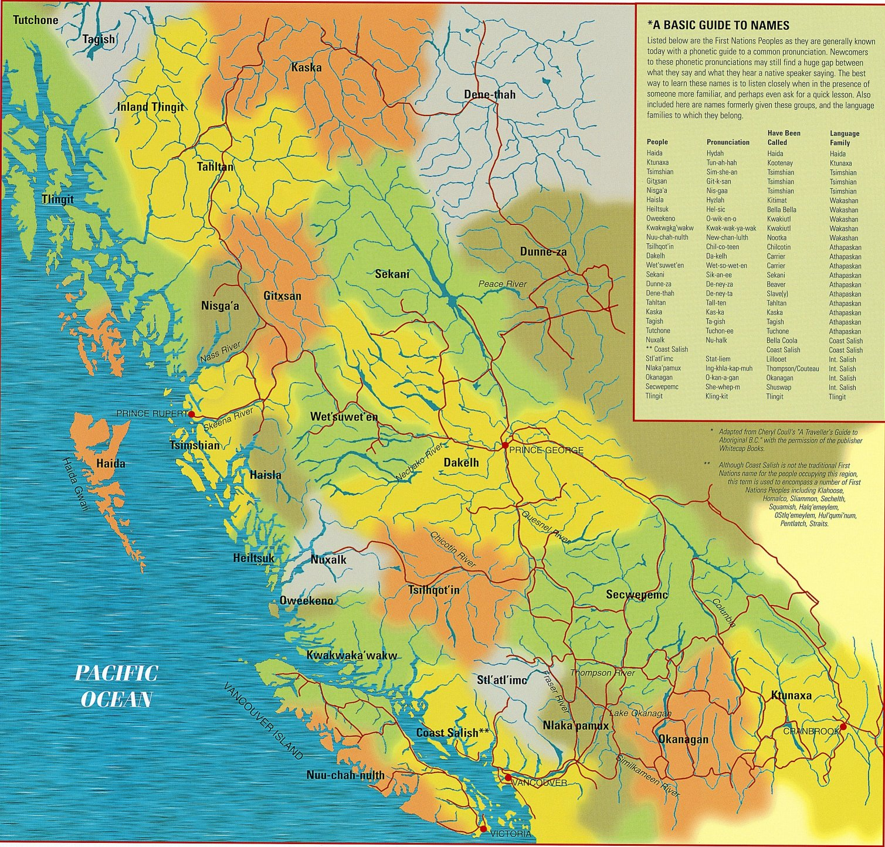
Notes:
28 distinct cultural groups in BC – 12 different language families
Like the linguistic diversity of Europe or Asia
203 independent bands in BC and over 600 in Canada
Strong desire to be self governing at the community level, can make it hard to do business
This map illustrates the rich diversity of the First Nations Peoples of British Columbia. Like all maps, it is a best attempt at reflecting a current reality, recognizing that "the map is not the territory".
"Traditional Territories of British Columbia First Nations as set out by Statements of Intent accepted by the B.C. Treaty Commission". The boundaries between territories are deliberately shown as blending into one another, in recognition of the complex territorial relationships involved. Many boundary overlaps are currently being negotiated by the First Nations as part of the B.C. Treaty Process. Names and pronunciations used on this map are as close as possible to those currently used by the First Nations (*please note the explanation for Coast Salish).
Most BC First Nations did not sign treaties in the past, making modern treaty negotiations a major undertaking. The Government of Canada, along with the Province of BC, is negotiating with 60 per cent of BC First Nations through the BC Treaty Process.
Since 1975, there have been 22 comprehensive claims agreements, commonly known as “modern treaties”,
concluded across northern Québec, the Northwest Territories, the Yukon and British Columbia.

Slide 5
Map of BC First Nations (handout)
First Nation profiles
http://pse5-esd5.ainc-inac.gc.ca/fnp/Main/Index.aspx?lang=eng
Reserves
Governance
Federal funding
Geography
Registered population statistics
Education
Age
Notes:
First Nations Consultative Area Database (CAD)
provides preliminary contact information for First Nations who may have Aboriginal Interests identified within the area queried. These contacts are based on knowledge currently available to the Province.

Slide 6
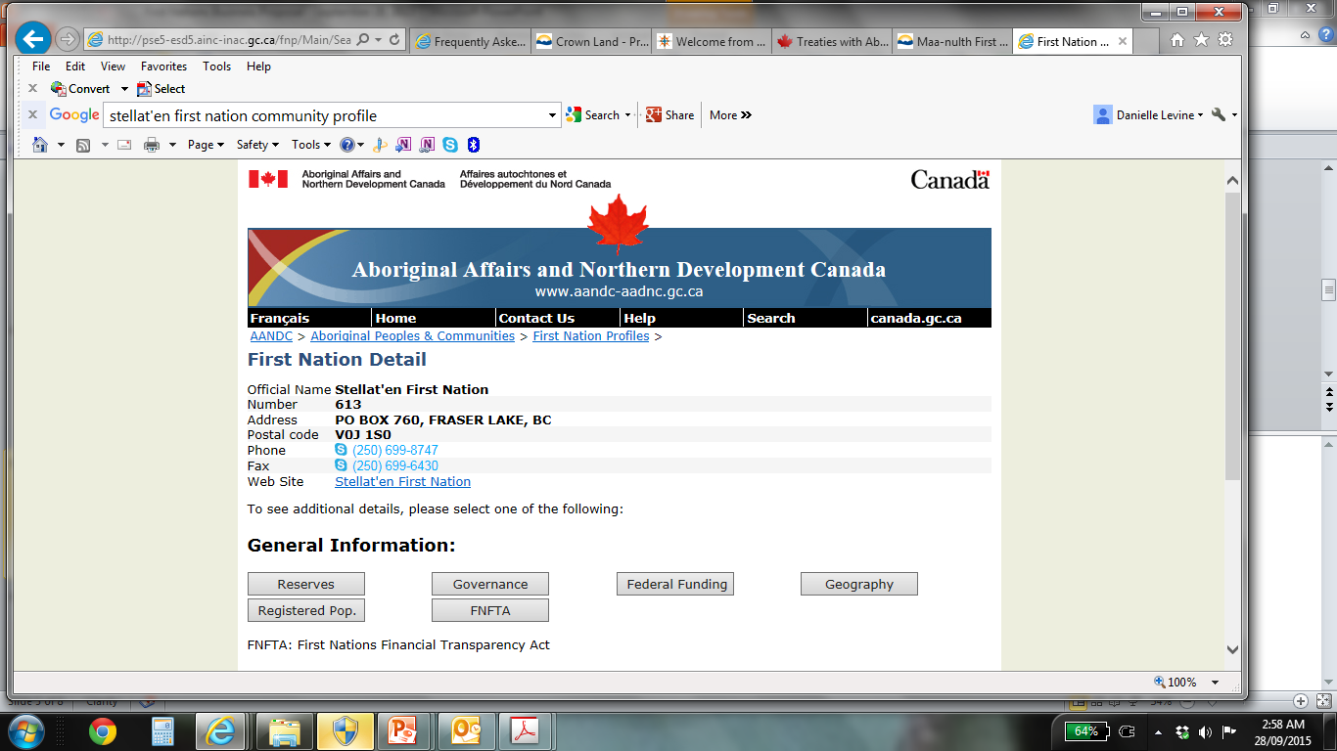
Notes:
Place names – community names and places generally describe the place. There is spiritual significance to the name so it is critical to use the First Nation names for places. Haida Gwaii not Queen Charlotte Island
Diversity
There are over 630 First Nation communities in Canada and each is at a different level of development, each has different capacity to take on greater governing responsibility and each has a different path it wants to follow.
First Nations have different cultures. And throughout Canada’s history these cultures have been disregarded and devalued. There is a resurgence amongst Aboriginal people to learn, reclaim, and relive their culture.
Names: names of communities, people and things are descriptive. They tell us something and are highly valued.
Time: belief that there is a right time and place for everything and it generally follows the natural order of things. “time is money”
Elders: keepers of traditional knowledge
Land: give life. Teaches us. It is alive and is sacred. Deep kinship to the land
Stories: Aboriginal people learn through stories. There is always a message and a lesson.
Values: youth, wholistic views, self determination, consensus decision making

Slide 7
History
What might history tell us?
What value do you see for yourself personally in learning about First Nation history?
How might learning about history benefit your working relationship with BC First Nations?
Notes:
Q: when we hear the word history what comes to mind?
Family history, community history, Canadian history
Q: What might history tell us?
About culture, origin, significant events, relationship, lifestyle
Q: What value do you see for yourself personally in learning about First Nation history?
Understanding the current situation
Q: How might learning about history benefit your working relationship with BC First Nations?
Bring us closer
Also to be trusted as business people, we need to look at the world through the eyes of First Nations people. We need to see and understand their struggles if we are going to work with them. What can I do to empower the community?

Slide 8
History
Pre-Contact Nations
Royal Proclamation
1867 Nations to Wards
Indian Act
Assimilation
1982 Wards to Nations
Constitution Act 1982
Calder 1973 – Nisga’a treaty 2000
Williams Decision 2014
Notes:
Build awareness of key events in First Nations history. This helps to create a greater sense and understanding of how history has shaped their reality and influenced their lives. It also provides you with knowledge that will help you see yourself working more effectively alongside Aboriginal people in the future.
The value of learning from history can also be a bonding experience. It can heal wounds, improve understanding, improve communication, diffuse conflict and tension, and reduce blame. Going into a community and knowing something about that community shows a level of respect for the people that you would be working with. The goal of this lecture is that you will have a better appreciation of what Aboriginal people have had to endure, the challenges they have overcome, and a better understanding of the issues today.
Pre-Contact Nations
Scientific – when did people populate North America? One theory is land bridge 10,000-12,000 year ago. People from Asia migrated into the Bering strait to populate North and South America. Populated prior to European contact.
Not primitive cultures – transportation not wheel but canoes or kayaks
Oral history not just written (passed on by songs, stores and oral communication)
Trade networks and communications through Ch’nook language
Aquaculture (shellfish), agriculture, food preservation (dried fish and smoked/salted fish)
Governance – sophisticated and formal
1492 Arrival in the New World by Christopher Columbus not empty land when he arrived. There was 100 million native people living in the americas (it was one fifth of the worlds population – so how could he have discovered?)
Aboriginal contact with Europeans was followed with drastic declines in Aboriginal populations. (small pox, tuberculosis, scarlet fever, influenza, and measles). Population at contact was 500,000 then by 1871 numbers fallen to 102,000
Don’t conquered people have the rights we give them?
Royal Proclamation 1763
In Canada, the relationship between the Crown and Aboriginal Peoples has been driven by the Royal Pro. Nation to Nation basis, should not be disturbed if the Nation has not ceded or purchased by the Crown, reserved lands, must get a license to buy the land.
Refers to Nations of AP, recognizing them as owners of the lands that the Europeans were using and occupying. Colonizing countries were to conduct government business with the inhabitants on a Nation to Nation basis and those inhabitants as owners of the land.
Today, under the BC Treaty Commission and the federal comprehensive claims policy, AP are approached as governments on a Nation to Nation basis. Any efforts to AP as anything less will be met with resistance.
There is an expectation within the Aboriginal community that they be treated as a nation as provided in the Royal Proclamation.
As evidence of this expectation many Bands have changed their band names from those imposed by the federal government to a First Nation name. Burrand Indian Band – Tsleil-Waututh
Royal Proclamation as early evidence of the recognition of Aboriginal rights in Canadian law, - Calder that Aboriginal title both pre-existed and survived the colonial occupation.
AP were wilderness survival tutors and military allies. Way for King George 111 way of building and maintaining Aboriginal support of England
1867 Nations to Wards
Balance of power began to shift – British paternalism, a policy of assimilation and the attitude that the Aboriginals were British subjects and not equal independent nations.
The British North America Act, 1867
91 (24) allows the federal government to make laws about Indians and lands reserved for the Indians. Move away from Nation to nation to wards of the state with a policy of forced assimilation.
Indian Act 1876
Gave Canada a coordinated approach to Indian policy (land, membership and local government)
Land – Indian agents drew boundaries on parcels of land that were set aside for the use and benefit of AP.
Membership – listing of names would become the band
Local government – if assimilation were to succeed then need a uniform form of government. Forced to abandon the hereditary chieftainship and to elect a chief and council
Indians on reserve don’t own the land, assets on reserve are not subject to seizure under legal processes, makes it difficult to borrow money to purchase assets
Permit to leave the reserve (not allowed in public places – cafes or pool rooms), a permit to sell
Potlatch law – prohibited cultural ceremonies
Residential schools – got started in 1844 (isolated from parents and communities) … pupils could aquire the manners, habits and customs of civilized life. Christian indoctrination was the main focus and learning a trade become secondary. Many students died in the schools. 50% of the children did not live. The last residential school closed in 1996. Effects are intergenerational.
A lot of the social ills (alcoholism, violence, verbal and sexual abuse and suicide found in Aboriginal communities have their roots in the residential school system.
Right to vote, in 1960.
1982 Wards to Nations
In 1982, the Government of Canada patriated the Canadian Constitution and formally entrenched Aboriginal treaty rights in the supreme law of Canada.
Section 35 (1) Protects the existing Aboriginal and treaty rights of the Aboriginal people in Canada are recognized and affirmed.
(2) Aboriginal peoples of Canada includes the Indian, Inuit and Metis.
Confirms existing rights
Government regulation of Aboriginal land rights might be possible if appropriate and meaningful consultation is undertaken with the affected Aboriginal communities. Created a space for the recognition, respect and reconciliation of Aboriginal rights and title.
Since 1982, numerous Supreme Court of Canada decisions have informed the Government of Canada's understanding of the nature of Section 35 of the Constitution Act, 1982. The courts have stated that the underlying purpose of section 35 is the reconciliation of the pre-existence of Aboriginal societies with the assertion of sovereignty of the Crown, and that negotiation represents the best approach to advancing reconciliation.
Aboriginal Rights
Practices, traditions or customs that are integral to the distinctive culture of an Aboriginal society and were practiced prior to European contact, rooted in pre-contact society
Central, defining and a part of the culture
Must be given priority over all other land uses
Continuity – connection with the land has continued to the present day
Do not include aspects of Aboriginal society that are true of every society such as eating to survive
Calder case in 1973 – the Nisga’a tribal council has asked courts to support their claim that Aboriginal title had never been extinguished. Ruled that Aboriginal title was rooted in the long time occupation, possession and use of traditional territories. Aboriginal title existed at the time of original contact with Europeans and at the time of formal assertion of British sovereignty in 1846. Then decided to negotiate with the Nisga’a on their land claim.
Delgamuukw 1997 – decision described Aboriginal title and the nature of the Crown’s duties of consultation and accommodation in the context of infringement of Aboriginal rights.
Aboriginal title as an encumbrance on the Crown’s ultimate title that contains an inescapable economic component: Crown duty of consultation that can include financial compensation for infringements of rights and title.
Aboriginal title encompasses the right to exclusive use and occupation of the land held pursuant to the title. Also encompasses the right to choose to what uses land can be put, but cannot destroy the ability of the land to sustain future generations of aboriginal people and third that lands held pursuant to Aboriginal title have an inescapable economic component.
“inescapable economic component means that the need to develop natural resources can justify the infringement (raising the duty to consult and accommodate). The court set out three components to prove title:
The land must have been occupied prior to European sovereignty (in BC that was 1849)
If the proof of pre-sovereignty occupation to be relied upon is current possession, then there must be continuity between pre-soverignty and present occupation
At the time that European sovereignty was established, Aboriginal occupation must have been exclusive or with provision for shared exclusivity.
Haida Nation v. BC Minister of Forests, 2004
The Council of the Haida nation brought an action against the provincial crown and weyerhaeuser company for not properly consulting with the Haida nation when renewing a tree farm license. The area contained old growth red cedar – a culturally significant tree used for totem poles, canoes and log houses. The Haida Nation wanted large areas of old growth forest protected from clear cutting and its potential detrimental effects on land, watershed, fish and wildlife.
Both levels of government have a constitutional duty to consult and accommodate Aboriginal communities in a manner that is meaningful, timely and reflective of the honour of the crown, the duty rests with the Crown and cannot be delegated to third parties.
The crowns duty to consult and accommodate regarding potential infringement on claims of Aboriginal rights and title is proportionate to the strength of the claim and to the potential harm that may be caused to that claim by the proposed policy or action.
Williams Decision, 2014
The unanimous ruling grants the Tsilhqot'in Nation title to a large area outside its reserve. It covers 1,700 square kilometres of land the group has traditionally used. Fighting for the past twenty years. "This decision building on previous Supreme Court of Canada decisions will be a game-changer in terms of the landscape in British Columbia and throughout the rest of the country where there is un-extinguished aboriginal title."
the Crown must take aboriginal title seriously and reconcile with First Nations honourably.
The first time proved Aboriginal title and that it means that the First Nation has the exclusive right to:
Occupy the land
Control and manage how the land is used
Enjoy the economic benefit from the use of the land
Can’t deprive future generations
Can be infringed by government if the First Nation consents, the government can justify the infringement
If you were to create a book what would you call each of these chapters? Where do you think the timeline will go?

Slide 9
UNDRIP
PART 6: LAND AND RESOURCES
Article 25: Spiritual relationship with traditional land & resources
Article 26: Right to own, use, develop & control traditional land & resources
Article 27: Indigenous laws & traditions on land & resources
Article 28: Rights when lands & resources are wrongly taken away
Article 29: Conservation & protection of the environment, lands & resources
Article 32: Land & resource development
Notes:
United Nations Rights of Indigenous Peoples
adopted by UN General Assembly, 2007
by a majority of 144 states in favour, 4 votes against (Australia, Canada, New Zealand and the United States) and 11 abstentions (Azerbaijan, Bangladesh, Bhutan, Burundi, Colombia, Georgia, Kenya, Nigeria, Russian Federation, Samoa and Ukraine).
Not legally binding, ‘sets important standards in human rights, discrimination and marginalization
Goal: to encourage countries to work with Indigenous Peoples
global issues e.g. development, democracy, etc.
http://social.un.org/index/IndigenousPeoples/DeclarationontheRightsofIndigenousPeoples.aspx
Free, prior and informed consent
many First Nations
across the country are advancing FPIC in a variety of ways, including procedural guidelines, Band Council Resolutions, Consultation Protocols, Indigenous land use planning, policy, and law. These initiatives aim to achieve certainty and transparency, which is fundamental to generating and supporting consent, and effective consultation, participation, and information management for developments at the community-specific level.
Industry can engage with Indigenous communities to understand and support their preferred engagement protocols, culture, values, and rights. Through
this understanding they can build working relationships by establishing Impact Benefit Agreements (IBAs) to guide project development and management.
Importantly, they can also support the review of projects through community controlled research, in particular on the Traditional Knowledge and Use of
the Indigenous peoples in the region or other studies identified as key by the affected Nation.
Free, prior, and informed consent (FPIC) refers to the right of local communities, particularly indigenous peoples, to participate in decision making about issues affecting them. Examples include natural resource management, economic development, uses of traditional knowledge
“Facilitate informed decision making by the SSN Communities in a manner which is consistent with our laws, traditions, and customs and assesses project impacts in a way that respects our knowledge and perspectives”

Slide 10
Consultation
What is the applicable consultation policy?
Is there a large gap between government policy and Aboriginal expectations?
Meaningful consultation – decision making
Aboriginal rights held communally not individually
Pro-development or pro conservation?
Notes:
Aboriginal consultation policies are usually written by government officials and tend to focus more on process management issues like jurisdiction, due diligence, timelines
BC Environmental Assessment Process
Wind Energy Project Environmental Assessment
The environmental assessment (EA) in British Columbia is a comprehensive process that helps to predict any environmental effects of the proposed projects prior to beginning construction. With the assessment, we then have the opportunity to eliminate or reduce any potential environmental impacts. While wind farms use the boundless natural wind resources to deliver energy to transmission lines, there is no waste, air pollution, or greenhouse gases that are produced. In fact, wind energy can contribute to preventing further climate change and wind farms are one of the most environmentally friendly energy initiatives in the world.
Whereas Aboriginal consultation would focus more on relationship building issues like recognition, values and priorities and consensus
Early on in the process
Aboriginal people: pro-development or pro-conservation
It depends on belief structures and socioeconomic conditions
Creation – lands were to be used and protected for the Aboriginal peoples benefit and required for their long term cultural survival for the next 10, 000 years and beyond. Suggests a pro-conservation belief.
Other considerations:
High unemployment
High rates of suicide and violence because of a lack of economic opportunities?
If a community has poor socioeconomic conditions, may be more inclined to address short term socioeconomic issues through natural resource or other development.
Resource Development Chronology
Idea
Due diligence and initial investment
Permitting
Proving resource
Feasibility study and project design
EA Development permitting
Final investment decision
Development construction
Completion
Operation/monitoring/mitigation
Risks for not consulting:
Legal liabilities or penalties from deficiencies
Delays in processing of application for regulatory approval
Reputation damage – negative publicity, blockades and boycotts
Better FN relations can mean
Greater direct access to new development
Access by referrals and testimonials
Credibility with lenders and regulators
Corporate social responsibility – doing the right thing. Its about pursuing a broader and more inclusive approach to business practices and performance measurement and placing environmental and social standards alongside rather than beneath financial indicators.
Investors and markets will reward values-based business practices.
If government does the consultation well then no risk to industry – risks the project can be delayed. Don’t consider as the sole responsibility of government take as opportunity to build relationships. Think and act proactively.
A process of consultation and accommodation that is fair and meaningful from (the perspective of Aboriginal peoples) can go a long way toward managing risk.
Regulatory requirements – monitor the operations of such bodies and processes in your area of business to avoid consequences.
Nation to Nation treaty arrangements – section 35 of the Canadian constitution. Industry should follow the progress of land claims and treaty negotiations.
Rewards:
Move ahead with development objectives
Address long term employment challenges
Some strategies:
Develop and implement consultation programs that focus on needs of Aboriginal community rather than blindly following the government
Provide training to employees to help them work effectively with Aboriginal people
Build capacity within Aboriginal communities to help them work more effectively with you
Make business development with Aboriginal communities a priority
Make workforce development with Aboriginal communities a priority
Engage in co-management work that blends western science with traditional ecological knowledge to make decisions about land use
Engage in revenue sharing and co-management activities with Aboriginal communities
Seek to form equity position partnerships with Aboriginal communities on new developments
Some questions:
Have blockades been an issue?
How often are band council elections?
Consult widely – elected, hereditary, elders and the rest of the community
Has the community conducted a negative media campaign?
Legal action?
Large membership with a blend of federal, provincial and independent sources of revenue?
Is community involved in planning? Will community benefit from the project?
Meet or exceed consultation policy? Supported by senior execs?
Aboriginal relations policy – post externally on website (work with Aboriginal leaders to further develop the policy)
Community membership – degrees
Make resources available – legal analysis, studies, participation at meetings, hiring a community liaison person
Addressing Aboriginal concerns
Injunction (effectively like a veto)
Judicial review
The duty of consultation rests with the Crown: “ Does that mean its safe business practice to rely on Crown to conduct adequate and meaningful consultation?”

Slide 11
Handouts
Aboriginal Joint Ventures
Ch’nook Aboriginal Management Program

Slide 12
Conclusion
Desk research
Please remember – do not contact the First Nation directly
Writing exercise

Slide 13
Questions?
Office Hours
HA 441 (Ch’nook boardroom)
October 28, 2015
1:00 – 3:00 pm
Sign up sheet on the Ch’nook office door

