Slide 1
Presenting in Groups Part 1
Bowker Comm 395

Slide 2
Watch the video clips identified in the notes section of the following slides and answer the question posed in the title.

Slide 3
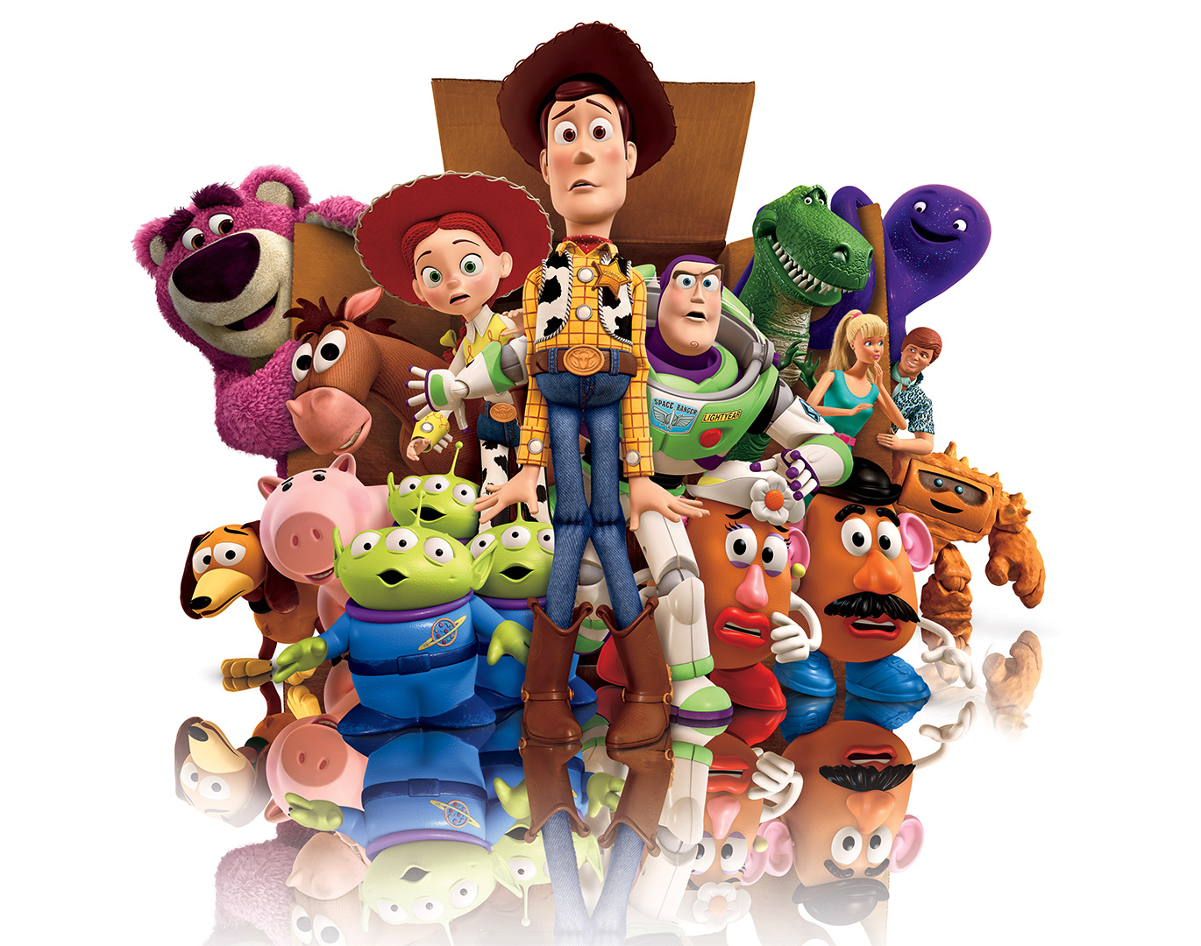
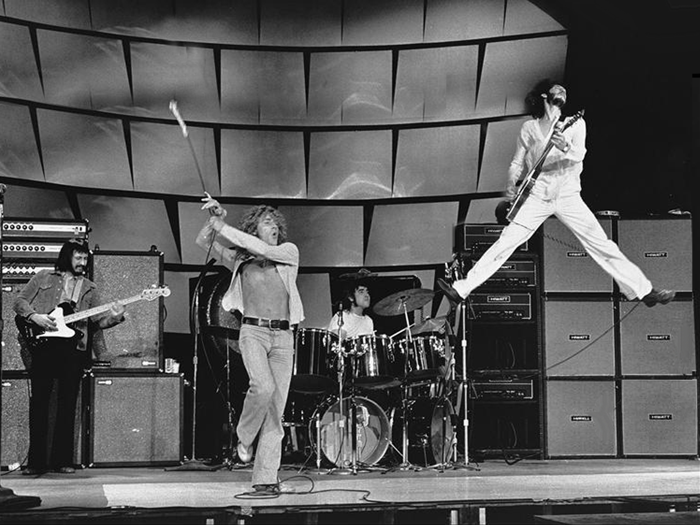
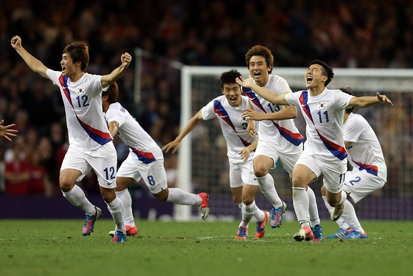
What are the qualities of a good team?
Notes:
Korea
http://www.youtube.com/watch?v=1r3BDc8RbhA
Women’s World Cup 2011
https://www.youtube.com/watch?v=r1PlC9mj-N0
Here It Goes Again
http://www.youtube.com/watch?v=dTAAsCNK7RA
Baba O’Reilly
http://www.youtube.com/watch?v=hKUBTX9kKEo
Sorority Hip Hop Competition
https://www.youtube.com/watch?v=6tSYVdoceDY

Slide 4
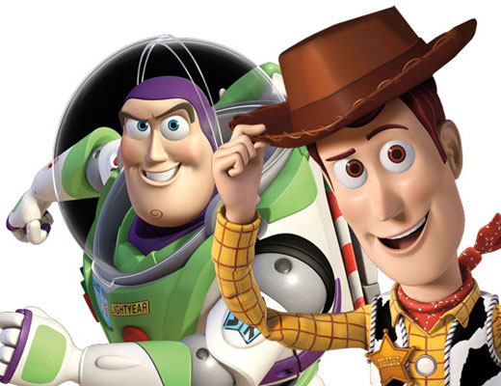
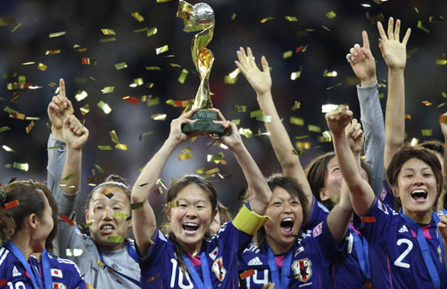
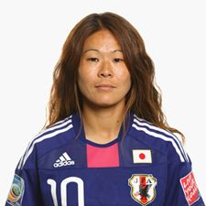
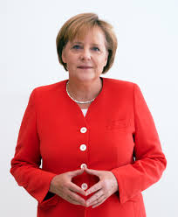
What are the qualities of a good leader?
Notes:
Why is Woody a better leader than Buzz?
Did OkGo need a leader to pull this off?
Toy Story
http://www.youtube.com/watch?v=Lu0sotERXhI
http://movieclips.com/ycmYA-toy-story-3-movie-weve-got-to-switch-him-back/
Star Wars
http://www.youtube.com/watch?v=vZ734NWnAHA&feature=c4-overview-vl&list=PL3339D1C61DB4AB28

Slide 5
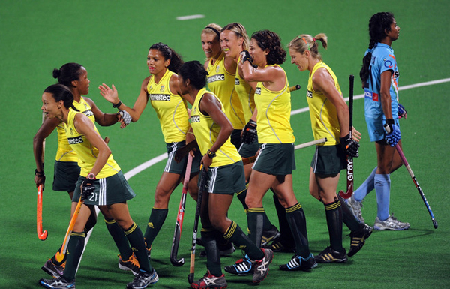
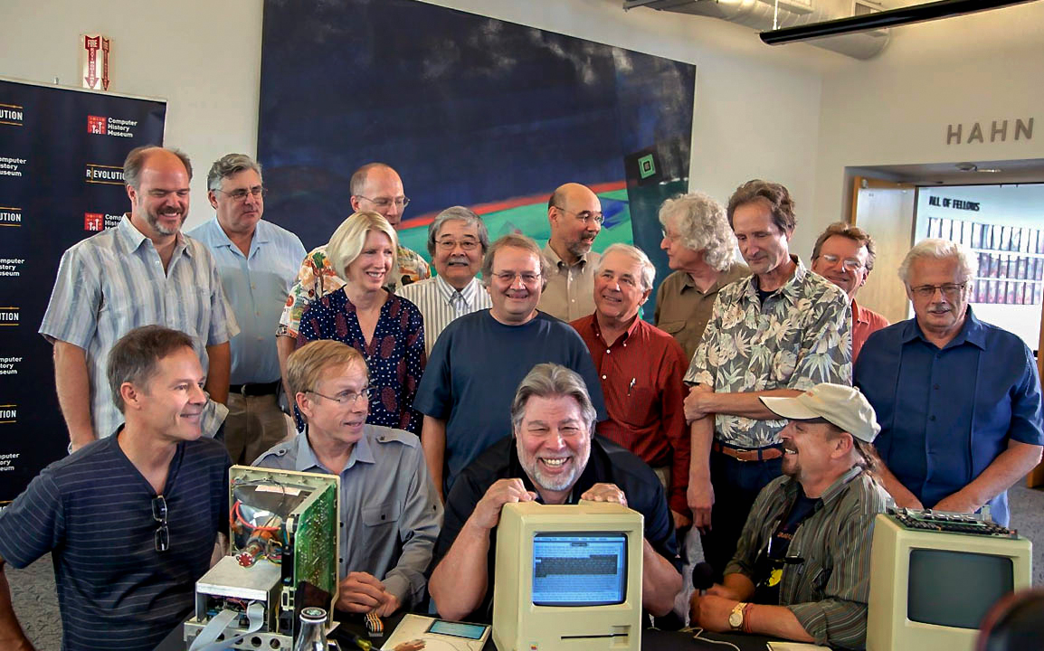
What are the qualities of a good team mate?
Notes:
Charlie’s Angles trailer: https://www.youtube.com/watch?v=wGxZbI92nO4
Say My Name: https://www.youtube.com/watch?v=sQgd6MccwZc

Slide 6
End

