Slide 1
Headings & Subheadings
Bowker, COMM 390

Slide 2
Key Concepts - Headings & Subheadings
1. Group Information
3. Fill in the Detail
2. Build the Structure
headings
subheadings

Slide 3
Group Information
Group related ideas
Then prioritize those ideas
Sequence the groups logically so it is easy for the reader to follow
Notes:
Start by clustering information so that you can decide what fits together. Then you can label it and order it.

Slide 4
Headings Are Your Framework
Headings provide the structure you will use to fill in the details and make your work complete.
To aid your reader, headings identify the form of your report and its key ideas
Notes:
You can use headings & subheadings to lay a framework. This allows you to get organized, work on the flow, and fit the pieces together appropriately.

Slide 5
Headings Keep You Organized
Help you stay organized as you write
Which makes it easier for you to build your argument logically.
And your reader to follow you through to the end.
Structure the content and guide the reader
Break information into manageable chunks
Are ordered logically
Help the reader see how you have built your argument
E.g. comparison, phases
Heading
Subheading 1
Subheadins 2
Notes:
Headings are the major categories of your report such as “Background” or “Regulatory Framework.” You probably figure these out before you start writing and probably only have a few in the whole report.

Slide 6
Subheadings Add Detail
Subheadings further refine the big ideas you identify in your headings.
It’s as if you break your headings into smaller pieces.
Are often, but not always, longer than headings
headings
subheadings
Notes:
Subheadings are just a finer level of detail than headings and you may have quite a few of these. They fall underneath a bigger heading.

Slide 7
Subheadings Add Definition
Example, subheadings are indented in grey:
Background
Project Problem
Industry Overview
Competitor Analysis
Project Analysis
Required Resources
Constraints
Competitive Advantage
Strategic Direction
Marketing
Operations
HR
Recommendation
Financial Projections
Growth
Differentiation
Notes:
Subheadings start to add content and fill out your argument or discussion.

Slide 8
Text
Text fills in the detail, and
Makes your work meaningful and complete.
Notes:
After the framework you are free to fill in the details. You’ve done the hard work of determining and organizing the big ideas and the structure. Now you add the content.

Slide 9
Formatting Options
Headings and subheadings must stand out from the rest of the text. Use:
Larger or coloured font
Bold
Italics
Boxes and shading
Underline (currently not in fashion)
Shading and Coloured Fonts
Help distinguish Headings & Subheadings from text…

Slide 10
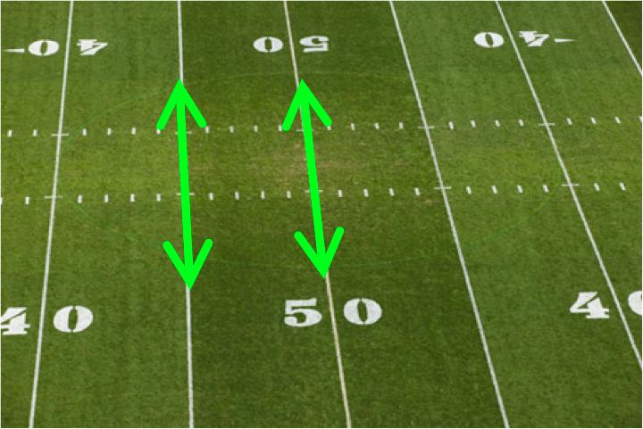
Formatting Headings
Headings must be obvious and easy to see.
Are always PARALLEL to each other:
Noun, verb & adjectives are in the same order each time.
Similar length.
Usually use larger font than subheadings
They descend in order of importance
Capitalize the important words
But not smaller words such as “the” or “and”
Notes:
Parallel – with the same angle, same tone, so that they match each other, even where there is variation like in the colour of the fabric in this quilt – the form is the same, it’s the content varies.
For instance, if you're not using "The" in front of all headlngs, don't use it in front of any.

Slide 11
Stay Parallel
Grammatical construction must be consistent
Not Parallel List
A part time job can develop:
Your decision-making skills
And you feel more self-confident and independent
A sense of responsibility
Parallel Headings
Make Decisions
Take Responsibility
Establish Self-confidence & Independence

Slide 12
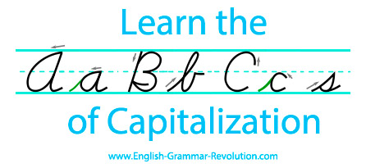
And in Case You Forget
Capitalize the important words
But not smaller words such as “the” or “and”

Slide 13
Be Descriptive
Headings should adequately describe the content and identify the purpose of what follows
You must guide your reader and help them know what to expect or find what they are looking for
“Point #1” doesn’t say anything of value
“Improved Competitive Advantage” or “New Financing Models” are both useful

Slide 14
Detailed is Usually Better
Target Market
Pricing Strategy
Sales Channels
OR
Identifying Your Target Market
Building a Tiered Pricing Structure
Using Multiple Sales Channels
Make sure you choose one or the other, don’t mix
Use verbs wherever possible – they provide more meaning
Notes:
The length and form of your headings will vary depending on the audience and the purpose but make sure you keep them parallel within each document. Subheadings are often longer than headings.

Slide 15
Examples of Descriptive Headings
Strong International Presence in the Market
Decision Making Criteria Based on Industry Best Practices
Significant Savings Through Reorganization of Data
Understanding the Customer Experience
Connecting to the Customer is Key to Good Service
New Plants Provide Better Access to Markets

Slide 16
Practice Question – to be done in class
Prepare descriptive headings and subheadings for an assignment you might be given at work. You’re not likely to receive much more direction than is provided below, you can make up the necessary details. Choose one of the following and complete it in class:
Research and compare software programs for a business application of your choosing (E.g. efficiency, accounting, design) OR
For a bus or shipping company, figure out why scheduling in Manitoba is consistently problematic and offer a solution. OR
Identify additional staffing needs if we add another location.
Notes:
You can practice now or wait until we take this up in class.

Slide 17
End
Notes:
formatting

