Slide 1
The Theory of Argumentation
Bowker Comm 390

Slide 2
Key Concepts
Be Specific.
Distinguish between fact and opinion.
Provide citations from the best source possible.

Slide 3
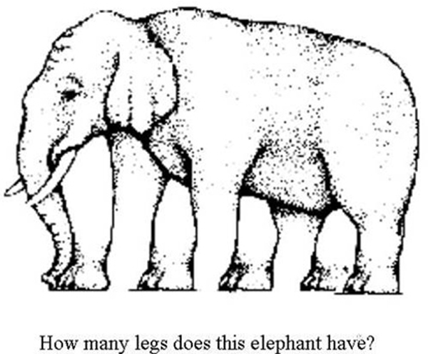
Assumptions
Assumptions are often ignored (or assumed) yet they allow us to develop a business case or make a plan. Specifically, assumptions are used:
To provide a starting point so we can identify that which we agree on.
To plan and make decisions when faced with uncertainty.

Slide 4
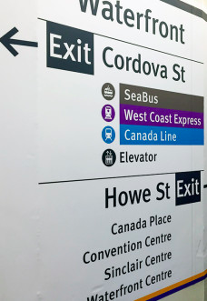
Definition: Assumptions
Something we reasonably believe to be true, but we lack sufficient proof to confirm.
An assertion we make as a starting point, like a hypothesis, or it might be a logical conclusion that we can’t confirm. For example:
Better signage will enhance the customer experience on transit,
Market research shows that our best price point is $99.99 per unit, or
We should expect to face litigation for a previous incident.
Notes:
http://www.inc.com/encyclopedia/assumptions.html

Slide 5
Example
When making arguments, it is unavoidable to make reasonable assumptions about certain matters. For example, when addressing the long-term economic effects of the world financial crisis
We can assume that the factors that brought this calamity about in the first place will not change moving forward:
Interrelatedness,
fluidity of world financial markets,
speculation and rent-seeking by certain institutions, and
likelihood of intervention by governments.

Slide 6
Best Practices: Be Specific
When making assumptions be as specific as possible and provide references as support.
Avoid vague claims such as “upper middle class,” Instead try:
Individuals with an annual income in excess of $150,000.
Go one step further and identify the age of these earners and possibly where they live, how much education they typically have, and their buying habits.
Avoid imprecise terms such as “Baby Boomers”
Remind us that Baby Boomers were born between 1946 and 1963 and state why this demographic is important for your company.

Slide 7
Note
High or low “class” are vague terms with negative connotations and not typically used in Canadian business.
Identifying income levels or other socio-economic markers is more accurate and more acceptable.
Using adjectives such as “luxury” or “affordable” can usefully be applied to goods or services.

Slide 8
Specificity
Avoid vague terms such as “most people.”
Substantiate with a clear definition of the behaviour, demographics or location of the people you are referring to.
Back it up with statistics or citations from research that proves your point.
For example, “a lot of people care about the environment,” Instead say:
In Canada x% of people identify the environment as one of their top 3 considerations when choosing a candidate in an election.
This is even more meaningful if you can show a trend: This is up x% in the last 20 years.

Slide 9
Practice Question
Answer on Connect: Find a credible source to make a strong statement about Canadian attitudes toward environmental stewardship.
Use a comparison or other tool to provide context and meaning to your assertion.
Consider polls, behaviour and spending.

Slide 10
Specificity
Similarly a phrase such as “yoga is a big trend” is a weak and incoherent statement. It’s much more meaningful to say:
33% of women between 18-35 years of age have been to yoga x times in the last month.
Provide a specific time frame: In 2013, or in the last 3 years;
Show a trend: up x% since 2005
Provide some geographic boundaries
Vancouver, Canada, or North America;
Provide the numbers
We can easily find out from StatsCan how many women in Canada are between the ages of 18-35, and calculating one-third of that is straightforward.

Slide 11
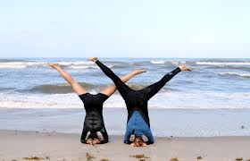
Example
“Yoga is a big trend” is a weak statement lacking any value. It’s much more meaningful to say:
1/3 of women in Vancouver aged 18-35 have been to yoga an average of x times in the last month.
And even better if you say when, perhaps 2013 or in the last 3 years; and where (Vancouver, Canada, North America) and then provide that number.

Slide 12
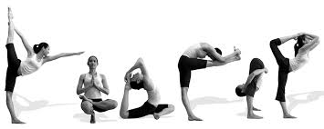
Practice Question
2) Use one or more resources to make a strong statement about the number of people engaged in yoga in 2013 or 2014.
3) Provide an example of what this information might be used for. E.g. an assumption about other activities our target market is engaged in or a fact about our customer base.

Slide 13
End

