Slide 1
Memos
Bowker, COMM 390

Slide 2
Purpose of a Memo
For distributing information quickly to an internal audience
Informal, routine or brief reports
Sometimes to register a formal opinion, especially if it is backed up with evidence or runs counter to prevailing opinion or policy
Read text pages 270-271

Slide 3
Distribution
Is usually but not always internal communication
Is usually but not always short
Is usually but not always saved in a document format, not only distributed within the body of an email
May be to one person or to the whole staff
memorandum

Slide 4
Structure of Opening
MEMO
To: Your audience, 1 or more person
From: You and/or your department, include your title
Date: Date of issue
Subject: HIGHLIGHTED IN SOME WAY, descriptive
For example:
To: All Staff
From: Jana Soone, VP Human Resources
Date: April 12 20x1
Subject: New Vacation Policy
Memorandum

Slide 5
Content
MEMO
Can vary, it might be to :
Provide an incident update or the results of a report, meeting or action
Inform of software changes or other factual information
Propose a new, or change to an existing, policy or procedure
Register a formal opinion

Slide 6
Guidelines
Be as brief as possible
Be very direct and use clear language
You don’t want any misunderstandings
Use bullet points and white space to make it easy to read
If you want people to do something, identify a clear and specific call to action
Be courteous and somewhat formal

Slide 7
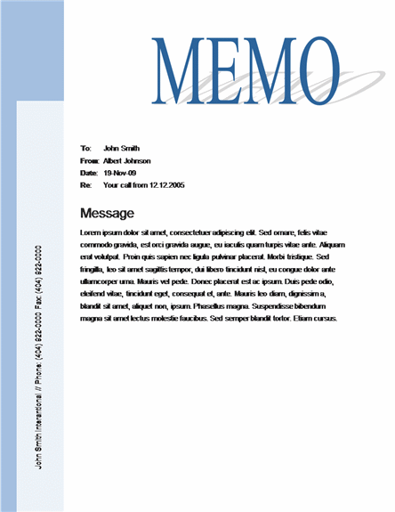
Sample

Slide 8
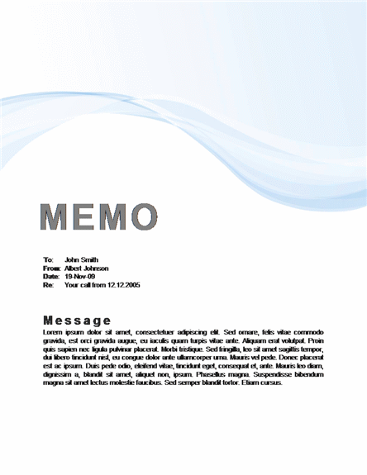
Sample

Slide 9
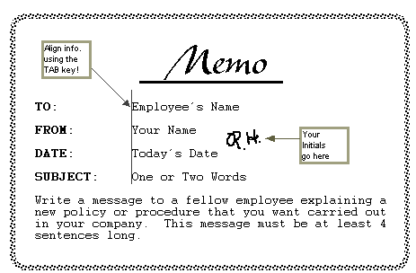
Sample

Slide 10
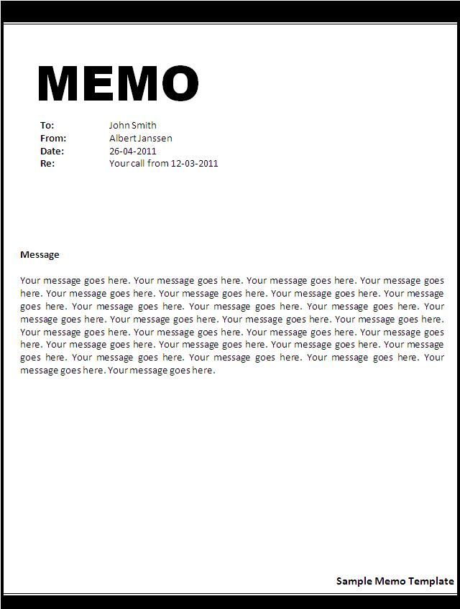
Sample

Slide 11
End

