Slide 1
Selected
Case
Studies
October 24 2021
image source: powtoon

Slide 2
01
presentations ~ 10 minutes, 10 minutes Q+A
02
discussion
TODAY’S CLASS
Image source: imgarcade.com

Slide 3
04
Lack of Access to Education in Sub-Saharan Africa
01
Period Poverty in Africa
02
Period Poverty in Germany
PRESENTATIONS - TODAY
Image source: imgarcade.com
Notes:
2:00 – 2:05
Name cards + introductions from those who were not here last class.
Intro cards from those who were not here last week.

Slide 4
06
The Unfair Treatment of Blue Collar Workers in Singapore
07
Environmental Effects of Fast Fashion (T1)
08
Environmental Effects of Fast Fashion (T2)
PRESENTATIONS – Wed Oct 26
Image source: imgarcade.com
Notes:
2:00 – 2:05
Name cards + introductions from those who were not here last class.
Intro cards from those who were not here last week.

Slide 5
03
Lack of Low-barrier Income Generating Initiatives (DTES)
05
Opioid Crisis in Vancouver
General Discussion + Wrap up
PRESENTATIONS – MON OCT 31
Notes:
2:00 – 2:05
Name cards + introductions from those who were not here last class.
Intro cards from those who were not here last week.

Slide 6
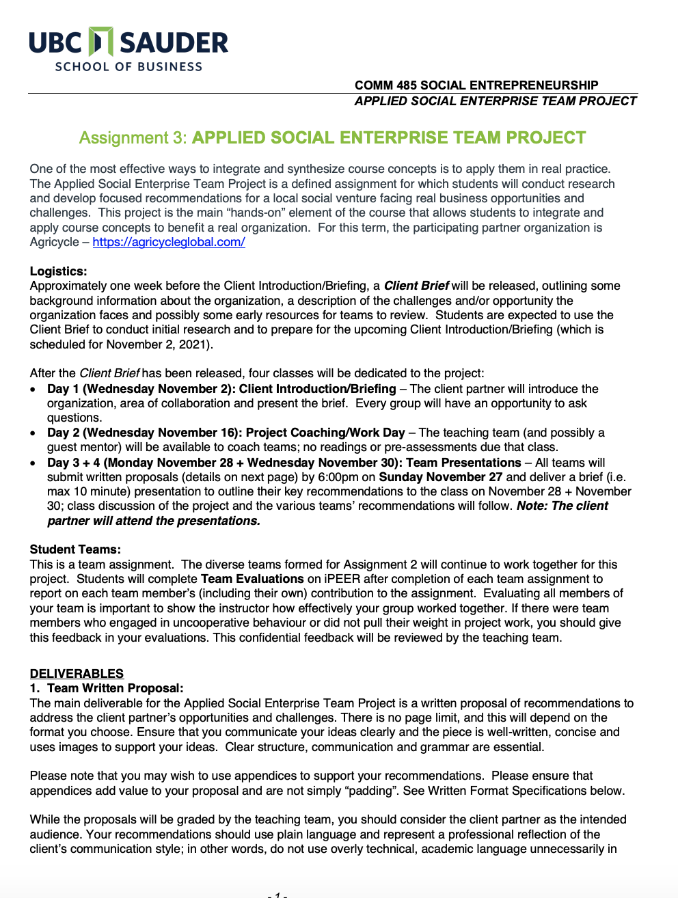
Assignment 3
Applied Social Enterprise Team Project
Due Tuesday November 29

Slide 7
01
05
Period Poverty 1
Opioid Crisis in Vancouver
02
06
The Unfair Treatment of Blue Collar Workers in Singapore
Period Poverty 2
03
Lack of Low-barrier Income Generating Initiatives (Vancouver DTES)
07
Impacts of Fast Fashion 1
04
Lack of Access to Education in Sub-Saharan Africa
08
Impacts of Fast Fashion on the Environment
A2 SELECTED CASE STUDY TOPICS
Image source: imgarcade.com
Notes:
2:00 – 2:05
Name cards + introductions from those who were not here last class.
Intro cards from those who were not here last week.

Slide 8
01
05
Alice, Anna, Colin, Daniel, Taylor
Anusha, Ettore, Justin, Michael, Nour
02
06
Celia, Fynn, Mads, Malvika, Teagan
Abhi, Benjamin, Carlos, Karan, Mien
03
07
Amanda, Harrison, Meagan, Ryan, Samuel
Aaryan, Aki, Celine, Nishant, Tanya
04
Baptiste, Keisha, Moriah, Nicole, Rishi, Sarah
08
Ben T, Nadine, Simon, Simran, Udhav
TEAMS (Assignments 2 + 3)
Image source: imgarcade.com
Notes:
2:00 – 2:05
Name cards + introductions from those who were not here last class.
Intro cards from those who were not here last week.

Slide 9
 |  | individual/ partner | team
prep: | Pre-assessments | 10%
assignment 1: | Social Problem Situational Analysis | 20%
assignment 2: | Selected Case Study + Presentation | 0 | 15%
assignment 3: | Applied Social Enterprise Project |  | 30%
assignment 4: | Reflection Paper | 10%
Participation*: | Participation + Engagement | 15%
total |  | 55% | 45%
ASSESSMENT
Notes:
INDIVIDUAL AND TEAM WORK ARE EQUALLY IMPORTANT.
THE KEY IS COMMITMENT TO THE PROCESS AND EACH OTHER.
AS YOU WILL SEE IN THE OUTLINE:
PARTICIPATION – 15%
REFLECTIONS – 25%
ASSIGNMENTS RELATED TO MAJOR PROJECTS – 60%

Slide 10
 | *Participation + Engagement ~ Participation “Portfolio”
1: | in class speaking (synchronous)
2: | discussion boards (asynchronous) ~ 1 week
PARTICIPATION
Notes:
INDIVIDUAL AND TEAM WORK ARE EQUALLY IMPORTANT.
THE KEY IS COMMITMENT TO THE PROCESS AND EACH OTHER.
AS YOU WILL SEE IN THE OUTLINE:
PARTICIPATION – 15%
PREASSESSMENTS -- 10%
REFLECTIONS – 15%
ASSIGNMENTS RELATED TO ASSIGNMENTS– 65%

Slide 11
 |  | due | present
prep: | Pre-assessments | ongoing
contribution: | In-class Participation + Engagement | ongoing
assignment 1: | Social Problem Situational Analysis | Oct 2
assignment 2: | Selected Case Study + Presentation | Oct 23 | Oct 24 - Oct 31
assignment 3: | Applied Social Enterprise Project | Nov 29 | Nov 30 + Dec 5*
assignment 4: | Reflection Paper | Dec 9
note* clients attend
DATES
Notes:
INDIVIDUAL AND TEAM WORK ARE EQUALLY IMPORTANT.
THE KEY IS COMMITMENT TO THE PROCESS AND EACH OTHER.
AS YOU WILL SEE IN THE OUTLINE:
PARTICIPATION – 15%
REFLECTIONS – 25%
ASSIGNMENTS RELATED TO MAJOR PROJECTS – 60%

Slide 12

01
Teams 6, 7, 8 present Wednesday October 26
02
Teams 3, 5 present Monday October 31
03
iPeer 1
04
Modo ~ client brief presentation, Nov 2
05
assignment 3 ~ due November 29
applied social enterprise team project
REMINDERS
Image source: imgarcade.com

