Slide 1
CSR ⬅ ➔ CSV
Philanthropy
Doing Good
Responding to pressure
Discretionary
Add-on
One directional
Separate
Cause focused
“one off”
Benefit
Societal
Environmental
Economic
Part of competing
Community
Circular, reinforcing
Embedded
Budget
Structure

Slide 2
CSR ⬅ ➔ CSV
A cost center
Reporting
Ranking
Accountability
GRI (reporting focus)
Compliance
A profit center
Value focused
Future
Creation
Core
Exploratory

Slide 3
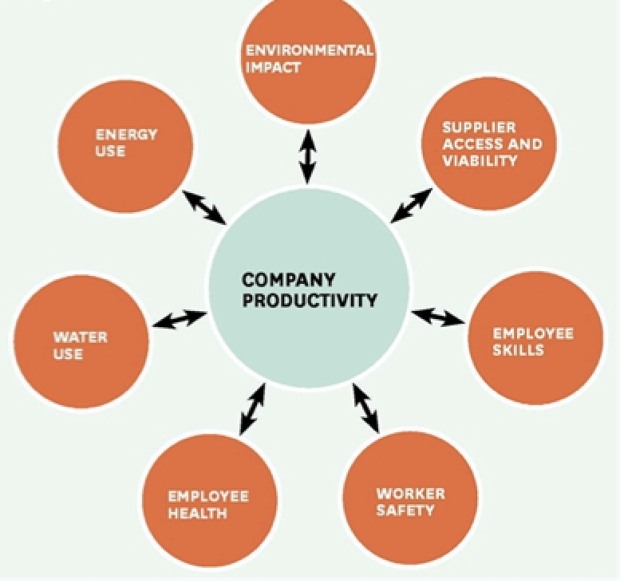
Heineken (groups 1,2,3)
Apple (groups 4,5,9
Nike (groups 6,7,8)
Choose two of the seven areas from the diagram and develop a series of actions that the company could take to create the desired outcome of “Shared value”
From your company’s perspective:
1) Choose 2 items ➔ score their CSV performance out of 10 and provide rationale
2) ➔ list desired outcomes ➔ articulate actions ➔ create assessment
3) Explain the value being created and how you will measure it.

Slide 4
For your company, write down top CSR things they are doing well:
-
-
-
-
-
Choose 1st Item
______________
What could they do better? Future desired Outcomes
-
-
-
-
-
Actions / Tactics
-
-
-
-
-
-
Assess /Measure
-
-
-
-
-
-
Conclusion on sustainability and CSR ______________________________________

Slide 5
For your company, write down top CSR things they are doing well:
-
-
-
-
-
Choose 2nd Item
______________
What could they do better? Future desired Outcomes
-
-
-
-
-
Actions / Tactics
-
-
-
-
-
-
Assess /Measure
-
-
-
-
-
-

Slide 6
Language and action
What language do different companies use and why?
Sustainable brands and sustainable business
(Unilever calls CSV activities ”sustainable”)
Leads to higher growth brands
Leads to higher margin brands
Why?
Clue: look to the activities
Actions
Outsourcing – limitations
Leading change in impact through whole chain
Supply
Use
Disposal
Partner with critics – not defence

