Slide 1
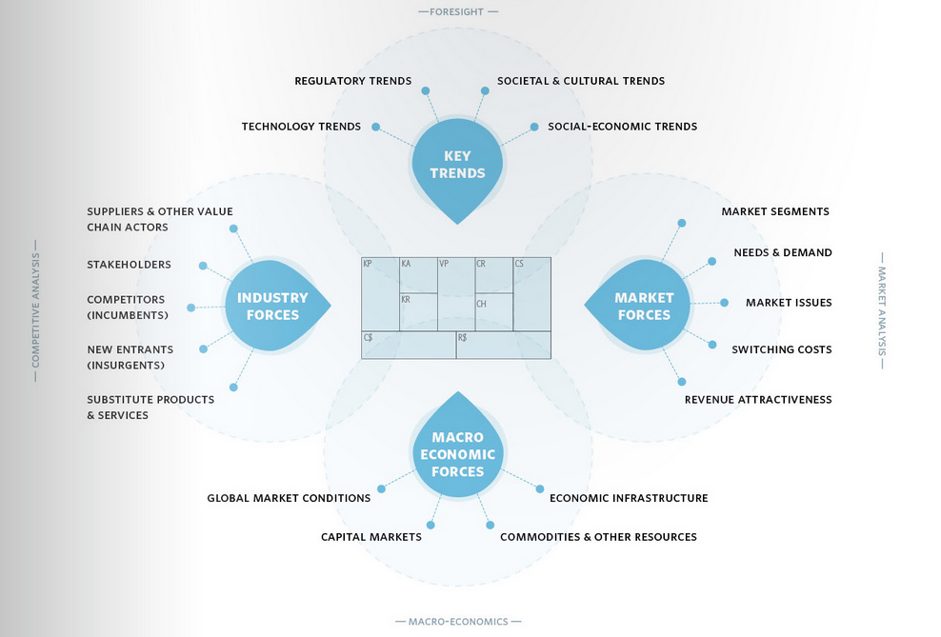
Source: Osterwalder, Business Model Generation, p201

