Slide 1
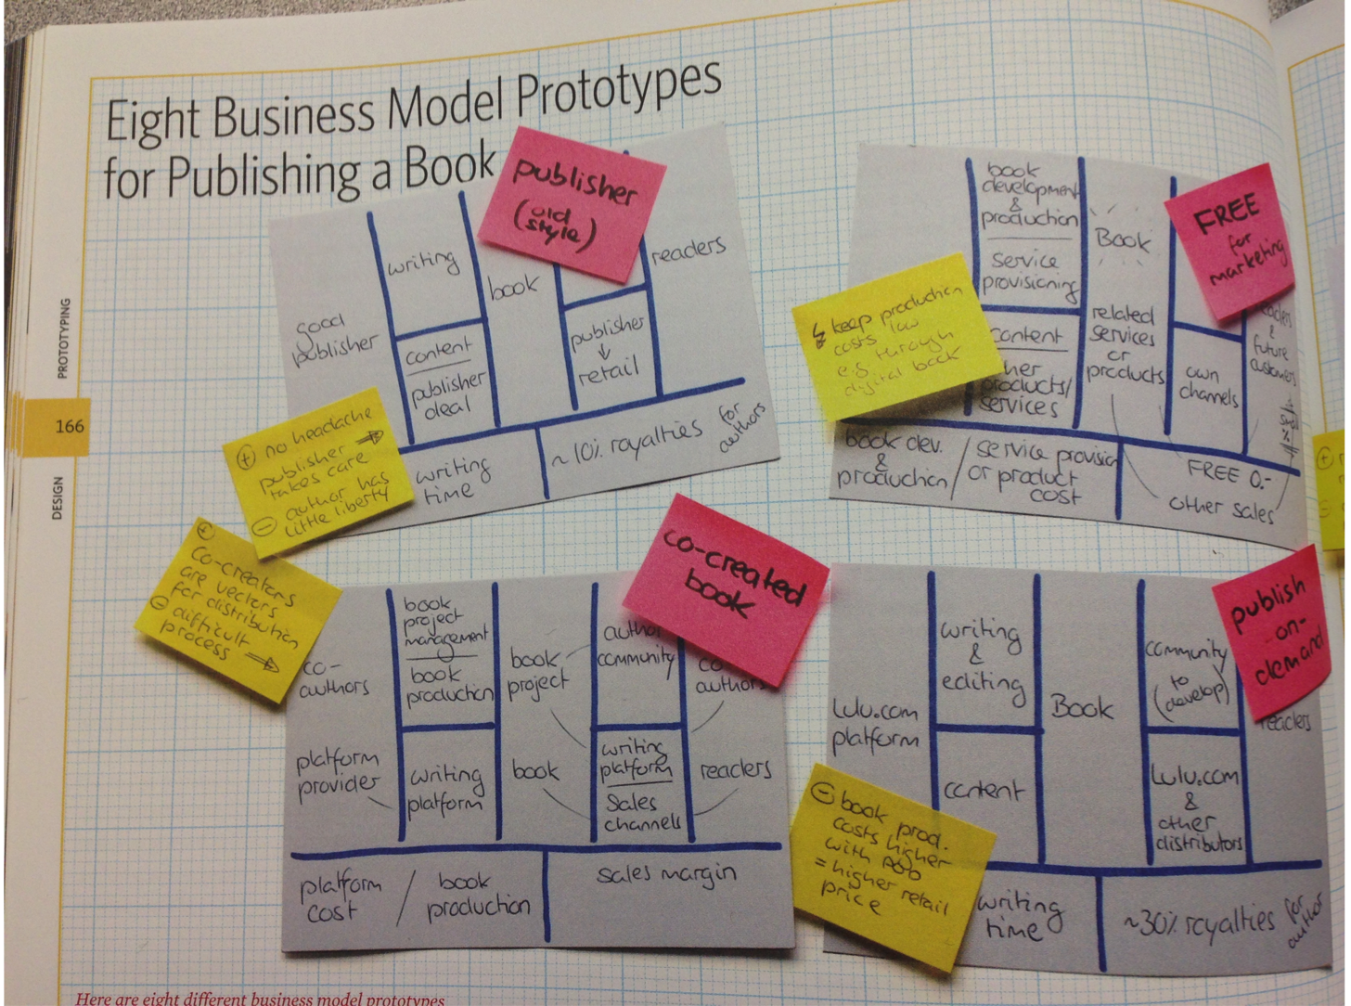
Source: Osterwalder, Business Model Generation

Slide 2
