Slide 1
Agenda – class 3 – comm486M
Your emerging strategy toolkit – whiteboard c2
Strategy in context
What are the components of a “strategy statement”?
Exercise on sequencing: Mission, Vision, Goals, STRATEGIES, tactics, measurement.
Exercise: Transient Advantage
Summary of learning
Next Steps

Slide 2
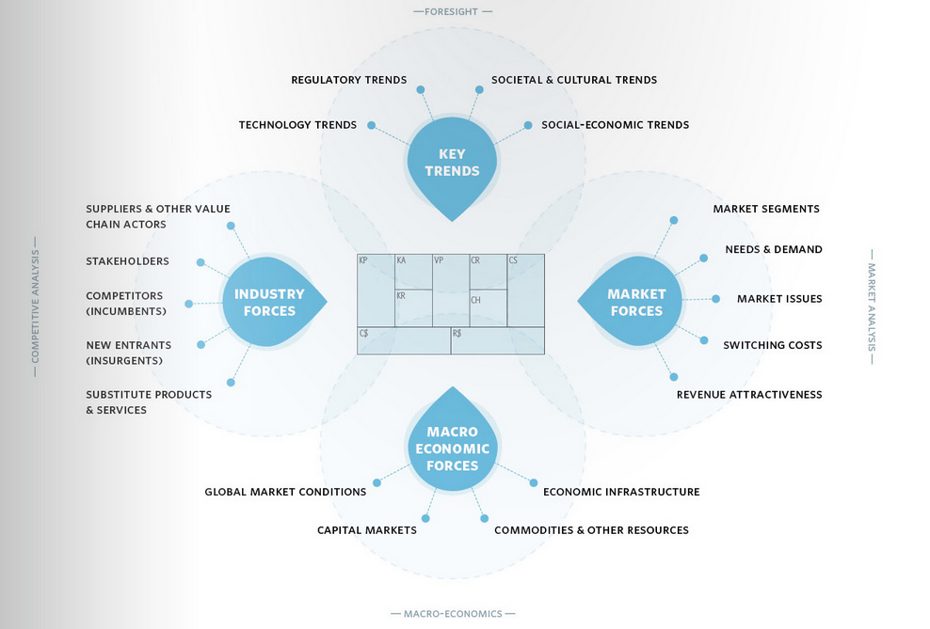
Source: Osterwalder, Business Model Generation, p201

Slide 3
Source: Osterwalder: Value Proposition Design, pages xiv-xv

Slide 4
http://www.marsdd.com/mars-library/strategy-statement-articulating-your-competitive-advantage-objectives-and-scope/

Slide 5
Levels of Strategy
Corporate or Organizational level
Business Unit level
Functional or Department level
Consider, where do your existing tools fit?
http://www.quickmba.com/strategy/levels/

Slide 6
Context for strategy
Who are we and what do we care about?
Values, purpose → Mission
BHAG – enVISIONed future – long term?
Where are we? Situational Analysis
A lot of your existing tools fit here.
Where could we be? Possibilities – Disruption – Changing the Rules – Creating Value
Where do we want to go? Goals. SMART
How do we get there? Part 1 – Strategies
How do we get there? Part 2 – Implementation – tactics
Are we getting there? Measurement – analytics, BSC

Slide 7
Exercise on sequencing: Mission, Vision, Goals, STRATEGIES, tactics, measurement.
Fill in worksheets as much as you can for assigned company.
What was easier and why?
What was more difficult and why?
http://www.thebodyshop.com/values/index.aspx
http://www.lululemon.com/about/manifesto
https://www.vancity.com/AboutVancity/VisionAndValues/
http://www.mec.ca/AST/ContentPrimary/AboutMEC/AboutOurCoOp/MecCharter.jsputm_source=mec.ca&utm_medium=redirect&utm_campaign=charter&bmLocale=en

Slide 8
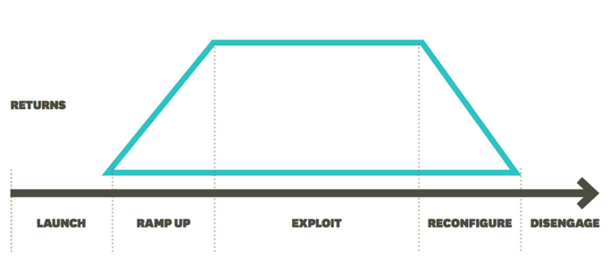
Transient Advantage (the “end” of sustainable competitive advantage.)
Identify a company for each of A,B,C and D
B
C
A
D
Implications for time horizon
McGrath: June 2013 HBR

Slide 9
Transient Advantage (the “end” of sustainable competitive advantage.)
For each company two strategies based on their relative position
B
C
A
D
Implications for time horizon
McGrath: June 2013 HBR

Slide 10
Exercise: Transient Advantage When to defend and sustain vs. when to flex, redesign and attack?
Sketch the transient chart
Place several companies at different parts of the chart
Label those you think are in
Attack mode – flexible, reconfiguring, transient
Defence mode - a “sustaining” advantage
Conclusions

Slide 11
Learning recap
Your preliminary strategy toolkit: Jan 5th 2015
The gaps and challenge
Building the toolkit
Extra course blog page – evolving content
Organizing the toolkit
Practicing using the toolkit

Slide 12
Next Steps
Teams
Tutorials
Class 4 case
Class 5 and 6 – client project
Updated course outline

