Slide 1
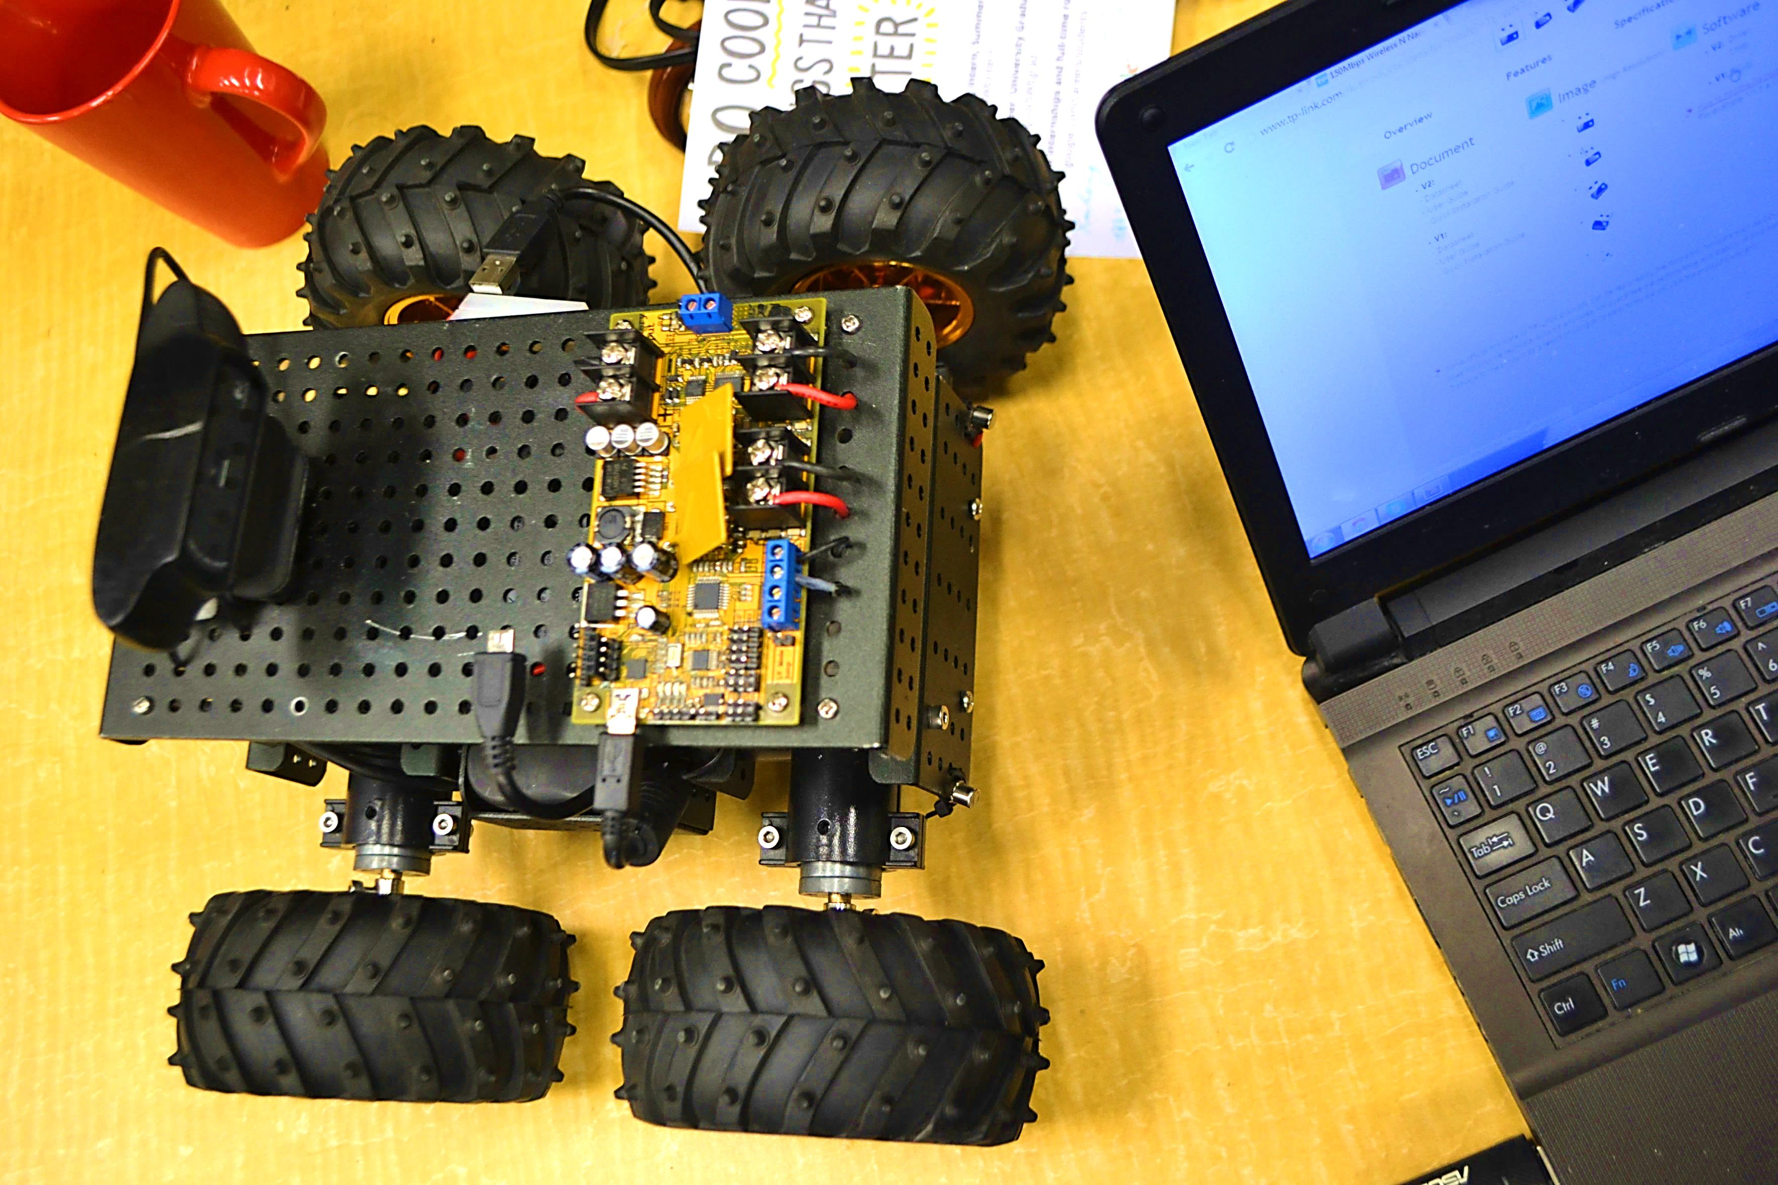
INQUIRY:
CODING IN
BC MONTESSORI
SCHOOLS

Slide 2
AGENDA
BACKGROUND
CODING IN SCHOOLS
MONTESSORI PRINCIPLES
IMPLEMENTATION

Slide 3
BACKGROUND
“It is my goal that (computer coding) doesn’t just become an opportunity for every child to take part in, but we ultimately make it mandatory for every child from kindergarten to grade 12.”
-Christy Clark, Jan 18, 2016
#BCTECH Summit

Slide 4
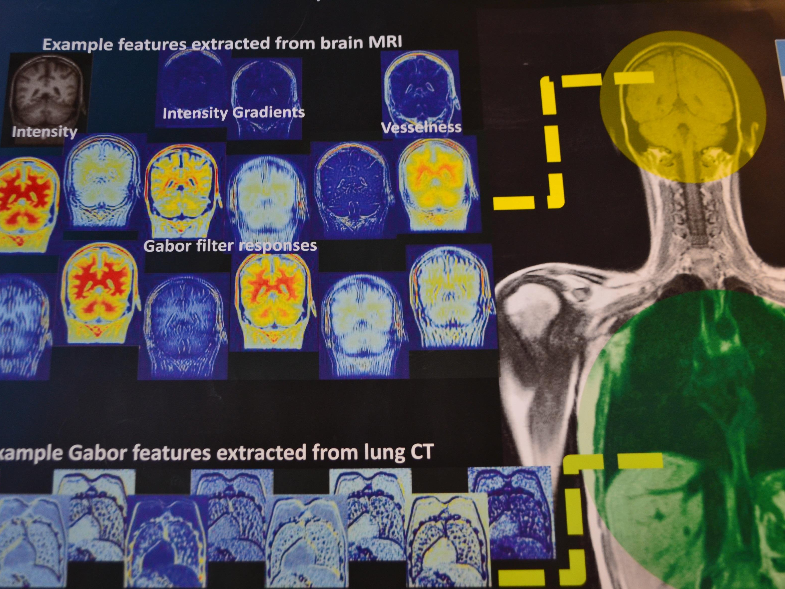
BACKGROUND
The economy has been and most likely will continue to shift from an ‘intuitive’, protected economy to a ‘quantitative’ global economy.

Slide 5
Implications
Computing Science is now a ‘mature’ science.
Students should be building literacy in this sphere.
Curricula and teachers also need to improve literacy in this area.
Teacher education ought to reflect this shift.

Slide 6
Computational Thinking
CT is a problem solving process that includes:
Formulating problems in a way that enables us to use a computer and other tools to help solve them
Logically organizing and analyzing data
Representing data through abstractions such as models and simulations

Slide 7
Computational Thinking
Continued:
Automating solutions through algorithmic thinking (a series of ordered steps)
Identifying, analyzing, and implementing possible solutions with the goal of achieving the most efficient and effective combination of steps and resources
Generalizing and transferring this problem-solving process to a wide variety of problems
-American International Society for Technology in Education & Computer Science Teachers’ Association (2011)

Slide 8
Computational Thinking
These skills are supported by:
Confidence in dealing with complexity
Persistence in working with difficult problems
Tolerance for ambiguity
The ability to deal with open-ended problems
The ability to communicate and work with others to achieve a common goal or solution
-American International Society for Technology in Education & Computer Science Teachers’ Association (2011)

Slide 9
Are these good skills for elementary learners?
Notes:
Note: each bullet will build automatically.
So explore, and you’ll discover that you have options in what you study, when you study, and where you study.

Slide 10
Are these skills compatible with montessori teaching?
Notes:
Note: each bullet will build automatically.
So explore, and you’ll discover that you have options in what you study, when you study, and where you study.

Slide 11
8 principles of Montessori
Movement and cognition are closely intertwined.
Children thrive on choice within structure.
Student interest is a powerful way of engaging learners.
Extrinsic Rewards inhibit the development of intrinsic motivation.
Lillard (2005)

Slide 12
8 principles of Montessori
Learning with and from peers is essential.
The context and purpose for knowledge must be clear to learners.
Teachers must provide freedom within structure.
The classroom environment must be carefully prepared to provide order and interaction with materials must be sequenced deliberately.
Lillard (2005)

Slide 13
Montessori and technology
"What purpose would education serve in our days unless it helped humans to a knowledge of the environment to which they have to adapt themselves?"
- Maria Montessori

Slide 14
Montessori and technology
AMS Statement on Information Technology
Students in the early years (P-K): no technology.
Gr. 1-7: Technology seen as a research tool more than a creative tool.
“Using Montessori's methods of observing will help us determine the place of technology in the Montessori world.”
-American Montessori Society

Slide 15
Montessori and technology
In Sum:
Technology cannot replace the sensorial materials.
Technology may complement the existing Montessori method.
The use of technology should follow the principles of Montessori.

Slide 16
Integrating Montessori and Technology
Principle 1: Movement and cognition are closely intertwined.
Computational thinking can be integrated in early years in concrete ways, and move to abstract methods later on.

Slide 17
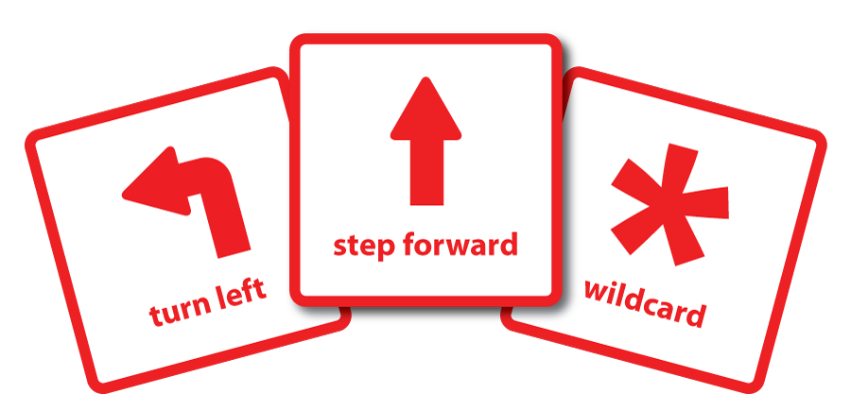
Integrating Montessori and Technology
Example: Coding Card Games

Slide 18
Integrating Montessori and Technology
Principle 2. Children thrive on choice within structure.
Links to:
Identifying, analyzing, and implementing possible solutions with the goal of achieving the most efficient and effective combination of steps and resources

Slide 19
Integrating Montessori and Technology
Example:
Using MIT app inventor to build unique apps for problems students identify themselves:

Slide 20
Integrating Montessori and Technology
Principle 3: Student interest is a powerful way of engaging learners.
Links to:
Formulating problems in a way that enables us to use a computer and other tools to help solve them.

Slide 21
Integrating Montessori and Technology
Example:
Minecraft to create structures, extending the study of art and architecture, electrical systems, basic physics based on student interest.
More info: minecraft.edu

Slide 22
Integrating Montessori and Technology
Principle 4: Extrinsic Rewards inhibit the development of intrinsic motivation.
This is definitely possible, although many educational systems for technology use extrinsic
eg: frequent trophies/badges in code.org

Slide 23
Integrating Montessori and Technology
Principle 5: Learning with and from peers is essential.
This principle is fully compatible with technology education.
Projects can be large and collaborative.

Slide 24
Integrating Montessori and Technology
Principle 6: The context and purpose for knowledge must be clear to learners.
Computational thinking is inherently applied – it solves a specific real-world problem.
Computing technology is a creative medium.

Slide 25
Integrating Montessori and Technology
Example:
Analog: Develop a series of steps (algorithm) for a task to make it work better (eg: class cleanup).
Digital: Code.org structures its intro to coding as a series of specific tasks.

Slide 26
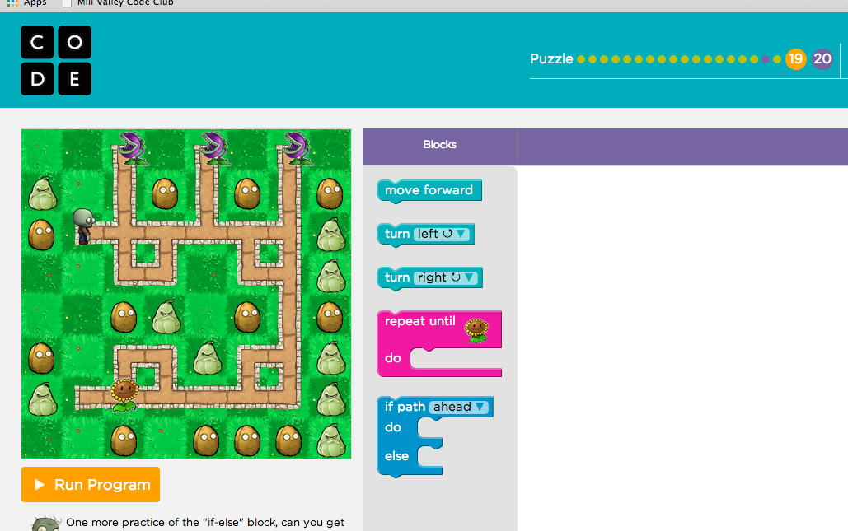
Integrating Montessori and Technology

Slide 27
Integrating Montessori and Technology
Principles 7 and 8:
Teachers must provide freedom within structure.
The classroom environment must be carefully prepared to provide order and interaction with materials must be sequenced deliberately.

Slide 28
Integrating Montessori and Technology
Example:
Code.org is a kind of prepared environment that:
Controls for error.
Involves a 3 period lesson system.
Builds progressively more complicated outcomes.
Provides a structured experience that moves to greater creative freedom.

Slide 29
Conclusions
Computational Thinking and Montessori Education are compatible.
Concerns around use of technology too soon in the montessori curriculum define the problem too narrowly.
Montessori educators must take a broader view of technology – embracing not only the information resource, but understanding it as a platform for computational thinking, creativity, and learning a programming language.

Slide 30
Future research
Can the use of technology improve the Montessorian’s use of empirical methods to collect data on the best pathways for developping the Montessori method for their students?
How do the ‘sensitive periods’ align with the introduction of computational thinking and computional language? Eg: the sensitive period for language; the sensitive period for ordering the world.

