Slide 1
BAMA 513
Welcome to eMarketing 2014

Slide 2
Overview of the Room

Slide 3
My Background

Slide 4
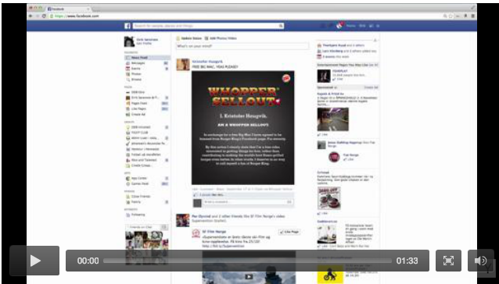
Let’s get some thinking going…

Slide 5
The work ahead…
• Flexibility to customize your learning: no book
• Hootsuite Pro
• Online Marketing Plan for live client (incl. options of adwords, e-mail, content and HS campaigns & Analytics reporting)
• Prepare, Participate & Be Present (10% of your grade)
Entire outline of assignment and grading breakdown will be up this week.

Slide 6
20% article/book report or interview (individual)
10% in class participation
30% project (team) content
20% reflective learning paper (individual) following client presentation
20% blog, (individual)
NO EXAM

Slide 7
Client Project
Phase 1 (30%)
Comprehensive marketing plan proposal
Execution of activities
Phase 2 (20%)
Individual report and reflective paper after client presentation

Slide 8
HootSuite Setup
Get HootSuite if you don’t have it.
www.hootsuite.com
Fill out the form on the blog with your registered email address.

Slide 9
Client Project Announcement 50% of your grade….
Assignment parameters
• Timings
• Teams
• Clients
• Detailed briefing online

Slide 10
Discussion
Why are you taking this course?
How many part-time vs full-time?
How do online and offline marketing strategies work together?
How have digital marketing and social media disrupted business and provided opportunity and challenges?

Slide 11
History of eM
Mid 1990s: slow connections, limited content and limited
people online
• 1994:Amazon; 1996 Yahoo & Hotmail; 1998: Google
• 1999-2000: first boom and bust: watershed
• ~2003+: web as mainstream channel
• 2003: LinkedIn; 2004: Facebook & Flickr; 2005: YouTube
• 2006: Twitter & Hubspot; 2008: Hootsuite
• social media impact: UGC & dialogue not monologue
• 2009+ user as creator; mobile web increase
• 2014+ Customization, location, big data, mobile/tablet

Slide 12
Forms of eMarketing
Display and rich media ads
Mobile marketing
Social media (now taking off! It reaches people on mobile in real-time)
Search engine advertising: Paid search engine inclusion and placement
E-mail marketing
Online catalogs
Online chat
Blogging and content marketing

Slide 13
Trends: Mobile
More than 2/3 of adults and 3/4 of teens use the cloud
Web vs. apps struggle: 35% have apps; 24% use apps
Features used by cell owners
76% take pictures
74% are texters (text overtook talk in frequency in 2009)
39% browse internet
34% are email users
34% record videos
34% play games
33% play music
30% are IM-ers
7% participate in video calls
Notes:
Quick reference to growth of the cloud
Quick review of Nielson Mobile – Pew data on apps usage
Quick review of cell features used by owners
Less than a minute

Slide 14
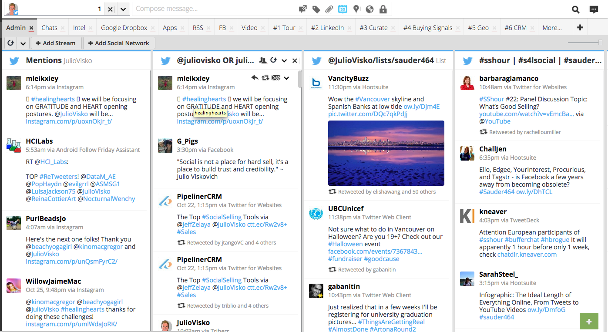
Trends: Social Media Consequences for info ecosystem Social networks as sentries (WOM)
Notes:
In the challenging new media ecosystem – as more information comes at them from more sources at ever-greater speeds – people cope with the change by relying more and more on their social networks. There are three important ways they do that.
The first is that they rely on their networks to act as their “alert” system – sentries. We hear from more and more people who begin and end their days by checking in with their social networks to see what’s new, what’s worth viewing, what’s most enjoyable in media spaces.

Slide 15
Consequences for info ecosystem Social networks as forums for action
Notes:
Another new way that people rely on their social networks is to use them as audiences. Indeed, tech social networks have expanded the traditional definition of a social network by adding a new “audience” layer to them. That new layer isn’t composed of strong ties or weak ties, but is less formal than weak ties, including FOAF connections.
As “weak” as it is, the audience layer is important and meaningful because it can be activated from time to time for a purpose. It’s also a place to find the wisdom of crowds – even strangers can help people make decisions.

Slide 16
Influencers
Hub vs Bridge
Metrics to identify influencers (Klout, Kred, BuzzSumo, Little Bird)

Slide 17
Influencer Exercise
Take 5-7 minutes and find an influencer in either Food, Music, Marketing, or Tech.
Why are they an influencer?
How did you find them?
If you were a brand in the space, how could you connect with them?

Slide 18
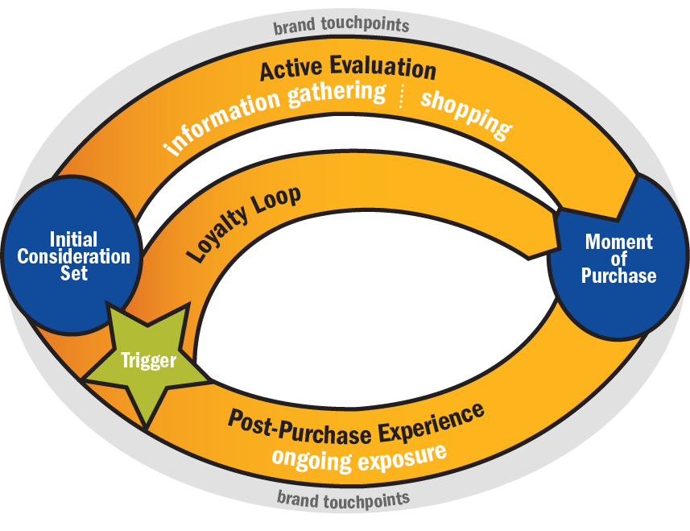
Implication: A New Consumer Decision Journey to Manage
ACTIVE EVALUATION:
The consumer adds 1.7 more brands to consideration, based on packaging and sampling
INITIAL CONSIDERATION:
PURCHASE:
Consumer starts with 1.5 brands in mind, influenced by previous trial and word of mouth
At the moment of purchase, the consumer has evaluated only 3.2 brands, and makes decision based largely on information learned before shopping
POST-PURCHASE EXPERIENCE:
66% of consumers engage with their brand after purchase (e.g., online research), and this engagement has a meaningful impact on the likelihood of repeat purchase
19

Slide 19
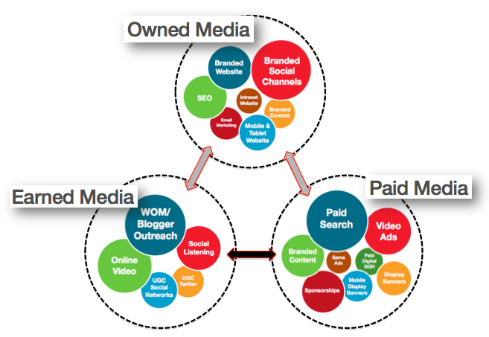

Slide 20
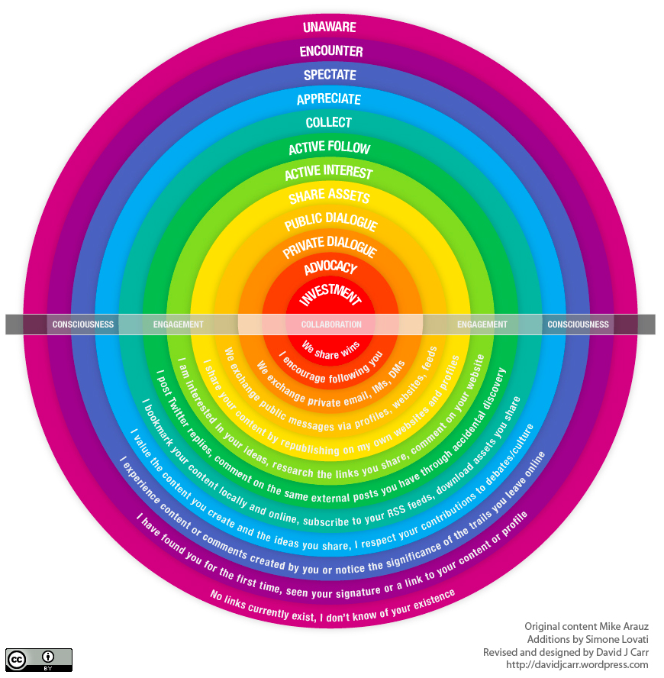

Slide 22
Notes:
P is People. Don't start a social strategy until you know the capabilities of your audience. If you're targeting college students, use social networks. If you're reaching out business travelers, consider ratings and reviews. Forrester has great data to help with this, but you can make some estimates on your own. Just don't start without thinking about it.
O is objectives. Pick one. Are you starting an application to listen to your customers, or to talk with them? To support them, or to energize your best customers to evangelize others? Or are you trying to collaborate with them? Decide on your objective before you decide on a technology. Then figure out how you will measure it.
S is Strategy. Strategy here means figuring out what will be different after you're done. Do you want a closer, two-way relationship with your best customers? Do you want to get people talking about your products? Do you want a permanent focus group for testing product ideas and generating new ones? Imagine you succeed. How will things be different afterwards? Imagine the endpoint and you'll know where to begin.
T is Technology. A community. A wiki. A blog or a hundred blogs. Once you know your people, objectives, and strategy, then you can decide with confidence.

Slide 23
10 Minute Break

Slide 24
Early successes and failures in eM

Slide 25
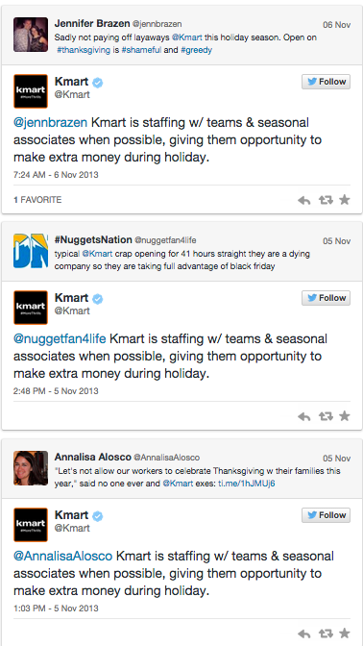

Slide 26
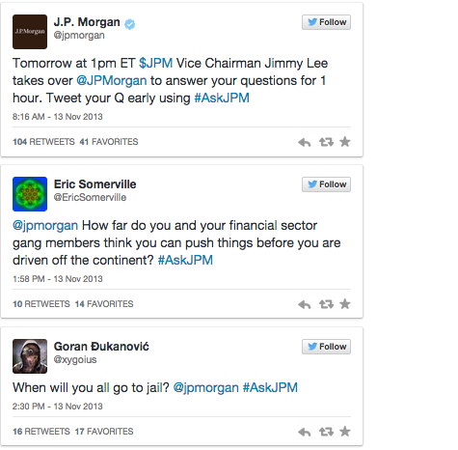

Slide 27
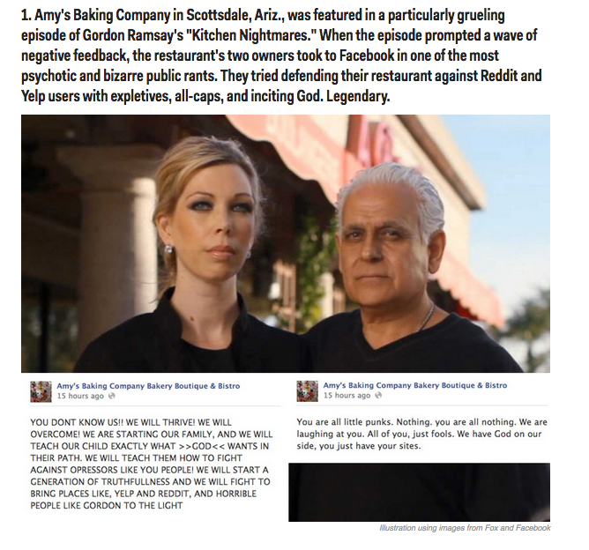

Slide 28
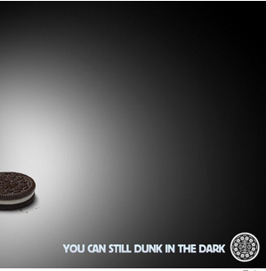
WIN
Kraft: When the lights went off unexpectedly at the Super Bowl for 34 minutes on Feb. 4, the folks on Oreo's social media team didn't blink. They responded almost immediately with this tweet. It was retweeted 16,000 times, easily the most memorable tweet of the evening.

Slide 29
eMarketing Ethics
Canada spam law
Marketing to children
Protection of data

Slide 30
Insight on eCommerce: Class Discussion
Why have online luxury retailers have had a difficult time translating their brands and look and feel of luxury shops into Web sites?

Slide 31
Discussion 2
Why is online marketing to children a controversial practice?
How do companies verify the age of online users?
Should companies be allowed to target marketing efforts to children under the age of 13?

Slide 32
Team Forming
Choose a client to work on. Have 1 main and 2 other options.
Decide who will work on what
The report is handed in as a team but everyone is responsible for one part.
Choose 5 of the 6 options to work on:
Google AdWords
Content Calendar
Social media scheduling and optimization
Google analytics
Social media analytics
Email marketing

Slide 33
Clients
Selection criteria
Fit for online marketing plan assignment
Getting approval from Julio
Contact
Setting expectations
Roles of team members
Website admin access for analytics, HS and Tw, FB, etc

Slide 34
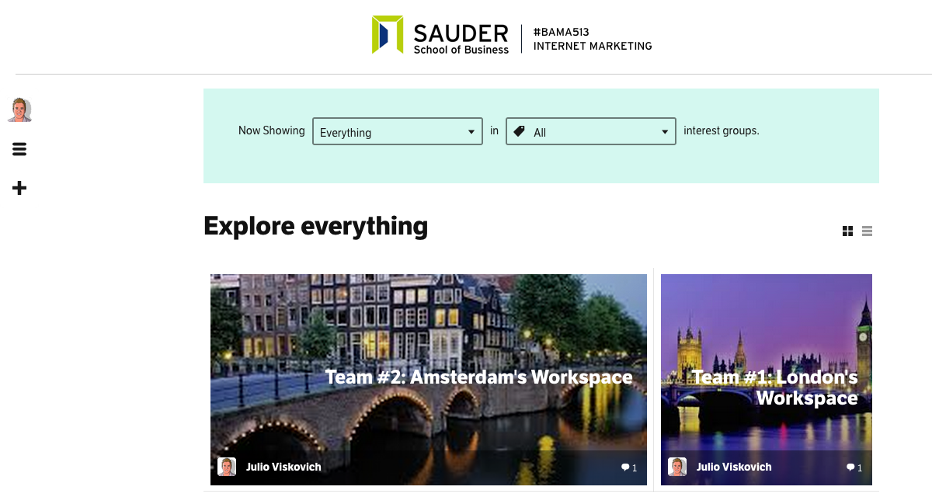
A Special Surprise…
The first class room in North America that I know that will have their own custom social network to collaborate on your client project.
http://bama513.hubifi.com/

