Slide 1
Welcome to History 358: Cuba in the World
Prof. Alejandra Bronfman
alejandra.bronfman@ubc.ca
Buchanan Tower 1121
Office hours Wednesday and Friday 1-3pm.

Slide 2
Raul Castro: “This is a revolution committed to its people” Granma International, January 3, 2013
US Congresswoman Ileana Ros-Lehtinen: “I am a fierce opponent of the Castro regime in Cuba, the Chavez regime in Venezuela, and other dictatorial regimes in Latin America that subvert the will of the people and seek to erode democratic institutions. Our Hemisphere must not be allowed to follow the insidious example of Castro’s Cuba.”
http://ros-lehtinen.house.gov/issue/foreign-affairs visited Jan 6, 2013

Slide 3
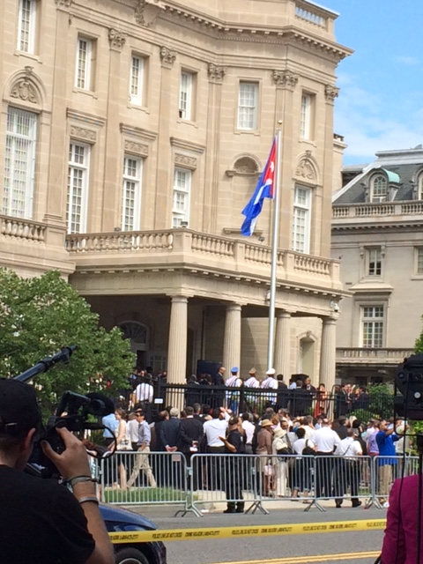
July 20, 2015 Cuban embassy
Washington DC
August 15, 2015, American Embassy in Havana

Slide 4
BRUNO RODRÍGUEZ PARRILLA, MINISTER OF FOREIGN AFFAIRS OF THE REPUBLIC OF CUBA
“The challenge is huge because there have never been normal relations between the United States of America and Cuba, in spite of the one and a half century of intensive and enriching links that have existed between both peoples.
The Platt Amendment, imposed in 1902 under a military occupation, thwarted the liberation efforts that had counted on the participation or the sympathy of quite a few American citizens and led to the usurpation of a piece of Cuban territory in Guantánamo. Its nefarious consequences left an indelible mark in our common history.
In 1959, the United States refused to accept the existence of a fully independent small and neighboring island and much less, a few years later, a socialist Revolution that was forced to defend itself and has embodied, ever since then, our people's will.
I have referred to History to reaffirm that today an opportunity has opened up to begin working in order to establish new bilateral relations, quite different from whatever existed in the past. The Cuban government is fully committed to that.
Only the lifting of the economic, commercial and financial blockade which has caused so much harm and suffering to our people; the return of the occupied territory in Guantánamo and the respect for Cuba's sovereignty will lend some meaning to the historic event that we are witnessing today.”

Slide 5
John Kerry, August 15, 2015
In 1959, Fidel Castro came to the United States and was greeted by enthusiastic crowds. Returning the next year for the UN General Assembly, he was embraced by then-Soviet Premier Nikita Khrushchev.
In the United States, that means recognizing that U.S. policy is not the anvil on which Cuba’s future will be forged. Decades of good intentions aside, the policies of the past have not led to a democratic transition in Cuba. It would be equally unrealistic to expect normalizing relations to have, in a short term, a transformational impact. After all, Cuba’s future is for Cubans to shape. Responsibility for the nature and quality of governance and accountability rests, as it should, not with any outside entity; but solely within the citizens of this country.

Slide 6
How does history matter?
When does it get written?
Is there such a thing as sovereignty?
What are the relationships between Cuba and other countries and how/why should we write about them?
Notes:
We begin long before the revolution, and end as close to today as we can, to get a sense of the long view and come up with our own interpretation of these scenes.
Apocalyptic and bloody

Slide 7
Africa

Slide 8
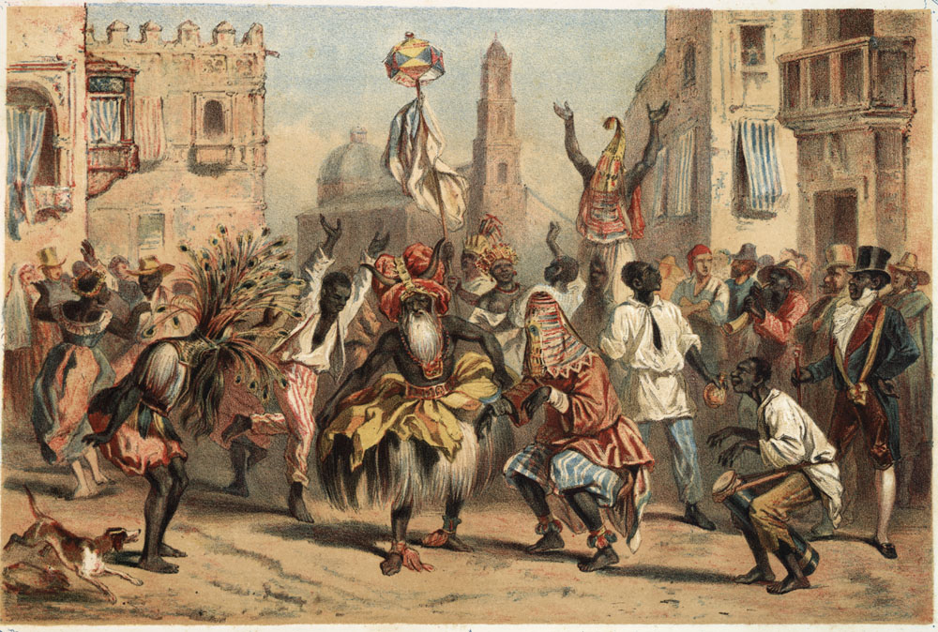
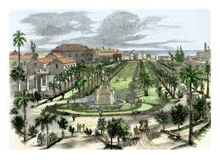
19th c
Spain

Slide 9
United States
Notes:
war

Slide 10
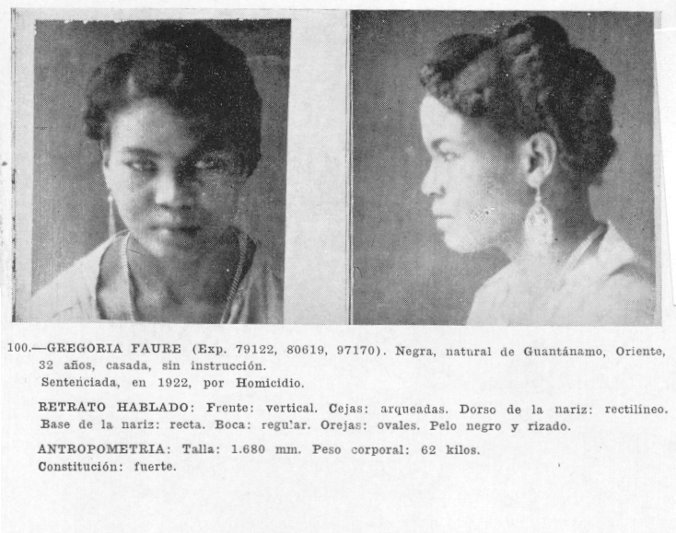
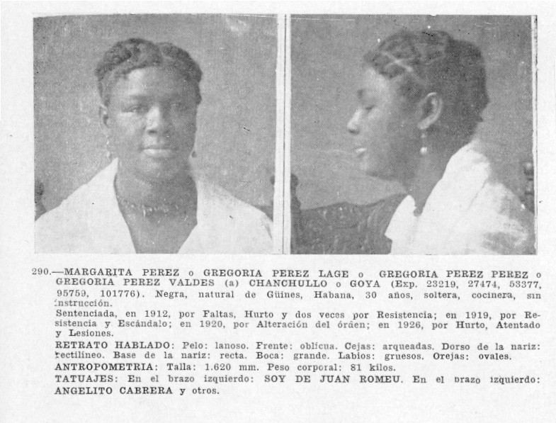
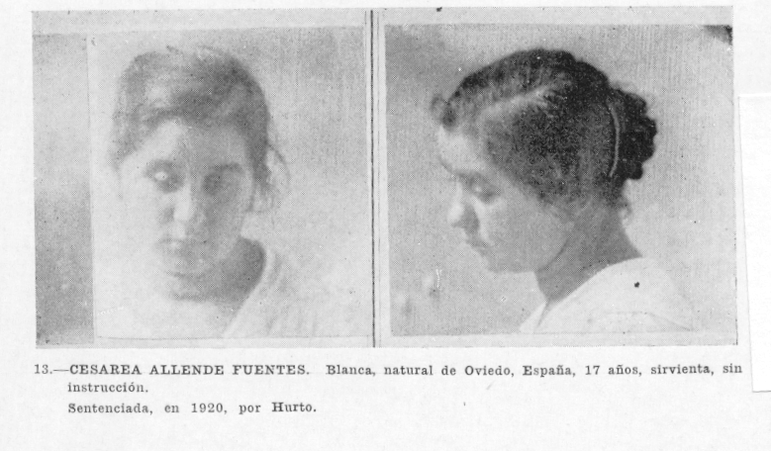
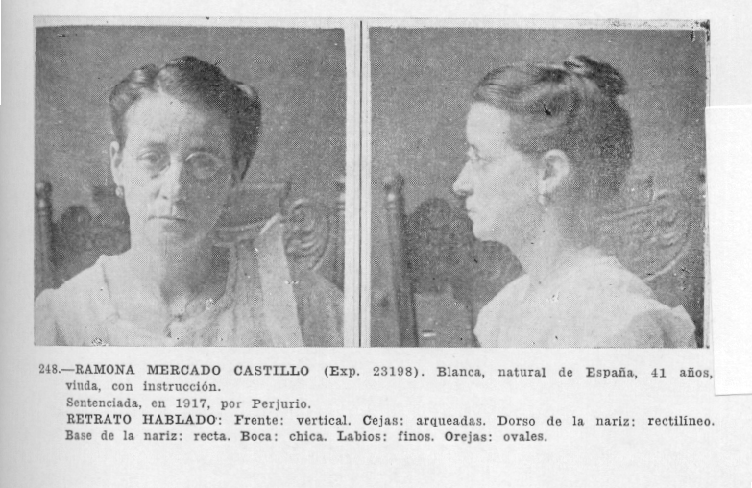
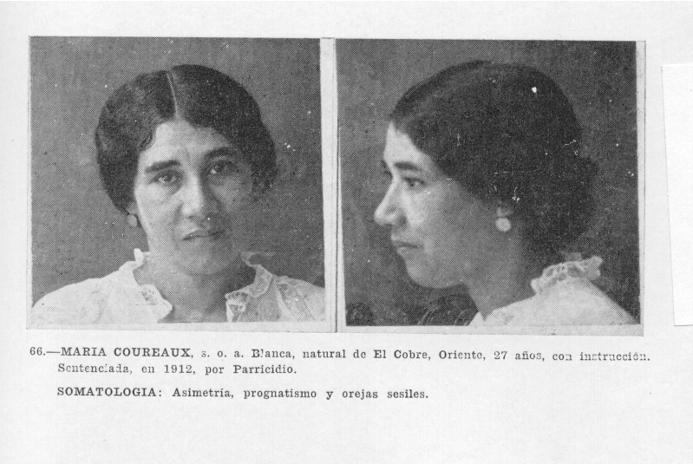
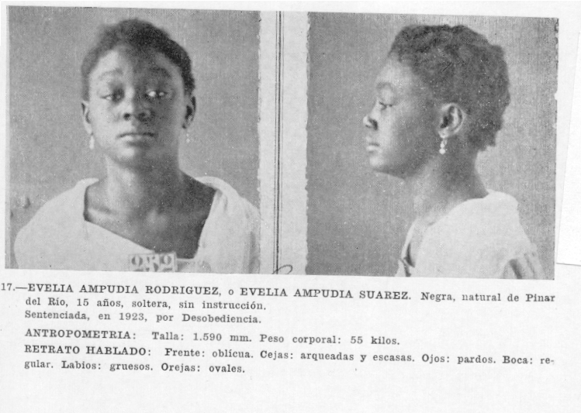
Notes:
Modernity, technology, citizenship, disciplinary regimes

Slide 11
Pioneers of revolution
Notes:
Revolution

Slide 12
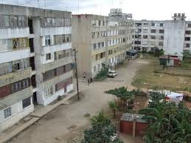
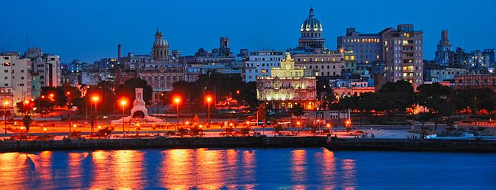
Governing, living, visiting
Notes:
Politics, living, tourism.

Slide 13
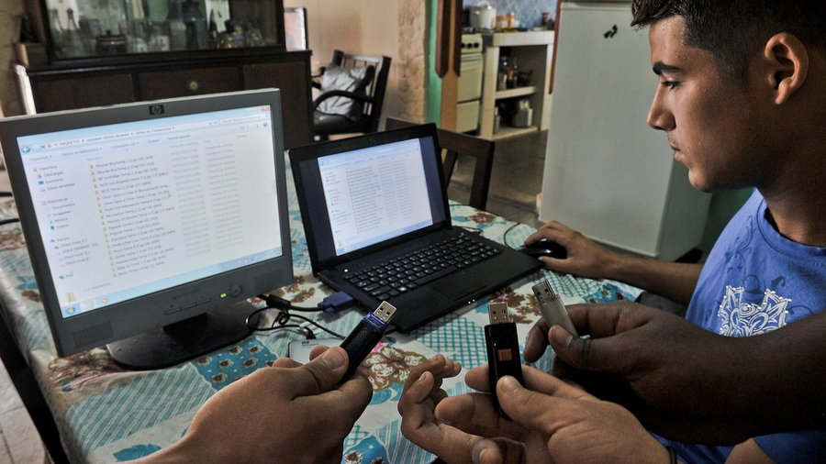
Crevasses of everyday life
Frikis in Havana
El paquete

Slide 14
Assignments
In class participation: reading, discussion: 20%
Blog postings: 15%
At least 6 during term. This should be a reflection and comment on the readings, in particular in relation to the themes of the lectures and discussions, and the previous readings. No longer than one paragraph. Due by 6am the day of discussion (usually Thursday).
Short paper: 15%
What did you know about Cuba before starting this class, and how have you learned it? How does Barcia’s book change or add to what you already knew? 500 words. Due September 29.
Map and timeline quiz October 8, in class: 10%
Paper on sources: 20%
Choose two texts we have read so far and discuss the author’s use of sources. What kind of sources do they use? How do they use them to make their arguments? What is the nature of evidence in these texts? 1000 words. Due November 5 in class.
Final paper/project: 20%
-Historiographic essay (choose 1 week and read one more book)—2000 words.
-Multimedia project with some scholarly content and at least 1500 words.
-Choose one author we have read and read another book by that author. Write an essay on their historical perspective, methods, and aims. 2000 words.
Due December 10.
***Extra credit: bring in a news item to share at the beginning of Tuesday’s lecture
This will bump your grade up by 3 points.

Slide 15
Website: http://blogs.ubc.ca/cubahistory/
Class attendance:
Everyone on Tuesdays
Thursdays: 9:30-10:07 :Alsaeedi-Lui
10:13-10:50: Macpherson-Zhang
Assignment for Thursday Sept. 17: Read Barcia, chapters 1-3, and do blog post if you are doing it.
Devices

Slide 16
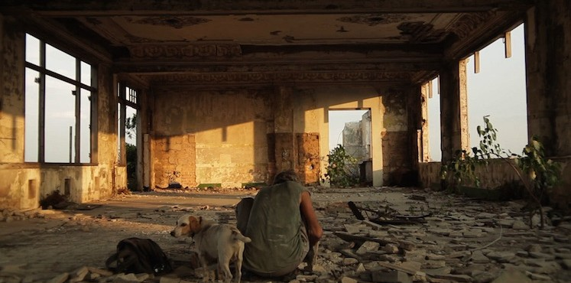
Go to the movies!
Hotel Nueva Isla
Today! Cinematheque, 5:15

