Slide 3
mp

Slide 4
Can we talk about causes, or contingencies, or accidents?
What are the necessary components, already present in Cuba, 1950s?
discontent- towards ruling govt
Corruption
Fpd
Figurehead-leader
Continuing imperialism
Alcp
Communications networks--underground
History of revolution
Taste of prosperity

Slide 5
What about outside?
Decolonization
Latin american guerrillas/peasant movements
Tourism
Beginning of cold war
Dollar imperialism
New deal

Slide 6
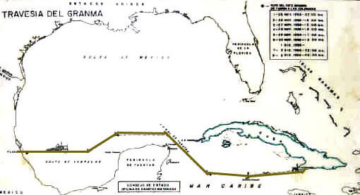
Story of a yacht, 1956

Slide 7
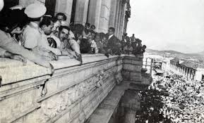
Guns and bananas, and a radio too
Coup in Guatemala, 1954
Castro in Bogota, 1948

Slide 8
money
Castro, raising anti-Batista money, University of Miami, 1955

Slide 9
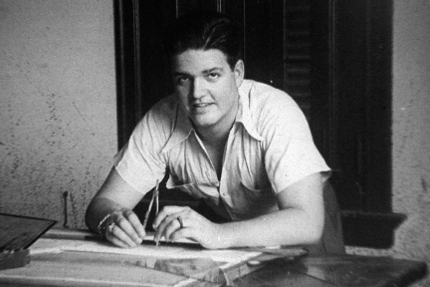
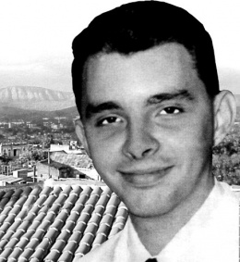
frenemies
Castro and Guevara
José Antonio Echeverría
Frank País

Slide 10
Lies, truths, and a public

Slide 11
February 24, 1957

Slide 12
January 1, 1959; many stories
The Guardian: UK
Castro in Control of Cuba
New York Times:
Batista and Regime Flee Cuba; Castro Moving to Take Power; Mobs Riot and Loot in Havana

Slide 15
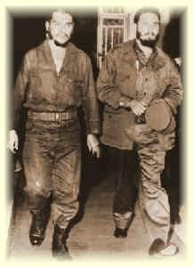
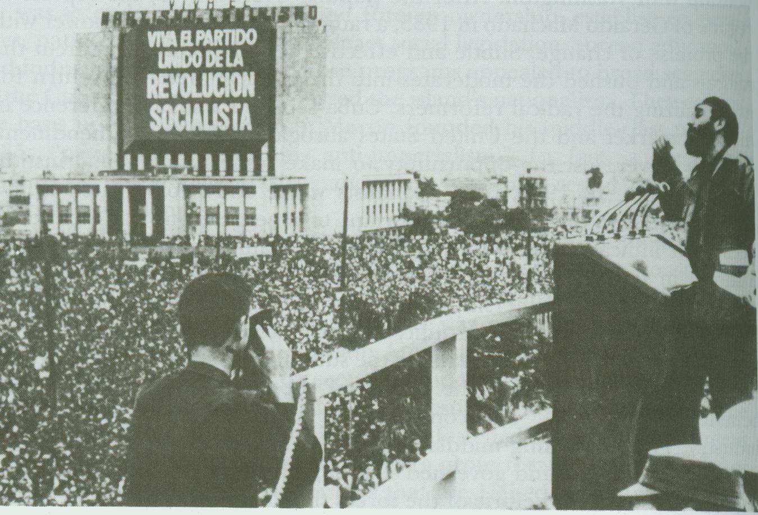
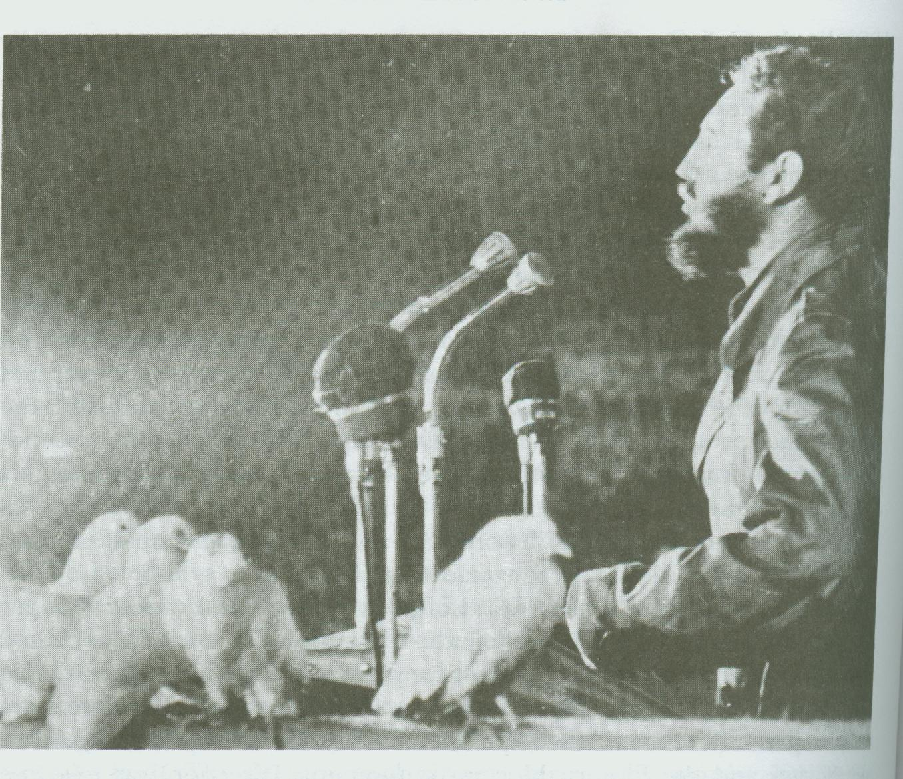
Notes:
Making a single story—this will be hard, as it will always escape
He never received any royalties for the image, because Castro did not recognize the Berne Convention for the Protection of Literary and Artistic Works. In 2000, he sued Smirnoff over the use of the image in advertisement. Commenting on the illicit use of his photograph, the artist said, "As a supporter of the ideals for which Che Guevara died, I am not averse to its reproduction by those who wish to propagate his memory and the cause of social justice throughout the world, but I am categorically against the exploitation of Che's image for the promotion of products such as alcohol, or for any purpose that denigrates the reputation of Che". His out-of-court settlement of US $50,000 was donated to the Cuban healthcare system

