Slide 1
Voices, documents and a mystery

Slide 2
Make a sentence or two (at the most) that uses these words and makes an argument about Cuban history.
Cuba, Haiti, Africa, Sugar, War, Freedom, Pork, Rumours, Ships

Slide 3
1. Ships from Africa brought slaves to Cuba and haiti, whence rumours of pork shortage sparked the slaves fought for freedom through guerrilla wars because the masters abused them in sugar plantations.
2. In Cuba, the constant arrival of slave ships from Africa for the production of sugar in addition to the unease from neighboring Haiti, then fighting a war for freedom , sparked curious rumors and the elite’s accusations of pork stealing.
Rumour has it; Cuba’s freedom is constantly under threat from Haiti, African slaves with their voodoo pork rituals, and British war ships. It also has sugar.

Slide 4
Much of Cuba’s history is affected by African Slaves in the sugar plantations/trade. With the Haitian War of Independence resulting the freedom of slaves, simple rumours around pork shortages and rituals resulted in mass panic with the arrival of slave ships.
African war and ships brought slaves to Haiti. The rumours of pork shortage and slave freedom moved the sugar trade to Cuba.
Slaves shipped from Africa fighting for freedom in Haiti sparked rumours (as pork disappeared) that there will be a new war in Cuba as they took over the sugar trade.

Slide 5
The revolution in Haiti impacted Cuba, because the white population feared war and insurrection, as demonstrated by the missing pork rumour, as opposed to through an actual revolutionary uprising for freedom on the part of the slaves; nevertheless, they continued importing more on ships from Africa to increase sugar production.
African slave rebellion for freedom in Haiti spurred rumours about slave war at home in Cuba, compounding colonial fears of voodoo worship from pork shortages. This, along with sugar and ship-building industries, shaped Cuban identity and industry in its history.

Slide 6
Slaves from Africa working on sugar plantations in Haiti fought a war for freedom, when there was a pork shortage in Cuba rumours spread of voodoo sacrifices and rebels coming on ships.
In the history of Cuba, slave trade from Africa to support the expansion of sugar plantations following the 7 Years War, instigated and uprising in Haitian slaves to fight for freedom; this struggle was reflected in Havana through the appearance of pork shortages, supported by a rumor about the insurgency of religious rituals to instigate slave uprising in Cuba, a fear that was strengthened by the arrival of Haitian ships full of white plantation owners that were escaping to Cuba.

Slide 7
The war in Haiti for freedom by enslaved people whom arrived by ships from Africa led to tension in Cuba. The tension was caused by rumours of ritualistic pig slaughtering which forced sugar plantation owners to restrict the supply of pork.

Slide 8
Sources
Ch 1
Cabildo minutes
Royal decrees, laws, edicts
monographs
Memoirs
Ch. 2
Letters to captain general
Accounts of punishments of slaves
Monographs on nature of slave rebellion
Notes:
Critiques of the first 3 chapters
No slave voices

Slide 9
Ch. 3
Monographs
Notarial archives
Ch. 4
Depositions
Ch. 5
Correspondence
Military commission
Notes:
Condesa de merlin: reading

Slide 10
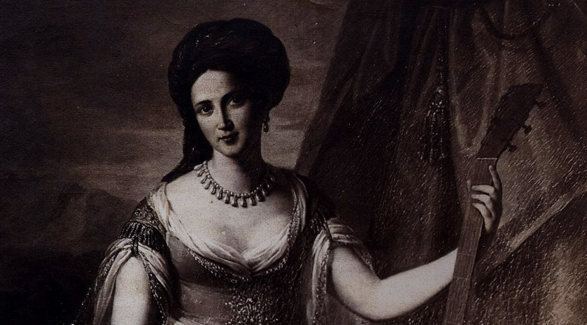
“Mercedes dressed to sing Bellini’s Norma” http://www.alinagarcialapuerta.com/who-was-la-belle-creole/
Notes:
Condesa de merlin: bn in havana, 1789, raised by grandmother, back to spain w/ parents 1808, napoleon, war, etc. goes to paris, then back in havana in 1830s, where she writes a memoir of her childhood and an account of her travels. What kind of source is this?

Slide 11
Aponte’s book
Notes:
72 images, spoken testimony about them, book is missing:
Powerful black men: king, ministers, ambassadors, priests
Black virgin, armies, etc
Popes: clement XI with black librarians and cardinal
Pious 4 and three black priests
Historical images, recent history and allegories, one that seems to celebrate commerce in 1807, but the ship was the san lorenzo, which he did not talk about, but which carried french prisoners to cuba during haitian revolution, another trip carried the remains of columbus but also black revolutionaries—decorated black heroes to havana

