Slide 1
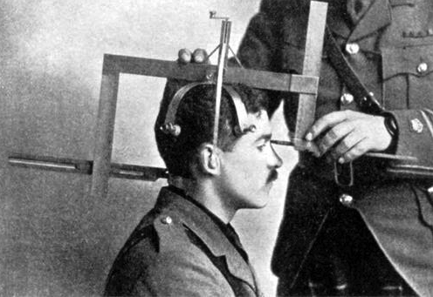
Notes:
Alfred Binet, (1857-1911): independently wealthy non-practicing lawyer with interest in psychology
Stanch supporter of craniometry: a method of assessing intelligence from the volume of the cranium
After 5 years of research was forced to admit “The idea of measuring intelligence by measuring heads seems ridiculous.”
1905-1911: co-developed an measure with Simon that would help identify children 5-15 who had learning challenges which proved useful for helping these students
Stressed their test was not a general measure of innate intelligence, or for ranking pupils

Slide 2
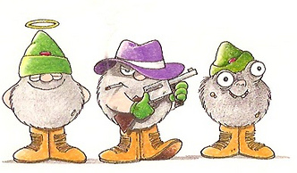
Your Assessment Experiences – The Good, The Bad, and The Ugly

Slide 3
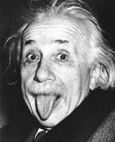
“Not everything that can be counted counts and not everything that counts can be counted.”
Albert Einstein

Slide 4
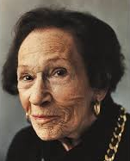
“Remember –
you are teaching students,
not the curriculum.”
Maxine Greene

Slide 5
Classroom assessment supports learning BIG IDEA #1
“Classroom assessment is the collection, evaluation, and use of information to help teachers and students make decisions that improve learning.”
Classroom assessment ≠ Testing
Classroom assessment = Supporting learning
(Adapted from McMillan et al., 2011)

Slide 6
Assessment is about the whole path BIG IDEA #2

Slide 7
Assessment is about the whole path BIG IDEA #2
Where is the learner right now?
Where is the learner going?
How is the learner going to get there?

Slide 8
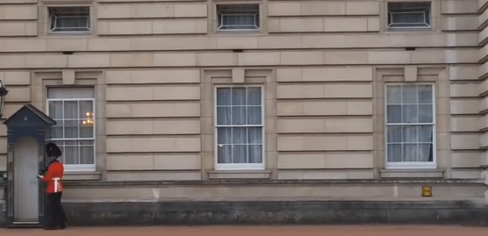
(aka – it’s a camcorder, not a camera) BIG IDEA #2
Notes:
CA’s measurement zone is not just at the beginning and the end (like a camera that makes a couple of snapshots).
It’s not about testing – it’s not just product-oriented

Slide 9
(aka – it’s a camcorder, not a camera) BIG IDEA #2
Notes:
Good classroom assessment functions like a camcorder through the teaching/learning process
Ongoing assessment helps with the process and the product rather than just taking a snapshot at the end of learning.

Slide 10
Assessment is integrated with teaching BIG IDEA #3
Learning outcomes
Assessment before teaching
Determine acceptable evidence of learning
Lesson plan
Teaching
←during→
Assessment
Assessment after teaching
(Adapted from McMillan et al., 2011)

Slide 11
Put assessment in students’ hands BIG IDEA #4
 | Where the learner is going | Where the learner is right now | How to get there
Teacher | Clarifying and sharing learning outcomes, expectations, criteria for success | Engineering effective classroom discussions, activities, tasks, that elicit evidence of learning OBSERVATION, QUESTIONING | Providing feedback that moves learning forward FEEDBACK
Peer | Understanding and sharing learning outcomes, expectations, criteria for success | Activating learners as instructional resources for one another PEER ASSESSMENT
Learner | Understanding learning outcomes, expectations, criteria for success | Activating learners as the owners of their own learning SELF ASSESSMENT

Slide 12
Make high quality inferences about student learning BIG IDEA #5
Reliability: How sure am I?
Validity: How well am I measuring it?
Fairness: Does everyone have an
equitable chance?
(Earl & Katz, 2006)
Notes:
A test in and of itself is not reliable, valid, fair….

Slide 13
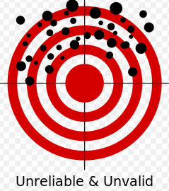
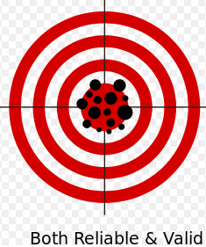
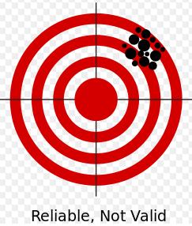
Reliability and validity BIG IDEA #5

Slide 14
Fairness BIG IDEA #5
A fair assessment:
1) is transparent, equitable
2) gives students opportunities to learn
3) gives them opportunities to demonstrate learning
4) leads to positive consequences and environments
(Tierney, 2013)

Slide 15
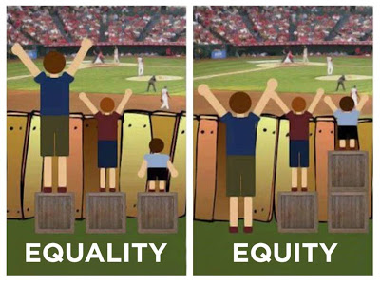
Fairness and being equitable BIG IDEA #5

Slide 16
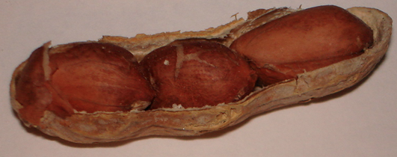
In a nutshell…
Reliability = consistency
Validity = meaning
Fairness = comparability
(Messick, 2000)

