Slide 1
Telling Stories Together
Decoding Social Media
January 28 2014

Slide 2
Today’s class
In the news
From crowdsourcing to crowdfunding
Break
Presentations
Social media profile feedback

Slide 3
In the news
Caroline Criado-Perez campaigned for a female figure to appear on a Bank of England note
Notes:
Two jailed for Twitter abuse of feminist campaigner
http://www.theguardian.com/uk-news/2014/jan/24/two-jailed-twitter-abuse-feminist-campaigner

Slide 4
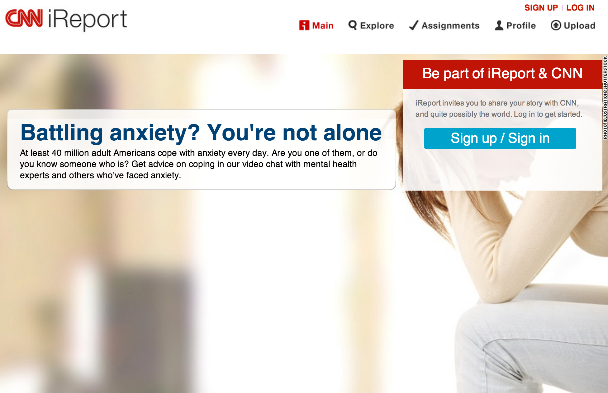

Slide 5
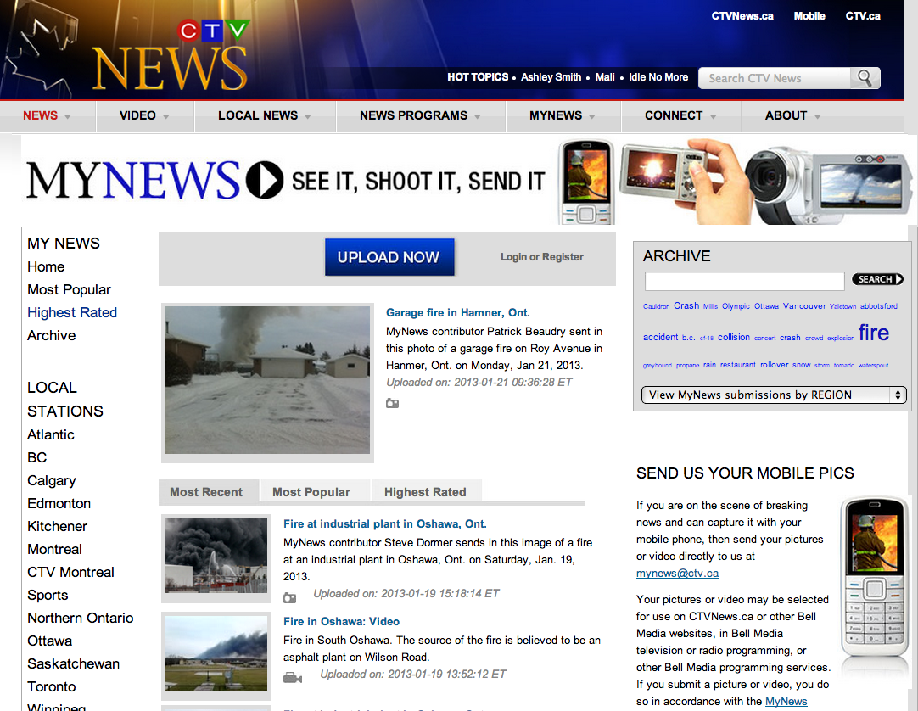
CTV MyNews

Slide 6
BART

Slide 7
Notes:
http://www.ninesights.com/community/kraft

Slide 8
Types of communities
Crowd of people
Group of experts
Community of kindred spirits

Slide 9
Notes:
BBC NHSWINTER
https://www.facebook.com/NHSWinter
http://www.bbc.co.uk/news/health-24947467

Slide 10
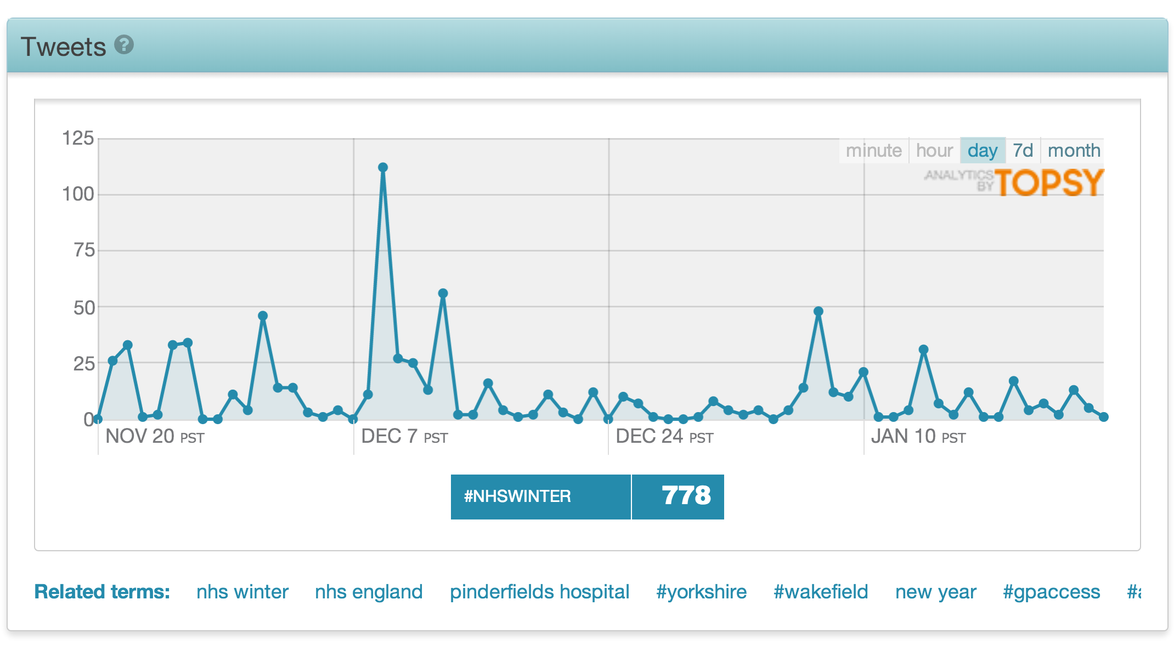

Slide 11
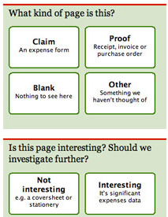
Crowdsourcing: MPs’ expenses
The challenge
700,000 documents in 5,500 PDF files
Four years of expenses by 646 MPs
Topic issue making headlines

Slide 12
Crowdsourcing: MPs’ expenses
Response
Rapidly created online system
Comment on expenses
Highlight ones of interest
Rate how interesting
Notes:
http://www.guardian.co.uk/politics/2009/dec/16/mps-expenses-what-we-learned

Slide 13
Crowdsourcing: MPs’ expenses
Results
70,000 docs reviewed in first 80 hours
£105 claim for chimney sweep
£43.56 for 3 garlic peeling sets from QVC
£2.95 on a lamb dinner and cup of Horlicks
“Excessive” £1,035 claim for leather recliner

Slide 14
Guiding principles
Tap into people’s passions
Timing matters
Be open
Acknowledge the community
Reward active contributors
Plan for the end

Slide 15
Aggregation vs curation
Aggregation
Bundle information together without meaning
Curation
Find, evaluate, organise, contextualize, create order
http://www.flickr.com/photos/emsl/

Slide 16
Curation: Best practice
Find
Evaluate
Organise
Contextualise
Share
http://www.flickr.com/photos/emsl/

Slide 17
Curation: CBC Community
Notes:
http://www.cbc.ca/newsblogs/yourcommunity/2014/01/brands-chimed-in-whengmailwasdown.html

Slide 18
Curation: Best practices
Timeliness
Tone
Community and participation
Filter
Convenience

Slide 19
Crowdfunding
Funding a project or venture by raising many small amounts of money from a large number of people, typically online
Notes:
In journalism:
http://www.indiegogo.com/projects/support-my-pakistan-and-afghanistan-reporting-project
http://www.indiegogo.com/projects/hamilton-s-24-7-live-local-journalist

Slide 20
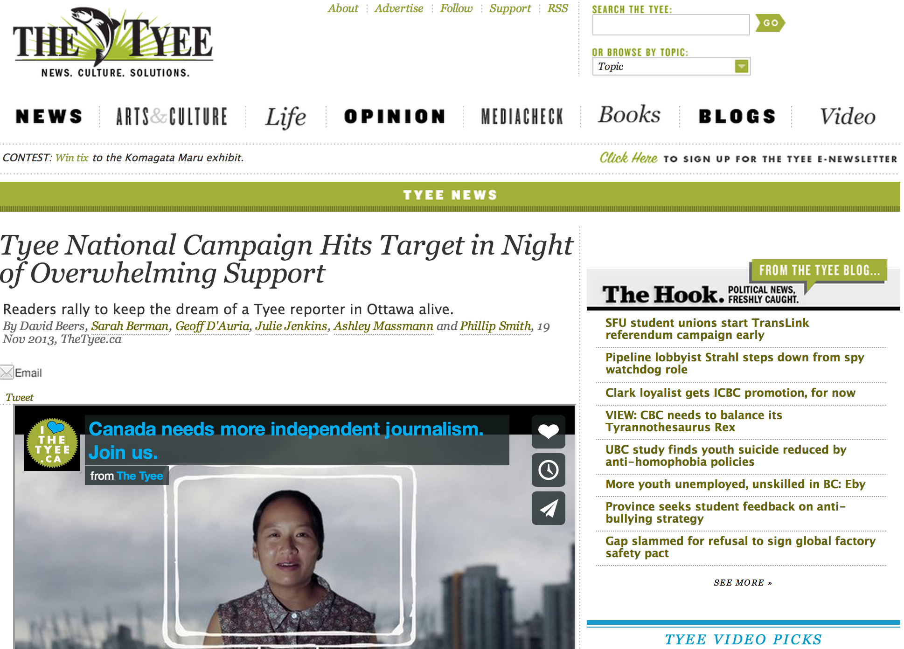
Notes:
http://thetyee.ca/Tyeenews/2013/11/19/Tyee-National-Day-After/

Slide 21
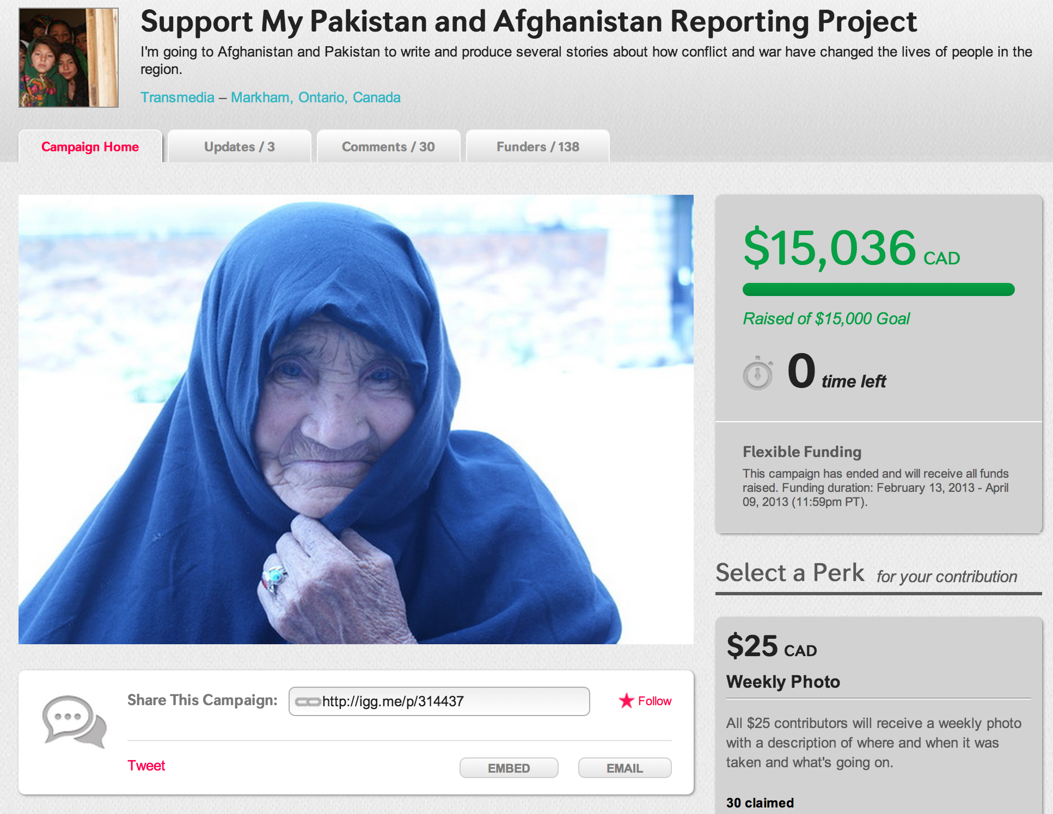
Notes:
http://www.indiegogo.com/projects/support-my-pakistan-and-afghanistan-reporting-project

Slide 22
Crowdfunding: Best practices
Make a specific ask
Killer video
Levels of contribution
Effective rewards offerings
Hustle

Slide 23
Collaborative content
How could you apply one or more
Crowdsourcing
Curation
Crowdfunding
toyour client?

Slide 24
Break: 15 minutes

