Slide 1
Social Media strategies. Metrics. Class 5, Decoding Social Media
News
SM strategies
Metrics
Break
Student presentations and discussion
Next steps

Slide 2
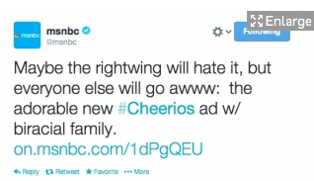
The perils of social media as a career
Notes:
http://www.adweek.com/news/television/msnbc-twitter-manager-fired-saying-rightwing-will-hate-interracial-cheerios-ad-155367

Slide 3
Content is king – inspiring bloggers
http://www.jonloomer.com/ FB focus
http://www.razorsocial.com/blog/ analytics
http://socialmouths.com/blog/ applied
http://www.postplanner.com/blog/ tactical
http://dustn.tv/ story-telling
http://dannybrown.me/blog/ content
http://kimgarst.com/blog/ tactical
http://jennstrends.com/ tools
http://topdogsocialmedia.com/blog/ news
http://simplymeasured.com/blog/ metrics
Notes:
http://www.socialmediaexaminer.com/top-10-social-media-blogs-2014-winners/

Slide 4
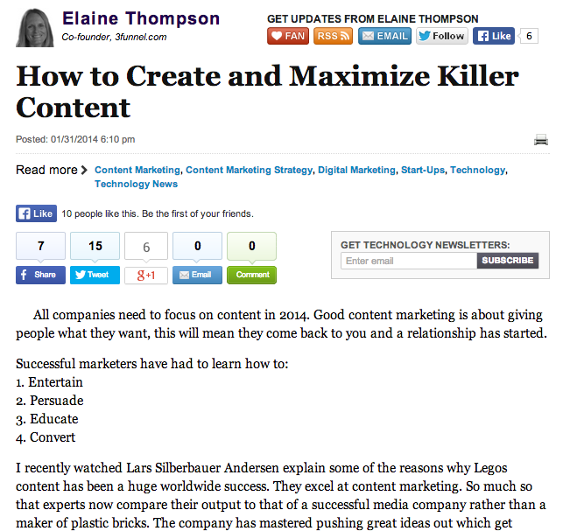
“..to produce great content and get people involved you have to make a connection and be attentive and observant (as he put it, think like you are first date!)”
Notes:
http://www.huffingtonpost.com/elaine-thompson/how-to-create-and-maximis_b_4652414.html

Slide 5
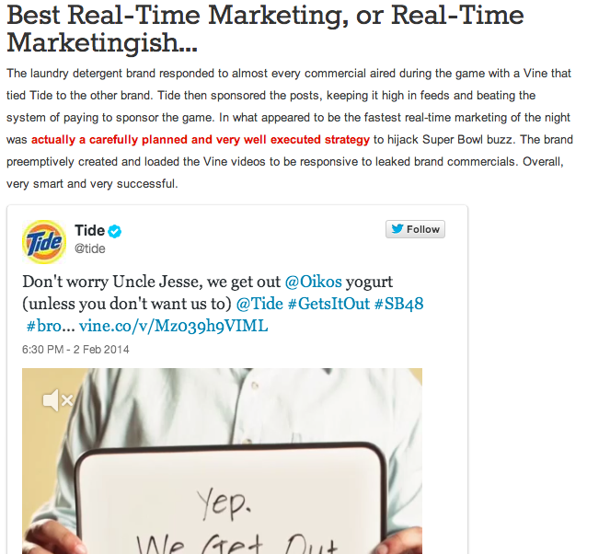
Superbowl social media review
What worked, what didn’t? From advertisers and non advertisers!
Tide in focus:
Vine & Twitter combo
Notes:
http://firstwefeast.com/eat/social-media-highs-lows-super-bowl-xlviii/
http://www.adweek.com/news/technology/tide-will-try-hijack-butterfingers-super-bowl-spot-vines-155435

Slide 6
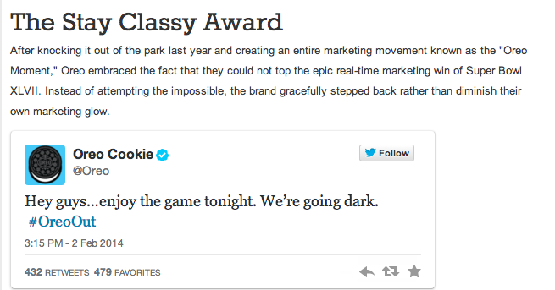
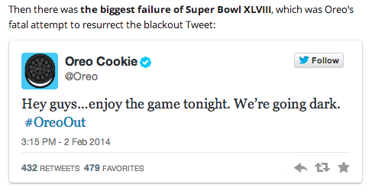
Not all commentators agree on what worked
Ignitesocialmedia.com
Firstwefeast.com

Slide 7
Context for strategies in SM
In c3 we covered POST
Audience (people)
Objectives
To-day: social media strategies

Slide 8
Social Media Strategies 1
Monitoring
Responding
Conversing
Amplifying
Building and sharing
Stimulating user generated content (UGC)
Helping the community to support itself

Slide 9
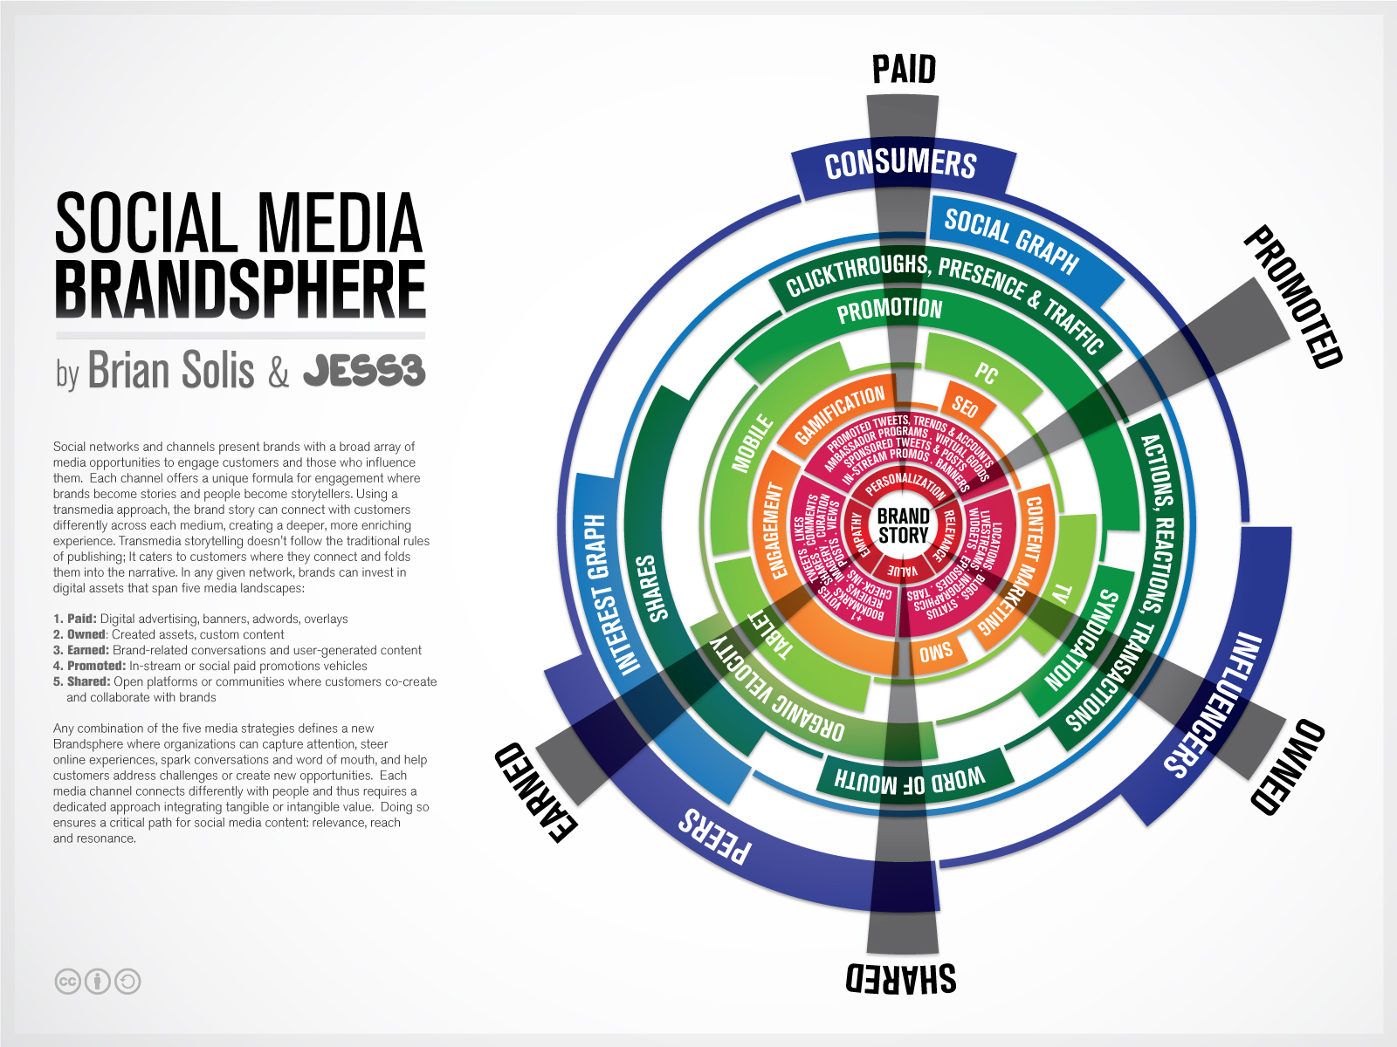
Leveraging and combining “paid, owned & earned.”
Notes:
What do we mean by responding, engaging, amplifying and

Slide 10
Monitoring
Approaches to monitoring
Reasons to monitor
Possible outcomes
Good and bad practice
Triage methodology
Manual vs. semi-automated

Slide 11
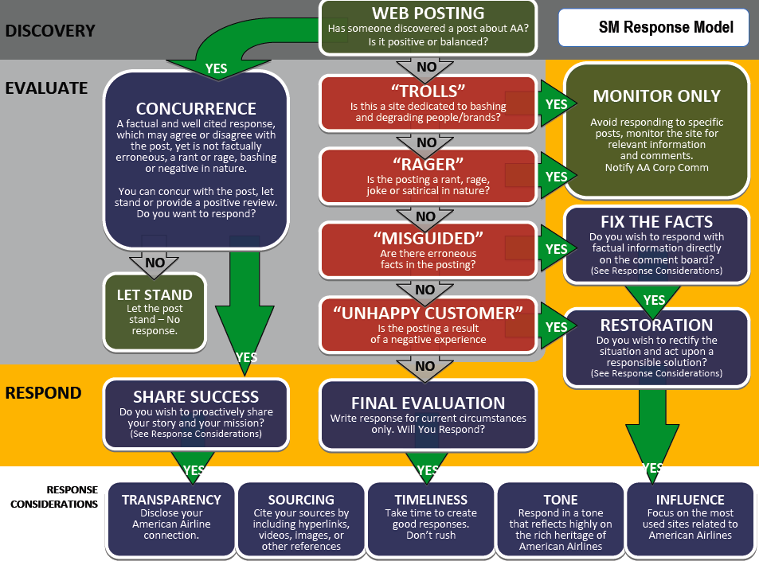

Slide 12
Social media “triage”
Take reasonable action to fix issue and let customer know action taken
Positive
Negative
Yes
Yes
No
Do you want to respond?
Assess the message
Evaluate the purpose
Does customer need/deserve more info?
No Response
Yes
Unhappy Customer?
Yes
Are the facts correct?
No
Gently correct the facts
No
Yes
Can you add value?
No
Dedicated Complainer?
Yes
Are the facts correct?
No
No
Yes
Respond in kind & share
Thank the person
Comedian Want-to-Be?
Is the problem being fixed?
Yes
Explain what is being done to correct the issue.
No
This framework was built using the USAF Blog Triage. (Added this attribution post webinar)
From Slideshare public view, Altimeter Group.
Yes
Let post stand and monitor.
Notes:
http://www.slideshare.net/jeremiah_owyang/social-strategy-gettingcompanyreadyapr14final

Slide 13
Responding
Types of response to audience comments
Reasons to respond
Possible outcomes
Good and bad practice
Tip: refer back to the “triage” monitoring chart which is the step before responding

Slide 14
Conversing
Types of conversation – (multiple exchanges)
Reasons to converse
Possible outcomes
Good and bad practice

Slide 15
Amplifying
What do we mean by “amplifying” a user message?
Why do it?
When?
How?
Good and bad practice.

Slide 16
Building and Sharing
How is “building and sharing” different from “amplifying?”
Significance?
Good examples.

Slide 17
Stimulating User Generated Content
When might you want to do this?
Why?
How?
Pitfalls?
Good examples.

Slide 18
Engaging audiences in social conversations
What are the similarities and differences in approaches from journalism and business in facilitating community content conversations – and what can they learn from each other?
Mixed student teams. 10 mins to work on this and then 10 mins of facilitated discussion.

Slide 19
Social Media Strategies 2 – a further dimension to aid planning
RaDaR
Reach
Depth
Relationship
Within your target audiences think about their loyalty or “stage in the journey” with you. This will influence the specific SM strategies that you choose to use.

Slide 20
Integrate Social into your Marketing RaDaR, Aug 7th 2013, Forrester
Notes:
http://www.forrester.com/Integrate+Social+Into+Your+Marketing+RaDaR/fulltext/-/E-RES73881?objectid=RES73881

Slide 21
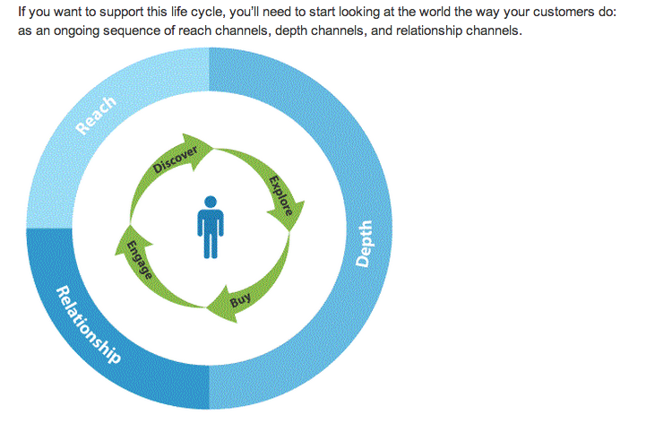
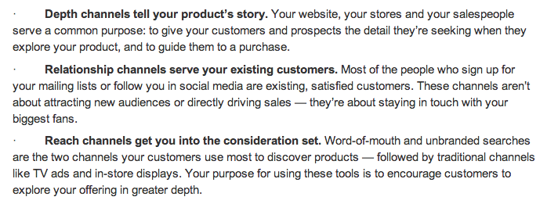
Forrester
(link in
Speaker notes)
Notes:
http://www.forrester.com/Integrate+Social+Into+Your+Marketing+RaDaR/fulltext/-/E-RES73881?objectid=RES73881

Slide 22
Notes:
http://www.forrester.com/Integrate+Social+Into+Your+Marketing+RaDaR/fulltext/-/E-RES73881?objectid=RES73881

Slide 23
 | Reach | Depth | Relationship
Monitoring
Responding
Conversing
Amplifying
Building & Sharing
Exercise: although these concepts are presented from a commercial
perspective they have high relevance to the media and non-profit SM
situation.
What are the implications for planning for your client?
Where will you focus and why?

Slide 24
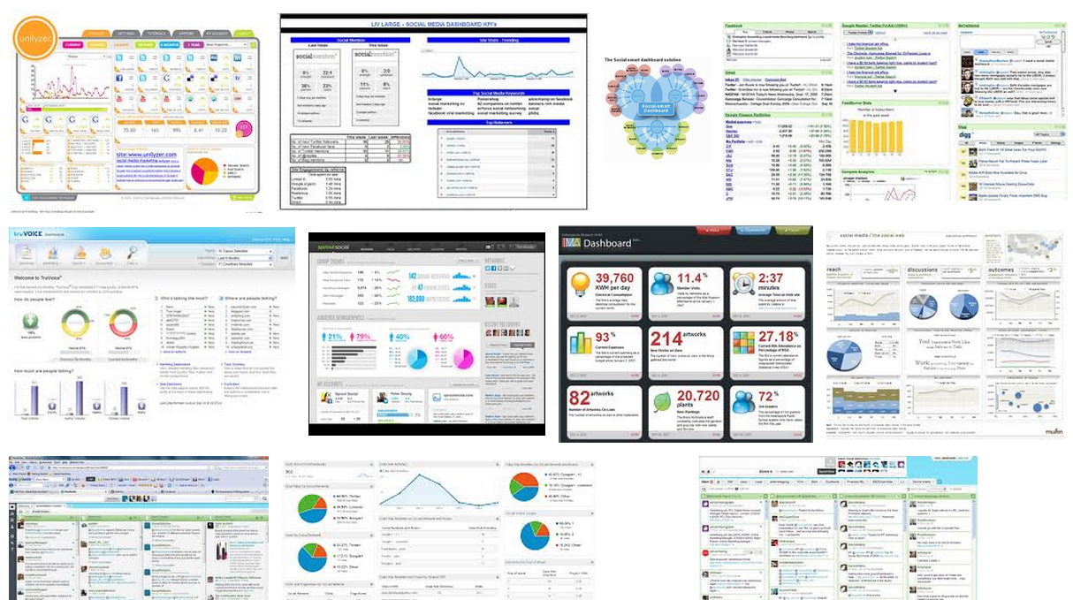
Are these dashboards useful?
Notes:
What do you want in a dashboard?

Slide 25
Metrics & Performance Dashboards
What to measure?
Easy versus useful.
How to measure it?
Direct and combination. Ratios & comparisons.
How to report it to different stakeholders?
Different people want different information. Who wants what and why?
ROI vs. ROO.
Return on investment ($) vs. Return on Objective.

Slide 26
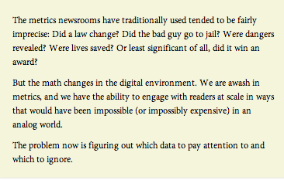
Notes:
http://www.niemanlab.org/2012/08/metrics-metrics-everywhere-how-do-we-measure-the-impact-of-journalism/

Slide 27
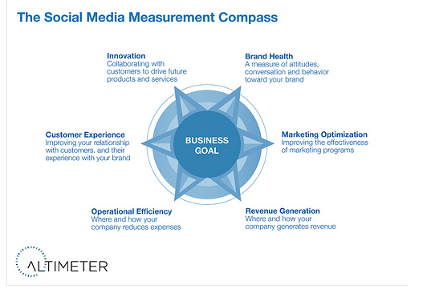
Substitute “customer
for “audience”
Which are most applicable
to your client?
Notes:
http://www.web-strategist.com/blog/2011/08/12/open-research-a-framework-to-social-analytics/

Slide 28
Notes:
http://www.web-strategist.com/blog/2010/12/13/framework-the-social-media-roi-pyramid/

Slide 29
Metrics and Performance Dashboards
What will you measure and why?
What will you choose not to measure?
How will you use what you measure for reporting to different stakeholder groups?
Exercise in project teams: 10 mins to work on this and then 10 mins of facilitated discussion.

Slide 30
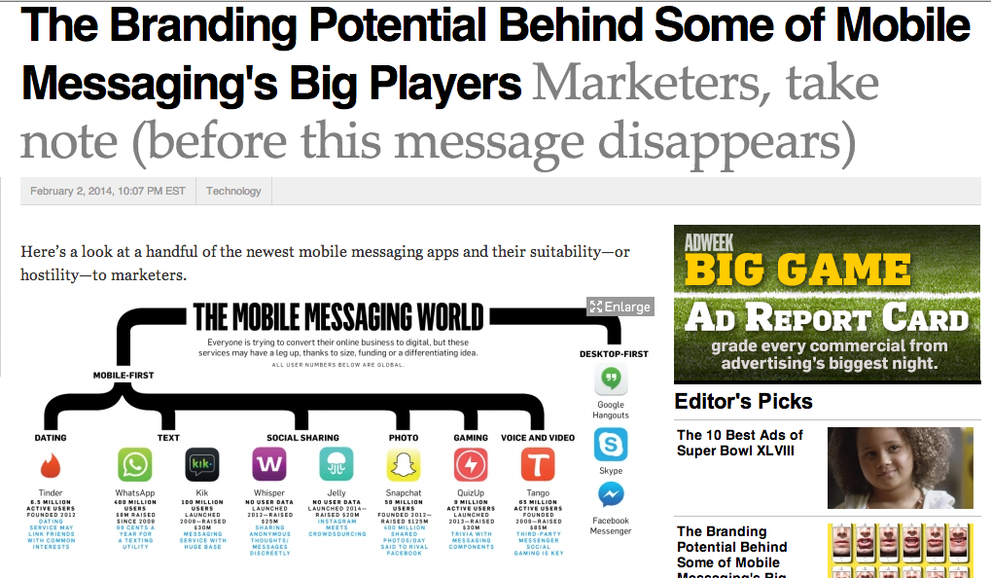
SM platform assessment- a continually growing list – get used to needing to review
Notes:
http://www.adweek.com/news/technology/branding-potential-behind-some-mobile-messaging-s-big-players-155421?page=2

Slide 31
Presentations on social tools
Exercise based on initial 4 student presentations -
Which audiences, objectives and strategies would these platforms work well for? And which would they work less well for? Why?

Slide 32
Next steps
Client project proposals and feedback
Class 6 (Feb 11th)
Week 7 – no class – reading week
Week 8: applied class on client projects

