Slide 1
Decoding Social Media class 3

Slide 2
Agenda
News and discussion
Principles
Three mini exercises
BREAK
Guest speaker
Next steps
Client projects
Platform presentations
Social Media Professional Profile
Hootsuite Pro and HSU
Class 4 prep

Slide 3
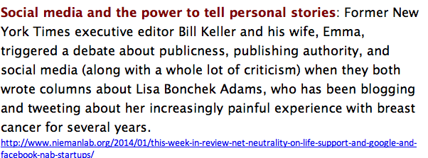
Notes:
http://www.niemanlab.org/2014/01/this-week-in-review-net-neutrality-on-life-support-and-google-and-facebook-nab-startups/

Slide 4
Annual discussion topic
Maximizing buzz – advertisers and the Superbowl
Pre-release ads
OR
Use surprise to maximize impact?
http://nyti.ms/VOCO6Q
Notes:
This was a 2013 story, but it’s perennial in relevance

Slide 5
Shiny Objects: beware!
I want an iPhone app, Instagram promo…..
Notes:
One of the challenges with social media is “bright shiny object syndrome!” Companies say, “build be an iPhone app” without thinking about why someone would download it, how it provides utility that does not already exist, etc.
SONOMA IPHONE APP: http://travel2dot0.com/2010/02/case-study-sonoma-county-iphone-app/

Slide 6
What did you make of to-day’s readings? How do they help you plan a SM strategy?

Slide 7
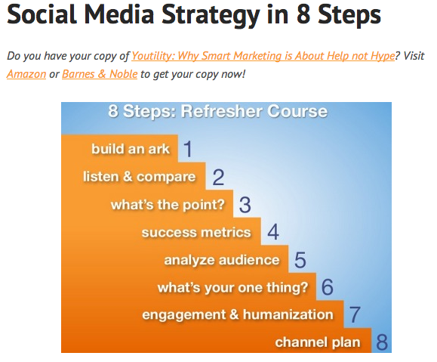
Notes:
http://www.convinceandconvert.com/social-media-strategy/social-media-strategy-in-8-steps/

Slide 8
Designing a Social Media Strategy
People – Audience – who to target?
Objectives – what are we trying to achieve?
Strategies –how? The macro level approach. (more C5)
Ex 1: Monitor, talk, energize, support
Ex 2: Reach, Depth, Relationship
Tactics: technologies and tools (the micro level activation of the strategies.)
Refer to Forrester’s POST framework in “Groundswell” and RaDaR model – blog link in speaker notes.
Ch 20 in “Engage” summarizes technographics
Notes:
Audience: who (and why)
Objectives: what
Strategies: how
Tools: implementation of strategies
http://empowered.forrester.com/groundswell/contents.html
http://blogs.forrester.com/nate_elliott/13-01-24-introducing_the_marketing_radar
http://books.google.ca/books/about/Engage.html?id=AUczMkQo5F4C

Slide 9
Topic 1: Audience (editorial not selling stuff)
Who are we targeting and why?
Primary and secondary audiences?
Audience focus: big or small?
How to define and profile?
What matters, when and why?
Challenges and approaches for each?
Similarities and differences
In project teams
10 mins to discuss
10 mins plenary debrief
Notes:
Debrief here to ensure we pull out:
-inter-connection with objectives
-primary and secondary audiences

Slide 10
The messy reality of setting objectives in social media
NYT and Twitter
NPR and FB
Notes:
1) 2006 example of crowdsourcing information: http://crowdsourcing.typepad.com/cs/2006/11/the_new_investi.html
2) 2010 CBC News co-creation of coverage of G20 summit in Toronto: http://www.cbc.ca/canada/g20streetlevel/
3) 2012 NPR project on why some local stories are more social than others: http://digitalservices.npr.org/post/9-types-local-stories-cause-engagement
4) 2011 The Federal Emergency Management Agency uses Facebook to coordinate disaster response and communicate with citizens: http://ourpublicservice.org/OPS/publications/viewcontentdetails.php?id=218

Slide 11
Topic 2: Objectives
Broadcast or traditional publishing and advertising (interrupt, one-way, top down) versus engagement and loss of hierarchy via social media.
How do objectives change with social media?
What are the implications for strategies?
Client groups
10 mins to discuss
10 mins plenary debrief
Notes:
get clarity on objectives:
Is this about reputation, a call to action, an attempt at engagement…….how do the objectives of this initiative fit into the overall organizational objectives, and, indeed its mission – its reason to exist?

Slide 12
BREAK

Slide 13
Next steps
Projects and clients
Discovery meeting planning
Goals, challenges, mechanics
Format
Hootsuite Pro
SM profile
SM platform presentations
Class 4 readings and prep

