Slide 1
Native Ads – confusing content?
Consider the different perspectives
Audience
Media organizations
Companies (advertising brands)
What are the issues?
Why is this a dynamic, rapidly changing area?
What do you think should happen? Will happen?
What are the implications for you professionally?

Slide 3
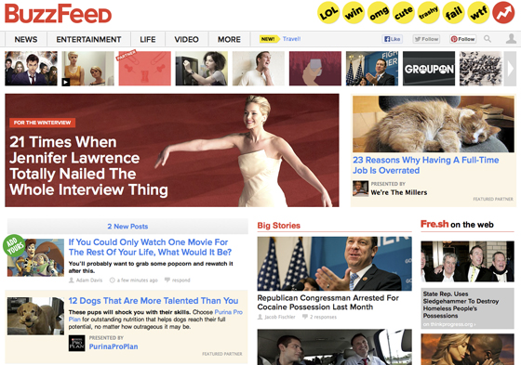
Notes:
An example of native advertising from http://www.brandchannel.com/home/post/2013/11/19/FTC-Native-Advertising-111913.aspx
Click once to reveal the highlighting around the examples of native advertising

Slide 4
This type of promotion:
is easy to differentiate from news and other editorial content. What’s the problem?
is designed to mislead consumers. Buyer beware.
is ethical in certain situations, such as...
should be regulated, and banning it would be better.
is necessary to reach audiences today.
Notes:
Previous slides plus this one provide a quick background of the topic based on the class prep (infographic and video) and the article below. Then click once to reveal the iClicker question.
http://www.huffingtonpost.co.uk/ben-hooper/native-advertisng-opposites-attract_b_4156860.html
“It used to be so simple. Media owners focused on creating interesting, engaging editorial and advertisers provided eye-catching creative. Everyone knew their place. Years of (relative) tranquility and mutual understanding followed. Bored with the status quo, brands then started to try their luck with the unfortunate creation of advertorials and sponsored features; ghastly attempts at matching brand messaging with editorial credibility. We seemed destined to be stuck in a marketing cul-de-sac; how could a brand ever become an accepted content provider?
Fast-forward to the present day and our media landscape looks like a shattered kaleidoscope - ridiculously fragmented, all over the place. The democratisation of media; handing power back to people so they can read and watch what they want, when they want (not to mention be publishers and broadcasters themselves) has fundamentally changed the way media owners and brands operate together. Interruptive advertising can weaken not just the brand but also the environment in which it is placed - people just won't engage - so now, more than ever, brands and media need to work together.
AOL's definition of native advertising refers to it as: sponsored content, which is relevant to the consumer experience, which is not interruptive, and which looks and feels similar to its editorial environment. I think we have to be careful referring to this as just 'advertising'. The challenge, and the opportunity, lies in shifting our mindset away from advertising towards editorial and broadcasting, focusing on defining exactly what the brand or product story is and then whether it's worth creating content around.
This self-awareness is essential if we're to avoid ludicrous scenarios where dishwasher tablet brands are releasing daily news bulletins. There is definite opportunity for certain brands to step up and acknowledge that they can add value beyond their product(s) but this does not apply to everyone. If you have a story to tell or have something interesting to say that entertains, is useful, or both, then great, work out how best to communicate that. We must always remember though that if we don't apply rigour here, we risk annoying people or being ridiculed (Andrex, take a bow).
There is no blueprint for this, not a realistic one anyway. Red Bull is the king of content marketing but they create content to grow their media business, the Red Bull Media House, so selling cans of energy drink isn't a direct objective. They also have an ever increasing raft of stories to tell from within their vast music, event and sport properties. For everyone else, finding that balance between brand messaging and editorial value is always going to be tricky. What's clear is that the increase in content specific agencies, the addition of editorial skills to creative agencies and in-house teams growing their production offering, shows that the search for this balance is forming an essential part of how we approach marketing moving forward.
Native advertising presents one of the most conflicting, disruptive shifts the marketing and media industries have seen in recent years. It's not just asking them to begrudgingly get along, it's asking them to get into bed and make beautiful babies week in, week out. Time to hone those matchmaking skills...”

Slide 5
Coca Cola’s view: Jan 7-2014 Huffington Post
Notes:
http://www.huffingtonpost.com/brian-honigman/digital-innovators-mcmurry-tmg-content-marketing_b_4548572.html

Slide 6
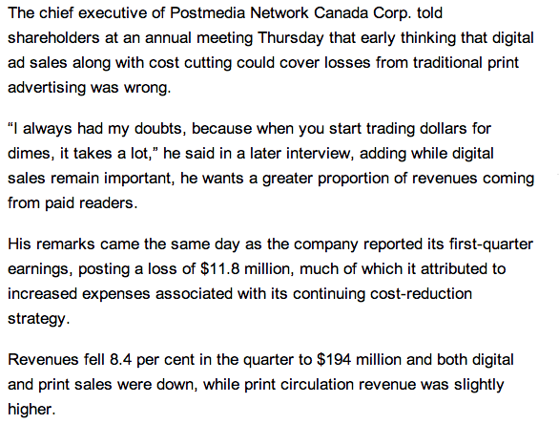
Notes:
http://www.vancouversun.com/business/Subscription+revenue+essential+Postmedia+says/9369660/story.html

Slide 7
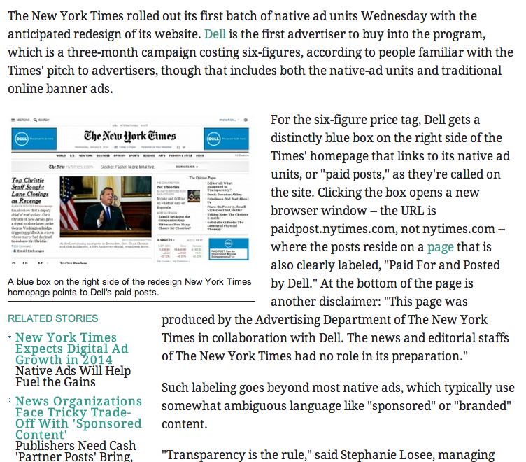
Notes:
http://adage.com/article/media/york-times-debuts-native-ad-units-dell/290973/

Slide 8
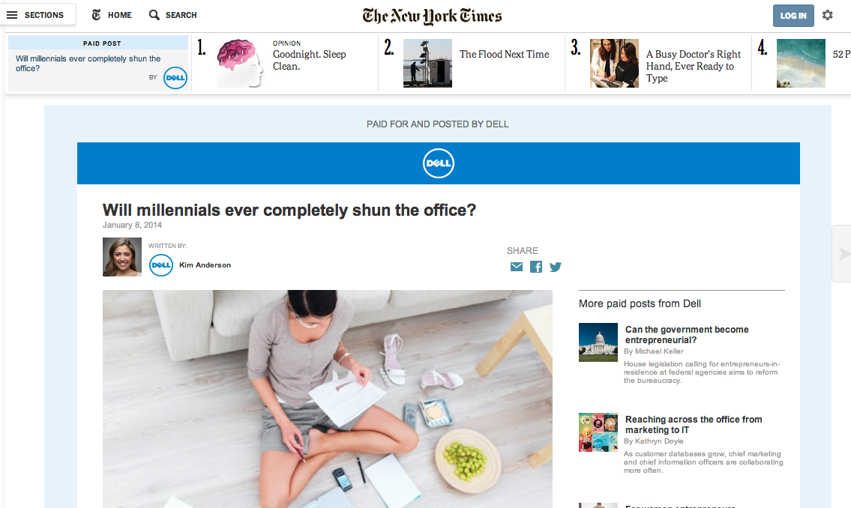
And paid posts – will they be read?
Notes:
http://paidpost.nytimes.com/dell/will-millennials-ever-completely-shun-the-office.html#.UtVoR2RDuLc

Slide 9
Native Ads – confusing content?
Consider the different perspectives
Audience
Media organizations
Companies (advertising brands)
What are the issues?
Why is this a dynamic, rapidly changing area?
What do you think should happen? Will happen?
What are the implications for you professionally?

