Slide 1

Ethics and social media
Decoding Social Media
March 4 2014

Slide 2
Today’s class
In the news
Ethics and social media: Issues and best practice
Verification and social media
Student presentation

Slide 3
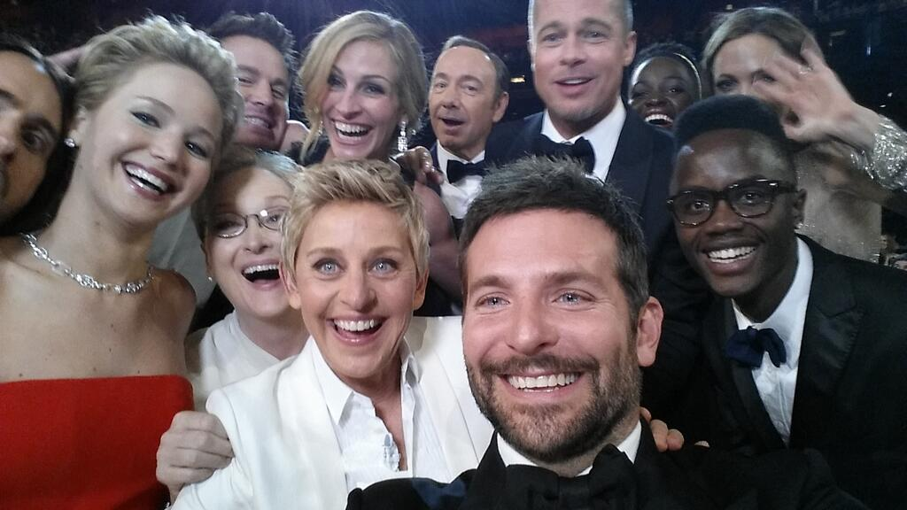
Notes:
https://twitter.com/TheEllenShow/status/440322224407314432

Slide 4
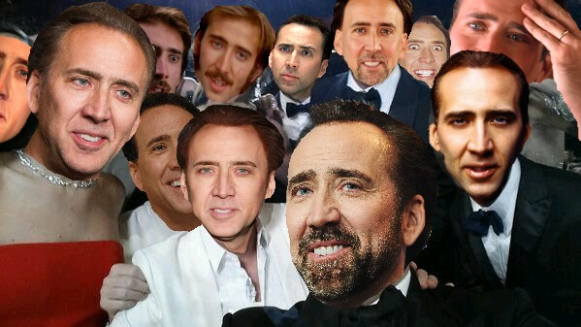
Notes:
http://mashable.com/2014/03/03/ellen-oscar-selfie-parody/

Slide 5
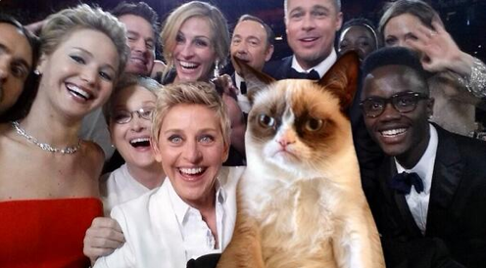
Notes:
https://twitter.com/YahooTV/status/440650747676327936

Slide 6
Ethical guidelines
Society for Professional Journalists
Public Relations Society of America
Seek truth & report it
Minimise harm
Act independently
Be accountable
Advocacy
Honesty
Fairness
Independence
Expertise
Loyalty
Notes:
http://www.poynter.org/latest-news/everyday-ethics/93592/poynter-newsrooms-develop-social-networking-policies-for-journalists-on-facebook-myspace-twitter/

Slide 7
Why ethics matter
Trust is like the air we breathe. When it’s present, nobody really notices. But when it’s absent, everybody notices.
  Warren Buffett

Slide 8
Notes:
http://www.edelman.com/insights/intellectual-property/2014-edelman-trust-barometer/

Slide 9
Who do you trust?
Notes:
http://www.edelman.com/insights/intellectual-property/2014-edelman-trust-barometer/

Slide 10
Trust in 2013
Notes:
http://www.edelman.com/insights/intellectual-property/trust-2013/

Slide 11
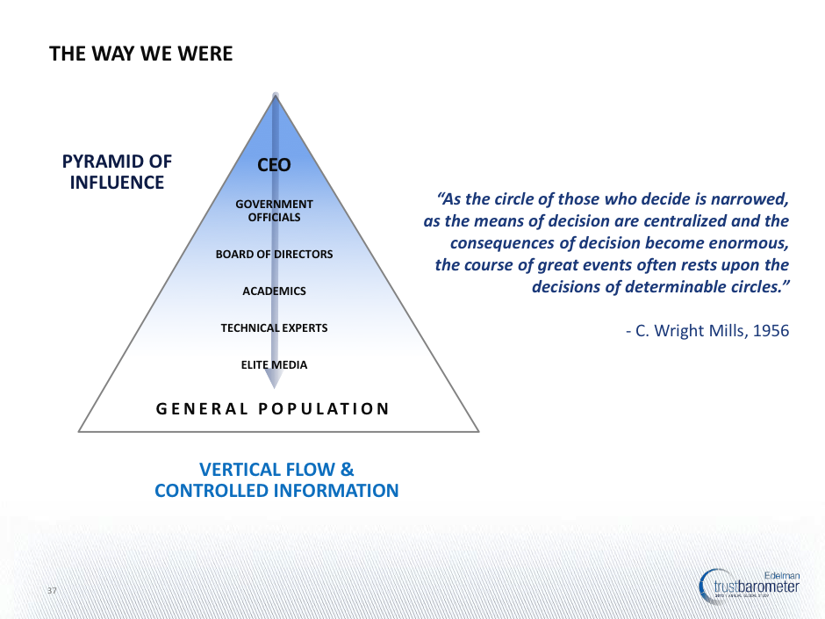
Notes:
http://www.edelman.com/insights/intellectual-property/trust-2013/

Slide 12
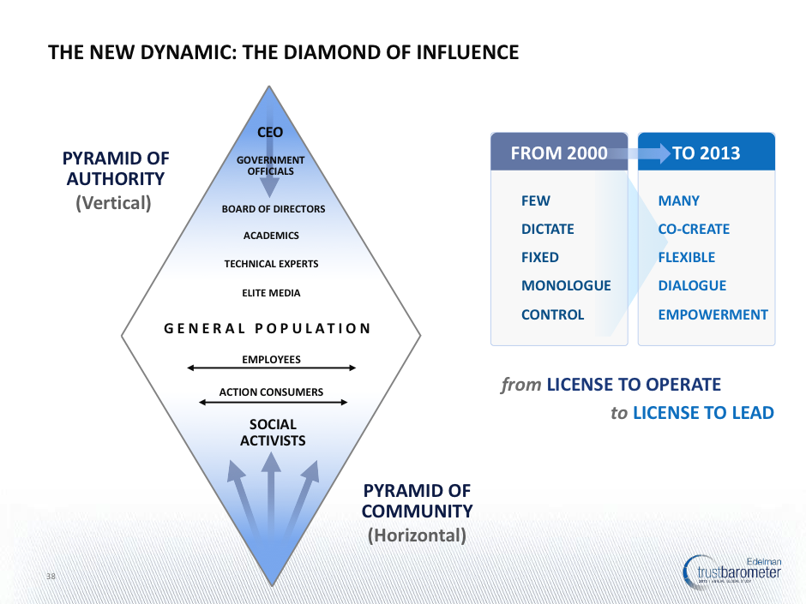
Notes:
http://www.edelman.com/insights/intellectual-property/trust-2013/

Slide 13
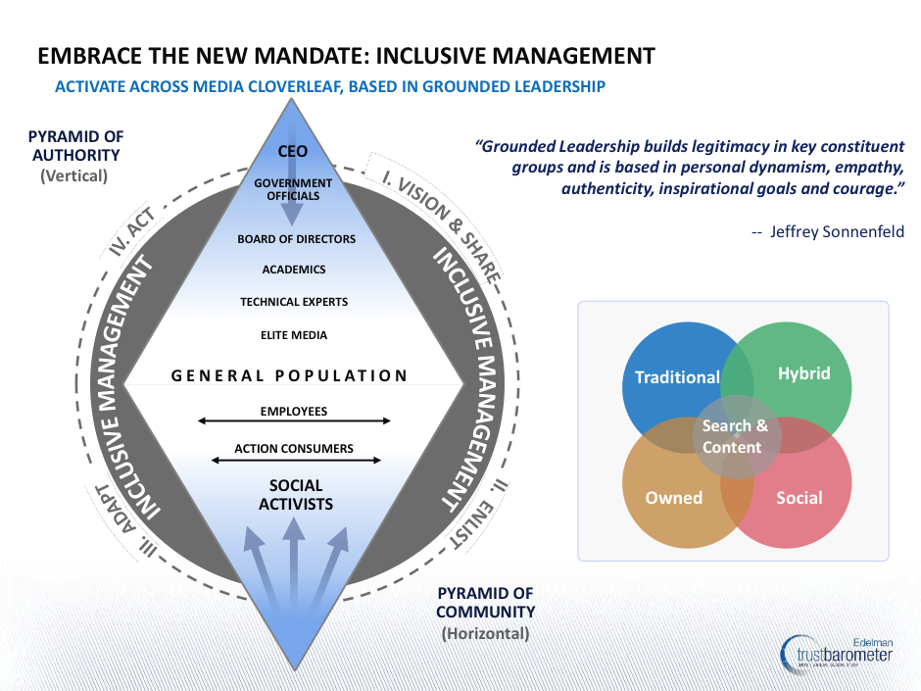
Notes:
http://www.edelman.com/insights/intellectual-property/trust-2013/

Slide 14
Building trust
Notes:
http://www.edelman.com/insights/intellectual-property/2014-edelman-trust-barometer/

Slide 15
Ethical scenario #1
Someone posts to a public Facebook page that is campaigning to keep a local hospital open. You work at a local radio station and read the post out on air. The person complains saying they didn’t agree to their words being shared on a broadcast medium.
What do you do? What are the ethical issues?
Notes:
http://clairewardle.com/2011/09/21/journalism-ethics-in-a-social-media-world/

Slide 16
Dynamics of networked publics
Invisible audiences
Collapsed contexts
Blurring of private/professional
    boyd, (2010) Social Network Sites as Networked Publics: Affordances, Dynamics, and Implications

Slide 17
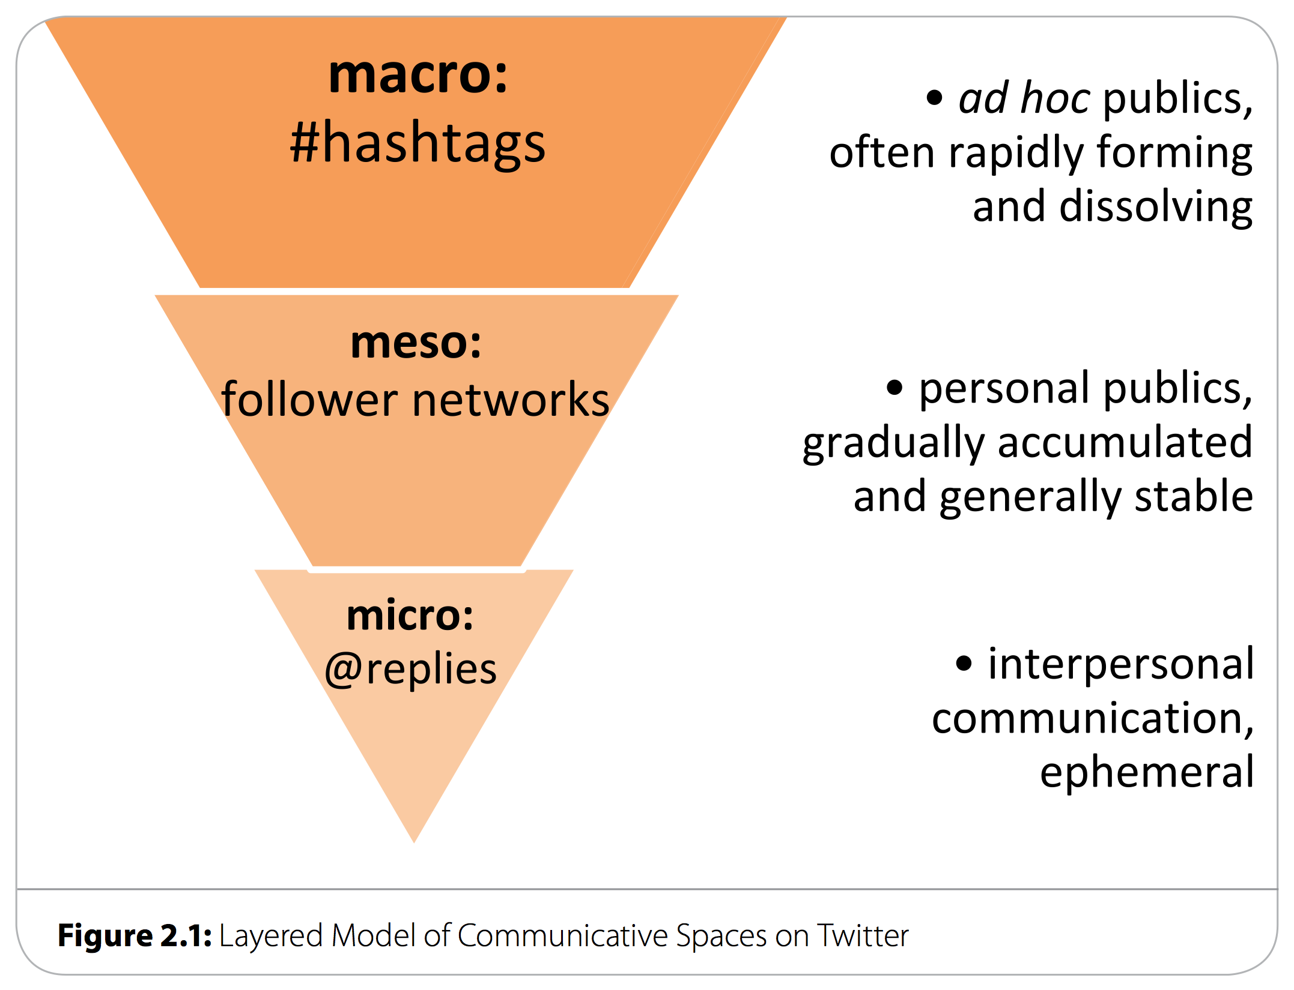
Twitter: Navigating publicness
  Bruns, Axel & Moe, Hallvard (2013) Structural layers of communication on Twitter. In Twitter and Society. Peter Lang.
Notes:
http://eprints.qut.edu.au/66324/

Slide 18
Tweet out loud

Slide 19
Tweet out loud

Slide 20
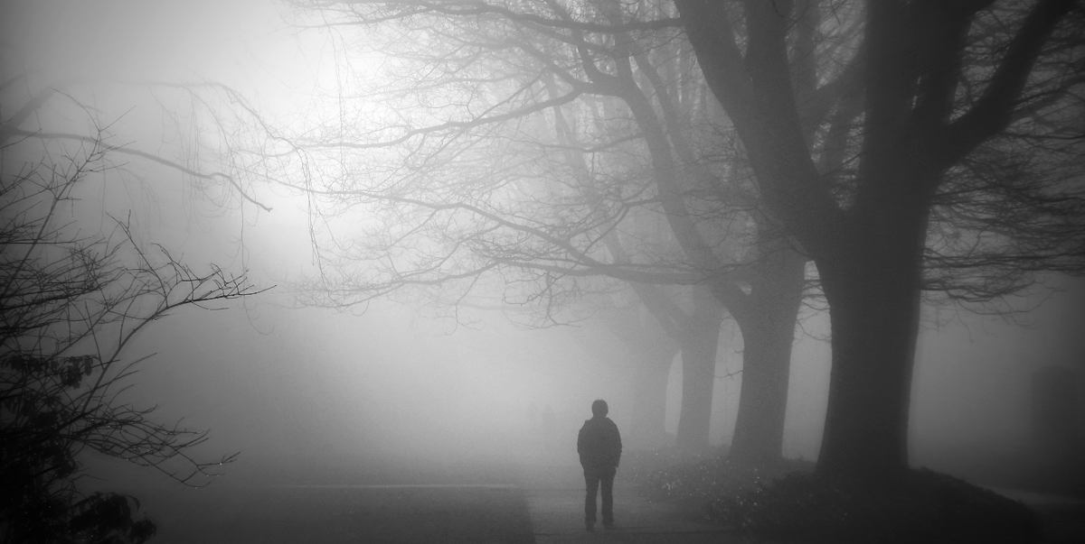
Privacy through obscurity

Slide 21
Best practice: Privacy
What are the sensitivities in using the content?
What was the original intention in publication?
What is the impact of exposing content to a much wider audience?
What are the legal issues of privacy and copyright?

Slide 22
Ethical scenario: #2
As a student, you campaigned as an environmental advocate, with strong views on the tar sands development in Alberta. You regularly posted on Facebook pages about the issue and engage in discussions with others. A year later, you are working for a news organization that has asked you to do an in-depth report on the tar sands, based on your knowledge and interest in the topic.
What do you do? What are the ethical issues?

Slide 23
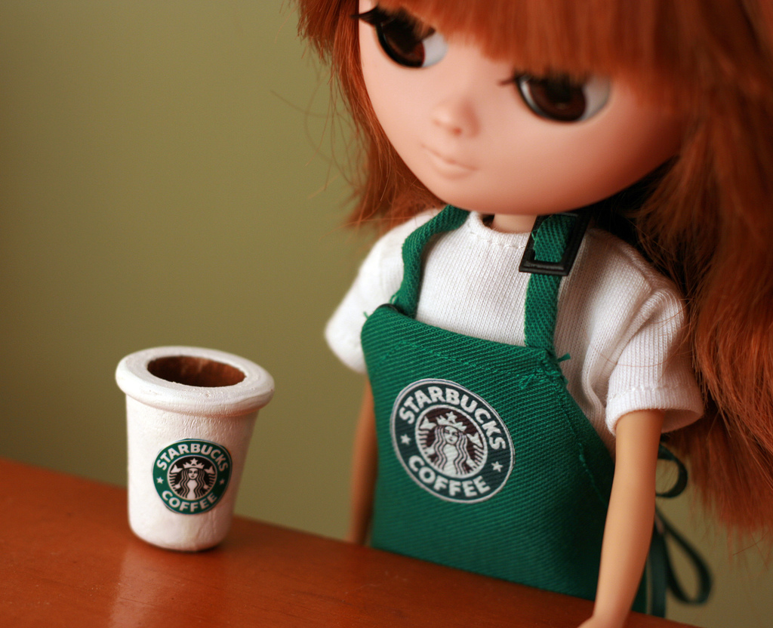
Act independently
Blurring of private/professional
Photo http://www.flickr.com/photos/betsyjean79/

Slide 24
BBC social media guidelines
Consider adding your own comment to the ‘tweet’ you have selected, making it clear why you are forwarding it and where you are speaking in your own voice and where you are quoting someone else’s.

Slide 25
BBC social media guidelines
You may wish to make "friends" on a third party web page. But remember that approving a "friend" may make other users of a site think they are more trustworthy. Check all friends carefully before you approve them. Look at their profiles first.
Notes:
http://www.bbc.co.uk/editorialguidelines/page/guidance-blogs-bbc-full

Slide 26
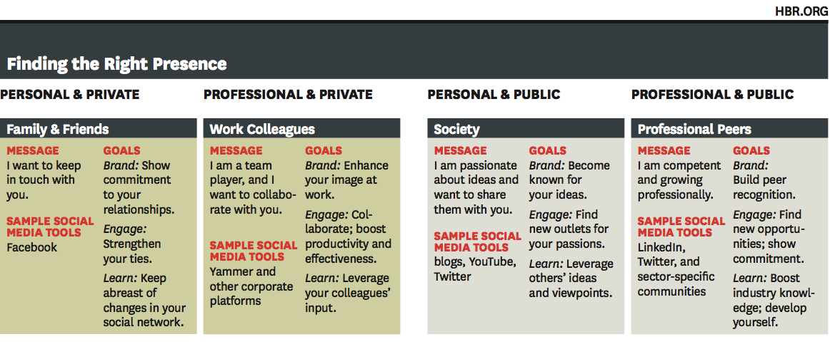
What’s Your Personal Social Media Strategy?
Harvard Business Review, November 2010
Notes:
http://hbr.org/2010/11/managing-yourself-whats-your-personal-social-media-strategy/ar/1

Slide 27
Break

Slide 28
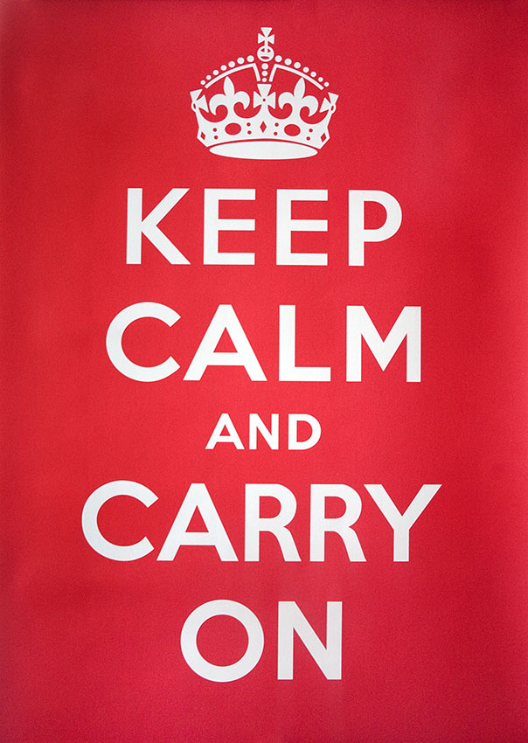
Verifying information on social media
Photo: Robert Croma
http://www.flickr.com/photos/croma/

Slide 29
Systemic verification
Message-based analysis
User-based analysis
Topic-based analysis
Propagation-based analysis

Slide 30
Systemic verification
Message-based analysis
User-based analysis
Topic-based analysis
Propagation-based analysis

Slide 31
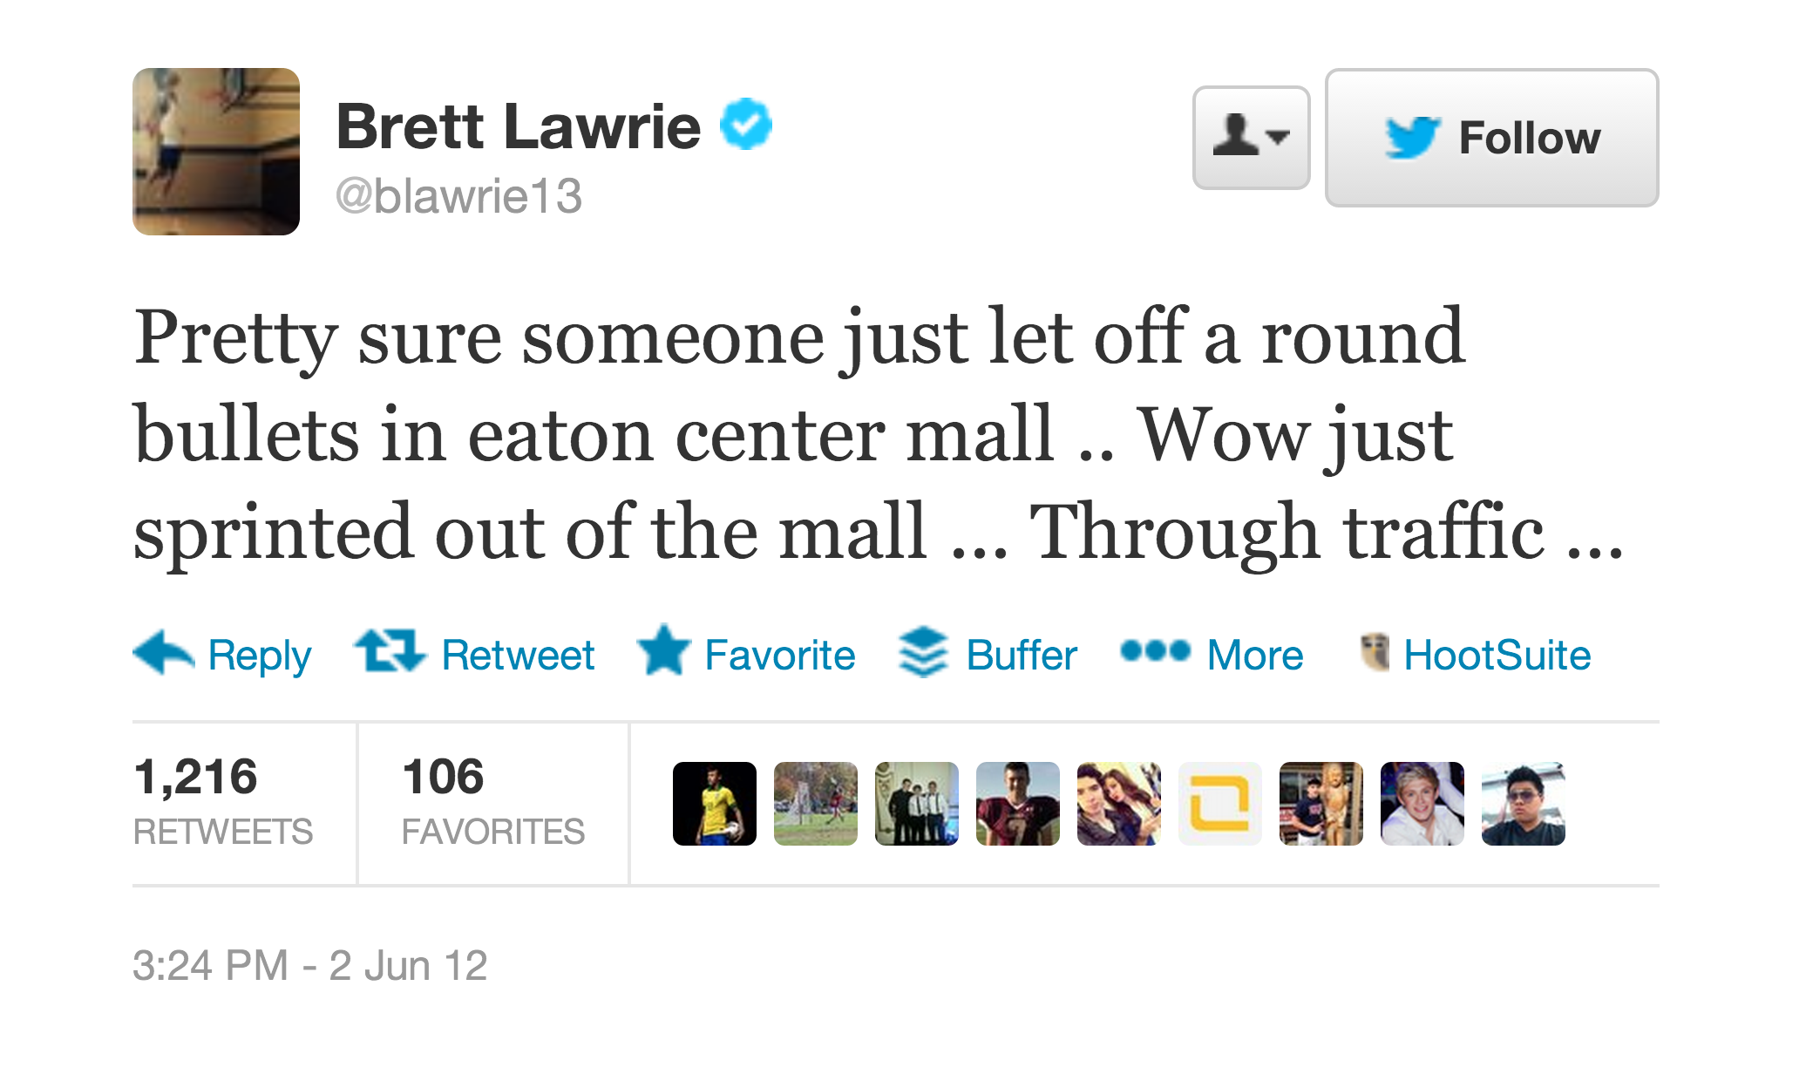

Slide 32
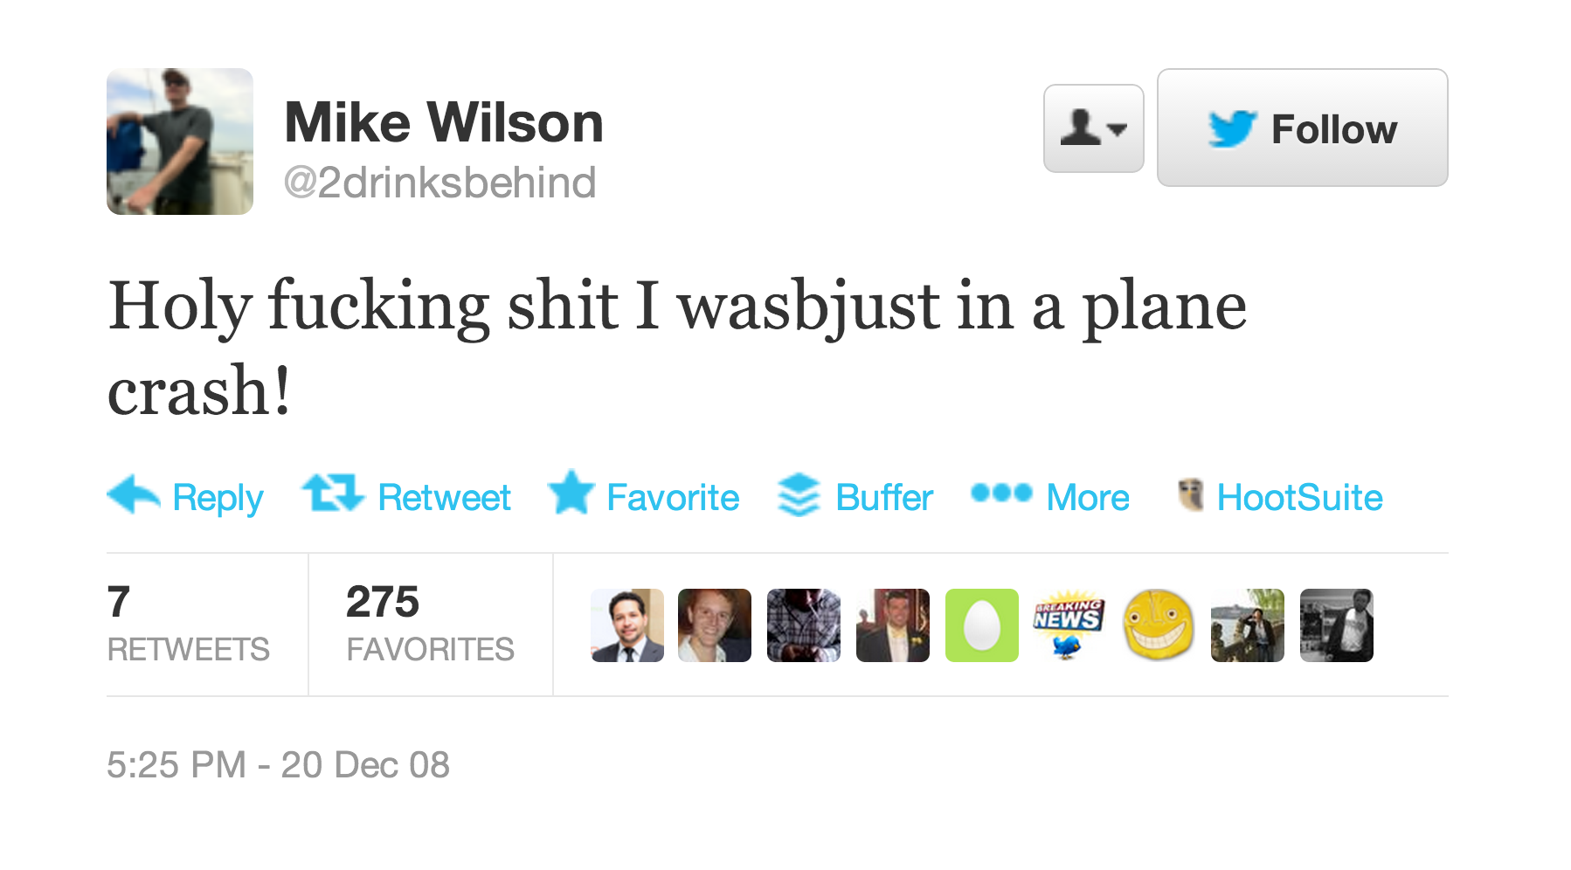

Slide 33
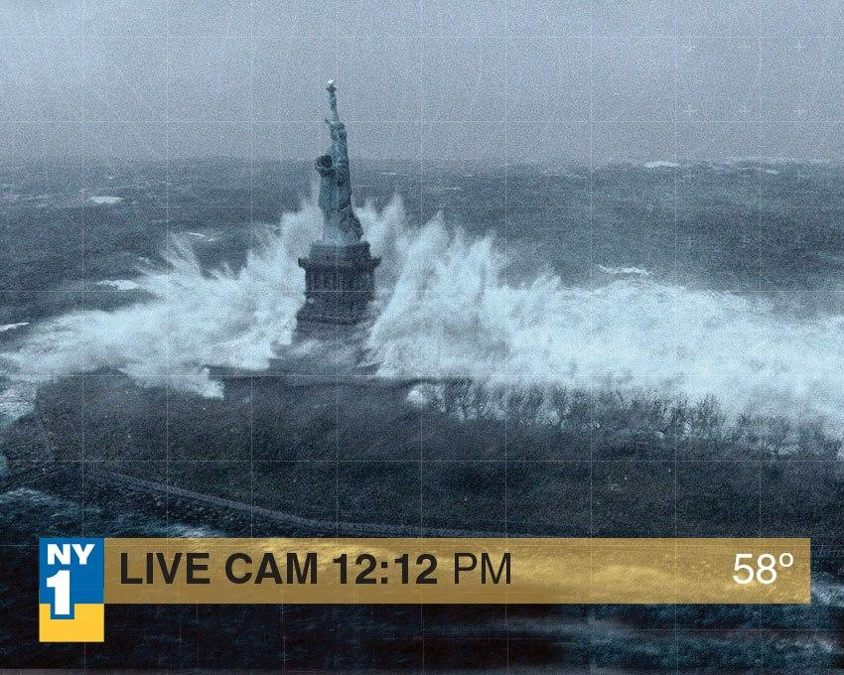
Fake!

Slide 34
Systemic verification
Message-based analysis
User-based analysis
Topic-based analysis
Propagation-based analysis

Slide 35
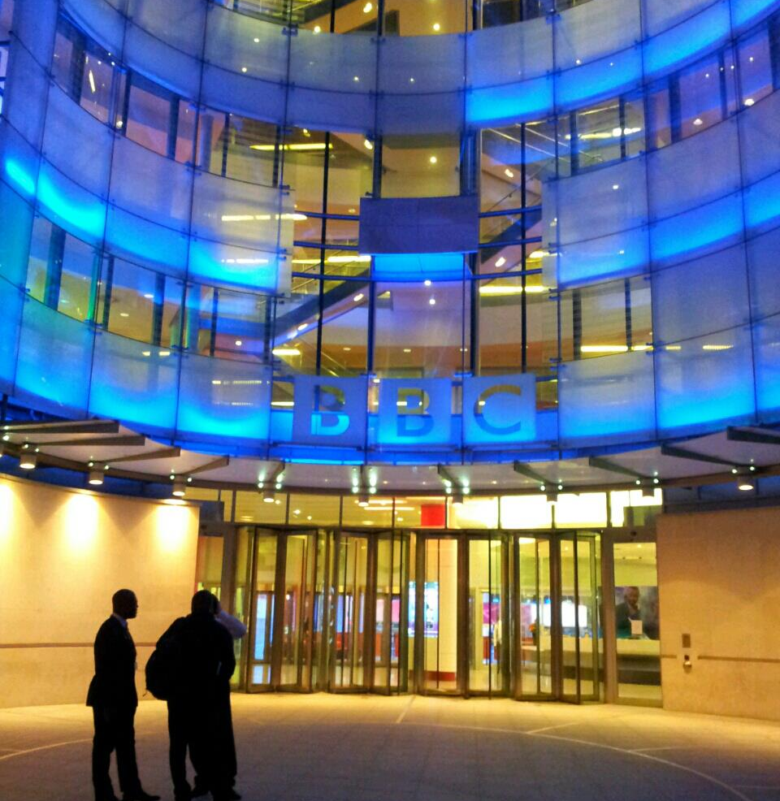
BBC golden rule
Contact the source

Slide 36
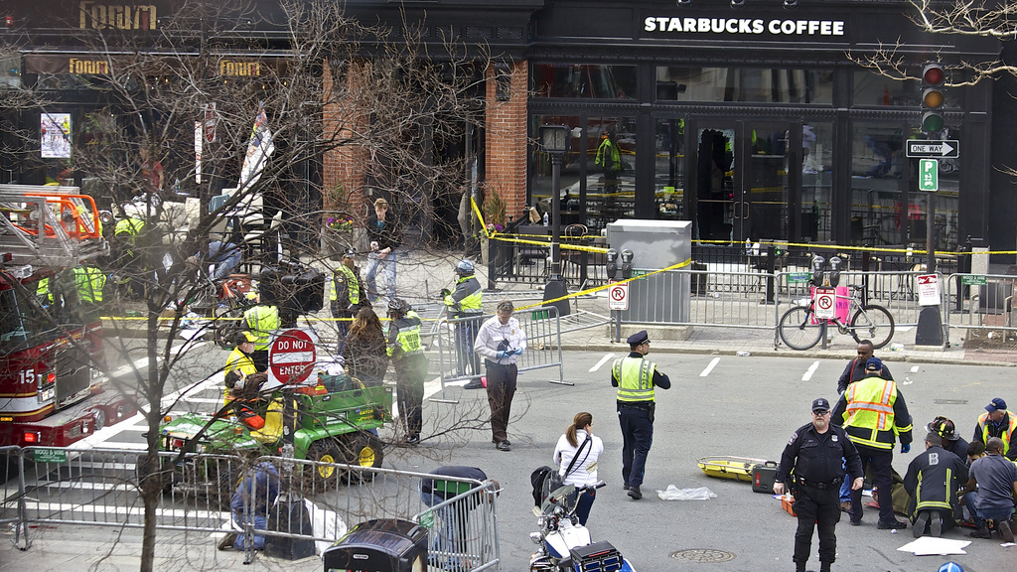
Surge of new Twitter accounts
Photo: Rebecca Hildreth http://www.flickr.com/photos/rebeccahildreth/

Slide 37
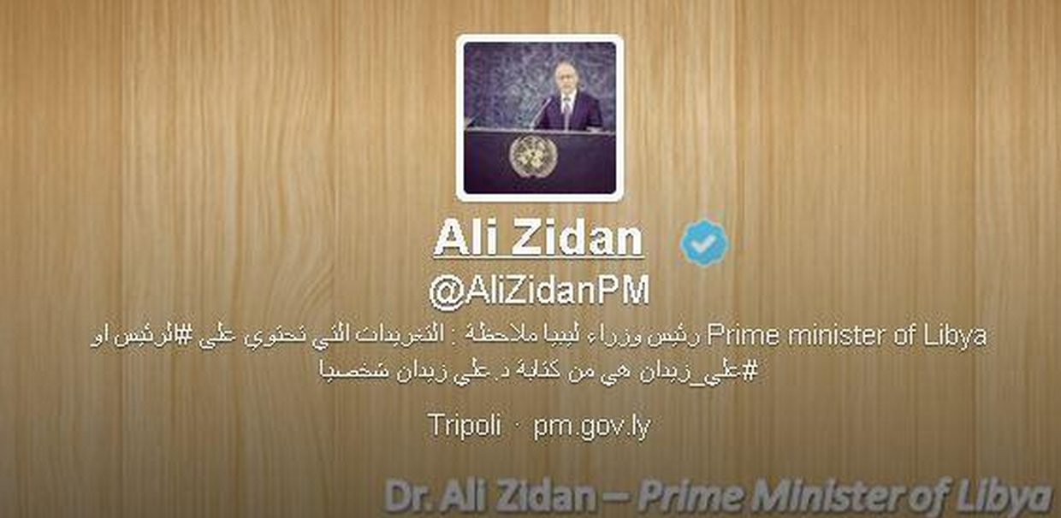

Slide 38
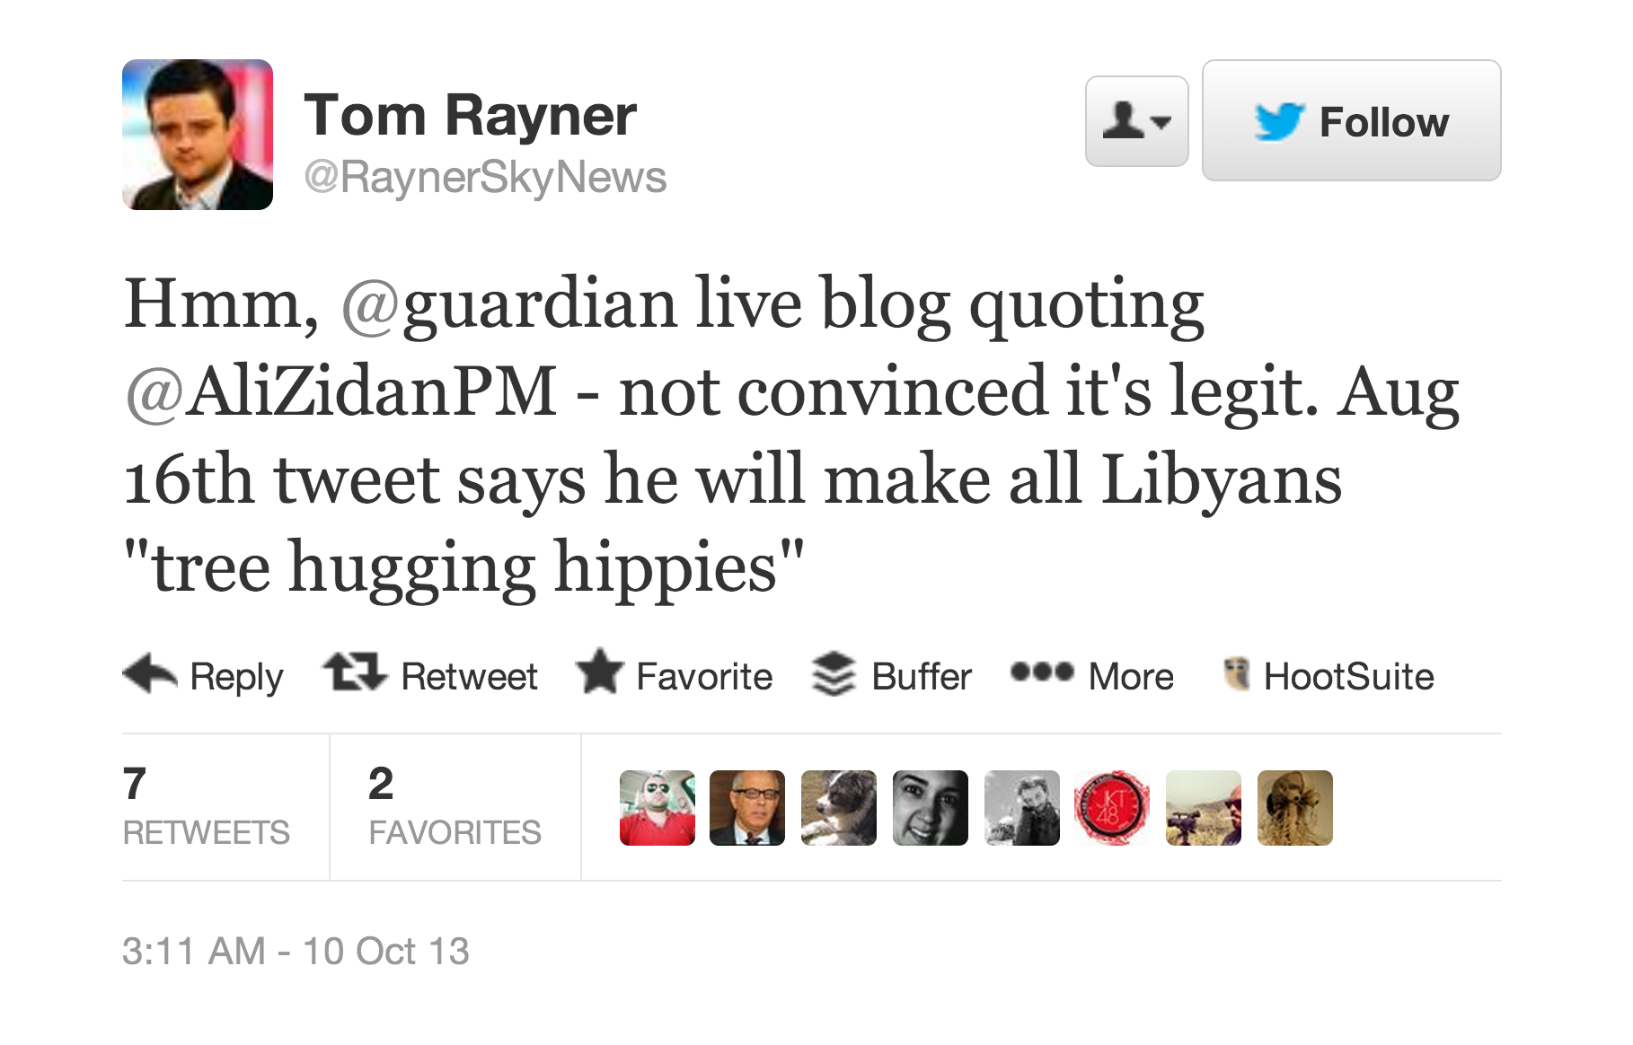

Slide 39
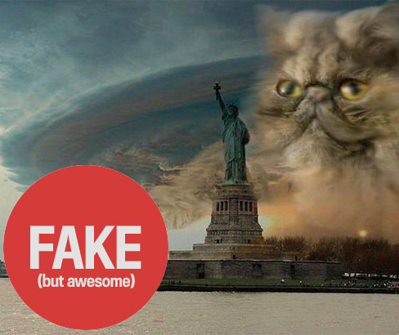
Best practice tips
Apply critical thinking
Show restraint
Provide context

Slide 40
Verification exercise
Look for some reports, photos to video from #Ukraine on Twitter. Assess the veracity of the material and the source (10mins)
Report back to class.

