Slide 1
Developing your social media profile
Decoding Social Media
February 10 2015

Slide 2
Today’s class
In the news
Developing your social media profile
Break
Branding Workshop
Student presentations

Slide 3
What is your promise?
If you:
Hire me
Read my story
Watch my video
Follow me on Twitter
You will get:
?
?
?
?
Notes:
http://www.slideshare.net/RobinJPhillips/personal-branding-for-journalist

Slide 4
What is your promise?
If you:
Hire me
Read my story
Watch my video
Follow me on Twitter
You will get:
Be hard-working
Be informed
Be entertained
Be knowledgeable
Notes:
http://www.slideshare.net/RobinJPhillips/personal-branding-for-journalist

Slide 5
Key points
Google yourself
Clean up social
Be consistent
Claim your name
Identify your niche
Have a goal
Find/engage experts
Share with purpose
Develop influence
Measure & revise

Slide 6
Namechk.com/
Notes:
http://namechk.com/

Slide 7
http://www.mthomps.com/
Notes:
http://www.mthomps.com/

Slide 8
http://blog.webjournalist.org/about/
Notes:
http://blog.webjournalist.org/about/

Slide 9
http://www.rleonardi.com/interactive-resume/
Notes:
http://www.rleonardi.com/interactive-resume/

Slide 10
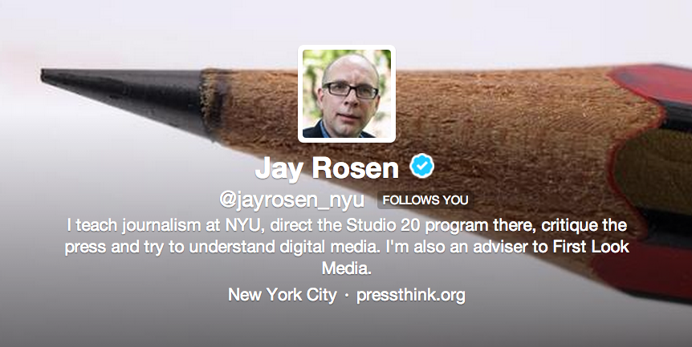
You are what you tweet
Notes:
https://twitter.com/jayrosen_nyu

Slide 11
You are what you tweet
Expertise
Passions
Networks
Personality

Slide 12
You are what you tweet
Expertise
Passions
Networks
Personality

Slide 13
Personal Branding Tools

Slide 14
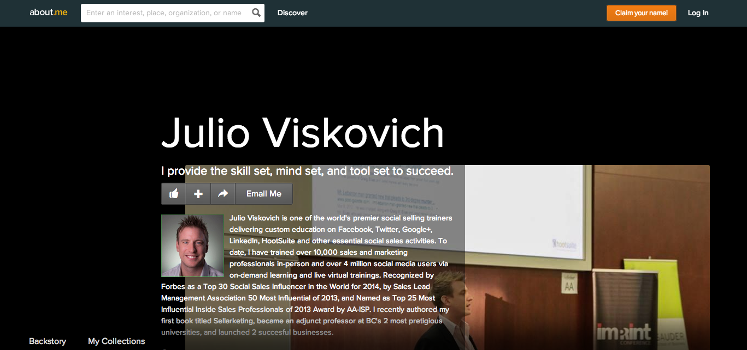
About.me

Slide 15
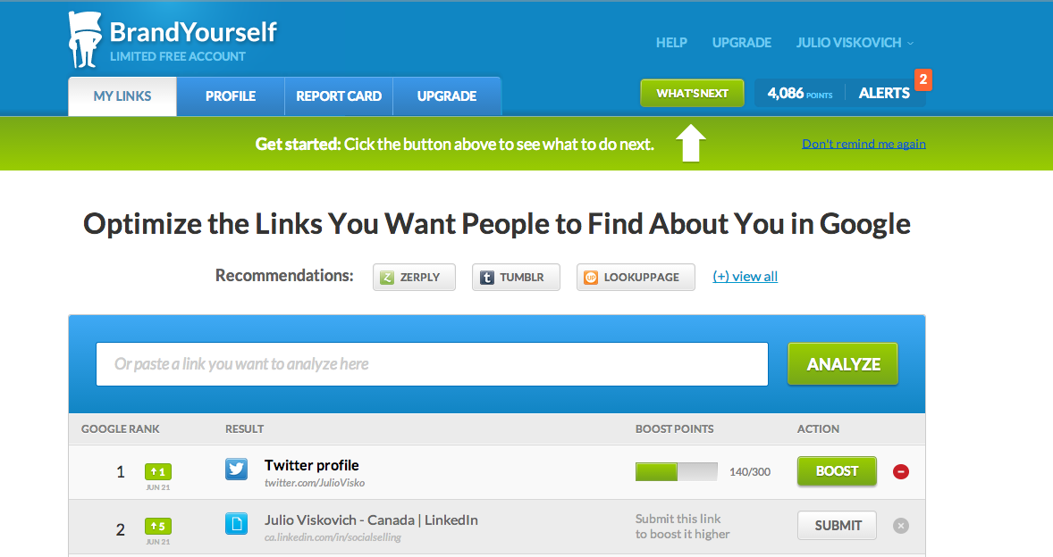
BrandYourself

Slide 16
Efficiency Tools

Slide 17
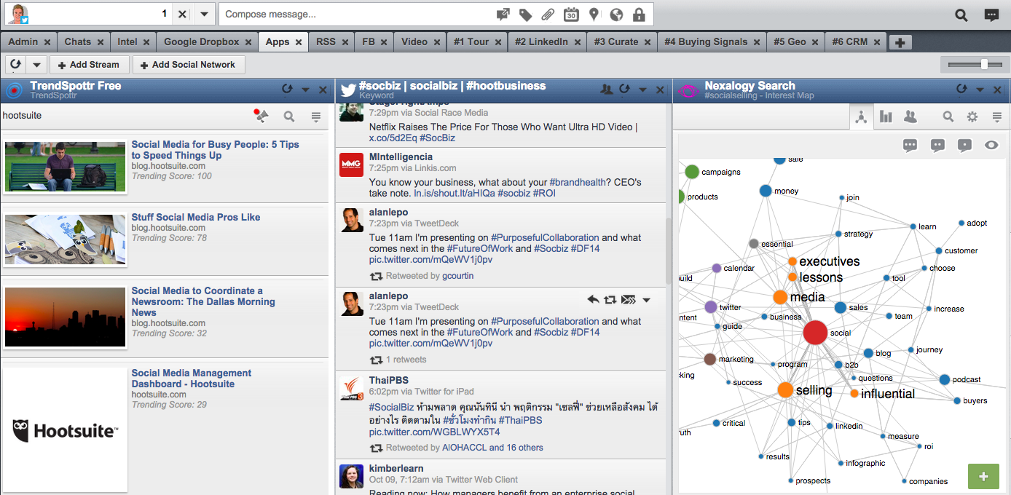
HootSuite

Slide 18
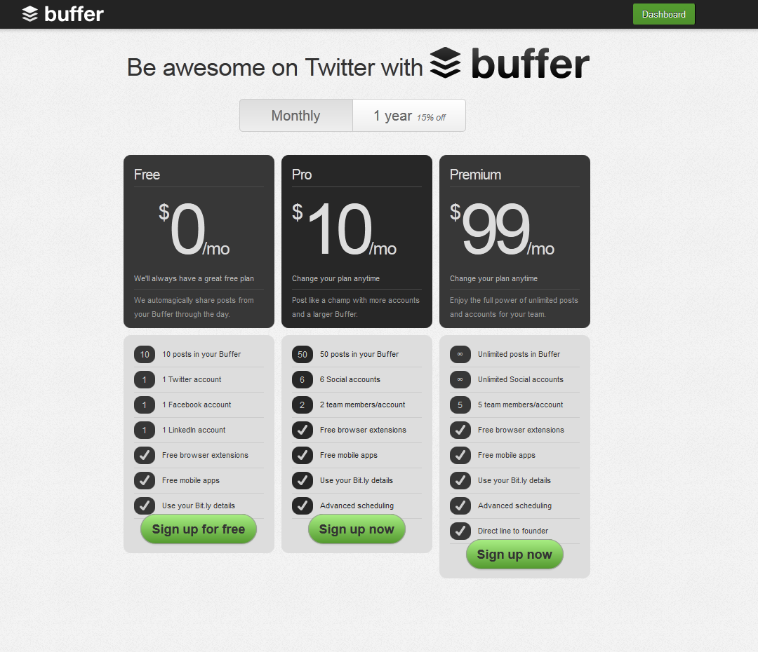
Buffer

Slide 19
Influencer Tools

Slide 20
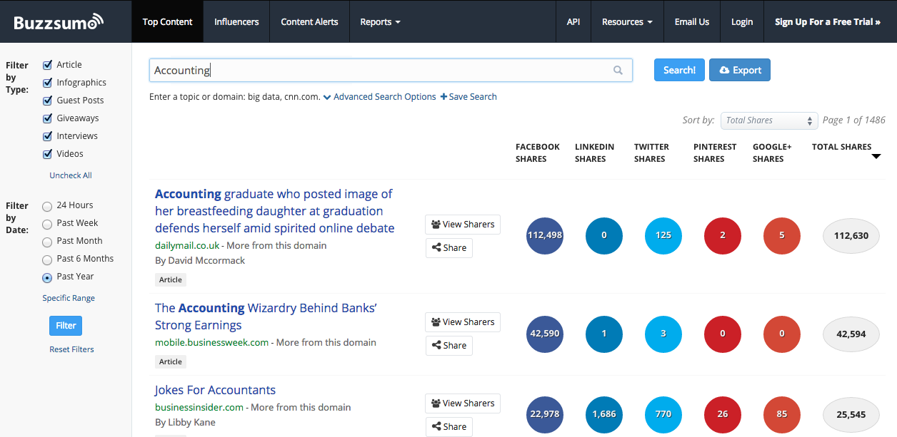
BuzzSumo

Slide 21
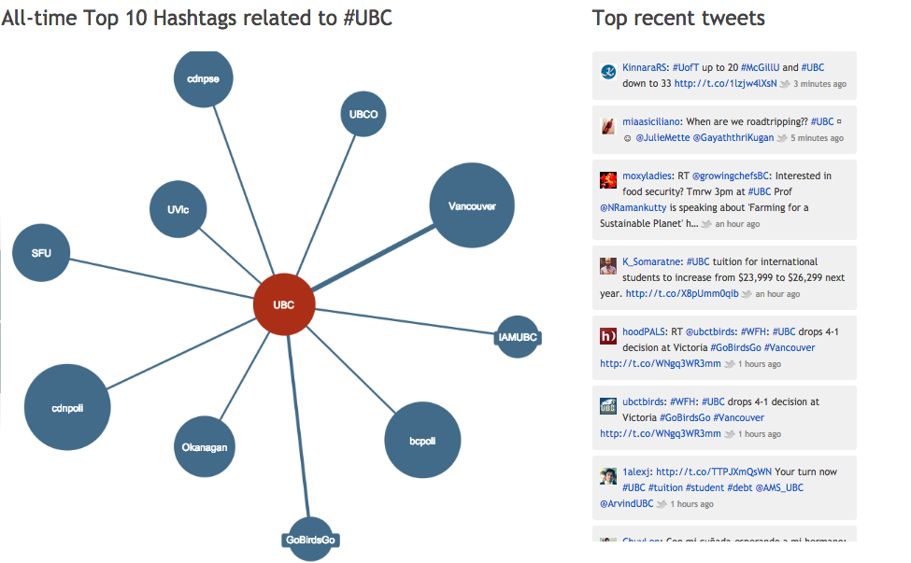
Hashtagify

Slide 22
Exercise: Twitter and you
In client groups, compare Twitter accounts.
Analyse what do your tweets say about
Your expertise, passions, networks, personality
10 mins in all

Slide 23
Break: 15 minutes

Slide 24
A Crash Course in Social Media for Personal Branding
Notes:
Your social media presence has a vital part to play in your personal employment brand and your interactions with potential employers.
Think of it like your digital footprint that presents to potential employers what you’re about and why they might want to employ you.
But much like a real footprint your personal, and social, employment brand is an ever moving thing.

Slide 25
Agenda
Why social media for personal branding?
Which networks to be on and why?
How to take advantage of these networks?
Which tools can help you build your brand?

Slide 26
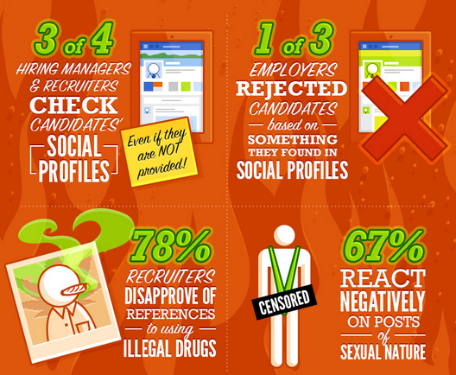

Slide 27
Keys to Personal Branding Success
• Make sure you’re passionate
• Define your personal goals
• Create value-added relationships
• Create a tribe – Seth Godin
• Connect with influencers

Slide 28
EXERCISE
Write down 1-2 things you’re passionate about.
Write down 3-5 keywords that relate to these passions.
Find and write down the highest authority in the space you’re passionate about.
Find and write down 3 leaders or influencers in the space.
Connect or follow them on their social networks.

Slide 29
4 Key Personal Branding Networks
Notes:
More recruiters and employers are using social tools to search for job candidates. To the point where they can search sites like Facebook and LinkedIn for people in particular areas, which particular interests who like particular brands.
Its important that you have a presence on the platforms that potential employers are using. Remember your digital

Slide 31
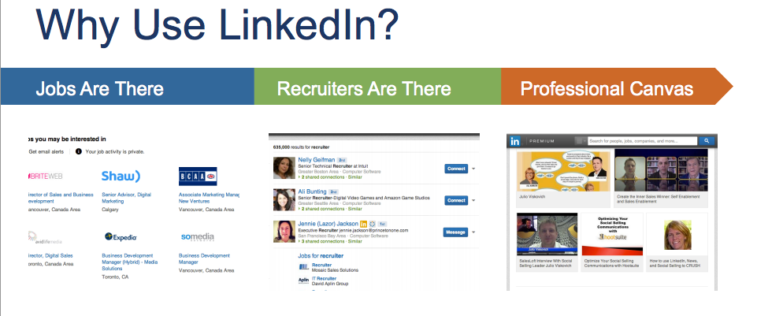

Slide 32
Benefits:
Your online CV
Find and follow potential employers
How to use it:
Be active in groups
Share articles and blogs – yours and others
Personalize your connection requests every time you send
Connect with recruiters and follow prospective companies
Notes:
Asynchronous communication
Individualistic knowledge sharing.
Share detailed advice and experience (4000 characters).
Time delay.
More time to read and reflect on discussions.
Might only check discussions once a day/week/month.
Restriction/discernment for connections
Discussion focused on particular groups or contacts

Slide 33
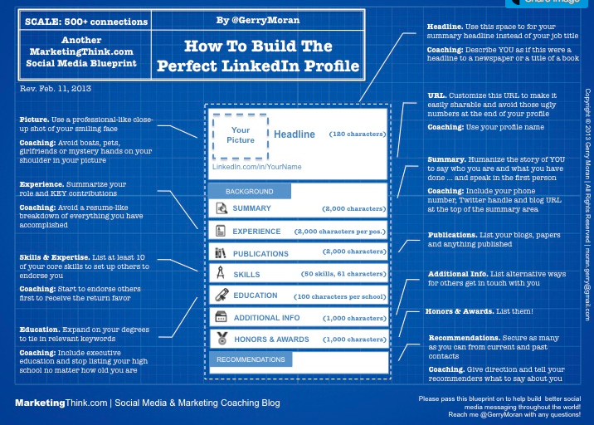

Slide 34
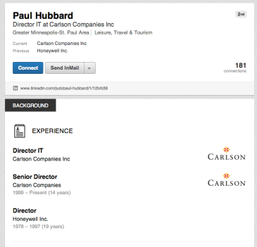
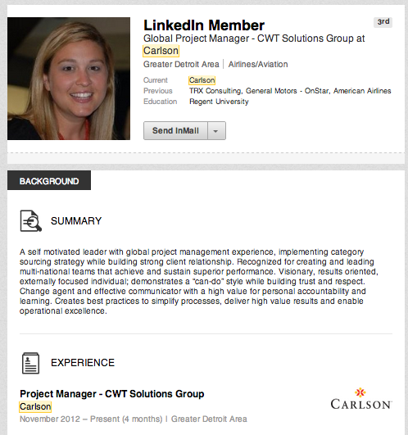
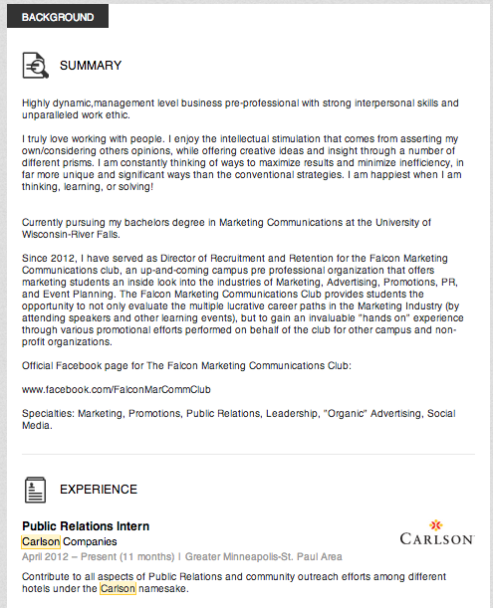
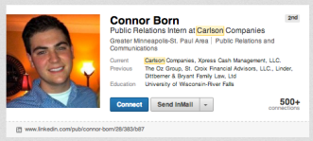

Slide 35
10-Point Profile Scoring System
Profile exists, has picture?
Updated/improved headline?
Summary exists?
Summary - built out and in 1st person?
Attached to current employer company page?
Member of 5 groups or more?
5 recommendations or more?
Post at least 1 update in last week?
500+ connections?
Contact information - phone, e-mail?

Slide 37
Why use it:
#1 network for news distribution
Social learning is very easy – create a PLN
Authenticity – mix of work & play
What to do:
Profile - use a professional picture
SEO - use hashtags & keywords in your profile
Get involved in your niche’s hashtags
Connect with influencers and add value to conversations

Slide 38
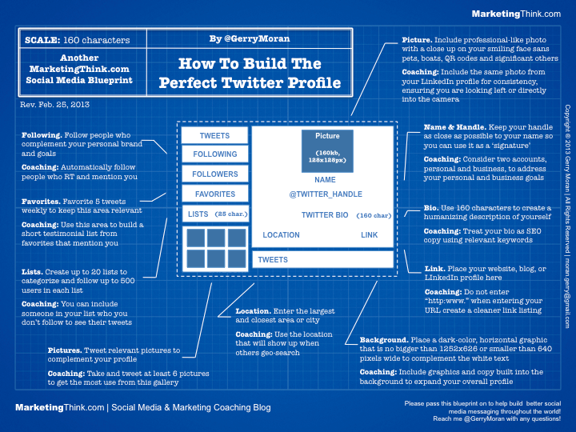

Slide 39
How to get started
Find, follow and list 10 influencers in your space
Retweet one of them once a day.
Tweet “good advice” in reply to one of their tweets per day.
Find and tweet information using industry hashtags.
Info tweets should contain a link, 1-2 hashtags, and be as succinct as possible

Slide 41
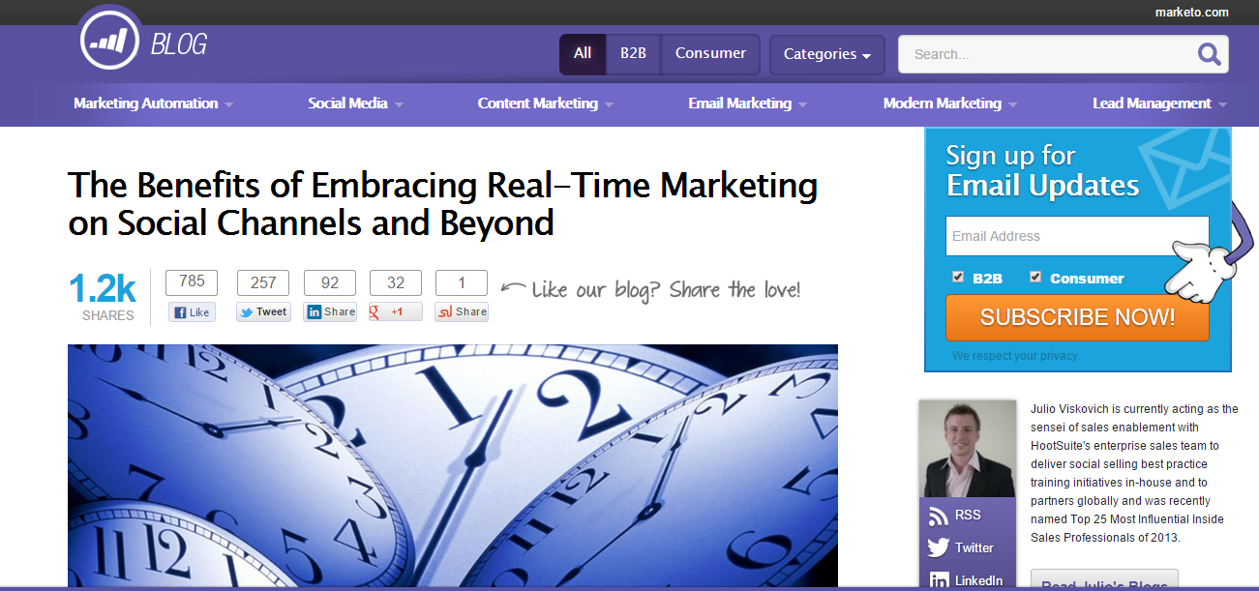

Slide 42
Benefits:
Demonstrates your knowledge
Gives credibility to your CV
Stand out from peers
Have substance when hiring managers do searches
How to use it:
Professional writing about your niche
Relevant to your audience
Reference other people and resources
Notes:
Content – what kind of material will you post
Context – where will you post it – what are the most appropriate platforms.
Connect – who will you connect with
An easy way to find this out is to search for people in the industry you are looking to work with and see what they are posting, where they are posting it.

Slide 44
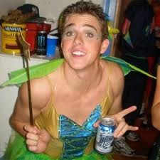
Do you know this guy’s story?
Notes:
And not forgetting face book.
- Check your privacy settings

Slide 45
Benefits:
Recruiters love to check this (Instagram too)
Shows your personality more than the others
How to use it:
Clean up your profiles (pics and immature posts)
Review and set up your privacy settings accordingly
Like prospective company pages
Actively comment and like posts to establish familiarity

Slide 46
Next Steps
Part 1
Part 2
Join and set up accounts at these networks.
Start listening.
Start engaging.
Follow best practices.
Be consistent.
Use tools to help find content to share and write on.
Use tools to help you schedule messages.
Create an about.me page.
Use BrandYourself to gamify your personal brand.

