Slide 1
Social media and disruption
Decoding Social Media
March 17 2015

Slide 2
Today’s class
Disruption in media, business and activism
Guest speaker: Don Wright, Amnesty International
Student presentations

Slide 3
What is disruption?
Disruption is a predictable pattern across many industries in which fledgling companies use new technology to offer cheaper and inferior alternatives to products sold by established players.
New York Times Innovation Report

Slide 4
What is disruption?
And can’t we just dismiss the BuzzFeeds of the world, with their listicles and cat videos?
New York Times Innovation report

Slide 5
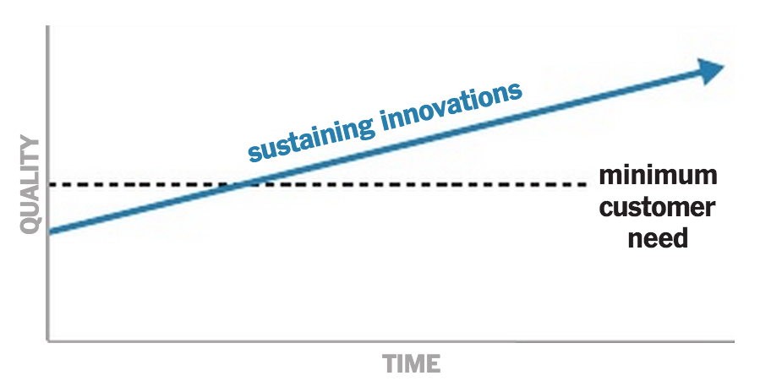
Sustaining innovation

Slide 6
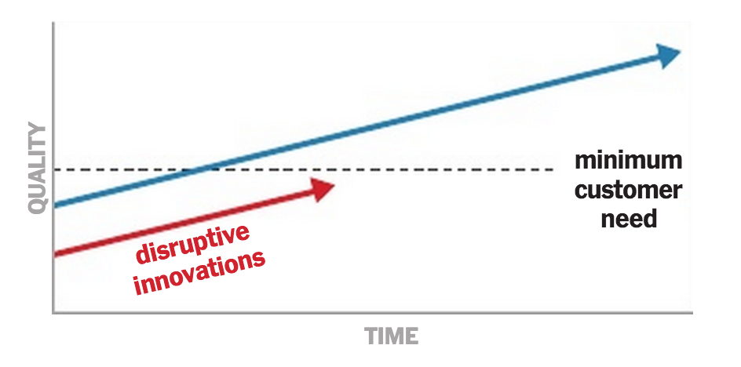
Disrupting innovation

Slide 7
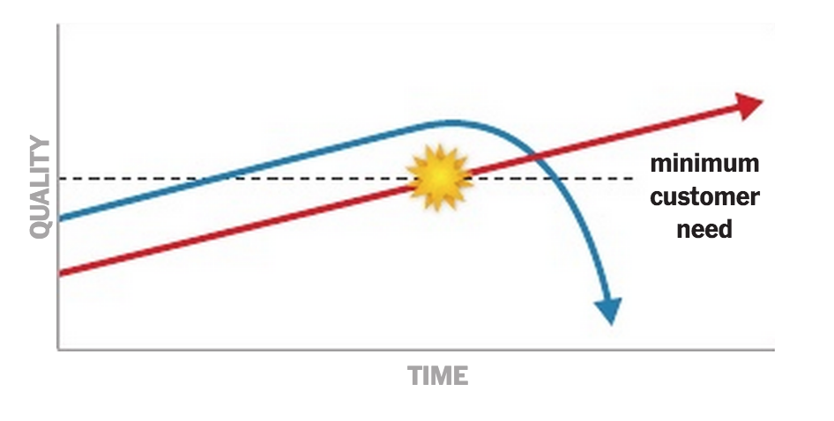
Innovation tipping point

Slide 8
Hallmarks of disruption
Introduced by an “outsider”
Less expensive than existing products
Targeting underserved or new markets
Initially inferior to existing products
Advanced by an enabling technology
New York Times Innovation report

Slide 9
In pairs, come up with two examples
of ideas from the innovation report

Slide 10
Disruption best practice
Launch efforts quickly, then iterate
Set goals and track progress
Reward experimentation
Kill off mediocre efforts
Plan for “version 2.0” and beyond
Make it easier to launch an experiment than to block one
New York Times Innovation report

Slide 11
Why social media?
In groups, come up with two reasons why is social media is disruptive

Slide 12
Notes:
A new question this year – we looked at trust in a variety of people who create content on online sites such as social media and blogs. Friends and family at 72% are the most trusted, whereas CEOs are at 46%. Interestingly, companies I use have a 60% trust factor, while less than 1 in 3 believe content from brands they do not use. The old adage of “the more I know you, the more I trust you” remains true here, but it is extremely important for our clients to see the value of owned media channels. Only 53% believe journalists, which is not much higher than a CEO. Also beware of using celebrities.
====
In AdWeek current issue interview w/ Rodale CEO mentions that they are steering away from celebrities on mag covers as they “just don’t sell” – in fact their Nov. Men’s Health issue was best selling ever when the cover was of a disabled Veteran – reinforces our trust data on celebrities
http://www.adweek.com/news/press/publishing-stalwart-maria-rodale-state-magazines-162676
“Will it follow the celebrity formula? Are we going to be seeing a Hollywood star in her garden on the cover? In fact, what we've been finding over and over again in multiple magazines is that other things besides celebrities work better. For example, the cover of the Men's Health Reader's Issue [last November, featuring Iraq War veteran Noah Galloway, who lost his left arm and leg to an IED] was our best cover of the last year—it went gangbusters. It shocked but in a way that was so positive because it spoke to real life, a real person, real issues. That's inspiring, and I do think that's a huge role of a magazine, to inspire.”

Slide 13
The way we were

Slide 14
Diamond of influence

Slide 15
What are your experiences with disruption and innovation with your client?

Slide 16
Marshall McLuhan
”When faced with a totally new situation, we tend always to attach ourselves to the objects, to the flavor of the most recent past. We look at the present through a rear-view mirror. We march backwards into the future.”

Slide 17
Break

