Slide 1
Ethics and social media
Decoding Social Media
March 3 2015

Slide 2
Today’s class
In the news
Ethics and social media: Issues and best practice
Student presentations
Handling a social media crisis

Slide 3
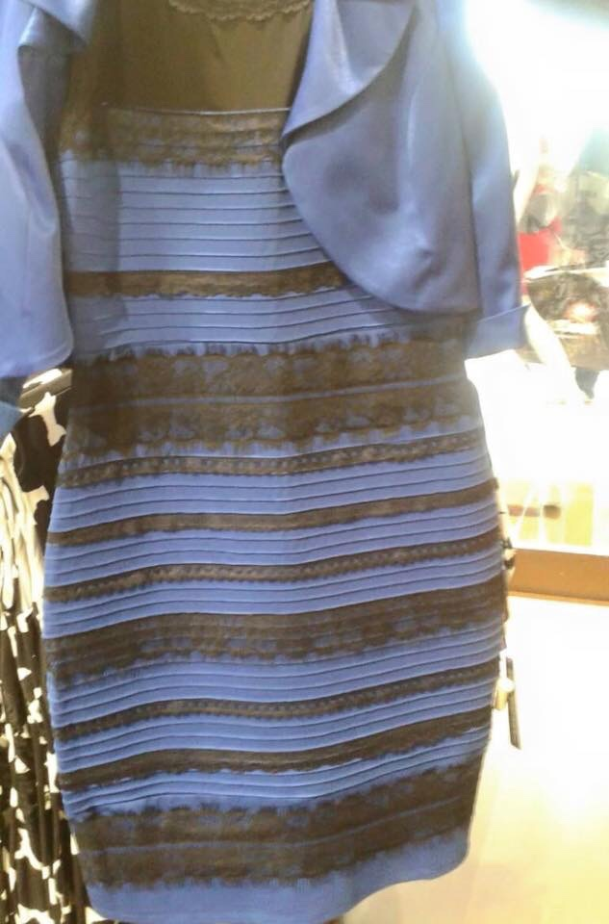
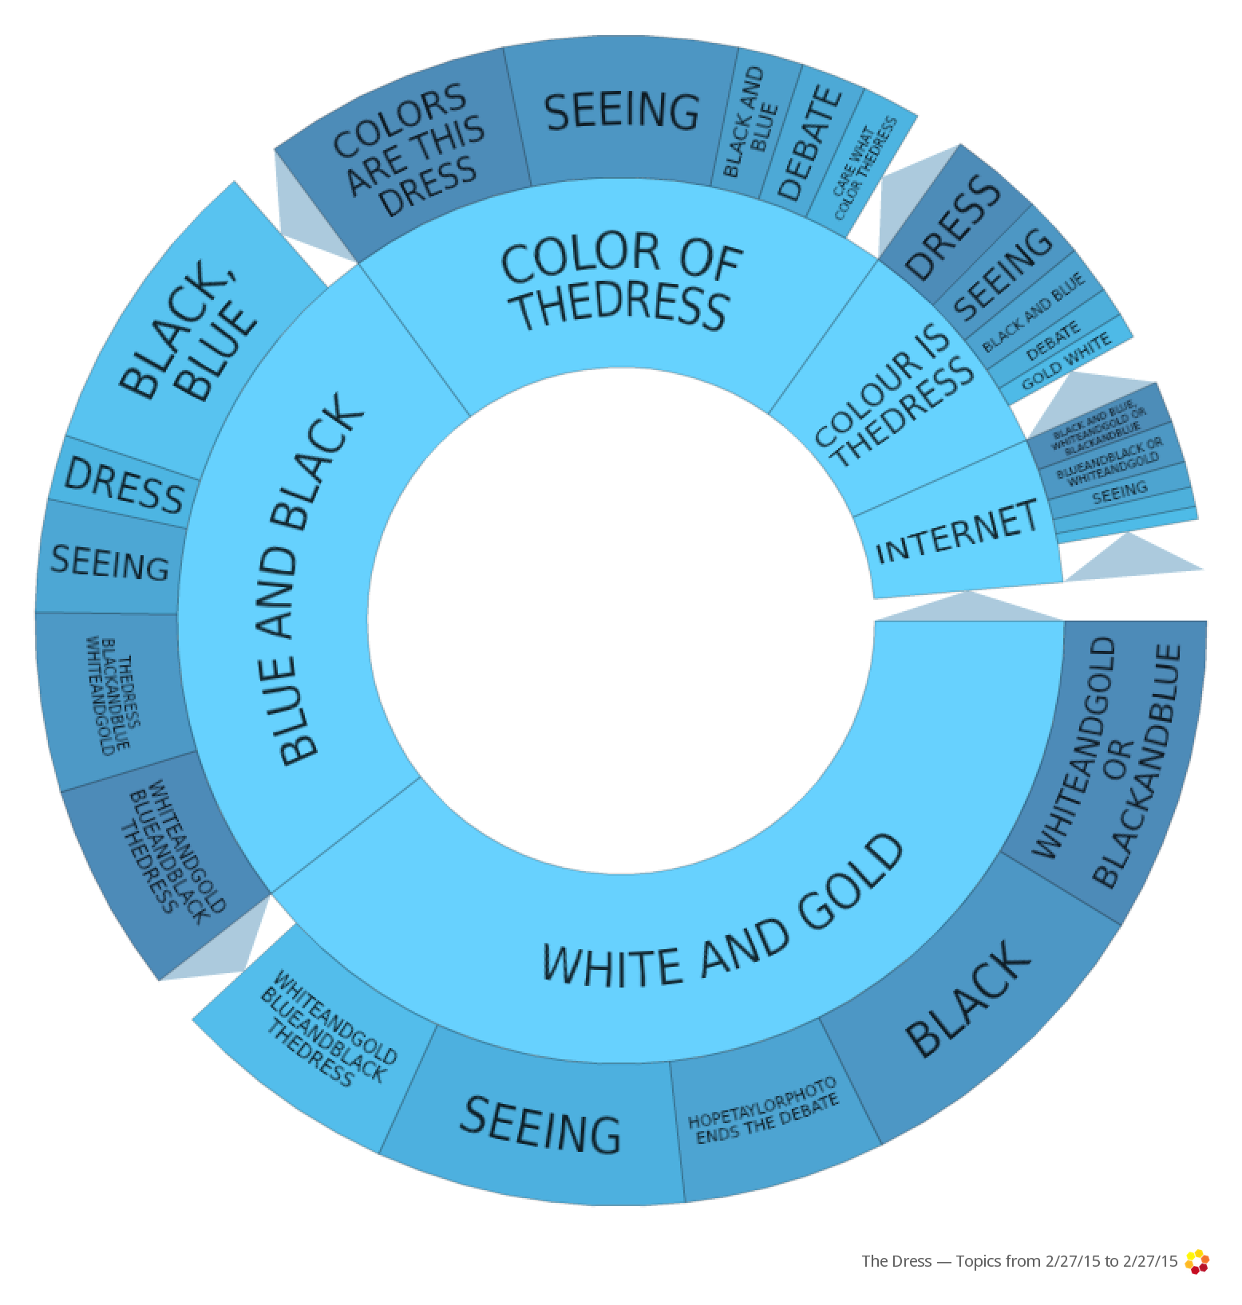
#thedress

Slide 4
Ethical scenario
As a student, you campaigned as an environmental advocate, with strong views on the tar sands development in Alberta. You regularly posted on Facebook pages about the issue and engaged in discussions with others on Twitter. A year later, you are working for an organization/company that has asked you to do an in-depth report on the tar sands, based on interest in the topic.
Discuss in pairs: What are the ethical issues?

Slide 5
Why ethics matter
Trust is like the air we breathe. When it’s present, nobody really notices. But when it’s absent, everybody notices.
Warren Buffett

Slide 6
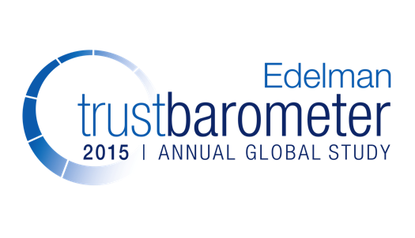
Notes:
This is the 15th year of the Edelman Trust Barometer.
Early on in the history of the Trust Barometer, we saw the power of NGOs, in the middle of the decade was the rise of a person like yourself and the development of a horizontal, peer-to-peer communications path. Then it was the recovery of trust in business after its terrible fall in 2008/2009.
The images this year speak to major points of context throughout a year that was filled with previously unimaginable events: the conflict in Ukraine, the SONY Pictures hack, disappearance of MH370, spread of Ebola, controversy around Uber.

Slide 7
Notes:
Trust in 3 of 4 the four institutions fell this year, the lowest Trust since 2008, but the rank order remains the same.
Government was the only one to rise – largely because it could not fall any further – but also related to big rises in Russia, Indonesia and India. In fact, if you pull out India and Indonesia, government trust declines from 45 to 44.
Across the board, trust has evaporated. This is a new dynamic. Where we once saw a see-saw, now all boats are sinking.
What we have seen in 2015, which leads to our hypothesis, is this start of the era of skepticism. Post-Great Recession we anticipated a rebound recovery, but it has not been as significant or sustained. That recovery of Trust has reached a plateau and now is now on the decline.

Slide 8
Notes:
For the first time, we see online search as the most trusted source of media. The implications are that you can no longer rely on big, established brands – but rather dig deeper to get higher search rank (think BuzzFeed and Business Insider). There is also significant traffic to mainstream media driven through search.
Millennials: overall, they are just more trusting of media sources. The interesting thing is the gap between trust in traditional media and other types of media, which is far more pronounced between the overall global respondent set and Millennials. If Millennials are the consumers of today/tomorrow, the need to understand the definitively smaller gap between their trust in traditional media and their trust in hybrid, social or even owned media indicates important future trends.
Interestingly, the rise of search and social media is also giving rise to more news content that's social by design. In January 2015, the Edelman Media Network (a team of earned media specialists) teamed with two startups, NewsWhip and Muck Rack, to study U.S. social news consumption - the 2015 Edelman Media Forecast. According to this study, more than 75 percent of US journalists surveyed by Edelman and Muck Rack say they feel more pressure now to think about their story’s potential to get shared on social platforms. To make their stories more shareable, journalists are infusing their stories with more video, with nearly three quarters of US journalists said they are now creating original video content to accompany their stories.

Slide 9
Notes:
A new question this year – we looked at trust in a variety of people who create content on online sites such as social media and blogs. Friends and family at 72% are the most trusted, whereas CEOs are at 46%. Interestingly, companies I use have a 60% trust factor, while less than 1 in 3 believe content from brands they do not use. The old adage of “the more I know you, the more I trust you” remains true here, but it is extremely important for our clients to see the value of owned media channels. Only 53% believe journalists, which is not much higher than a CEO. Also beware of using celebrities.
====
In AdWeek current issue interview w/ Rodale CEO mentions that they are steering away from celebrities on mag covers as they “just don’t sell” – in fact their Nov. Men’s Health issue was best selling ever when the cover was of a disabled Veteran – reinforces our trust data on celebrities
http://www.adweek.com/news/press/publishing-stalwart-maria-rodale-state-magazines-162676
“Will it follow the celebrity formula? Are we going to be seeing a Hollywood star in her garden on the cover? In fact, what we've been finding over and over again in multiple magazines is that other things besides celebrities work better. For example, the cover of the Men's Health Reader's Issue [last November, featuring Iraq War veteran Noah Galloway, who lost his left arm and leg to an IED] was our best cover of the last year—it went gangbusters. It shocked but in a way that was so positive because it spoke to real life, a real person, real issues. That's inspiring, and I do think that's a huge role of a magazine, to inspire.”

Slide 10
Making ethical decisions
Utilitarian: Produces the most good/least harm
Rights: Best respects the rights of all those impacted
Justice: Treats people equally or proportionately
Common good: Best serves the whole community
Virtue: Act as the sort of person I want to be

Slide 11
Dynamics of networked publics
Invisible audiences
Collapsed contexts
Blurring of private/professional
boyd, (2010) Social Network Sites as Networked Publics: Affordances, Dynamics, and Implications

Slide 12
Justine Sacco
Notes:
http://www.adweek.com/adfreak/justine-sacco-fired-iac-hope-i-dont-get-aids-tweet-154639

Slide 13
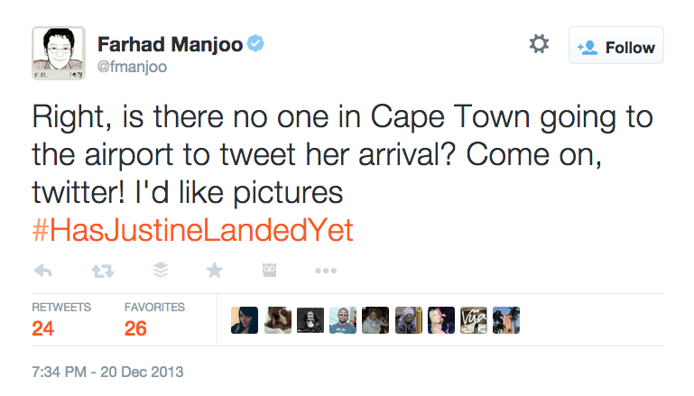
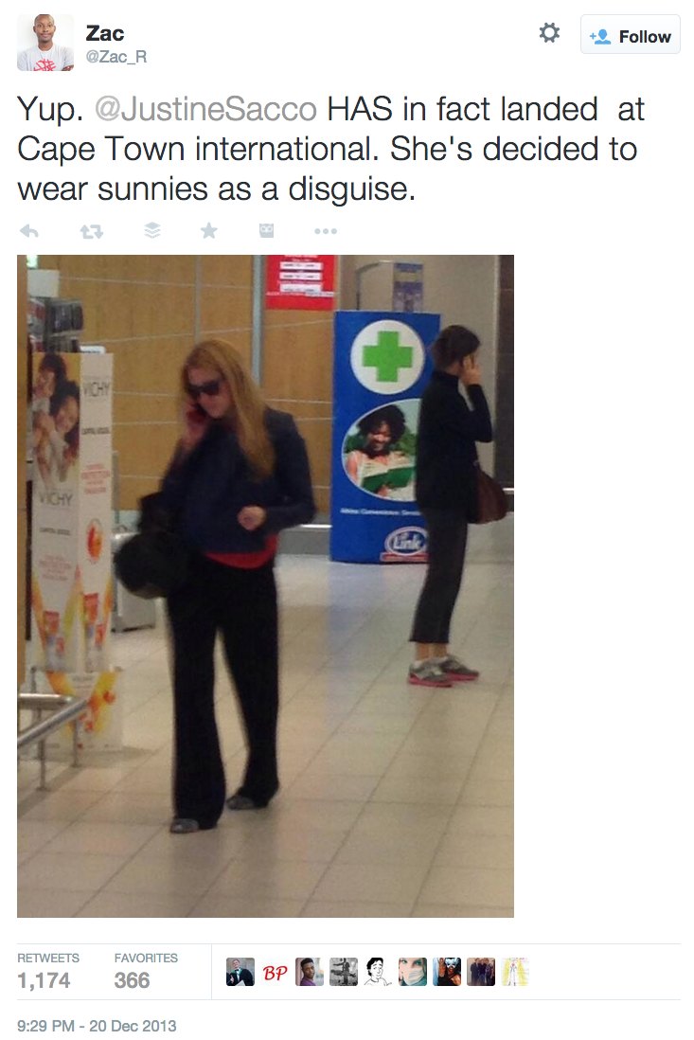
Notes:
https://twitter.com/fmanjoo/status/414237330149371904
https://twitter.com/zac_r/status/414266460656369664

Slide 14
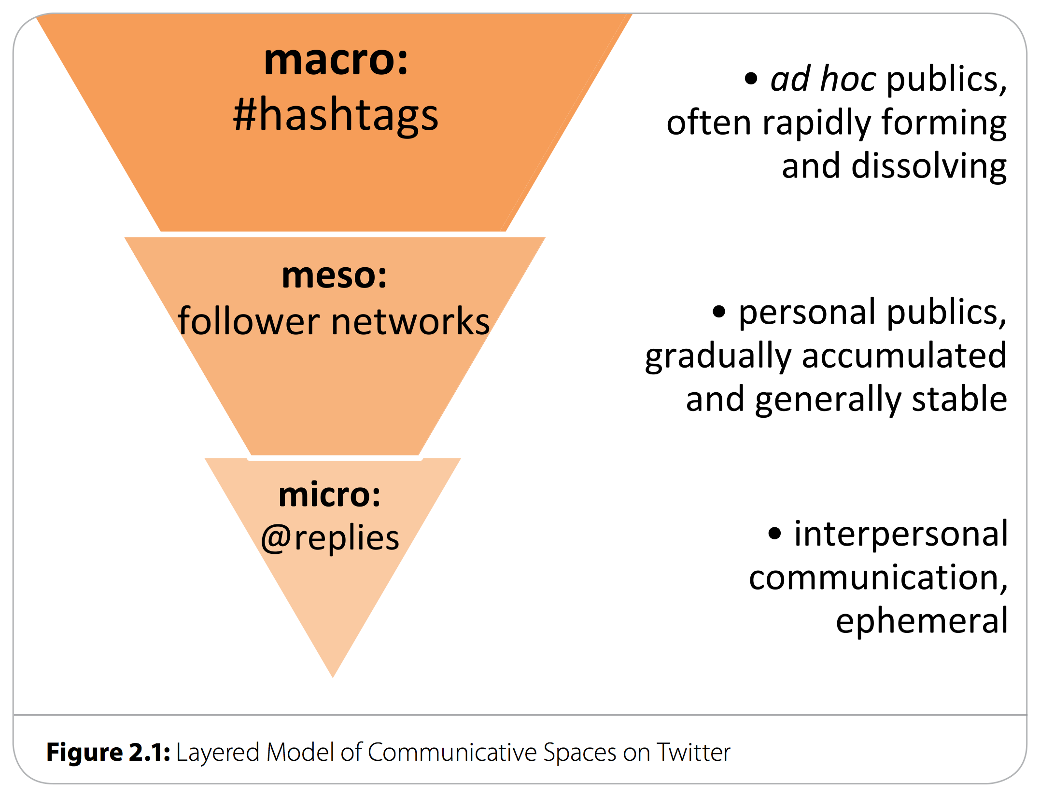
Twitter: Navigating publicness
Bruns, Axel & Moe, Hallvard (2013) Structural layers of communication on Twitter. In Twitter and Society. Peter Lang.
Notes:
http://eprints.qut.edu.au/66324/

Slide 15
Tweet out loud

Slide 16
Tweet out loud

Slide 17
Privacy through obscurity

Slide 18
Ethical scenario
Someone posts to a public Facebook page that is campaigning to keep a local hospital open. You work at a local radio station and read the post out on air. The person complains saying they didn’t agree to their words being shared on a broadcast medium.
Discuss in pairs: What are the ethical issues?
Notes:
http://clairewardle.com/2011/09/21/journalism-ethics-in-a-social-media-world/

Slide 19
Best practice: Privacy
What are the sensitivities in using the content?
What was the original intention in publication?
What is the impact of exposing content to a much wider audience?
What are the legal issues of privacy and copyright?

Slide 20
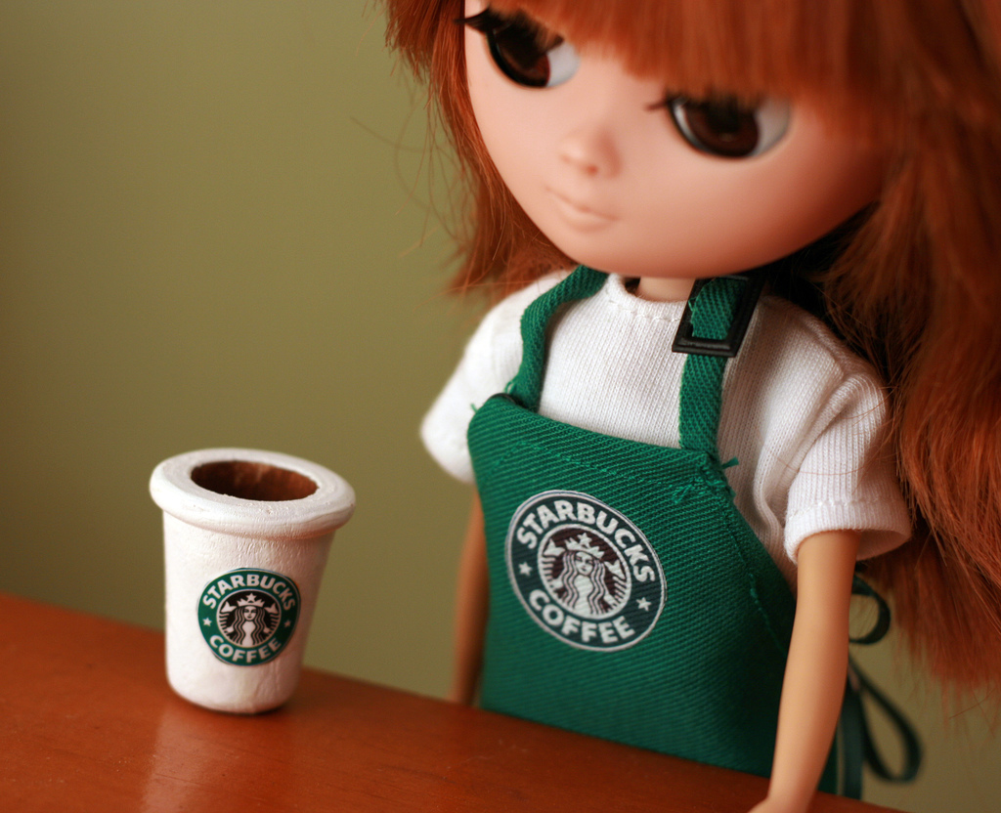
Act independently
Blurring of private/professional
Photo http://www.flickr.com/photos/betsyjean79/

Slide 21
BBC social media guidelines
Consider adding your own comment to the ‘tweet’ you have selected, making it clear why you are forwarding it and where you are speaking in your own voice and where you are quoting someone else’s.

Slide 22
BBC social media guidelines
You may wish to make "friends" on a third party web page. But remember that approving a "friend" may make other users of a site think they are more trustworthy. Check all friends carefully before you approve them. Look at their profiles first.
Notes:
http://www.bbc.co.uk/editorialguidelines/page/guidance-blogs-bbc-full

Slide 23
What’s Your Personal Social Media Strategy?
Harvard Business Review, November 2010
Notes:
http://hbr.org/2010/11/managing-yourself-whats-your-personal-social-media-strategy/ar/1

Slide 24
Break
Notes:
http://blog.adidas-group.com/wp-content/uploads/2011/06/adidas-Group-Social-Media-Guidelines1.pdf

Slide 25
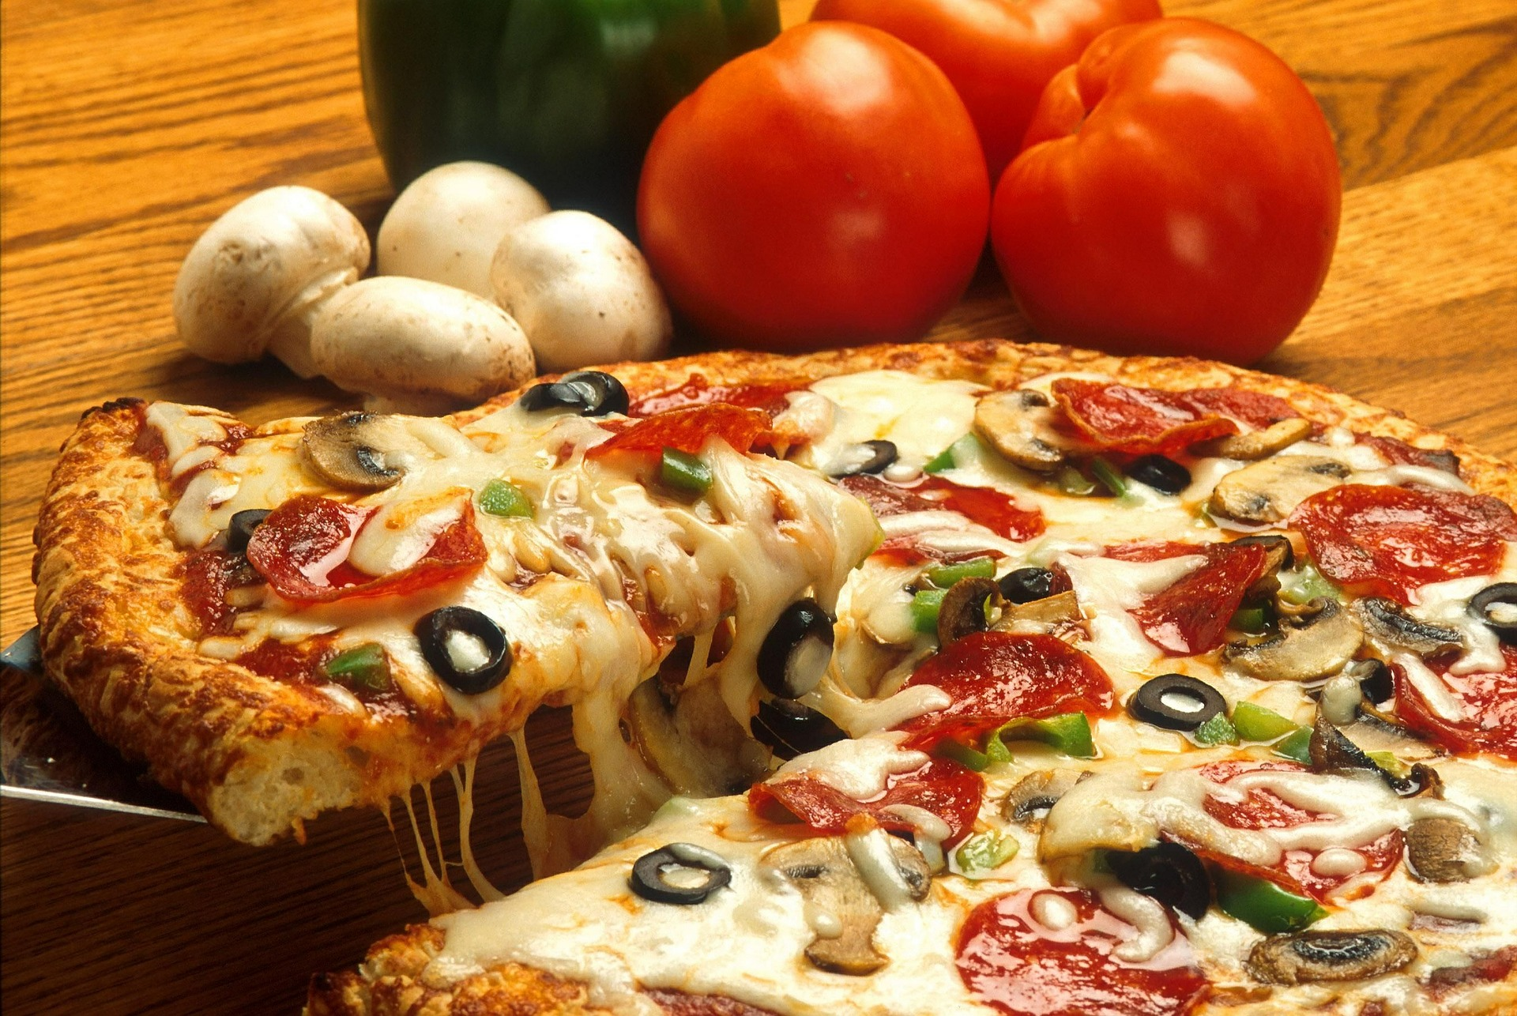
Hmm, pizza

Slide 26
Adidas
Even if you act with the best intentions, you must remember that anything you put out there about the Adidas Group can potentially harm the company. This goes for all internal media as well, like the intranet or any newsletters you send out. As soon as you act on the company's behalf by distributing information, you are upholding the company's image. Please act responsibly.

Slide 27
Best Buy
Act responsibly and ethically.
OR YOU COULD
Get fired
Get Best Buy in legal trouble
Cost us the ability to get and keep customers
Notes:
http://forums.bestbuy.com/t5/Welcome-News/Best-Buy-Social-Media-Policy/td-p/20492

Slide 28
Domino’s Pizza

Slide 29
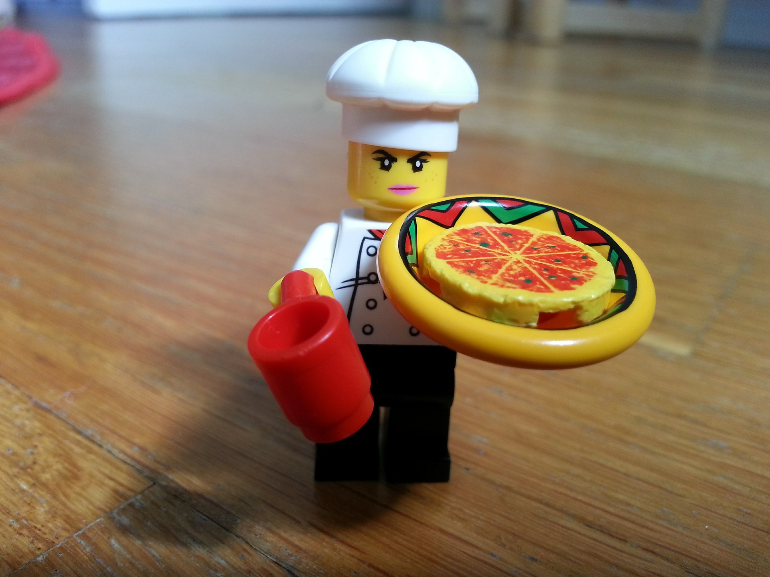
Going rogue on social media

Slide 30
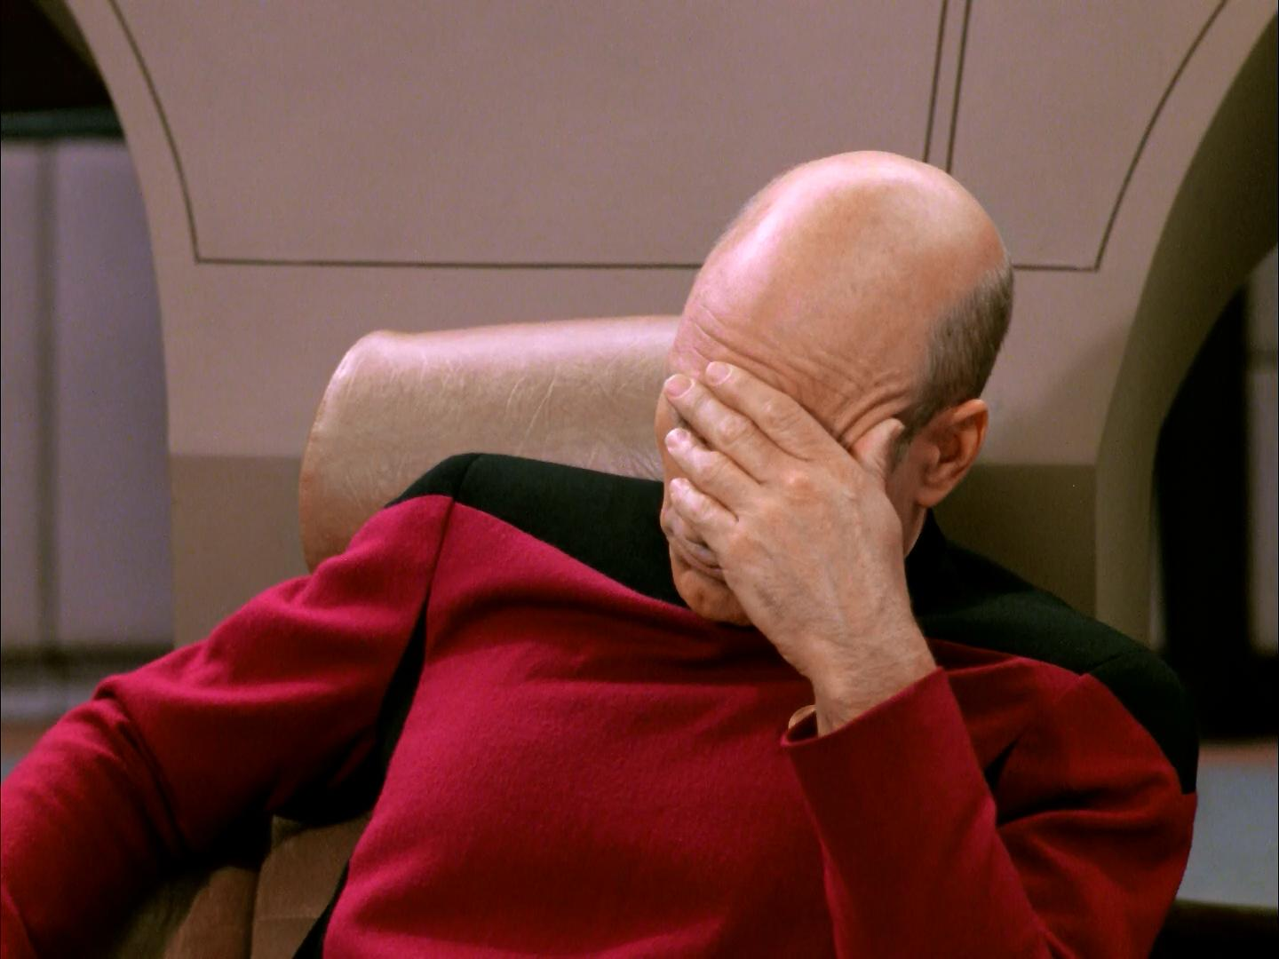
Trashed on social media

Slide 31
#O2outage

Slide 32
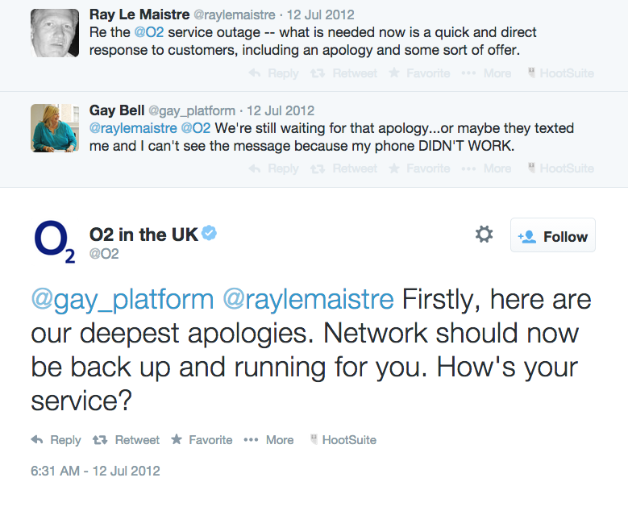
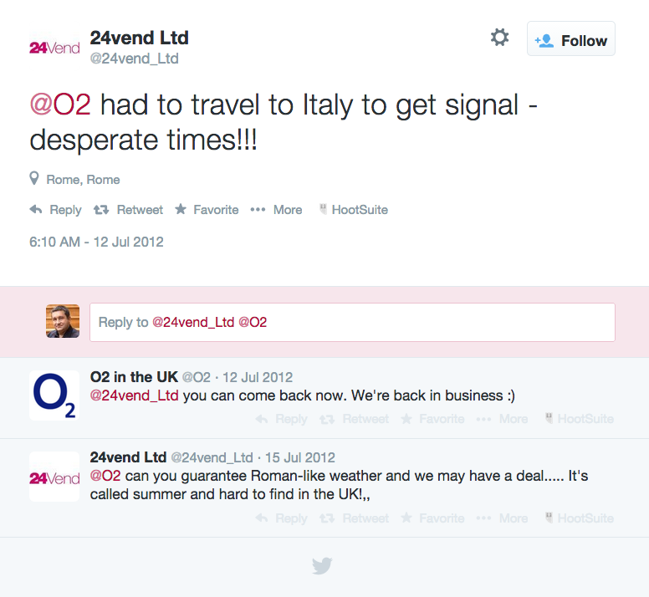
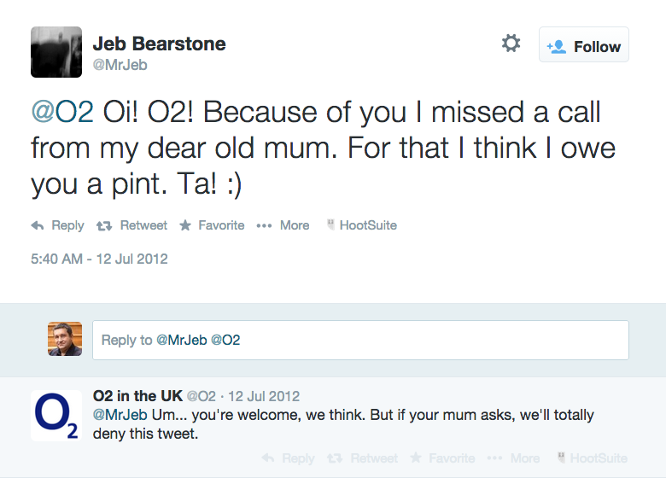

Slide 33
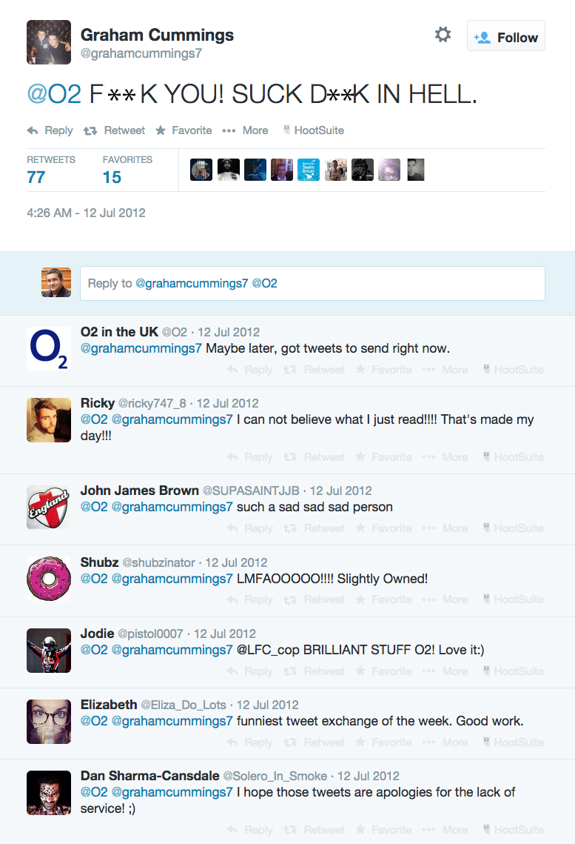

Slide 34
Ethical scenario
You are working as the social media intern for a sports clothing company. It has just launched a new line of yoga gear and has mounted a concerted social media campaign to promote the new line. But your boss is concerned at some of the negative reaction on social media, especially on the company’s Facebook page, to the gear and asks you to deal with it.
What do you do?

Slide 35
Best practice
Acknowledge
Apologise
Appropriate platform
Appropriate tone
Don’t censor
HAVE A PLAN

