Slide 1
DECODING SOCIAL MEDIA
Profs Alfred Hermida and Meena Sandhu
January 5, 2016

Slide 2
Guiding Principles

Slide 3
Listen

Slide 4
Talk

Slide 5
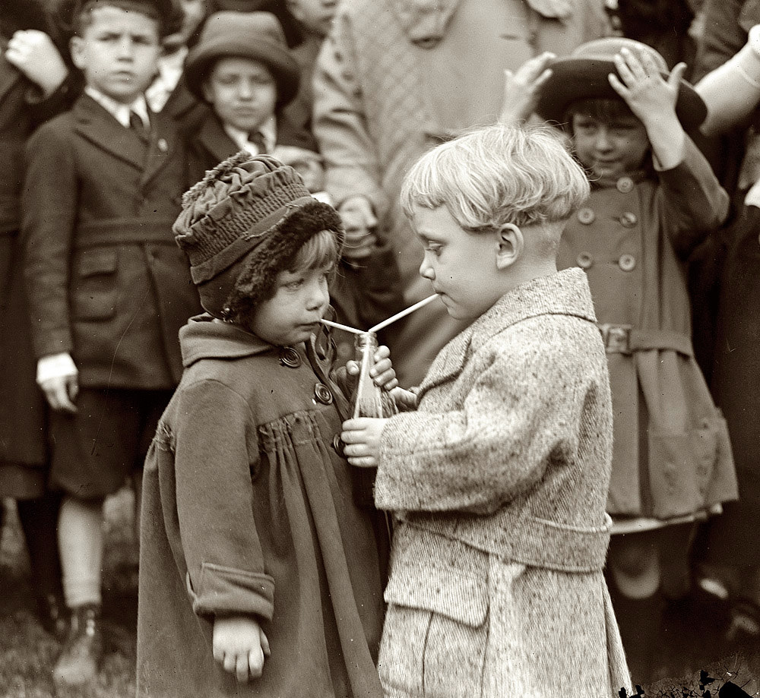
Listen

Slide 6
Engage

Slide 7
Connect

Slide 8
Positivity

