Slide 1

Why we share what we share
Decoding Social Media
Prof Alfred Hermida
Jan 19 2016

Slide 2
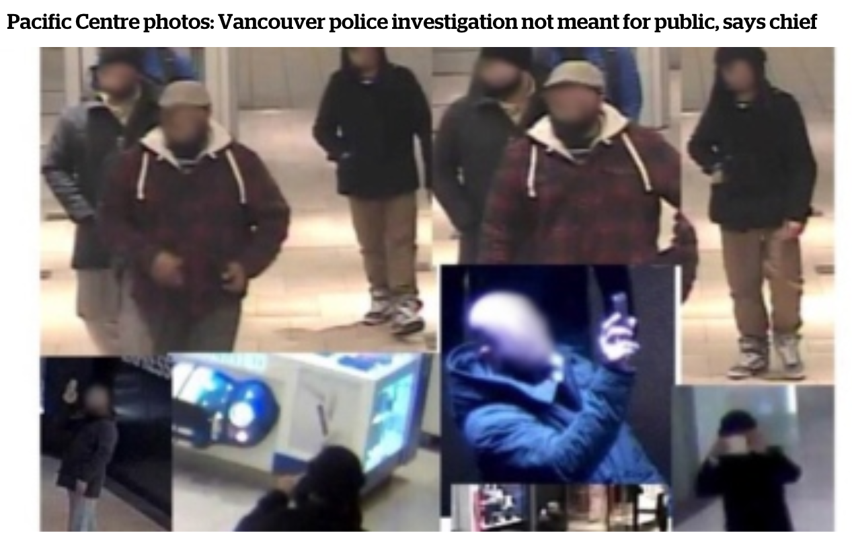
In the news

Slide 3


Slide 4

Reach
11m views in four months
2m registered users
94% emailed link to friends
Yearly car sales up 12%

Slide 5
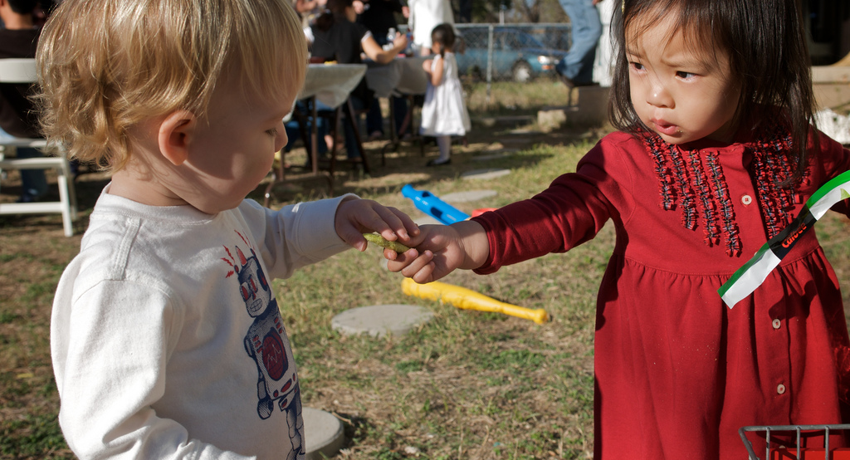
We are social beings
Photo Speedeye: http://www.flickr.com/photos/speedye

Slide 6
Pop psychology question
Two minutes to write down:
What are the advantages in being social beings?

Slide 8
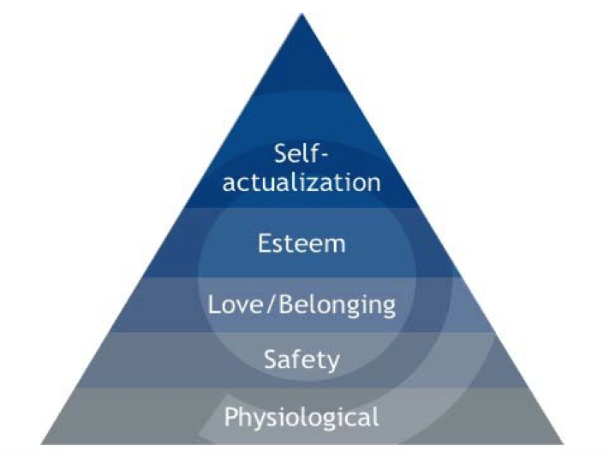
Client group exercise
How does your client relate to the hierarchy of needs?
Write three ideas/examples for shareable content meets one or more of these needs

Slide 9

How to make the important shareable and the shareable important
Notes:
http://www.buzzfeed.com/ariellecalderon/words-that-have-a-totally-diff-meaning-on-game-of-thrones

Slide 10
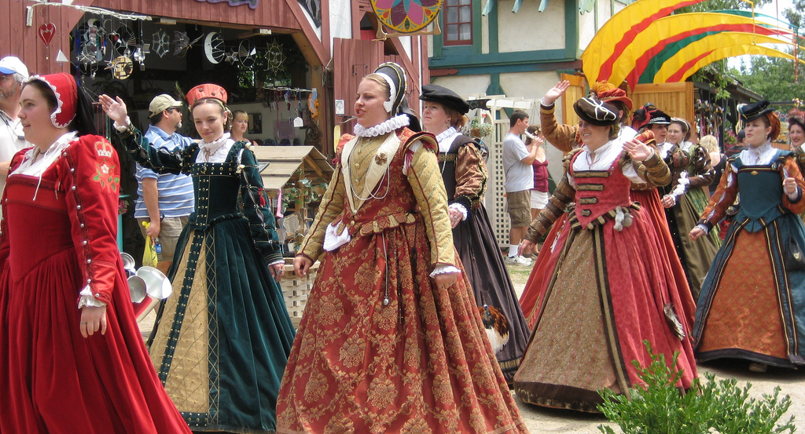
Express yourself
Photo Kate Skegg: http://www.flickr.com/photos/mindtalk/

Slide 11
#1: Client question
What is a reader saying about themselves when they share my story?

Slide 12
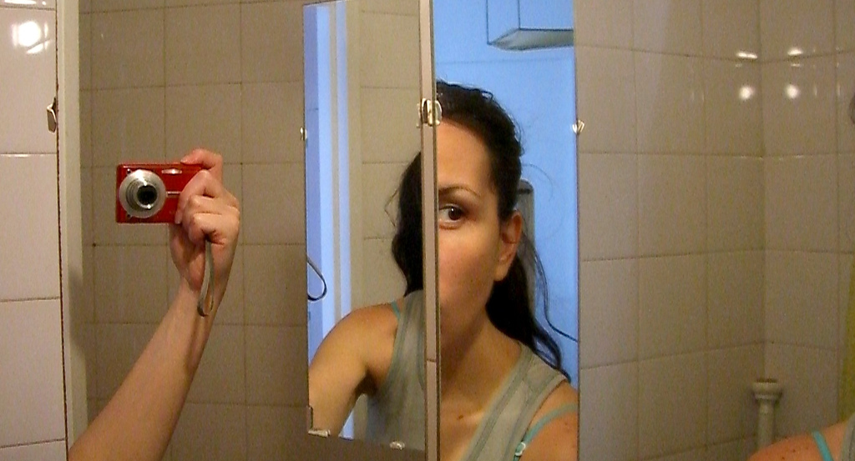
Me, myself and I
Photo Gisela Giardino: http://www.flickr.com/photos/gi/

Slide 13
#2: Client question
How does sharing your story empower a reader to talk about herself?

Slide 14
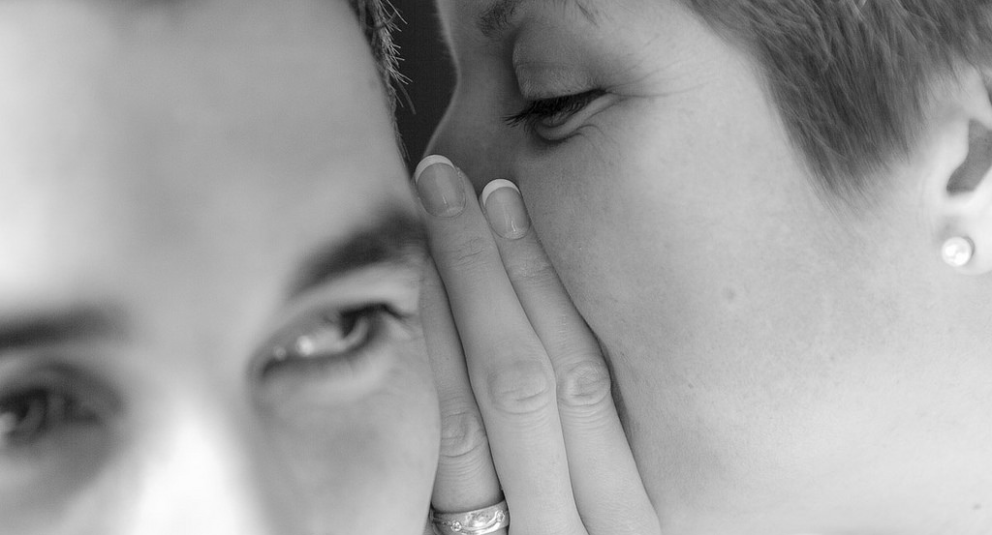
Relationships
Photo: jamacab: https://www.flickr.com/photos/macabrey/

Slide 15
#3: Client question
How does sharing your story help people connect?

Slide 16
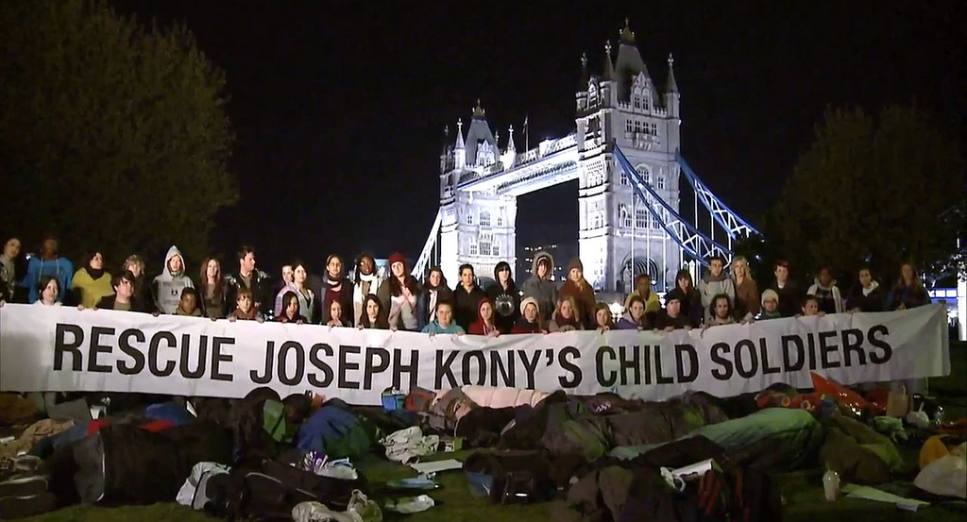
Show you care
Photo Kempton: https://www.flickr.com/photos/k-ideas/

Slide 17
#4: Client question
How does sharing your story reflect a reader’s priorities?

Slide 18
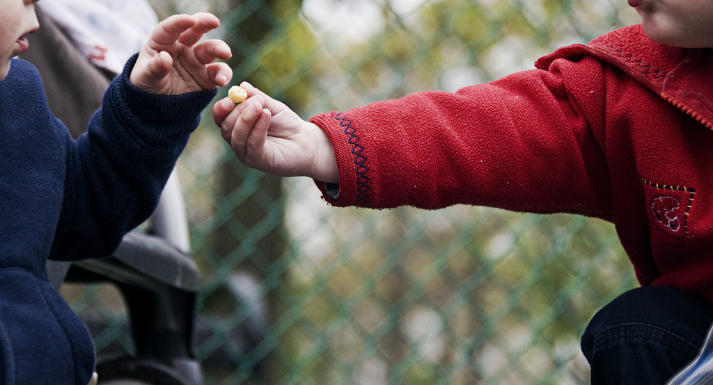
Giving is enriching
Photo Ben Grey: https://www.flickr.com/photos/ben_grey/

Slide 19
#5: Client question
How does sharing a story make someone feel they have done good?

Slide 20
Client group exercise
Come up with 3 ideas/examples of content to share that tap into the psychology of sharing
Express my identity
Talk about myself
Connect people
Show you care
Giving is enriching

Slide 21
Break

Slide 22
Emotions and sharing

Slide 23
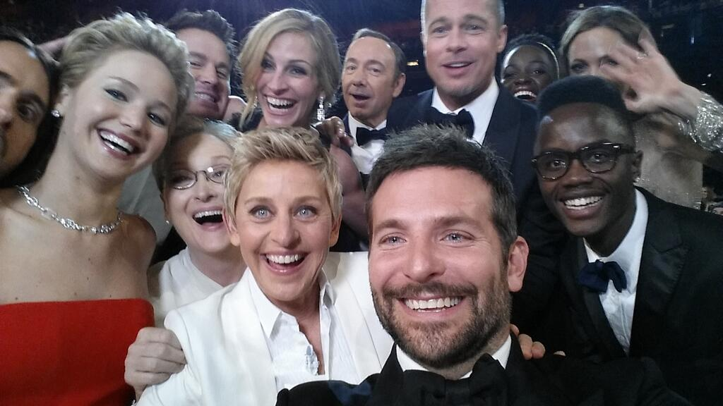
https://twitter.com/theellenshow/status/440322224407314432

Slide 24
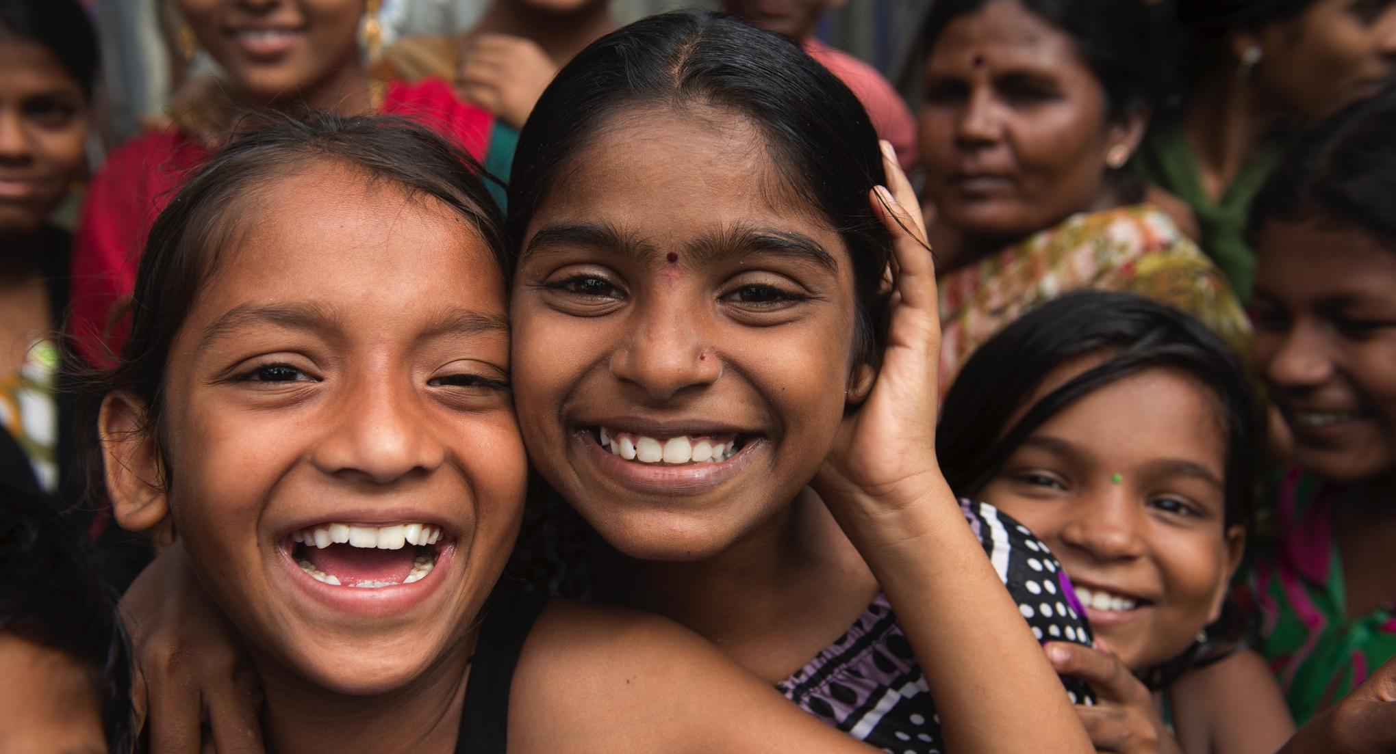
Be happy
Photo: Brett Davies https://www.flickr.com/photos/photosightfaces/

Slide 25
#1: Happiness
Don’t promote factual stories devoid of emotion on social media

Slide 26

Sad is bad
Photo: Donnie Ray Jones https://www.flickr.com/photos/donnieray/

Slide 27

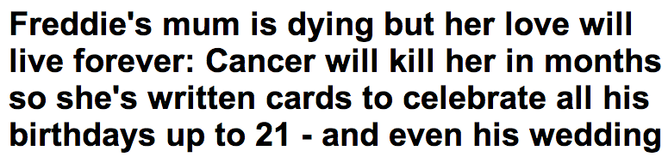
Notes:
http://www.dailymail.co.uk/femail/article-2540162/Freddies-mum-dying-love-live-forever-Cancer-kill-months-shes-written-cards-celebrate-birthdays-21-wedding.html

Slide 28
#2: Sadness (but)
Highlight the positive in a sad story to leave readers feeling inspired

Slide 29

Fear fear
Photo: Historias Visuales https://www.flickr.com/photos/jalevega/

Slide 30
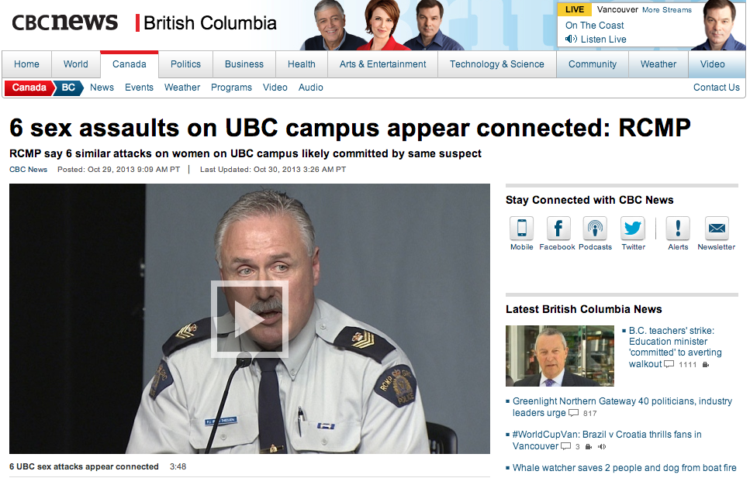
Notes:
http://www.cbc.ca/news/canada/british-columbia/6-sex-assaults-on-ubc-campus-appear-connected-rcmp-1.2286882

Slide 31
#3: Fear (but)
Stories that make us fearful tend not to be shared on social media

Slide 32

Get angry
Photo: Gatto Mimmo http://www.flickr.com/photos/gattomimmo/

Slide 33

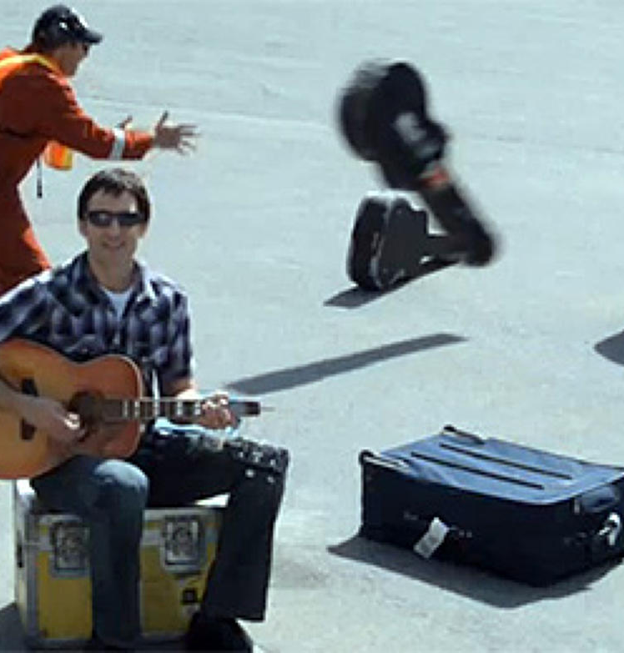
Dave Carroll

Slide 34
#4: Anger
Stories that make us angry prompt sharing

Slide 35

OMG! That’s disgusting
Photo: Jon Ovington http://www.flickr.com/photos/jon_ovington/

Slide 36
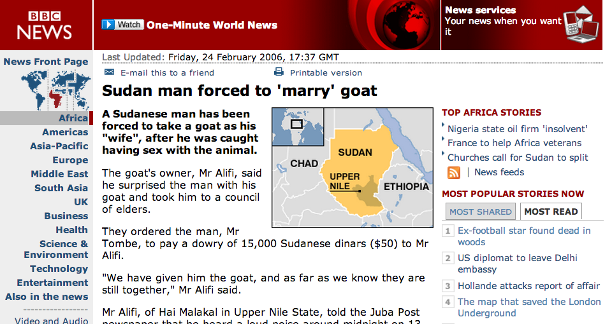
BBC News, Jan 10

Slide 37
#5: Disgust
Disgust is a very powerful driver for sharing

Slide 38
Group exercise
How do platform specific dynamics affect what is shared?
Analyse list of top posts from Facebook vs most tweeted on Twitter
Explain the similarities and differences
  Work in different groups to client groups

Slide 39
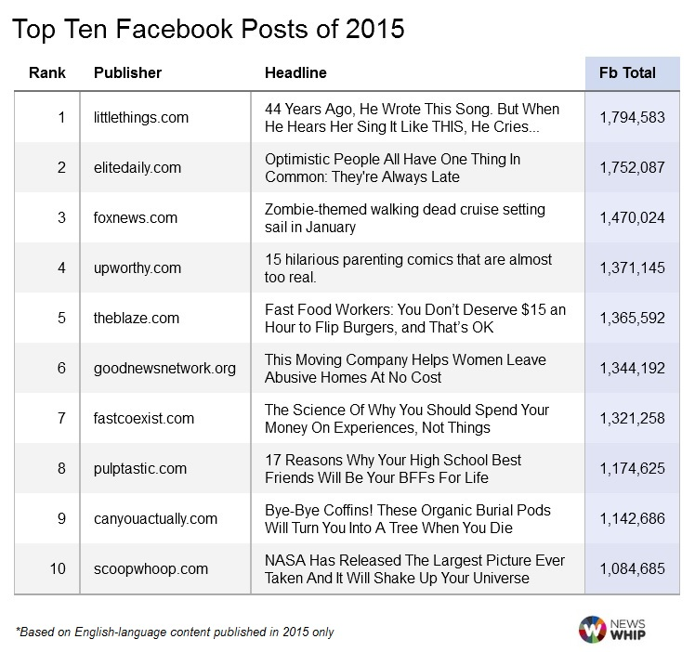
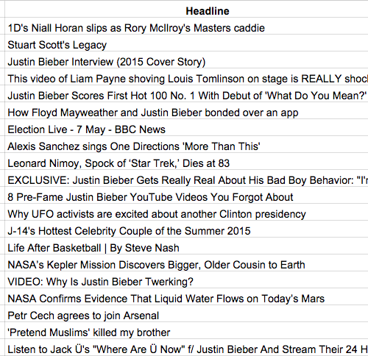
Facebook and Twitter

