Slide 1
Decoding Social Media
Profs Alfred Hermida / Meena Sandhu
January 5 2016

Slide 2
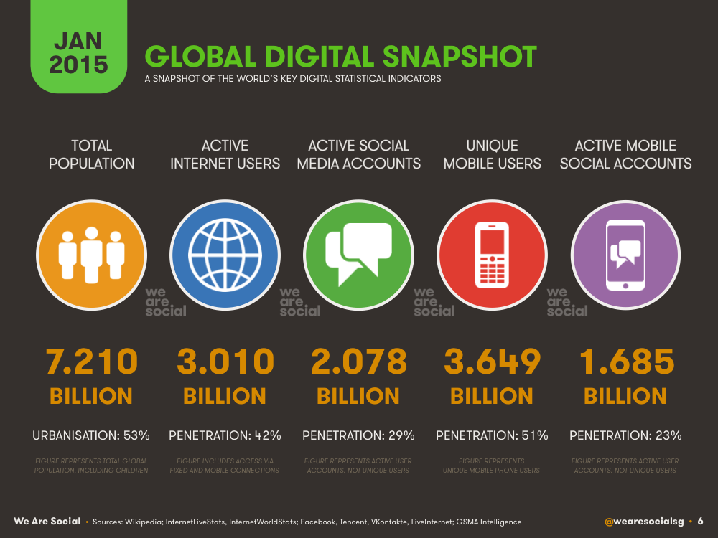
Notes:
http://wearesocial.com/uk/special-reports/digital-social-mobile-worldwide-201

Slide 3
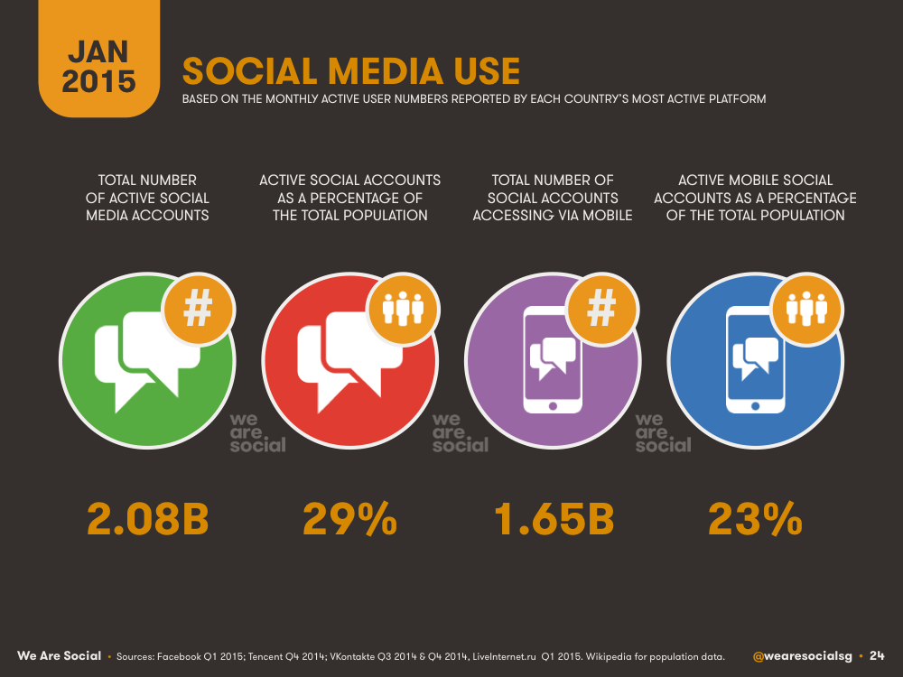
Notes:
http://wearesocial.com/uk/special-reports/digital-social-mobile-worldwide-2015

Slide 4
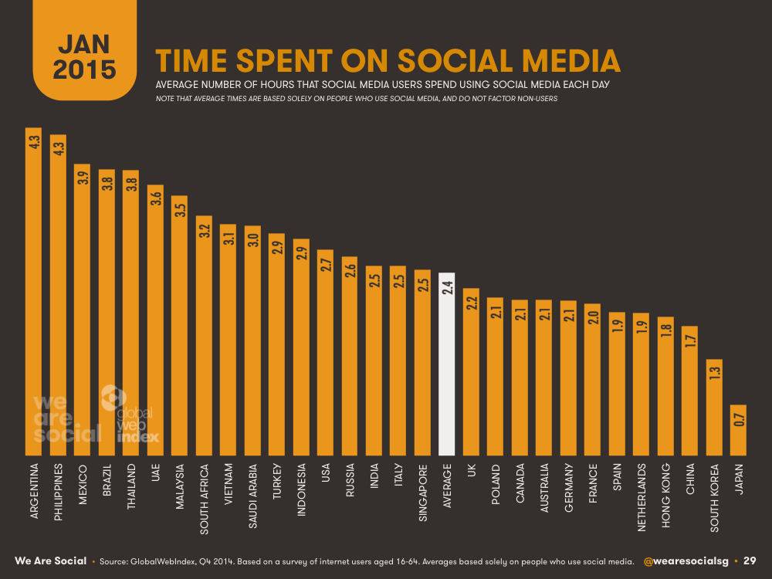

Slide 5
We are social exercise
In groups of four:
What do you use social media for?
What social media do you use for that activity?

Slide 6
What is social media?

Slide 7
Five ‘C’s of social media
Connection
Creation
Circulation
Conversation
Community

Slide 8
What do you bring to the class?

Slide 9
Syllabus
https://blogs.ubc.ca/decodingsocialmedia2016/

Slide 10
Assignments
HootSuite certification
Social media professional portfolio
Social media in-class presentations
Vancouver Social Instagram
Applied client project

Slide 11
Media partners
Canadian Journalism Foundation
CBC Vancouver
Discourse Media
Doxa Film Festival
Georgia Straight
Journalists for Human Rights
Pique Magazine
Roundhouse Radio

