Slide 1
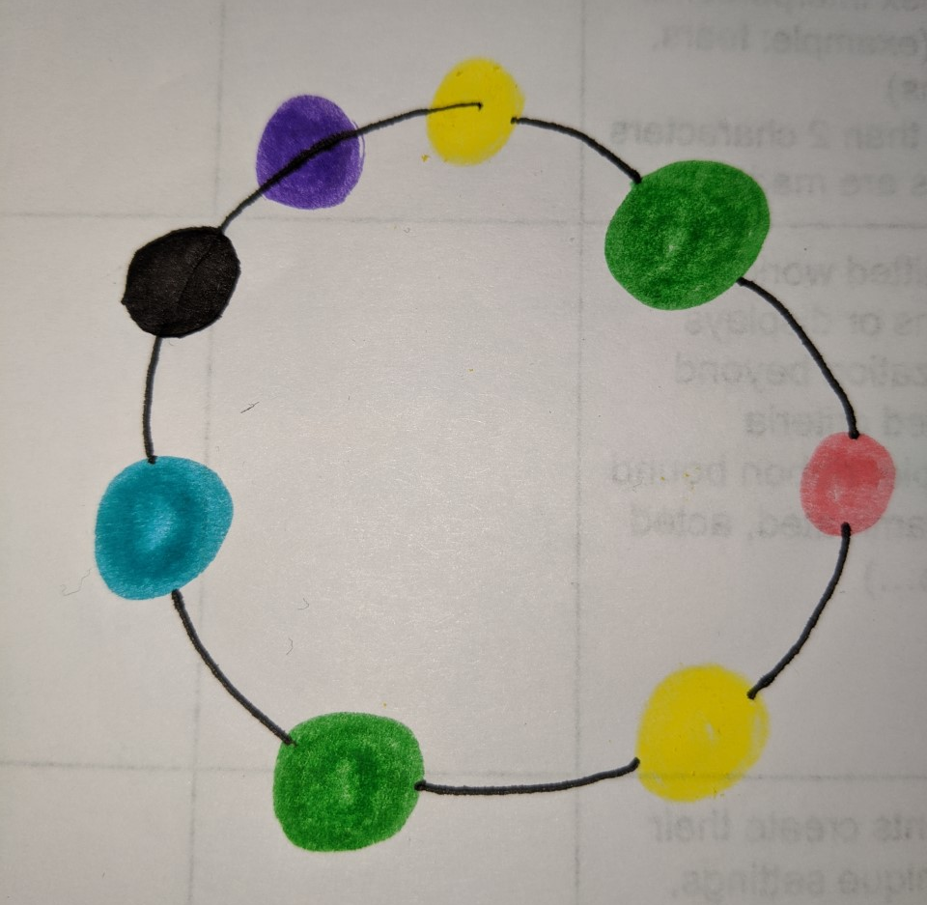
Identity Bracelets
Materials:
String
Beads
Markers
Paper
Other art supplies (you decide!)
Instructions
Cut a length of string (15-30cm for a child) and tie a large knot on one end
Read each bead number and choose the colour for each that best describes you
Write each bracelet bead colour’s meaning
Share your identity
If you don’t have string or beads, draw your bracelet instead!

Slide 2
Bead #1: Where in the world were you born?
Africa purple
North/Central America yellow
Asia green
Europe pink
Oceania orange
South America black
The Middle East blue

Slide 3
Bead #2. What is your favourite junk food?
Chips green
Slurpee purple
Chocolate black
Ice Cream pink
Candy blue
Cakes/Pastry yellow
Cola/Soft Drinks orange

Slide 4
Bead #3: Where was one parent born?
Africa purple
North/Central America yellow
Asia green
Europe pink
Oceania orange
South America black
The Middle East blue

Slide 5
Bead #4: What is your favourite genre of music?
Classical/Jazz purple
Rap/Hip hop yellow
Pop/Rock green
Kpop/Jpop pink
Nursery Rhymes orange
Country black
Movie/Game/TV blue

Slide 6
Bead #5: Which group is most important to you?
Family purple
Community (team/club) yellow
Friend green
Religious/Spiritual pink
Ethnic/Cultural orange
National (country) black
Online blue

Slide 7
Bead #6: What is your favourite landform?
Hills/ valleys yellow
Underwater blue
Mountain orange
Tundra (ice) pink
Forest green
City/houses black
Desert purple

Slide 8
Bead #7: How many languages do you speak?
1. orange
2. black
3. yellow
4. blue
5 pink
6. green
7+. purple

Slide 9
Bead #8: What do you do?
Music/dance purple
Sports yellow
Martial arts green
Academic (math, kumon) pink
Outdoor/garden orange
Tech/computers black
Other/not listed blue

Slide 10
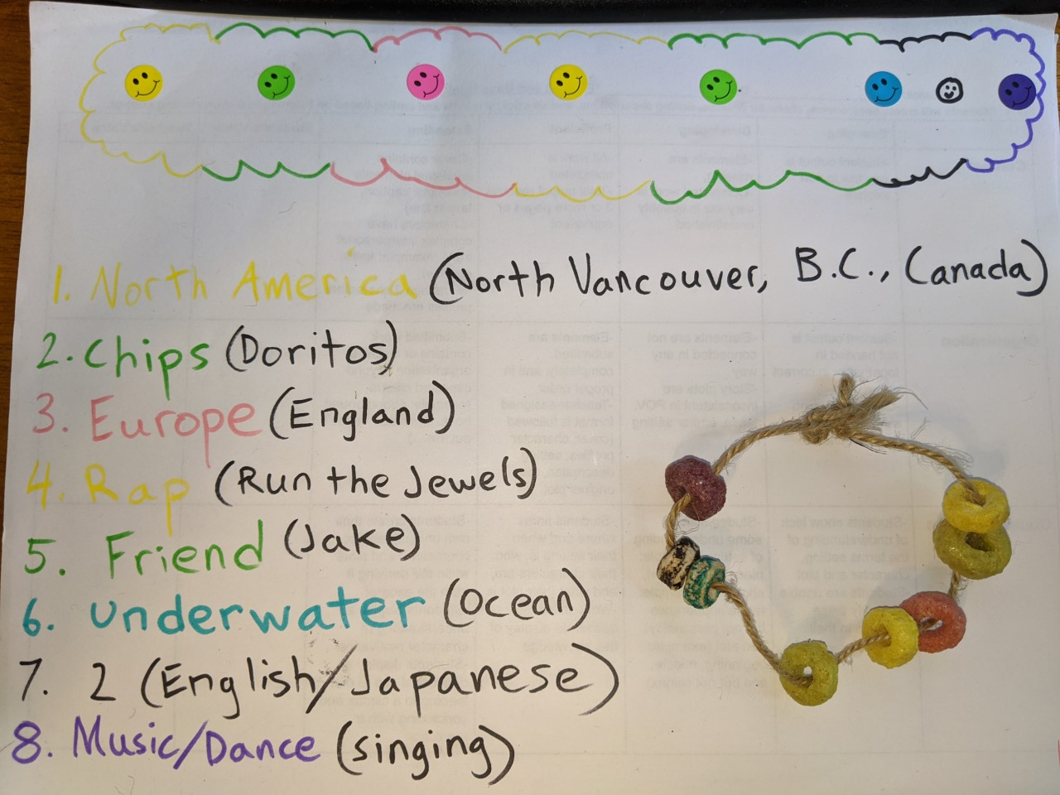
Mr. Walsh’s Identity Bracelet

