Slide 1
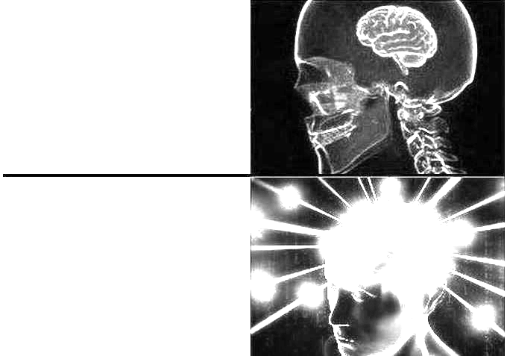
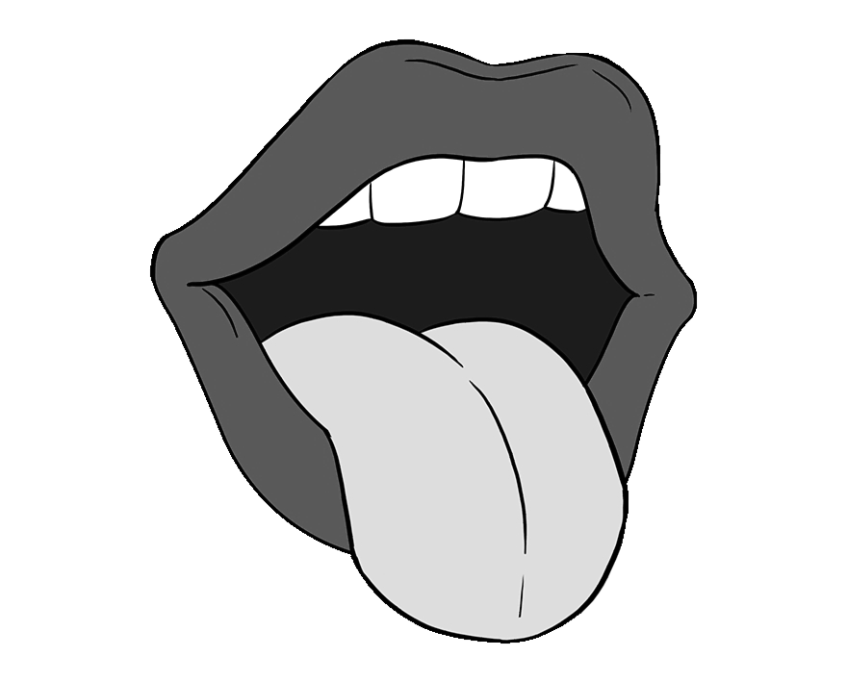
Imagery is descriptive language, such as words or phrases, that make you think of your senses. Imagery is used in text to make it more interesting.
Think of words or phrases that connect to the senses and write them in the boxes.
I HAVE A DOG.
Imagery
I HAVE A NOISY, WET DOG THAT STINKS.
Sight | Sound | Smell | Taste | Touch | Other (emotions, temperature, movement)

