Slide 1
Course development by the OERu: A case study using Davis’ Arena of change with technology in education
FLANZ Conference
9 – 11 April 2018
Danielle Dubien
danielle.dubien@pg.canterbury.ac.nz
Supervisors
Distinguished Professor Niki Davis
Associate Professor Annelies Kamp
Associate Professor Cheryl Brown

Slide 2
Context
Demand for Higher Education is increasing
Global HE enrollments:
165 million to ≈ 265 million by 2025 (UNESCO & COL, 2015).
“by 2020, 40% of the global workforce will be knowledge workers” (Kanwar & Daniel, 2010, p. 404).
There is an increasing need for digital skills.
(Bates, 2015; Erstad, 2011; Jenkins, Purushotma, Weigel, Clinton, & Robison, 2009).
Course development by the OERu: A case study using Davis’ Arena of change with technology in education by Danielle Dubien, Niki Davis, Annelies Kamp, and Cheryl Brown is licensed under a Creative Commons Attribution 4.0 International License.

Slide 3
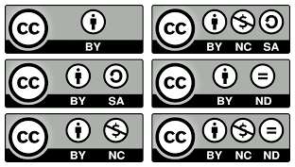
What are Open Educational Resources (OERs)?
Creative Commons licenses
5 Rs: retention, reuse, revision, remixing, redistribution
(Butcher, 2011; Hilton III, Wiley, Stein, & Johnson, 2010; OECD, 2007; Tuomi, 2006).

Slide 4
What are Open Educational Practices?
“practices which support the production, use and reuse of high quality open educational resources (OER) through institutional policies, which promote innovative pedagogical models, and respect and empower learners as co-producers on their lifelong learning path. OEP address the whole OER governance community: policy makers, managers and administrators of organisations, educational professionals and learners.”
(Ehlers, 2011, p. 2)

Slide 5
Problem
Open Educational Practices (OEPs )
Not common
Poorly implemented
(Conole, 2012; Minnaar, 2013; Murphy, 2013).
Effective implementation of Open Educational Practices requires organisational change
RESEARCH FOCUS: Processes
OEP implementation
Course design and development
OEP

Slide 6
Why?
To provide models for tertiary institutions interested in implementing OEPs, designing courses using OERs, and using open pedagogies

Slide 7
Main
Research Question
In what ways are the design and development of courses using OERs for use in higher education institutions influenced by implementing Open Educational Practices?

Slide 8
Guiding
sub-question
How do resources and processes influence the implementation of OEPs, particularly for instructional design for open education?
Case study of processes and OEPs related to designing a course

Slide 9
Methodology

Slide 10
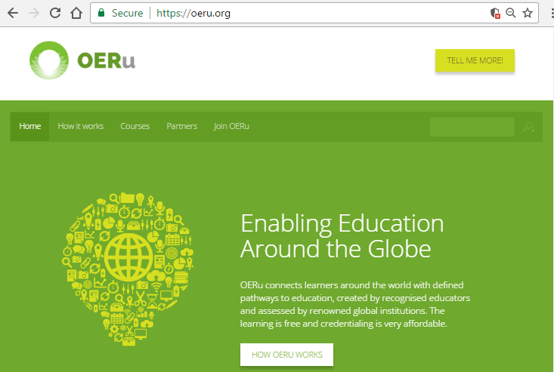
OERu
Open Education Resource universitas
Network of international higher education institutions
Based on the application of OEPs
Vision: provide affordable access to higher education
(OERu, n.d.a)
OERu characteristics
Started in 2011
31 international partners
Certificate of Higher Education in Business
Certificate of General Studies
(OERu, n.d.b)

Slide 11
OERu
Case study
Course A
Case study
QR team
Mini case study of
member institution
Mini case study of
member institution
(Creswell, 2007; Creswell, 2014; Gay, Mills, & Airasian, 2009; Yin, 2014)

Slide 12
Theoretical Framework: Davis’ Arena

Slide 13
What is the Arena?
Davis’ (2018) Arena of change with technology in education
Aims to increase the understanding of the impact of an educational innovation in a system.
Clarifies the complexity of a system
Exposes relationships within the system
Assists in identifying ways to minimise disruption with technology into a learning environment (therefore increasing sustainability)
Considers that educational technologies and learning environments cause each other to evolve. This is co-evolution.
(Davis, 2018)

Slide 14
Why use the Arena?
Holistic
Layered from local (innovation) to global
Categorised into sectors:
Resources
Professional
Community
Bureaucratic
Political
Considers interactions
(Davis, 2018)

Slide 15
Arena Framework Based in
Ecology
Course ecosystem
Organizational ecosystem
National ecozone
Global ecosphere
Ecosystems contain matter
Non-living matter
Living matter or species
(includes Keystone species)

Slide 16
Resources
Political
Course
Organization
Professional
Bureaucratic
National
Global
Community

Slide 17
Findings:
“Course A”

Slide 18
Resources
Political
A
Professional
Bureaucratic
Community
Notes:
http://course.oeru.org/lida101/course-guide/course-technologies/
This system has at its centre the course entitled Learning in a Digital Age, which is intended to help students develop technological and critical thinking skills. These skills are intended to prepare students for subsequent online studies, resulting in lower attrition rates and higher achievement.
required. The course is described by the OERu as follows:
[Learners] will develop the academic skills to discern the credibility, accuracy and integrity of open access resources available on the Internet and corresponding digital tools to research, analyse and present information for academic purposes. [Learners] will also develop competence in a range of digital tools including: social media; communication and collaboration tools; and publishing tools; to support learning in contemporary society. This will include knowledge of copyright, open licensing, media literacy and digital citizenship. Source: https://oeru.org/oeru-partners/otago-polytechnic/learning-in-a-digital-age/
The course is being developed by the OERu director who is the keystone species because he is the person with the greatest influence on the OERu and this course development. Given his knowledge of the OERu, he also has influence in the kind of content the course will contain. (indicate later that some parts – like the learning objectives and the organisation of the micro-courses were done through crowd-sourcing using social media and in a consultative meeting, respectively.
Other species in the course ecosystem are credited and non-credited learners. To explain, this course is intended to be delivered as an open boundary course which means that it will be offered at one or more universities to students who will complete formal assessments and, if successful, will receive credit for the course. At the same time, students from around the world will be participating, but they will not receive credit for their work. They are participating to learn informally. They can communicate with the for-credit students. The result is an increase in student-student interactions which can be a source of technical and subject-matter support, plus an enriching experience considering the variety of student perspectives. This flow of communication must be controlled so that the students are not overwhelmed to the detriment of their learning and their experience with the course and the other students.
Once the course is developed, the role of the OERu as keystone species is done. Those who facilitate the course will gain importance in the ecosystem. However, the students are expected to contribute to the course in many ways, including completing assignments, interacting with each other to comment on course content and to offer each other support. They strongly influence what is learned. Do they not take on a keystone species role?

Slide 19
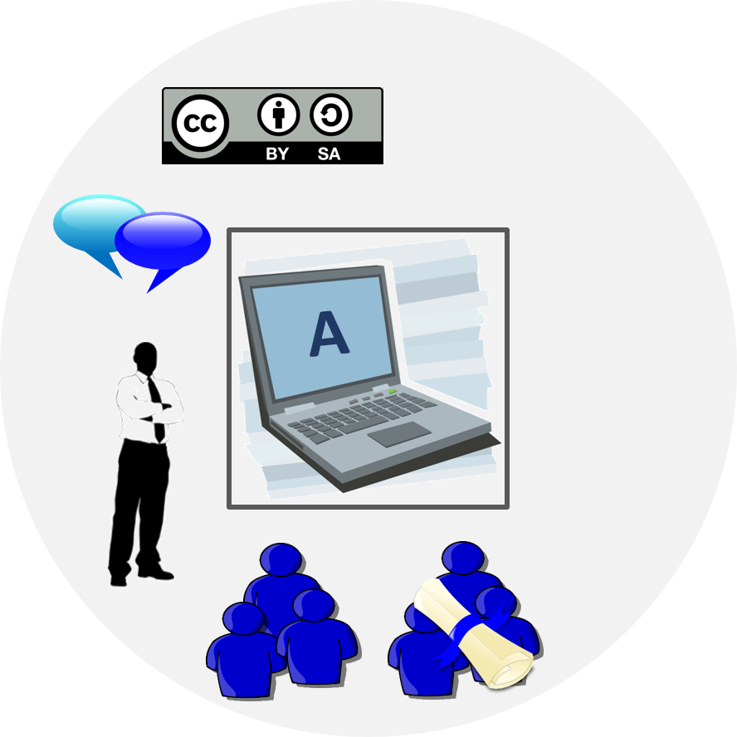
Analytics
Resources
Political
Professional
QR Team
Bureaucratic
Community
Notes:
The OERu director has free reign to design the course as he pleases because he leads both the OERu and the OER Foundation. He is also a bridge between course development and the ecosystem of the organization. This position grants him access to information, resources, and authority that can inform course development. For example, he was able to lead a crowdsourcing activity through social media where anyone could contribute ideas for course topics at the stage of course design. The idea for this activity came from a consultant hired to work on course design and development.
Bureaucratic topics
This course is part of the Certificate in General Studies, which is recognised by (can I identify the institution? It’s TRU.) This certificate equates to the first year of study in a general Bachelor of Arts degree.
The launch of the first year of study is an objective in the OERu’s strategic plan.
Strategic Goal: Develop a coherent OERu programme of study with defined learning pathways and exit credentials
Strategic objectives:
Develop product for a coherent OERu programme of study
Develop guidelines and implement procedures for building the OERu programme of study incorporating alternate pathways (streams)
Source: http://wikieducator.org/images/6/68/OERu_strategic_plan_2015-2017-Fin-Approved.pdf
While the strategic goal and a strategic objective mention a « coherent OERu programme of study » there are no plans to do any program design in the foreseeable future. Source: https://wikieducator.org/OERu/Planning/Quality/First_meeting
The OERu director held an online meeting that anyone could attend on June 6th 2016 Source: http://wikieducator.org/Learning_in_a_digital_age/1st_Meeting The purpose of this course was to discuss the order of the micro-courses, to showcase the course development and technological and pedagogical features of the course.
The living species (besides the keystone species) include the information technologist employed by the OERu, the Curriculum and Quality working group, the concept of Academic Volunteers International (AVI), the attendees of the annual International Partners meeting, the attendees of the annual meeting of the Council of CEOs, and the Marketing working group.
AVI is only at the conceptual phase at the moment. The intention is for this croup to be composed of volunteers who can provide general instructional support and discipline-related support.
The marketing working group was invited to attend the online meeting about LiDA so that it could write a case study of the course and be better informed and prepared for later marketing activities, such as the publicity of the launch of the first year of study. The OERu would use this case study for publicity of the course, to explain the OERu’s approach to course design, and to explain that this course is intended to be a part of the OERu’s first year of study certificate. Case study: https://oeru.org/news/learning-in-a-digital-age/
The open source technologist selects and implements technology in OERu courses and offers guidance to OERu members about coding and technology use.
The OERu has a Curriculum and Quality working group that is currently developing a framework for quality assurance standards to guide course development. This working group will also produce a guide on how to us the framework.
The attendees of the annual International Partners meeting gather in one location to suggest ideas for shaping the OERu’s strategic plan, among other topics. Anyone in the world can participate in the meetings because the OERu has provided links for webstreaming and editable web pages for inserting comments. All attendees, including those participating at a distance can suggest points to include on the agenda of the meeting of the Council of CEOs that meets for one day immediately following the International Partners meeting. The meeting of the Council of CEOs is closed; the only content available to the public are the agenda, the list of attendees, and the report of the meeting. The Council of CEOs provides administrative support.
The organisational culture is one of open philanthropy, which means that all planning and development work is available publicly online for anyone to edit and comment on. The planning and development pages are located on the Wikieducator site. « WikiEducator is a global community resource supported by the Open Education Resource Foundation”
Sources: http://wikieducator.org/Learning_in_a_digital_age and http://wikieducator.org/Main_Page

Slide 20
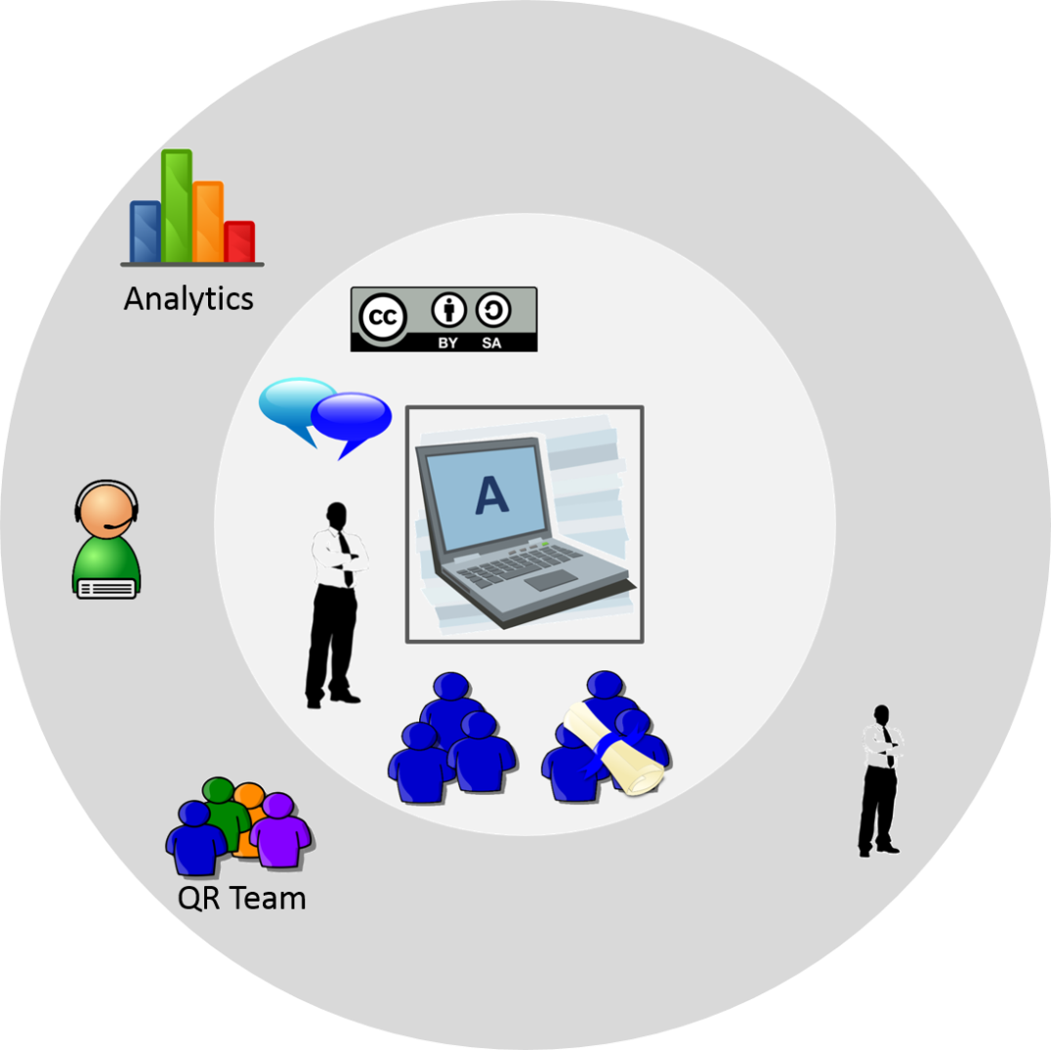
Resources
Political
Professional
Bureaucratic
Community

Slide 21
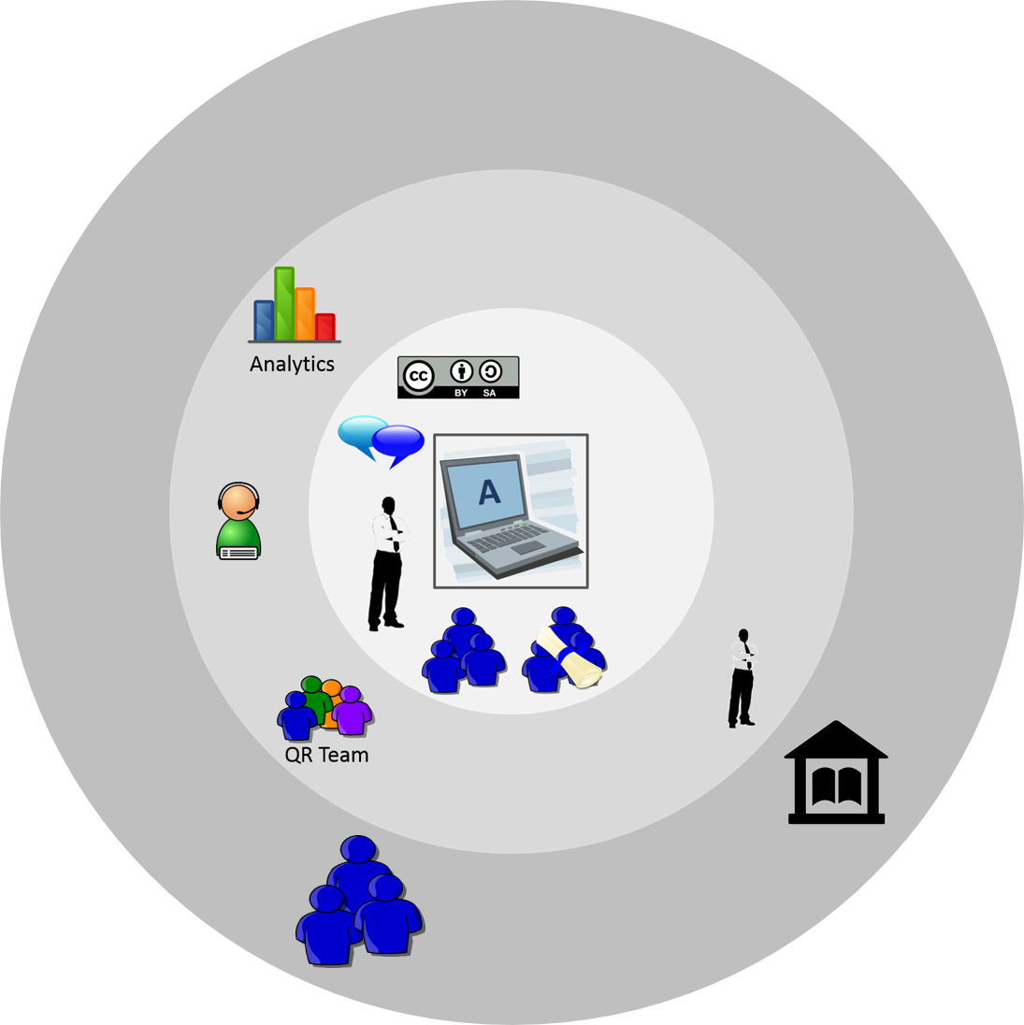
OER
Resources
Political
Wiki
Educator
AVI concept
Professional
Bureaucratic
Community
Notes:
UNESCO/COL/ICDE chair in OER
https://www.icde.org/icde-chairs-in-oer#sthash.NVE81xFa.dpbs
http://oerchairs.net/
http://unesdoc.unesco.org/images/0014/001439/143918e.pdf

Slide 22
OER
Resources
Political
Wiki
Educator
AVI concept
Professional
Bureaucratic
Community
Notes:
UNESCO/COL/ICDE chair in OER
https://www.icde.org/icde-chairs-in-oer#sthash.NVE81xFa.dpbs
http://oerchairs.net/
http://unesdoc.unesco.org/images/0014/001439/143918e.pdf

Slide 23
Where is the co-evolution?

Slide 24
References

Slide 25
Bates, A. W. (2015). Teaching in a digital age. Retrieved from: http://opentextbc.ca/teachinginadigitalage/
Butcher, N. (2011). A basic guide to open education resources (OER). Vancouver: COL & UNESCO. Retrieved from: http://oasis.col.org/handle/11599/36
Conole, G. (2012). Integrating OER into open educational practices. In J. H. Glennie, & N. &. Butcher (Eds.), Open educational resources and change in higher education: Reflections from practice (pp. 111 – 124). Vancouver: Commonwealth of Learning. Retrieved from http://oasis.col.org/handle/11599/80
Creswell, J. W. (2007). Qualitative inquiry & research design: Choosing among five approaches (2nd ed.). Thousand Oaks: Sage.
Creswell, J. W. (2014). Research design: Qualitative, quantitative, and mixed methods approaches (4th ed.). Thousand Oaks: Sage.
Davis, N.E. (2018). Digital technologies and change in education: The arena framework. London & New York: Routledge.
Ehlers, U.-D. (2011). Extending the territory: From open educational resources to open educational practices. Journal of Open Flexible and Distance Learning, 15(2), 1-10.
Erstad, O. (2011). Citizens navigating in literate worlds: The case of digital literacy. In M. Thomas (Ed.), Deconstructing digital natives: Young people, technology and the new literacies (pp. 99-118). New York, NY: Routledge.
Gay, L. R., Mills, G. E., & Airasian, P. W. (2009). Educational research: Competencies for analysis and applications (9th ed.). Upper Saddle River, NJ: Merrill/Pearson.
Hilton III, J., Wiley, D., Stein, J., & Johnson, A. (2010). The four ‘R’s of openness and ALMS analysis: Frameworks for open educational resources. Open Learning: The Journal of Open, Distance and e-Learning, 25(1), 37-44. doi:10.1080/02680510903482132

Slide 26
Kanwar, A., & Daniel, J. (2010). Distance Education and Open Universities A2 - Peterson, Penelope. In E. Baker & B. McGaw (Eds.), International Encyclopedia of Education (Third Edition) (pp. 404-410). Oxford: Elsevier.
Minnaar, A. (2013). Challenges for successful planning of open and distance learning (ODL): A template analysis. International Review of Research in Open and Distance Learning, 14(3), 81-108.
Murphy, A. (2013). Open educational practices in higher education: Institutional adoption and challenges. Distance Education, 34(2), 201-217. doi:10.1080/01587919.2013.793641
OECD. (2007). Giving knowledge for free: The emergence of open educational resources. Retrieved from http://www.oecd.org/dataoecd/35/7/38654317.pdf
OERu. (n.d.a). About OERu. Retrieved from: https://oeru.org/about-oeru/
OERu. (n.d.b). OERu. Retrieved from: https://oeru.org/
Tuomi, I. (2006). Open educational resources: What they are and why do they matter. Report prepared for the OECD. Retrieved from: http://www.meaningprocessing.com/personalPages/tuomi/articles/OpenEducationalResources_OECDreport.pdf
UNESCO, Commonwealth of Learning. (2015). Guidelines for open educational resources (OER) in higher education. Vancouver: UNESCO & COL. Retrieved from: http://oasis.col.org/handle/11599/60
Yin, R. K. (2014). Case study research: Design and methods (5th ed.). Los Angeles: Sage.

Slide 27
Acknowledgements

Slide 28
Supervisors
Distinguished Professor Niki Davis
Associate Professor Annelies Kamp
Associate Professor Cheryl Brown
Research participants
OERu
Scholarship
University of Canterbury through the
Commonwealth Scholarship and Fellowship Plan
FLANZ Conference Postgraduate Student
Scholarship
Audience members

Slide 29
Questions

Slide 30
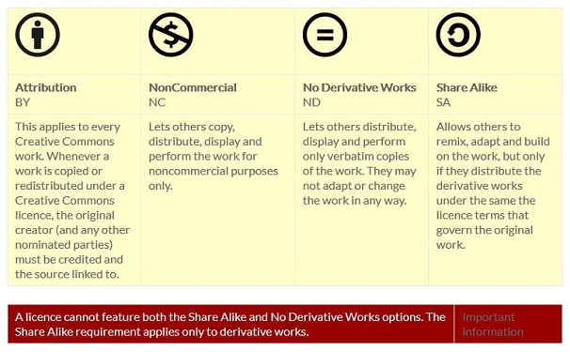
Content is available under the Creative Commons Attribution Share Alike License. http://wikieducator.org/course/Curriculum_design_for_open_education/Introduction:_Key_concepts_and_big_ideas/Creating_open_educational_resources_(OER)/
Creators:
Dr Carina Bossu and Wendy Fountain
http://wikieducator.org/course/Curriculum_design_for_open_education/Facilitators/

Slide 31
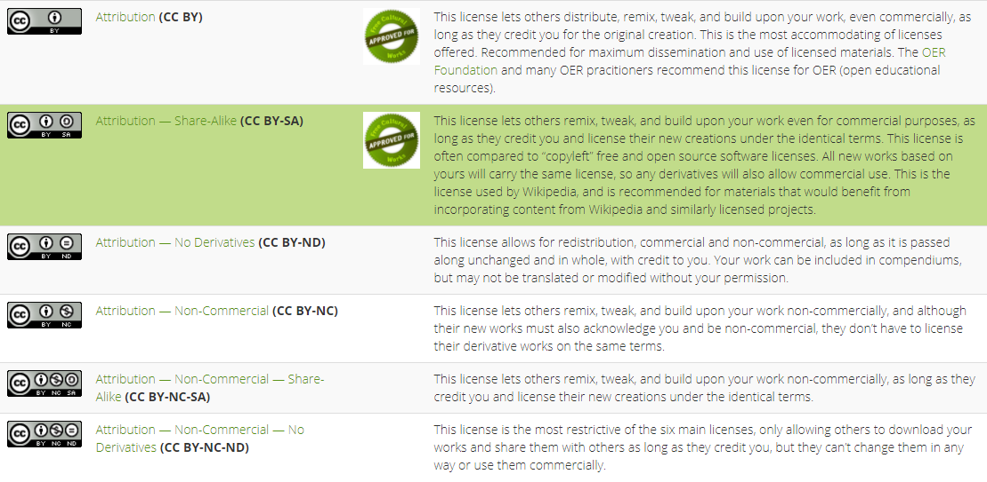
Content is available under the Creative Commons Attribution Share Alike License. http://wikieducator.org/course/Curriculum_design_for_open_education/Resources_and_technologies/The_CC_licenses/
Creators:
Dr Carina Bossu and Wendy Fountain
http://wikieducator.org/course/Curriculum_design_for_open_education/Facilitators/

Slide 32
Method of analysis
Inductive analysis using the constant comparative method
Categorical aggregation (Open coding)
Axial coding
Analytical memos
Deductive analysis
Davis’ (2018) Arena
Cameron and Quinn’s (1999) competing values framework
(Corbin & Strauss, 2008; Creswell & Poth, 2018; Merriam, 2002)

