Slide 1
Course development by higher education partners of the OERu:
Case studies using Davis’ Arena of change with technology in education
OER19
10 – 11 April 2019
Danielle Dubien
dubien.d@gmail.com
Supervisors
Associate Professor Cheryl Brown
Distinguished Professor Niki Davis
Associate Professor Annelies Kamp

Slide 2
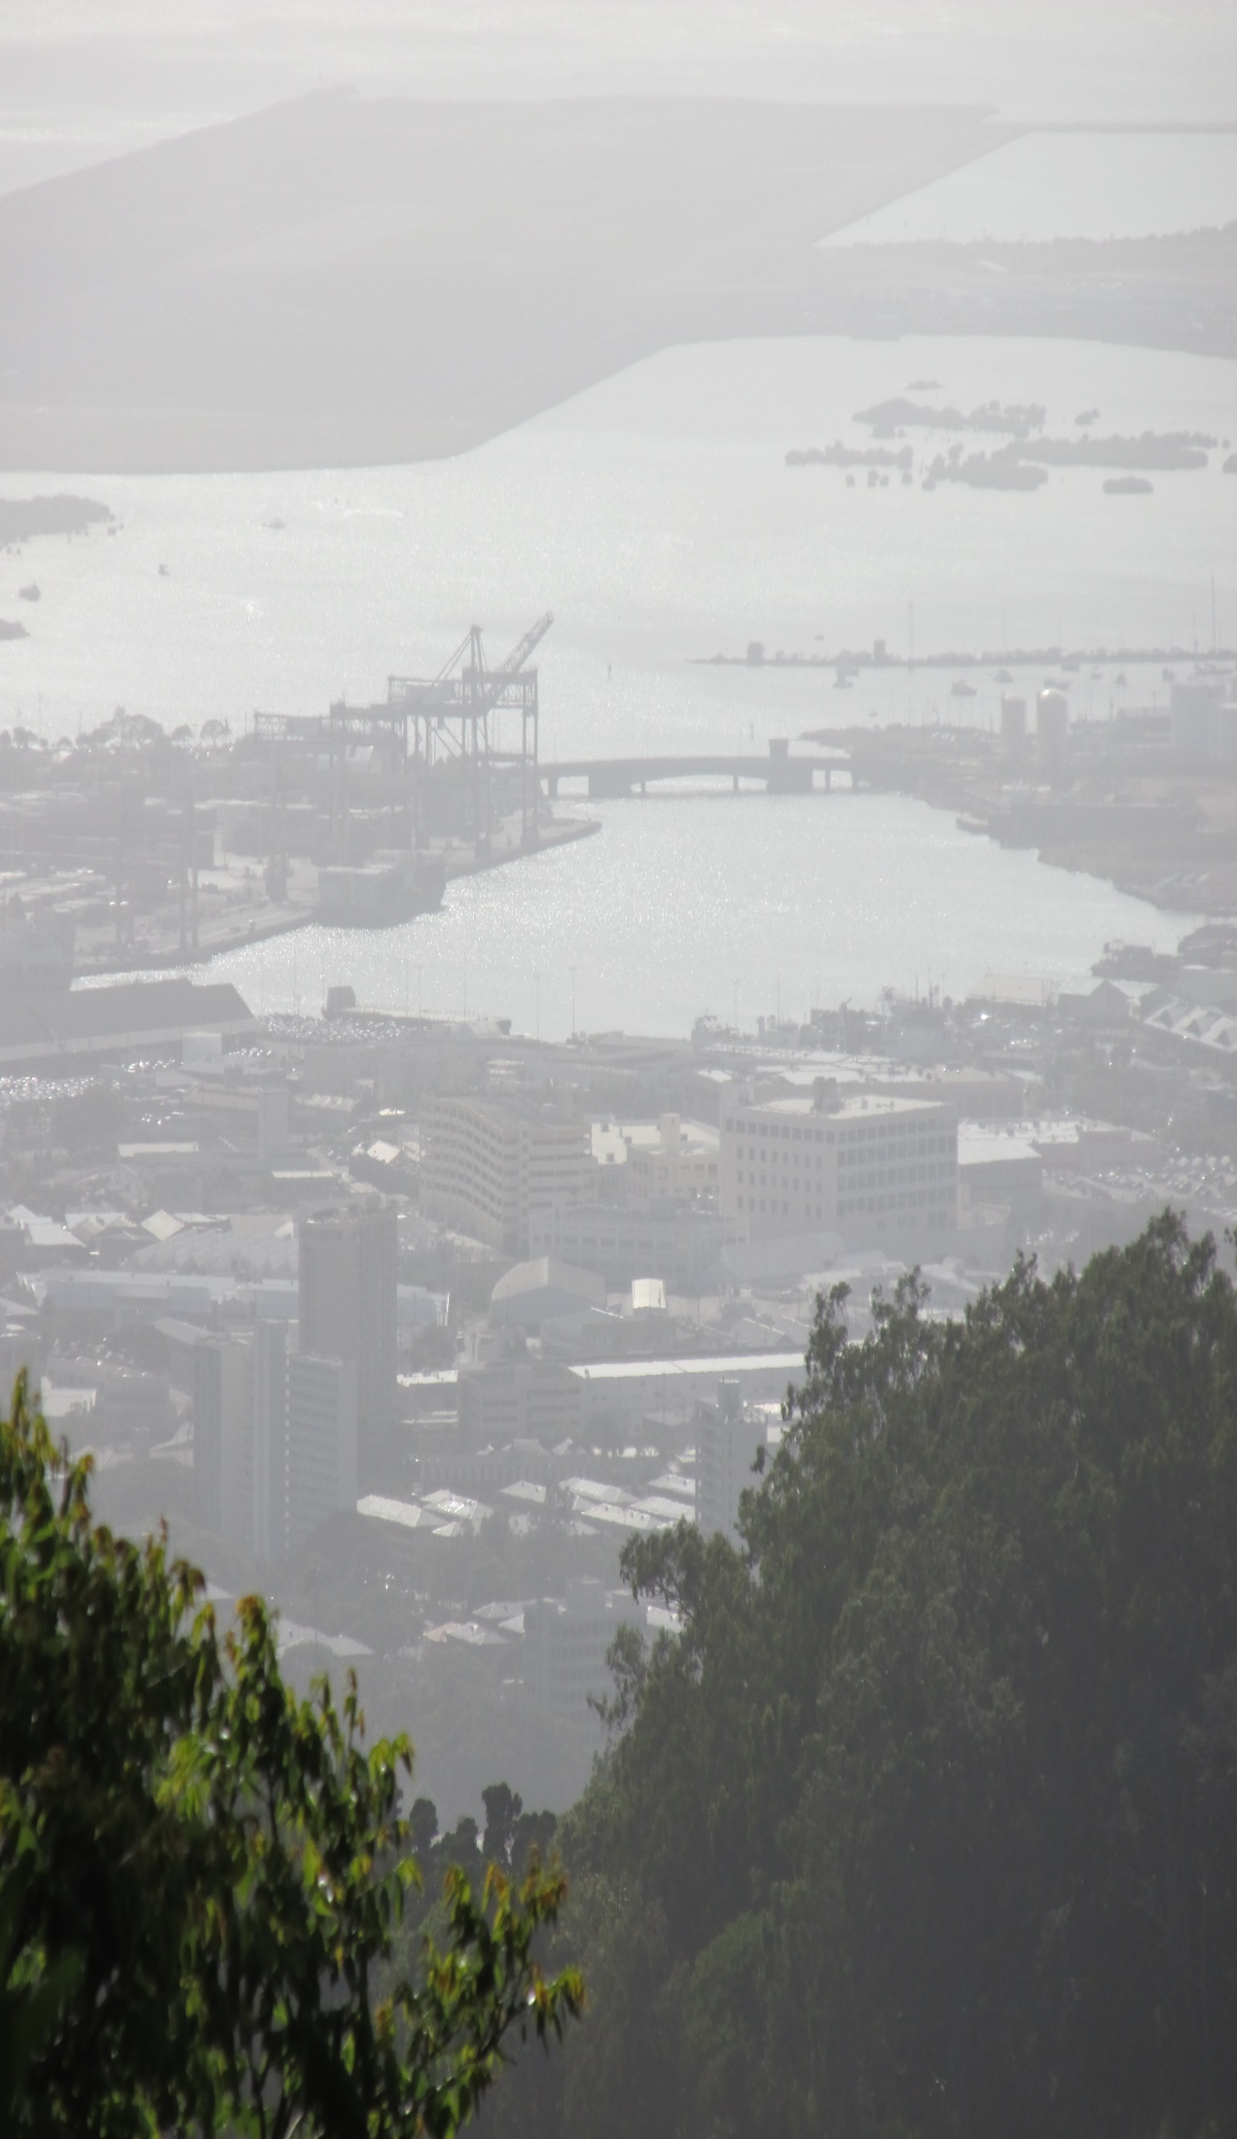
Context
Demand is increasing
According to UNESCO, demand for higher education is increasing by 1% annually (Marginson, 2016).
Desire for equality (Marginson, 2016).
There is an increasing need for digital skills.
(Bates, 2015; Erstad, 2011; Jenkins, Purushotma, Weigel, Clinton, & Robison, 2009).
OER can help to fill the demand.
OEP implementation can support effective OER use.
Course development by higher education partners of the OERu: Case studies using Davis’ Arena of change with technology in education. by Danielle Dubien, Cheryl Brown, Niki Davis, and Annelies Kamp. 2019. Licensed under a Creative Commons Attribution 4.0 International License.

Slide 3
Which definition of OER am I using?
Open Educational Resources are teaching, learning and research materials in any medium – digital or otherwise – that reside in the public domain or have been released under an open license that permits no-cost access, use, adaptation and redistribution by others with no or limited restrictions.
(William and Flora Hewlett Foundation, 2019)

Slide 4
Which definition of OEP am I using?
practices which support the production, use and reuse of high quality open educational resources (OER) through institutional policies, which promote innovative pedagogical models, and respect and empower learners as co-producers on their lifelong learning path. OEP address the whole OER governance community: policy makers, managers and administrators of organisations, educational professionals and learners.
(Ehlers, 2011, p. 2)

Slide 5
Research items
Problem
OERs are not widely used, and there remain questions as to how to increase their adoption by institutions (Kaatrakoski, Littlejohn, & Hood, 2017).
Case study of processes and OEPs related to designing a course within a
human ecosystem
Purpose
To provide models for tertiary institutions interested in implementing OEPs, designing courses using OERs, and using open pedagogies
Guiding question
How do resources and processes influence the implementation of OEPs, particularly for instructional design for open education?

Slide 6
Methodology

Slide 7
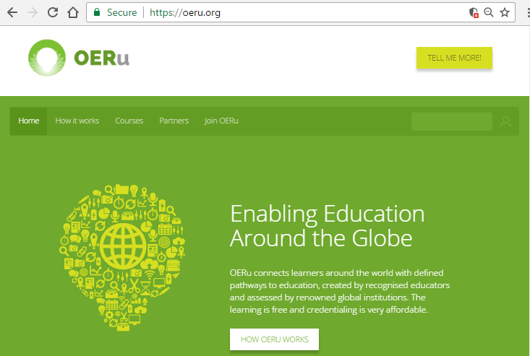
OERu
Open Education Resource universitas
Network of international higher education institutions
Vision: provide affordable access to higher education
(OERu, n.d.a)
(OERu, n.d.b)

Slide 8
OERu
Case study
Course A
OERu organizational culture and structure
Mini case study of
member institution
Mini case study of
member institution
(Creswell, 2007; Creswell, 2014; Gay, Mills, & Airasian, 2009; Yin, 2014)

Slide 9
Method of analysis
Inductive analysis
Constant comparative method
Categorical aggregation (Open coding)
Axial coding
Analytical memos
Deductive analysis
Davis’ (2018) Arena
Cameron and Quinn’s (1999) competing values framework

Slide 10
Theoretical framework:
Davis’ Arena

Slide 11
What is the Arena?
Davis’ (2018) Arena of change with technology in education
Aims to increase the understanding of the impact of an educational innovation in a system.
Clarifies the complexity of a system
Exposes relationships within the system
Assists in identifying ways to minimise disruption with technology into a learning environment (therefore increasing sustainability)
Considers that educational technologies and learning environments cause each other to evolve. This is co-evolution.
(Davis, 2018)

Slide 12
Why use the Arena?
Characteristics
Holistic
Layered from local (innovation) to global
Categorised into sectors:
Resources
Professional
Community
Bureaucratic
Political
Considers interactions

Slide 13
Arena framework is based in human ecology
Ecosystems contain matter
Non-living matter
Living matter or species
(includes Keystone species)
Course ecosystem
Organizational ecosystem
National ecozone
Global ecosphere

Slide 14
Findings

Slide 15
Case 1
OER
Resources
Political
course
Wiki
Educator
WordPress
CD
Exec
Exec
OERu
Professional
Bureaucratic
Community
Notes:
A course developer and an executive at this institution did the instructional design and development of a course for the OERu. They used a

Slide 16
Case 1
Resources
Political
course
Legal, safety, privacy issues
?
Educational experience
?
?
Business model
Support for learners
?
?
Bureaucratic
Professional
OERu
partners
?
Who are the learners
Community
Notes:
UNESCO/COL/ICDE chair in OER
https://www.icde.org/icde-chairs-in-oer#sthash.NVE81xFa.dpbs
http://oerchairs.net/
http://unesdoc.unesco.org/images/0014/001439/143918e.pdf

Slide 17
Case 2
OER
Resources
Political
Wiki
Educator
course
SME
CD
CD
CD
OERu Staff
OERu
Professional
Bureaucratic
Community
Notes:
UNESCO/COL/ICDE chair in OER
https://www.icde.org/icde-chairs-in-oer#sthash.NVE81xFa.dpbs
http://oerchairs.net/
http://unesdoc.unesco.org/images/0014/001439/143918e.pdf

Slide 18
Case 2
Resources
Political
course
?
Aesthetics
?
Business model
?
Bureaucratic
Professional
OERu
partners
?
Assessment
Community
Notes:
UNESCO/COL/ICDE chair in OER
https://www.icde.org/icde-chairs-in-oer#sthash.NVE81xFa.dpbs
http://oerchairs.net/
http://unesdoc.unesco.org/images/0014/001439/143918e.pdf

Slide 19
Comparison of the institutional case studies
 | Case 1 | Case 2
Type of course | Self-study with options for social media | Self-study with options for social media
Type of student work | Authentic tasks | Authentic tasks
Source of content | OER from Saylor OER found on the Internet Material designed from scratch | Material designed from scratch OER found on the Internet (images)
Student support | Link to a web site with text-based resources | Short demonstration videos
Keystone species | Executive | Subject-matter expert

Slide 20
 | Case 1 | Case 2
Nature of course developers’ experience | Strong in course design and development, using CC licenses finding and combining OER | Experienced in course design and development
Obtained support for | WikiEducator coding | WikiEducator coding CC licenses finding and combining OER
Support from | A highly skilled volunteer | OERu staff
Obtained feedback on course from | OERu community | Professional community related to course topic

Slide 21
 | Case 1 | Case 2
Obtained feedback on course from | OERu community | Professional community related to course topic
Disruptions | Developers and executives left | Developers and executives left
Sustainable measures | A large team was built up over years by the course developers Tech staff can do WikiEducator coding | Various staff know about OER & OEP Workflow processes are geared for re-usability Purchase of PressBooks license for open publication
By-product | Lessons learned | Empirical research article on pedagogy

Slide 22
Early conclusions

Slide 23
Influence of OEP on course design
Develop skills
Redistribute tasks
Produce courses and textbooks that are easier to modify and share than closed resources
Stimulate thinking about providing student support
Stimulate thinking about business models
Create a bank of courses to serve as models
Produce reports on lessons learned and research articles

Slide 24
Influence of OEP on course design
Processes for course development seem straightforward
Processes related to bureaucratic and business issues are less clear

Slide 25
Reflections

Slide 26
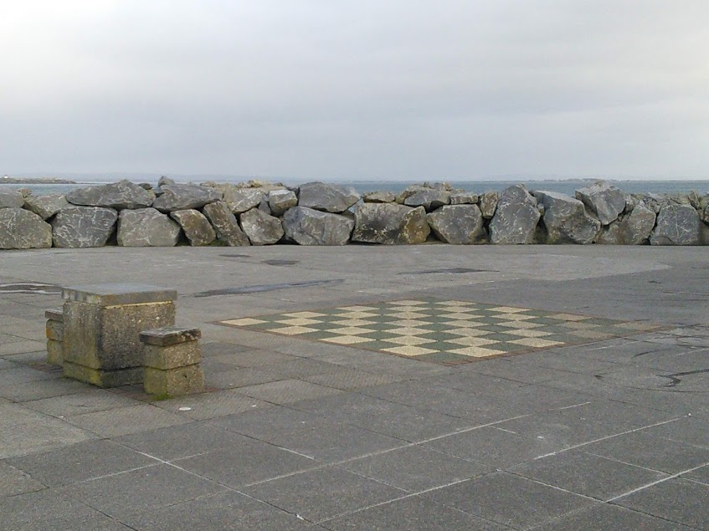
Interesting points about open research
I’ve been asked to share my work as it develops, even though I am in a learning phase
It seems taboo to discuss areas where open education could improve
Few empirical studies on OER and OEP
I have to remind myself to separate “open” practices from usual ones
Confusion about OEP definitions
Denial of OEP

Slide 27
What does it mean to be an open researcher
Easy to network when I have time
Most of my research is online: Convenient!
Most of my communication is text based and online: Confusion!

Slide 28
References

Slide 29
Bates, A. W. (2015). Teaching in a digital age. Retrieved from: http://opentextbc.ca/teachinginadigitalage/
Cameron, K. S., & Quinn, R. E. (1999). Diagnosing and changing organizational culture: Based on the competing values framework. Reading, Mass: Addison-Wesley.
Creswell, J. W. (2007). Qualitative inquiry & research design: Choosing among five approaches (2nd ed.). Thousand Oaks: Sage.
Creswell, J. W. (2014). Research design: Qualitative, quantitative, and mixed methods approaches (4th ed.). Thousand Oaks: Sage.
Davis, N.E. (2018). Digital technologies and change in education: The arena framework. London & New York: Routledge.
Ehlers, U.-D. (2011). Extending the territory: From open educational resources to open educational practices. Journal of Open Flexible and Distance Learning, 15(2), 1-10.
Erstad, O. (2011). Citizens navigating in literate worlds: The case of digital literacy. In M. Thomas (Ed.), Deconstructing digital natives: Young people, technology and the new literacies (pp. 99-118). New York, NY: Routledge.
Gay, L. R., Mills, G. E., & Airasian, P. W. (2009). Educational research: Competencies for analysis and applications (9th ed.). Upper Saddle River, NJ: Merrill/Pearson.

Slide 30
Jenkins, H., Purushotma, R., Weigel, M., Clinton, K., & Robison, A. (2009). Confronting the challenges of participatory culture: Media education for the 21st century. Cambridge: MIT Press.
Kaatrakoski, H., Littlejohn, A., & Hood, N. (2017). Learning challenges in higher education: An analysis of contradictions within open educational practice. Higher Education, 74(4), 599-615. doi:10.1007/s10734-016-0067-z
Marginson, S. (2016). The worldwide trend to high participation higher education: dynamics of social stratification in inclusive systems. Higher Education, 72(4), 413-434. doi:10.1007/s10734-016-0016-x
OERu. (n.d.a). About OERu. Retrieved from: https://oeru.org/about-oeru/
OERu. (n.d.b). OERu. Retrieved from: https://oeru.org/
William and Flora Hewlett Foundation. (2019). Open Educational Resources Available at https://hewlett.org/strategy/open-educational-resources/ [Accessed 4 Feb. 2019]
Yin, R. K. (2014). Case study research: Design and methods (5th ed.). Los Angeles: Sage.

Slide 31
Acknowledgments

Slide 32
Supervisors
Associate Professor Cheryl Brown
Distinguished Professor Niki Davis
Associate Professor Annelies Kamp
Research participants
Scholarship
Commonwealth Scholarship and Fellowship Plan
Funding from GO-GN to attend the 2019 GO-GN seminar and OER19.
Audience members

Slide 33
Questions

