Slide 2
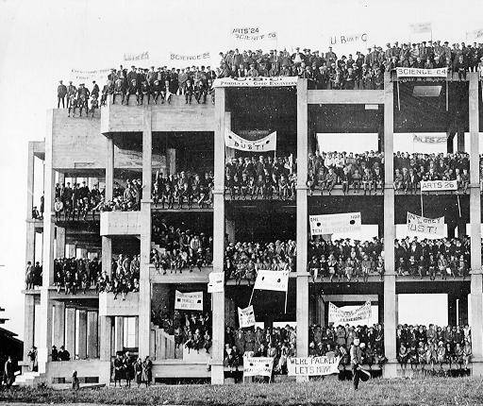
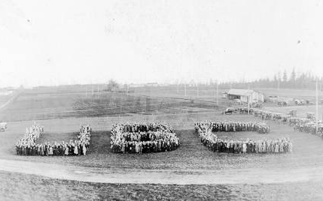
UBC History
The Great Trek
OUR HISTORY:GREAT TREK
Notes:
In the Great Trek of 1922, UBC students helped to convince the provincial government to open the Point Grey campus. On October 28th, almost 1,200 students with floats, bands and banners marched through downtown Vancouver and on to the Point Grey campus. Students climbed the unfinished infrastructure of the Science Building and hung their banners, then formed a “UBC” on the ground as a symbolic gesture to lay claim to the unfished campus. The activities of the students in undertaking an intensive public-awareness campaign helped to promote a better understanding of the goals and functions of the University amongst British Columbians. (Taken from http://www.library.ubc.ca/archives/humble.html)

Slide 4
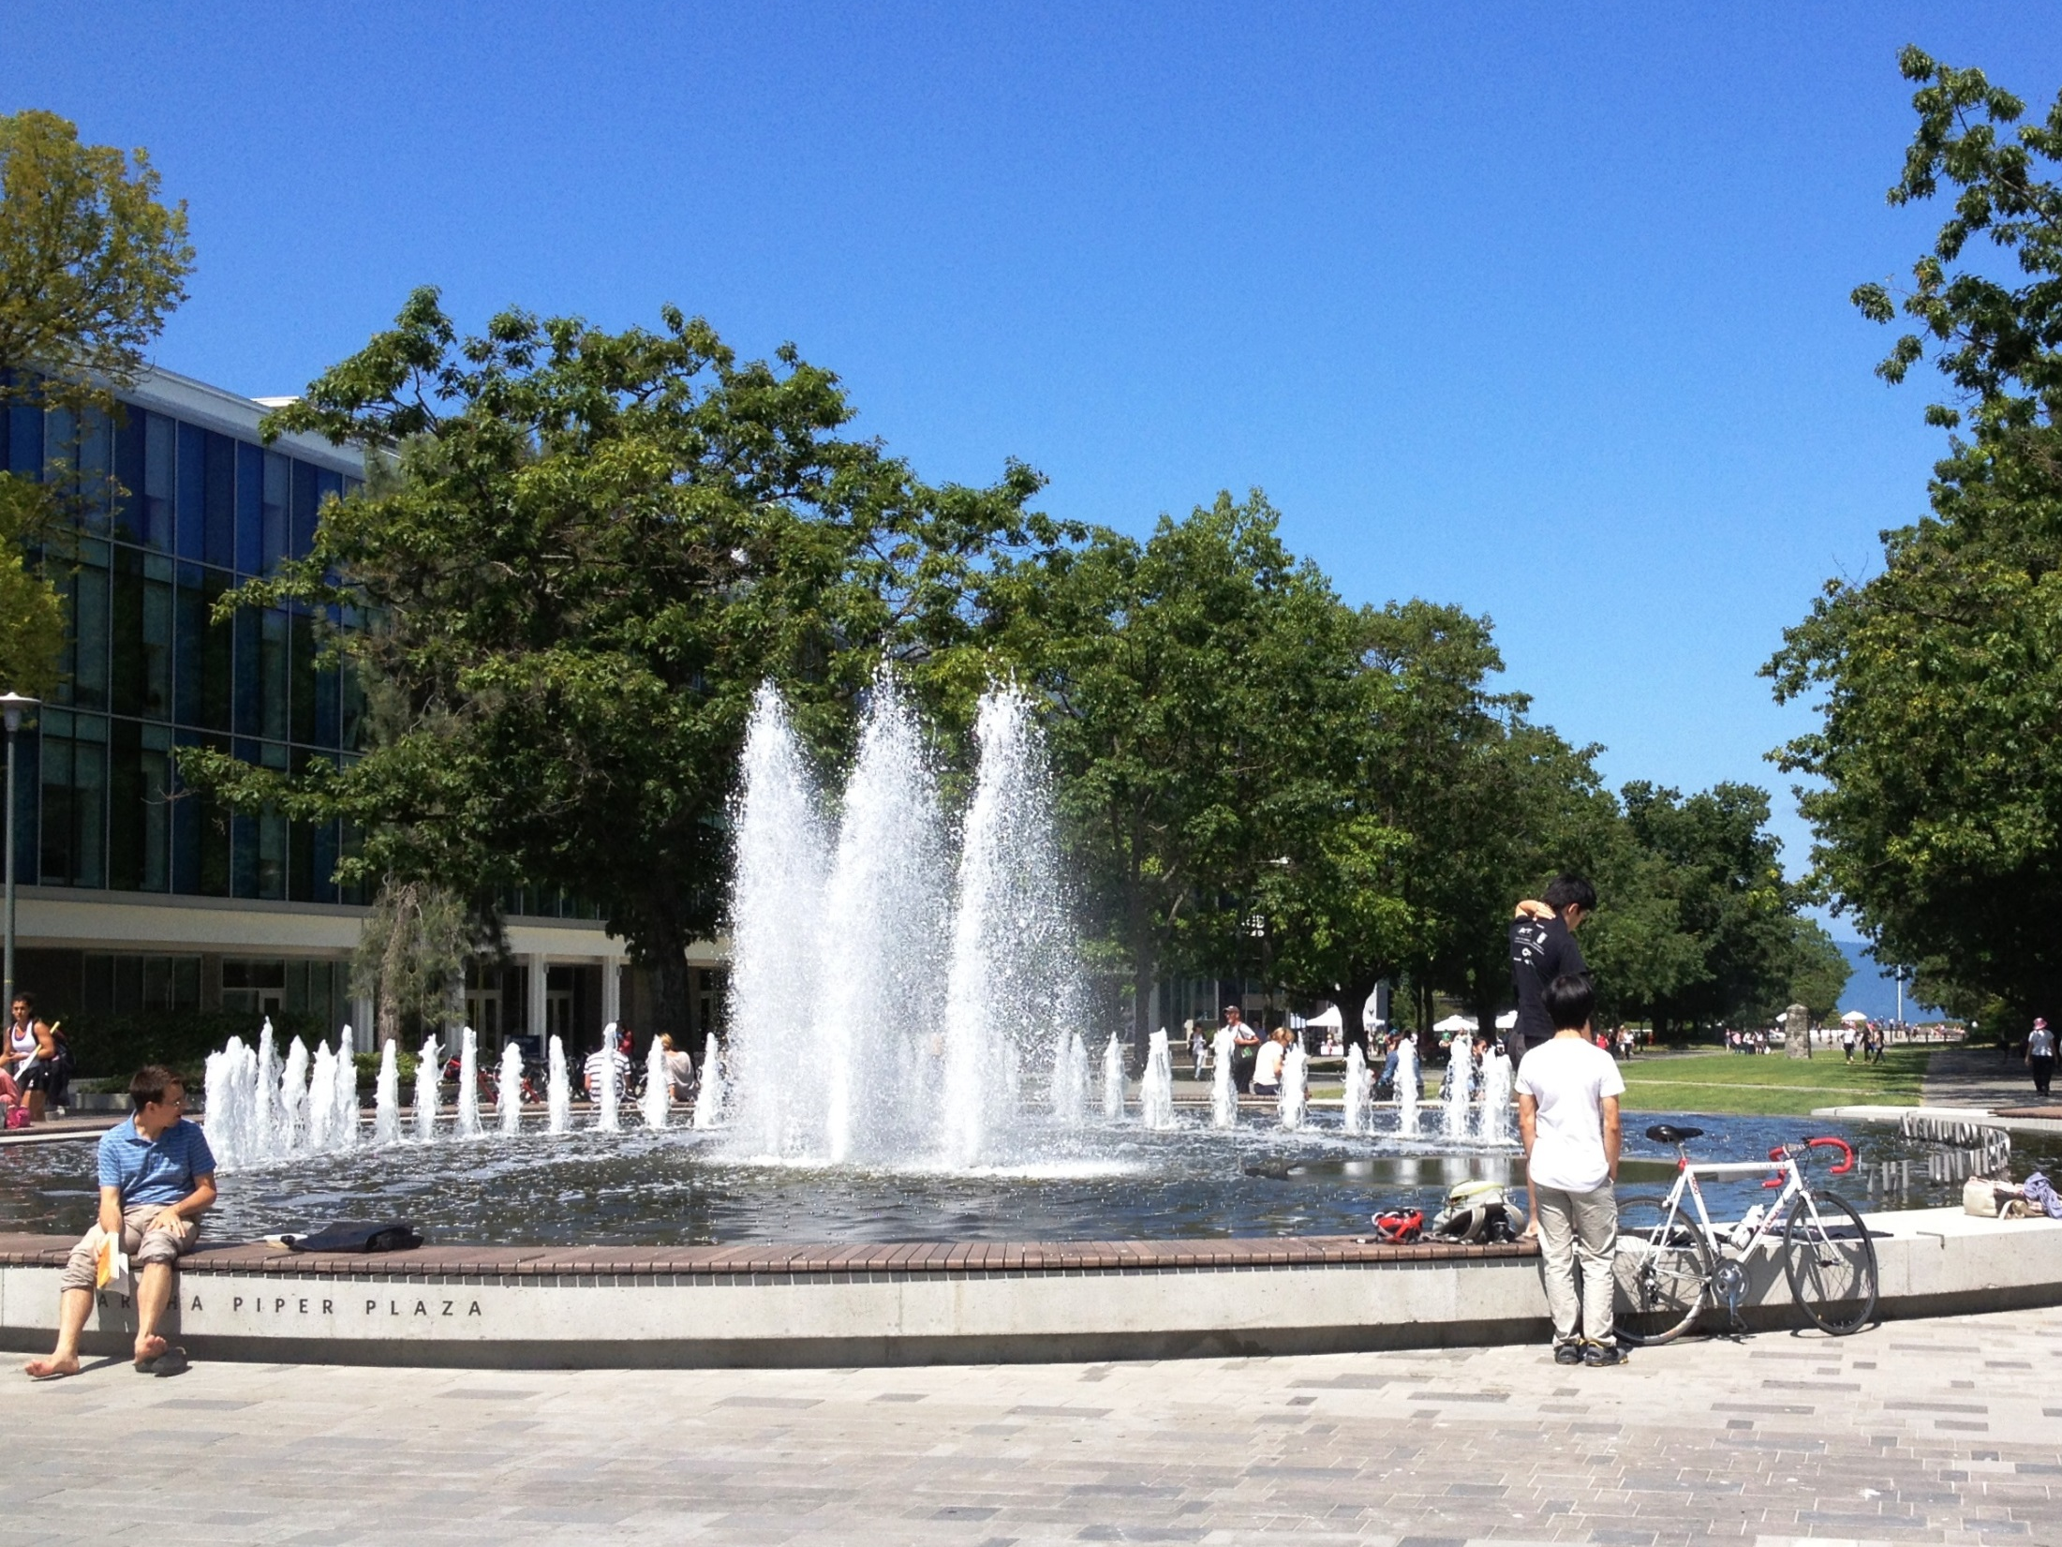

Slide 5
