Slide 1
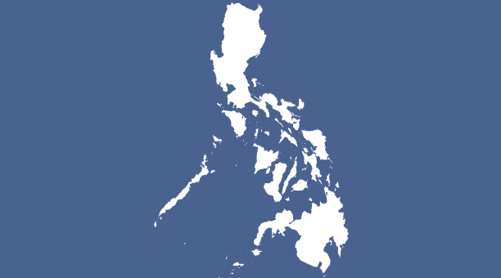
Jassen Ongcol
Did you eat yet?
GRSJ 230

Slide 2
DID YOU EAT YET?
I titled my blog this because it is the Filipino way of saying 'Hello'. I wanted a title that wasn't serious and was open to interpretation. My blog has nothing to do with food and/or eating, but in a way, my weekly posts act as a viewers weekly intake of Filipino knowledge. In the Filipino language (Tagalog), there is no individual word for 'Hello', and it is equivalent with the phrase, 'How are you?'. Growing up in a Filipino household, I have learned that there are two ways of saying 'Hello', and many times both ways are accompanied by each other:
'How are you?' Have you eaten?

Slide 3
Why I chose this topic for my blog
Niche: Exploring the types of people involved in the Filipino film industry
I chose this to be the topic for my blog because I have been interested in the models, actors, and television personalities involved in Philippine media. I am also interested in the thoughts of non-Filipino communities on Filipino culture.

Slide 4
Blog Posts
(From latest to most recent)
1) Title: How many?
• I did not really no how to start off my blog, so I decided to just provide facts about the population of The Philippines and Filipinos in Canada.
2) Title: Filipino-American identity
• How it feels to be part of the Filipino diaspora in America (video)
3) Title: The Country's Favourite Homosexual
• Prior to this post I wanted to touch upon the openly gay television personalities in the Filipino spotlight, because there aren't many.
4) Title: Miss Universe Philippines 2015
• the Philippines is usually a big contender in international beauty pageants, and this was a hot topic for pageant lovers in the spring of 2015, because it had to do with the Philippines not being able to compete in the Miss Universe competition
5) Title: "natural exfoliant"
• this post was influenced by the blog post a week before. This post is talking about a famous whitening soap bar in the Philippines, and the misuse of the word Mestizo in the Philippines

Slide 5
Continued…
6) Title: Filipino Mestizo
• this post was influenced by the blog post a week before. This post is talking about the misuse of the word Mestizo in the Philippines. I also attached a rappler article about a study that mapped out the demographics of the Filipino people
7) Title: What is wrong with Philippine Cinema?
• I attached an article that talks about how bad Philippine cinema is and I add on with my thoughts to agree with the article
8) Title: NIDO commercials
• This post is about analyzing similar features of Filipino NIDO commercials
9) Title: Is it really more fun in the Philippines?
• The final blog post. It talks about the Philippines national tourism campaign and how some Filipinos revise its advertising, to portray societal and political issues of the country

Slide 6
What I hope people gain from looking at my Blog:
I want the viewers to gain an interest in observing the emphasized and not so emphasized qualities that occur in the media from where they originate

Slide 7
Thank you! Salamat!
The End
Tapos

