Slide 1
Climate 2085 – Climate Change Impact Assessment of 157 Western North American Ski Resorts
Ethan Clark

Slide 2
General Overview
Goal: Modelling of future climate scenarios and the impact on length of ski season for 157 Western North American Ski Resorts
Modelled under two different Representative Concentration Pathways (RCP) to the years 2025, 2055 and 2085
Under RCP4.5 and RCP8.5 greenhouse gas emission scenarios
Data generated using ClimateNA and ClimateBC
Resort Lat/Long and Peak, Middle and Base Elevation
Polynomial regression used to generate daily mean temperature curves
-2°C threshold to determine season length
Geographic Information Systems visualizations and spatial analysis

Slide 3
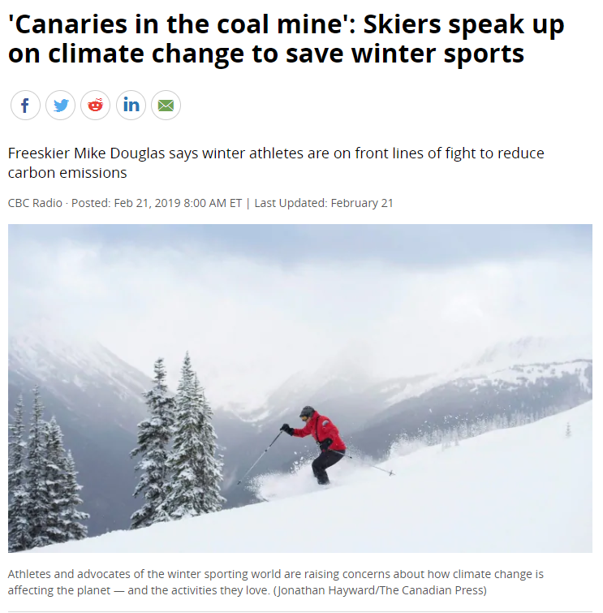
Goal
Climate change is impacting socioeconomic systems
In the USA alone, 9.8 million on-slope participants in 2010
(National Ski Areas Association, 2011)
In Canada, ski industry accounts for over $1 Billion a year
(Canada Ski Council, 2017)
Present a perspective to lobbying climate change mitigation efforts
Push for the industry for the reduction of carbon emissions
(CBC, 2019)
Notes:
Research conducted on winter sports and climate change effect on temperature and precipitation. Different view further the scope for the impacts of climate change. RQ: What changes will happen to the ski season length in the future, pattern identified to adapt or mitigate.

Slide 4
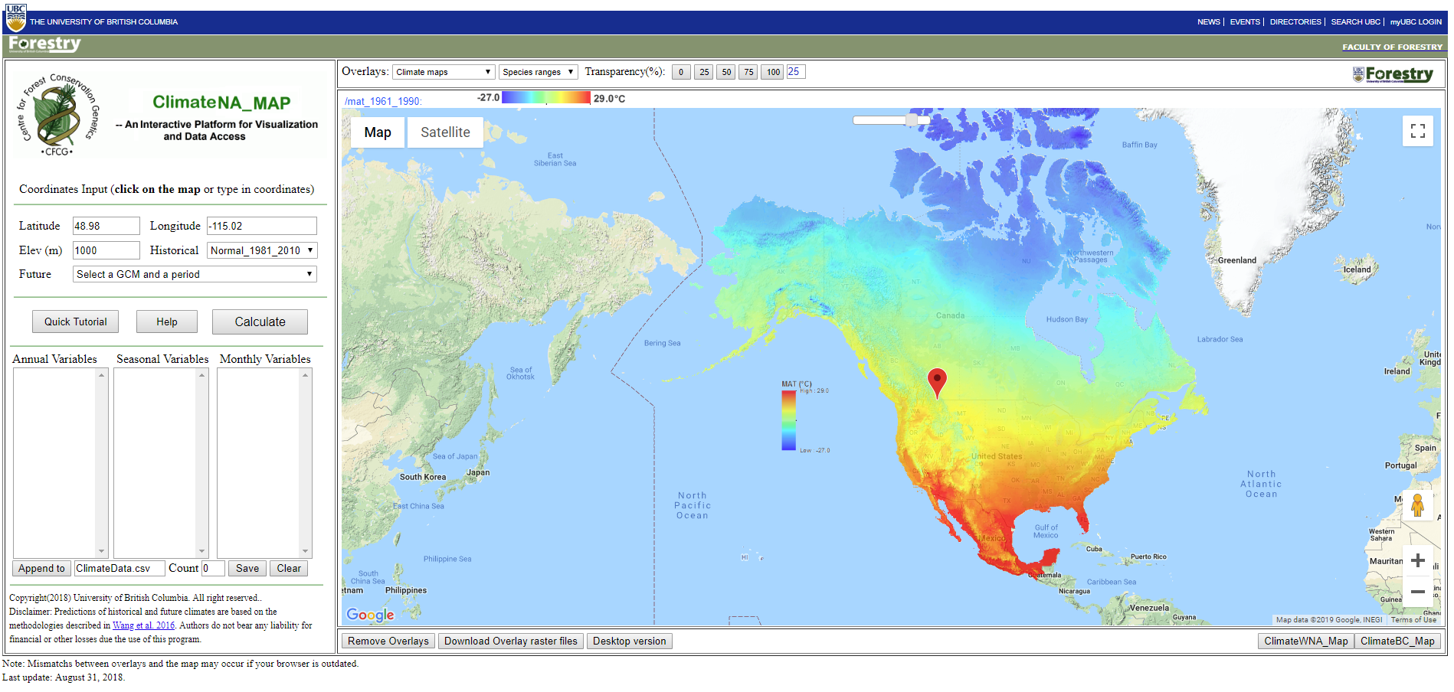
ClimateNA / ClimateBC
(ClimateNA, 2018)
Notes:
Downscaled PRISM [Parameter-elevation Regressions on Independent Slopes Model] (800x800m) climate data, bilinear interpolation to adjust elevation (also use DEM, weather station data, expert climate pattern knowledge) – 15 GCM represented based on the IPCC AR5 report (taking average of all)

Slide 5
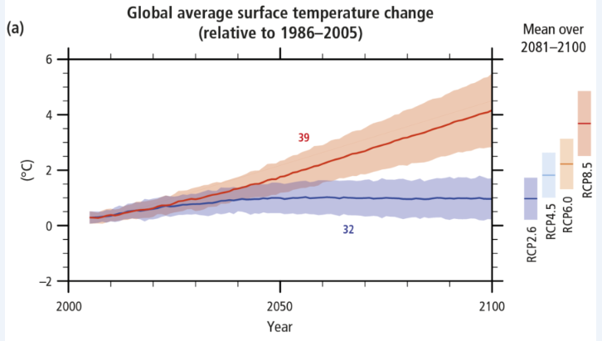
General Circulation Models
ACCESS1-0 (Australia)
CanESM2 (Canada)
CCSM4 (USA)
CESM1-CAM5 (USA)
CNRM-CM5 (France)
CSIRO-Mk3-6-0 (Australia)
GFDL-CM3 (USA)
GISS-E2R (USA)
HadGEM2-ES (UK)
INM-CM4 (Russia)
IPSL-CM5A-MR (France)
MIROC-ESM (Japan)
MIROC5 (Japan)
MPI-ESM-LR (Germany)
MRI-CGCM3 (Japan)
(IPCC AR5 Report, 2014)
Notes:
Used to provide range of possible outcomes not absolute. Rational of RCP4.5 and RCP8.5, extreme worst case and basically best case. Any response or in between values seem to be average of 4.5 and 8.5 (6.0)

Slide 6
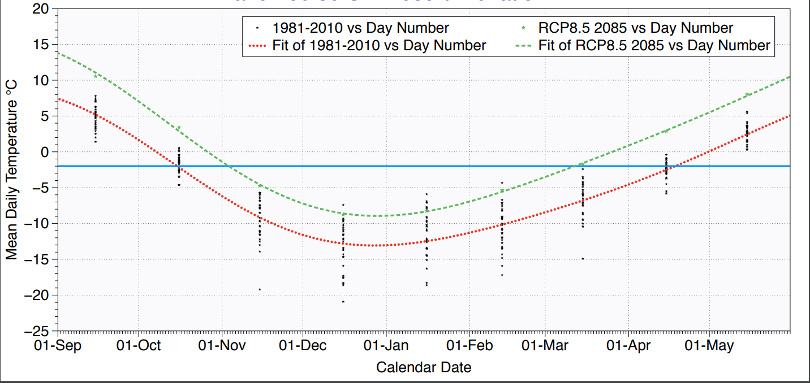
Length of Season - Polynomial Regression Example 1
Notes:
Minus two degree threshold is the value determined to make snow, obvious limitations with the effect of snowpack and precipitation type/proportion but the idea is the relative percent change models likely outcome → 185 days to 128 days → 31% reduction

Slide 7
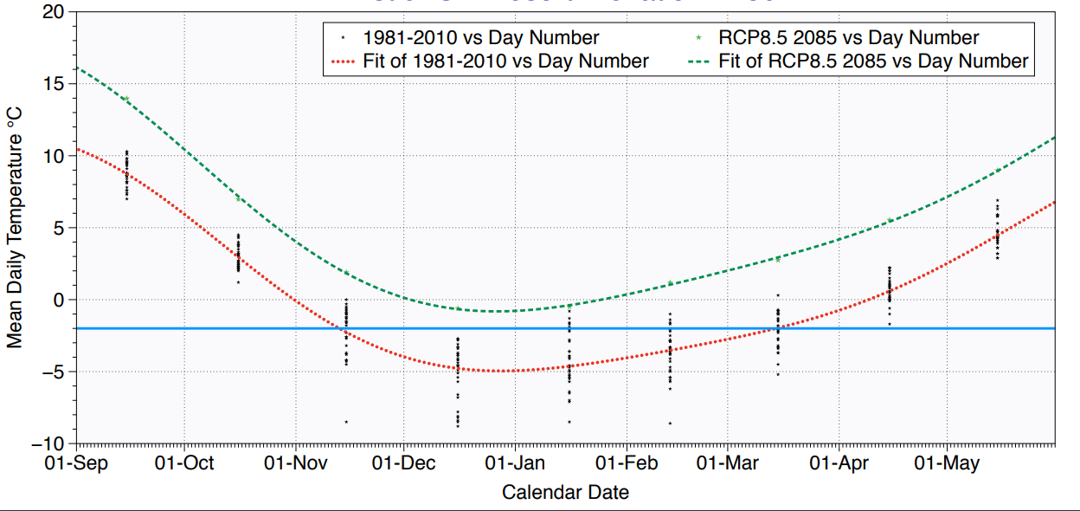
Length of Season - Polynomial Regression Example 2
Notes:
Minus two degree threshold is the value determined to make snow, obvious limitations with the effect of snowpack and precipitation type/proportion but the idea is the relative percent change models likely outcome → 121 Day season to zero days under RCP8.5

Slide 8
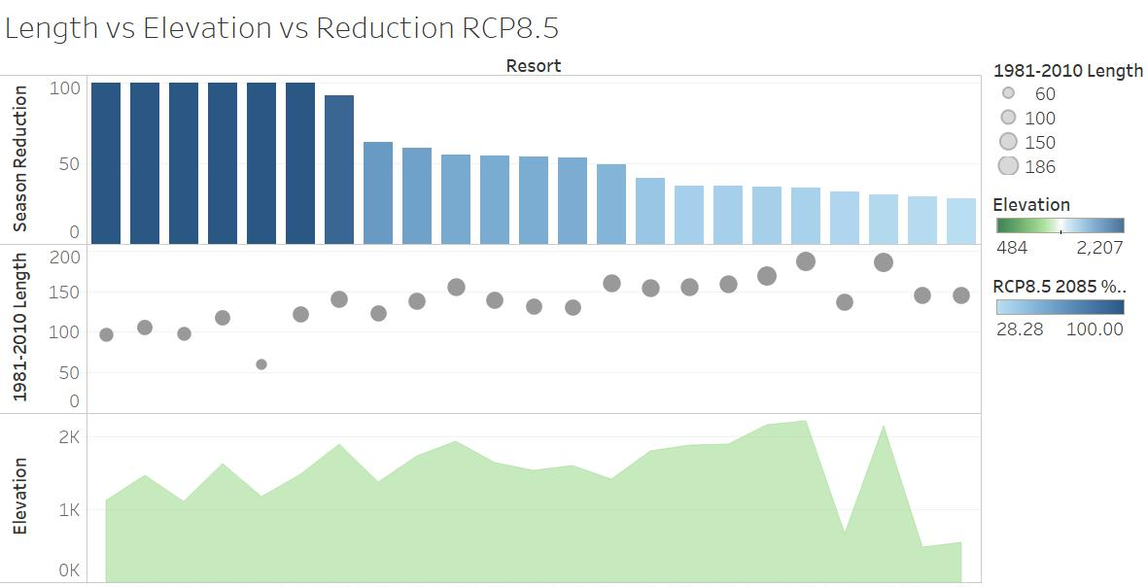
Western Canada Preliminary Visualization
(%)
(days)
(m asl)
Notes:
UNITS – different metrics for comparison

Slide 9
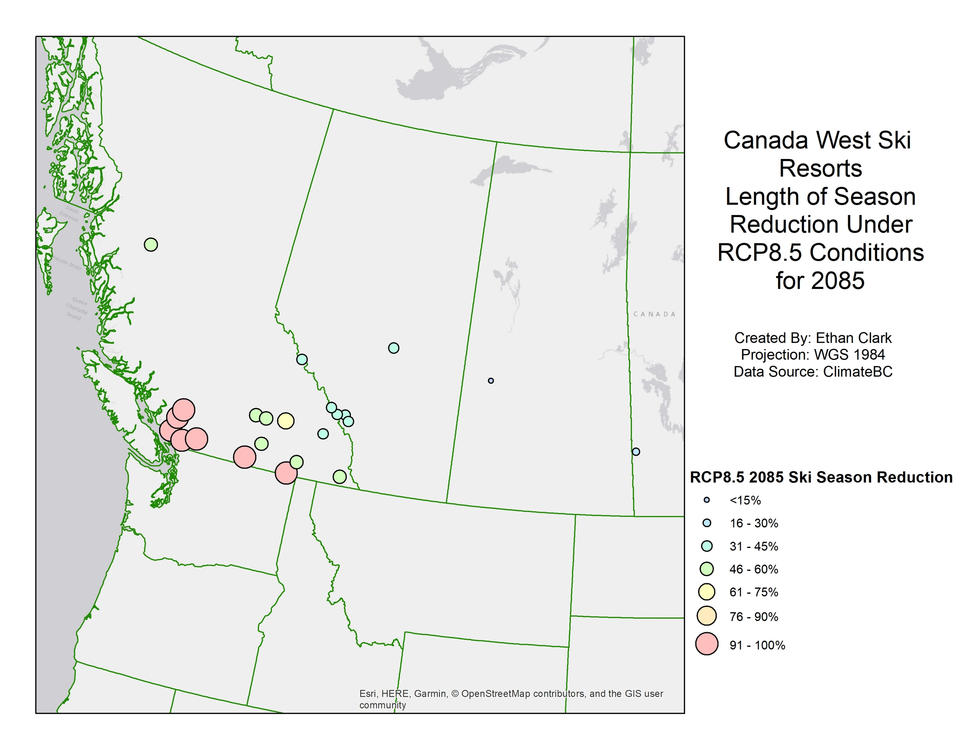
Western Canada Preliminary Visualization

Slide 10
Limitations
Snowpack
Changes observed in the spring end of the season end
Changes in future precipitation frequency and snow/rain proportion
Data – ClimateBC & ClimateNA v5.60
Temperature confidence increased
Past data updated from digitized records and increased access to climate data
Relative percent change assumption

Slide 11
Next Steps / Analysis
Data Processing
Western USA Resort Regressions
Determine Season Lengths
ArcMap Visualization
Western North America
Spatial analysis
Tableau Visualization
The effect of Latitude, Longitude and/or Elevation

Slide 12
Acknowledgements
Dr. Michael Pidwirny – Supervisor
Dr. Ian Walker – Supervisory Committee
Dr. Mathieu Bourbonnais – Supervisory Committee

Slide 13
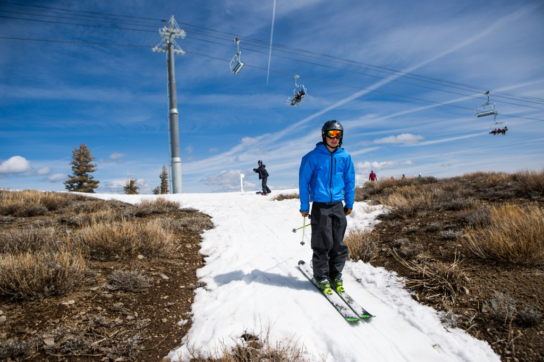
Questions?
(PBS, 2015)
Notes:
Goal to determine the changes in ski season length and use our findings to present alternative views to support mitigation and adaptation efforts so our ski seasons don’t look like this.

