Slide 1
Cartoons
How Cartoons have Changed Since their Beginnings
By: Ryan

Slide 2
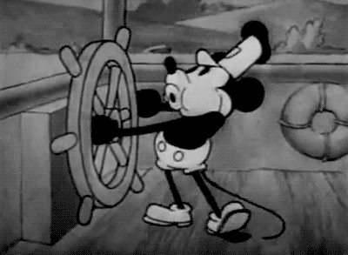

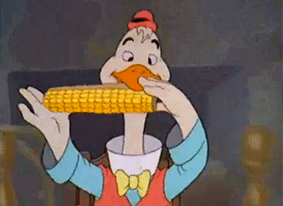
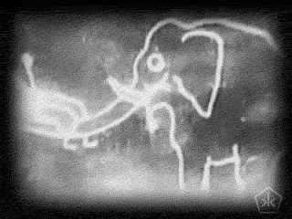
The History of Cartoons

Slide 3
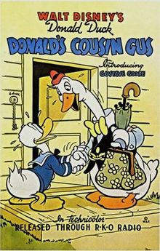
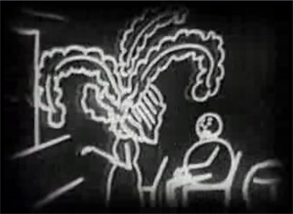

Brief History and Facts
Cartoon = motion pictures using animation techniques
Fantasmagorie (1908): first animated cartoon? Some historians believe so
August 16th,1930: Flip the Frog “Fiddlesticks” was the first cartoon to combine color & sound
May 19th, 1939: Disney cartoon Donald’s Cousin Gus was the first ever film cartoon released on US television
That face
Fantasmagorie
Flip the Frog: Fiddlesticks

Slide 4
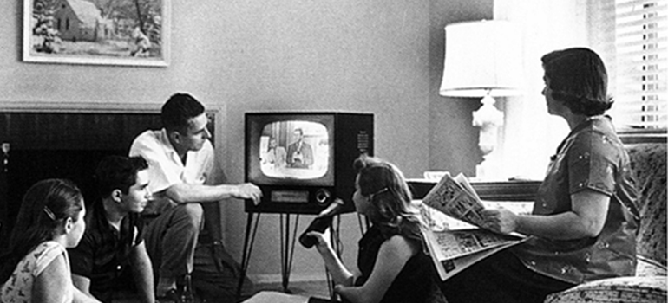
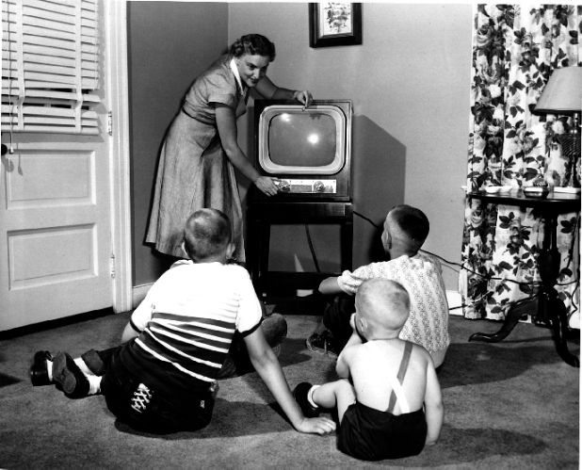
1950s: “The Golden Age of Television”
From approx late 1940s – early 1960s
TV became the new source of entertainment and a common household device
“Radio with pictures”
0.4% of the US pop. in 1948 owned a TV set → shocking 83.4% in 1958
Post WWII baby boom = more kids for moms to look out for = more incentive to buy television set to keep family entertained = more people watching cartoons

Slide 5
The Early Cartoons: Not Exactly Kid Friendly

Slide 6
The Racist, Censored, and Banned
Cartoons started off as entertainment for adults & had little restrictions on the content that they could show
During the 30s – 50s, many studios such as MGM, Warner Bros., & Walt Disney created thousands of cartoons depicting racist stereotypes, sexy, crude, & shocking content
Some of these included: alcohol, marijuana, smoking, adultery, sexual situations & gambling
Many of these cartoons were banned for their content years later

Slide 7

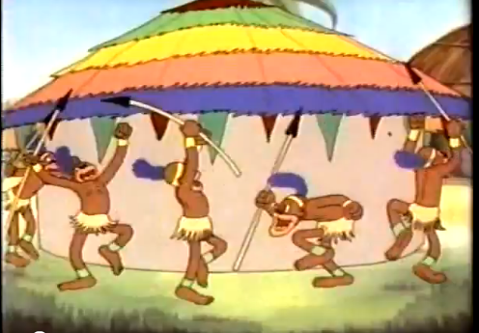
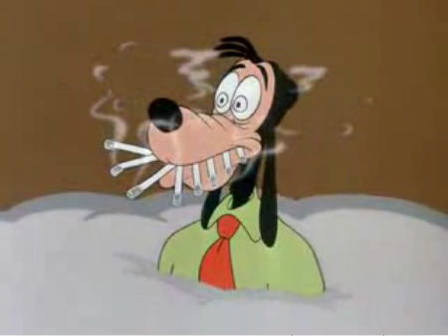
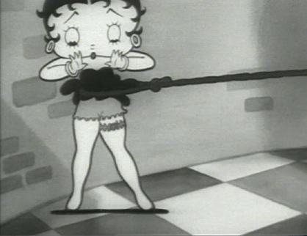
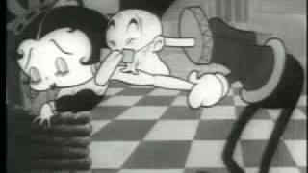
Cartoons Shocking to Today’s Society: Take a Look!
RACIST!
Click the box to watch!
BAD!
Jungle Jitters (1938): A salesman knocks on the doors of a tribe of African cannibals, who put him a pot of boiling water
Looney Tunes “Ballot Box Bunny” (1951): Bugs Bunny Commits Suicide
SMOKING!
SEXUAL!
Betty Boop “Chess Nuts” (1932): The King tries to “capture” Betty to keep for himself ;)
Goofy the Everyman “No Smoking” (1951): Goofy tries to quit his smoking habits

Slide 8
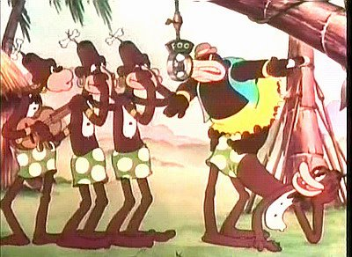
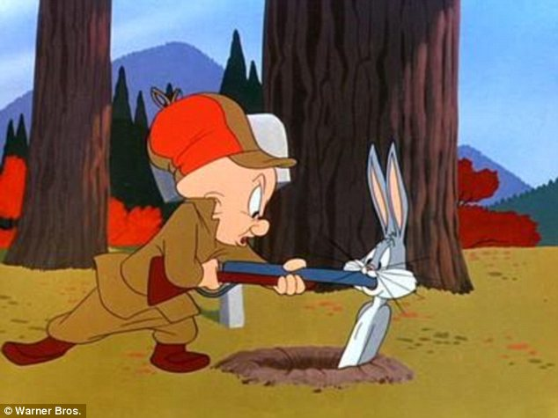
What Cartoons Should and Shouldn’t be Shown on TV?

Slide 9
1950s Television Regulations
March 1st, 1952: National Association of Radio and Television Broadcasters (NATRB) introduced television code
Some regulations within the code:* (SUMMARY ON THE NEXT SLIDE)
It is not enough that only those programs which are intended for viewing by children shall be suitable to the young and immature. Television is responsible for insuring that programs of all sorts which occur during the times of day when children may normally be expected to have the opportunity of viewing television shall exercise care in the following regards:
(a) In affording opportunities for cultural growth as well as for wholesome entertainment.
(b) In developing programs to foster and promote the commonly accepted moral, social, and ethical ideals characteristic of American life.
(c) In reflecting respect for parents, for honorable behavior, and for the constituted authorities of the American community.
(d) In eliminating reference to kidnapping of children or threats of kidnapping.
(e) In avoiding material which is excessively violent or would create morbid suspense, or other undesirable reactions in children.
(f) In exercising particular restraint and care in crime or mystery episodes involving children or minors
*http://historymatters.gmu.edu/d/6558/

Slide 10
1950s Television Regulations cont.
Basically, content shown on television should be suitable for children and not cause undesirable reactions (ex. excessive violence)
Promote moral, social, and ethical ideals represented by the American community
In general, keep television programs in line, which includes cartoons

Slide 11
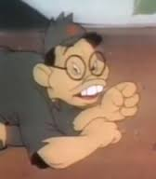


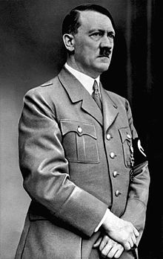
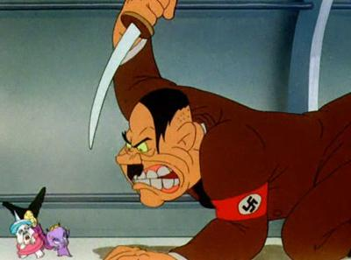
Connections to Other Events

Slide 12
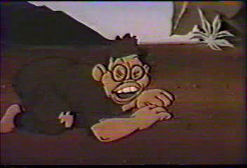
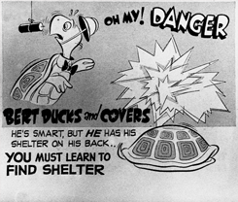
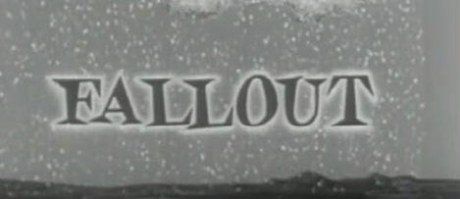
WW2 and the Cold War
During WW2, many Looney Tunes cartoons were created depicting racist images of Japanese and German people (enemies of the US)
During the Cold War, the atom bomb striking the US became such a threat that civil defense classes became standard in schools
Cartoons like Bert the Turtle “Duck and Cover” (1951) and “Fallout” by Civil Defense taught people what to do if caught in one of these situations
SIEG HEIL!
Click the box to watch!
Source: https://www.youtube.com/watch?v=eof7gacss90

Slide 13
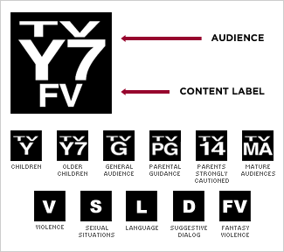
TV Parental Guidelines
December 19th,1996: United States Congress, the Federal Communications Commission (FCC), and the television industry proposed the Parental Guidelines system
January 1st, 1997: Went into effect on cable networks and most major US broadcast networks
To give parents an idea of the content in televisions programs
Ratings were determined by the participating broadcast and cable networks
TV-Y (suitable for all children)
TV-Y7 (suitable for children over the
age of 7 years old)
TV-G (suitable for all audiences)
TV-PG (parental guidance suggested)
TV-14 (parents strongly cautioned)
TV-MA (mature audiences only)

Slide 14
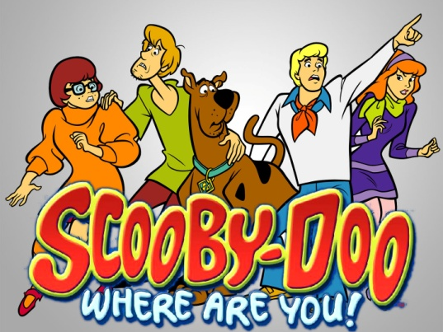
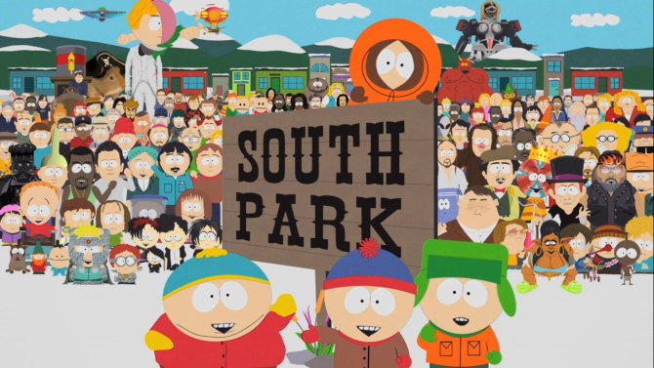
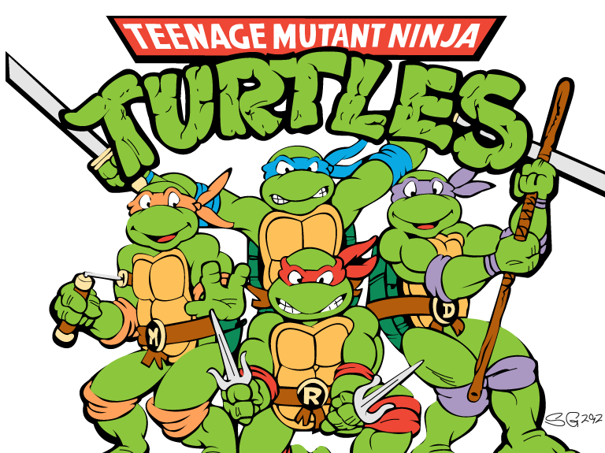
Cartoons Today
Cartoons such as Spongebob Squarepants, Teenage Mutant Ninja Turtles, Scooby Doo, and many more have captured the hearts of children everywhere
Still popular in today’s society, but unlike the 30s and 50s, cartoons are directed towards the child demographic
South Park and Family guy are some examples of cartoons made for mature audiences

Slide 15

FIN

